Slide 1
Camunda
Tamara Mihajlović, 16758

Slide 2
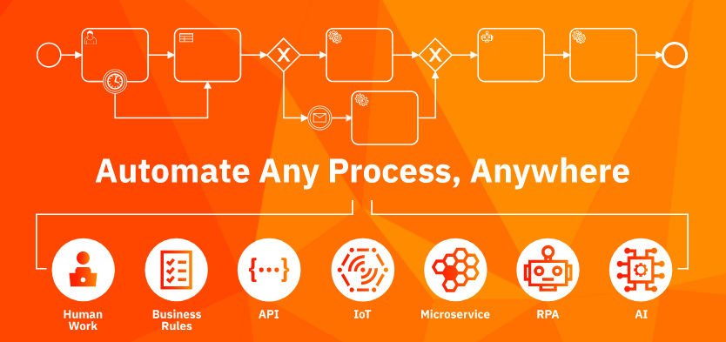
Čime se bavi
Wokrflow and Decision Automation Platform

Slide 3
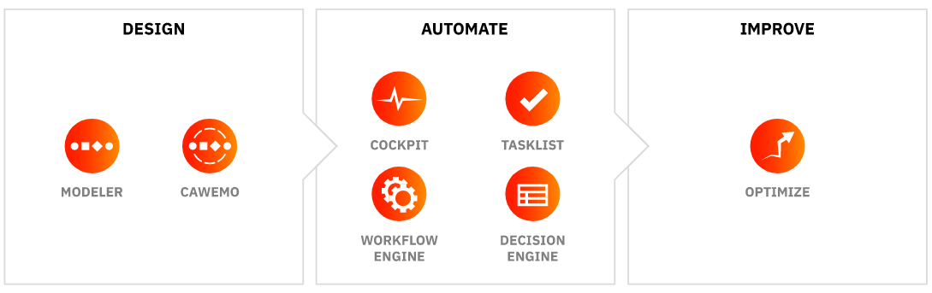
Camunda

Slide 4
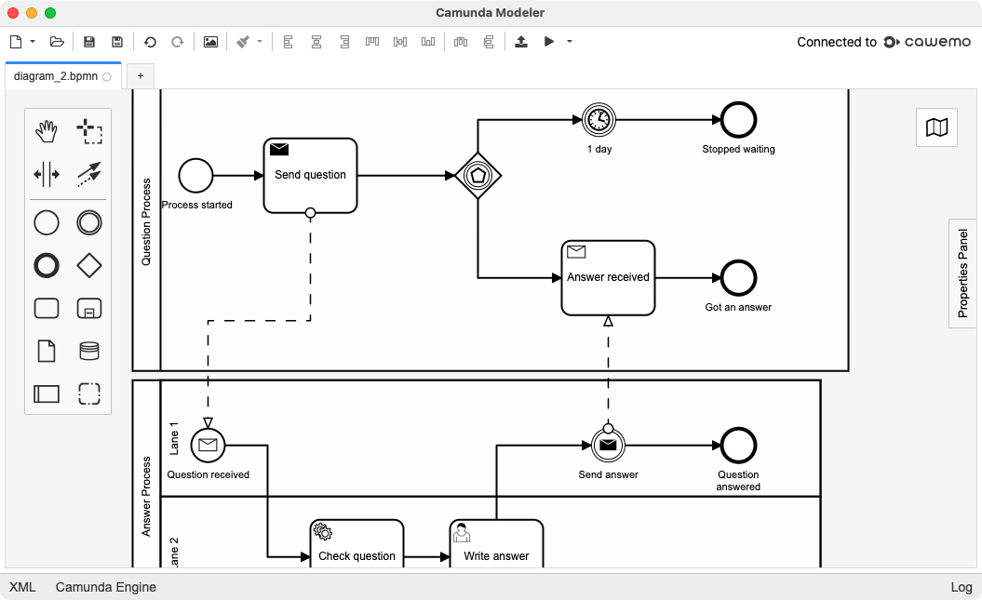
Modeler

Slide 5
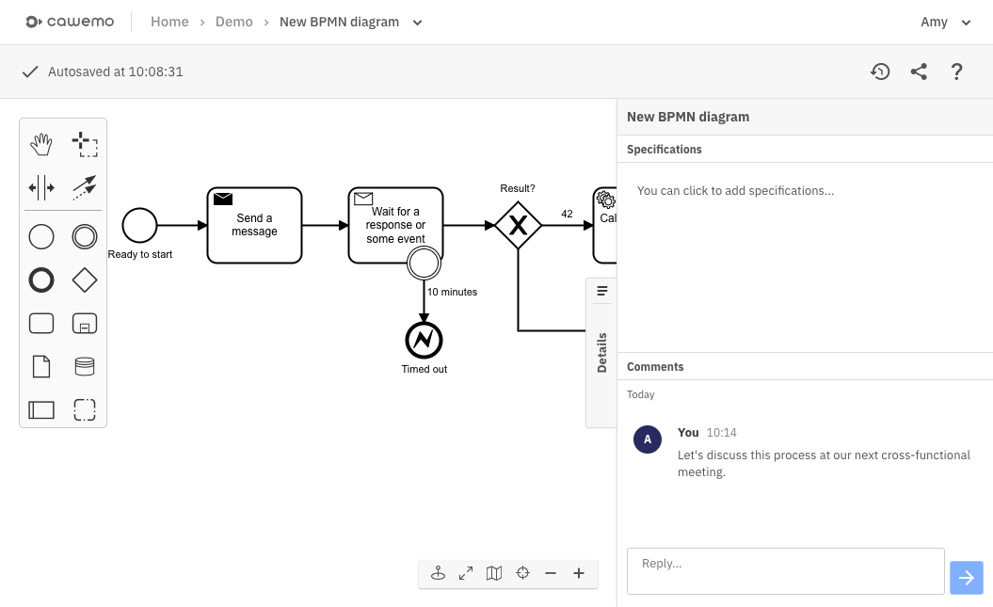
Cawemo

Slide 6
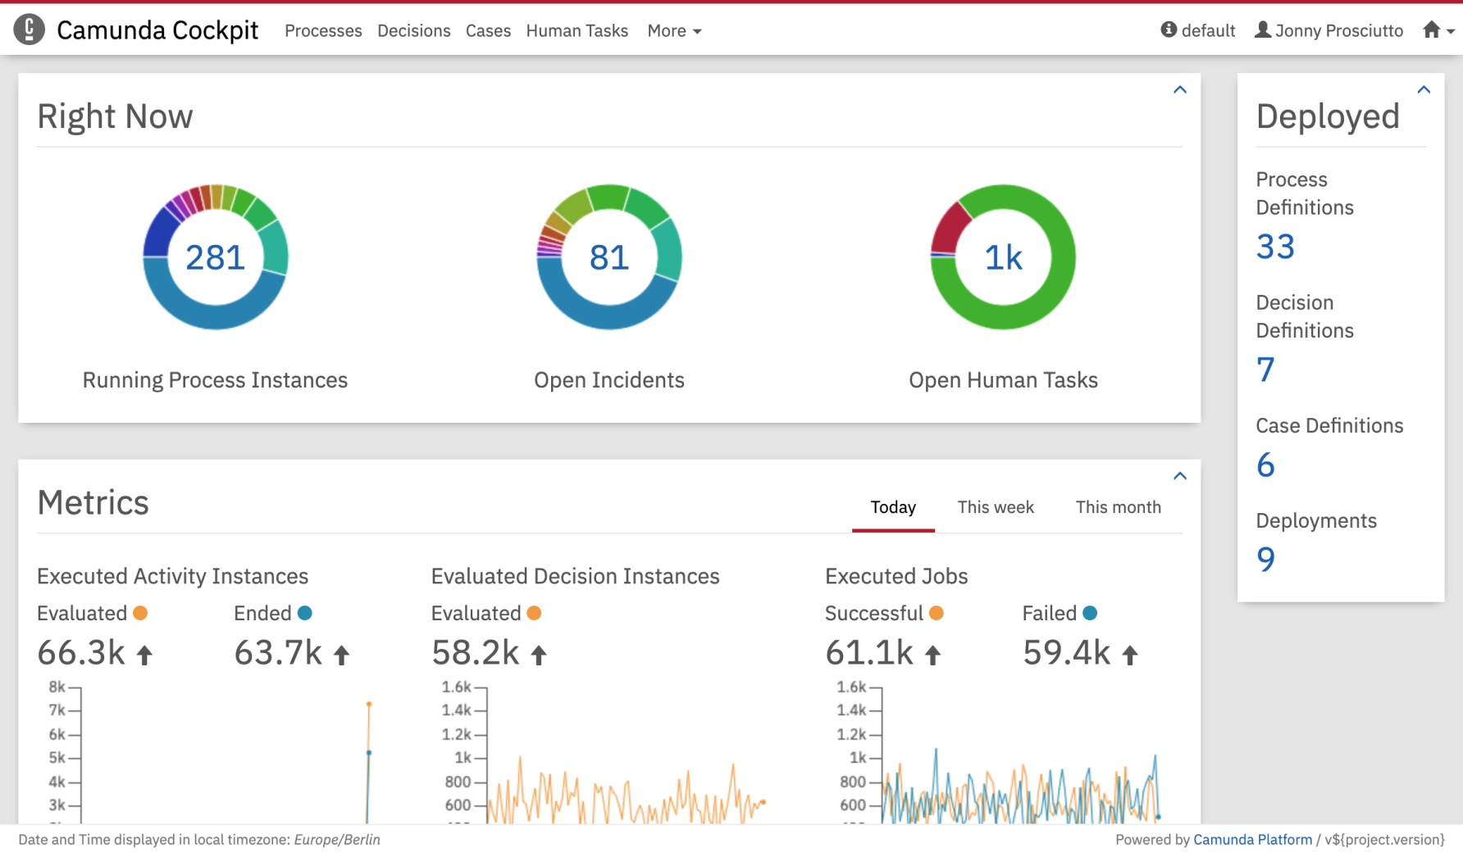
Cockpit

Slide 7
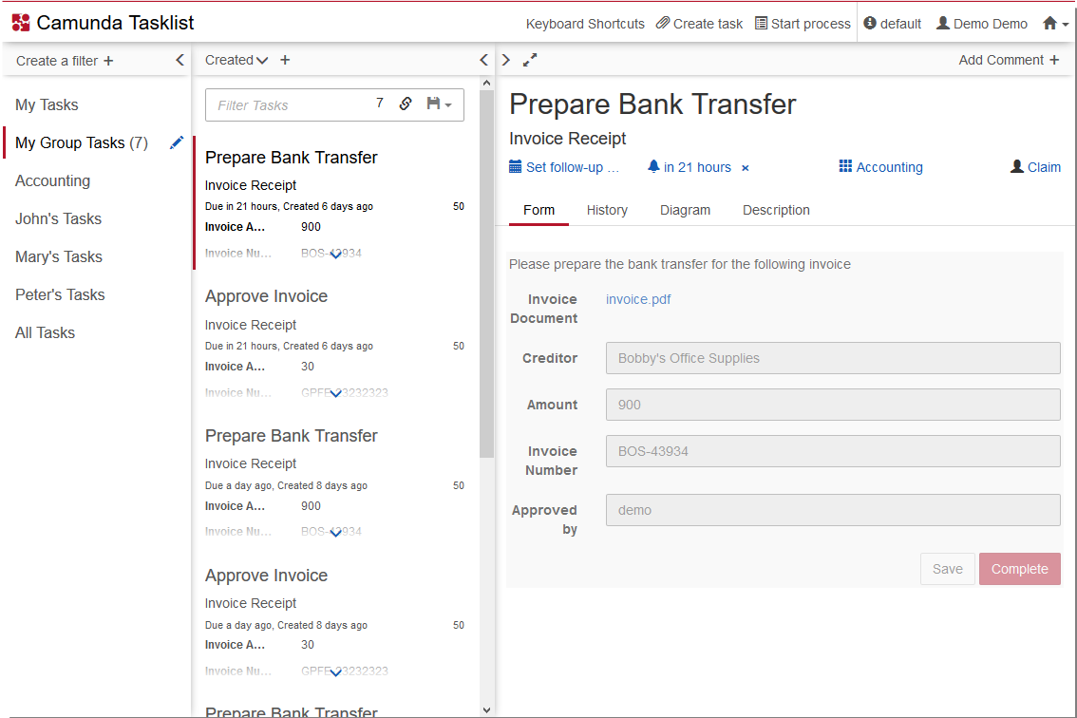
Tasklist

Slide 8
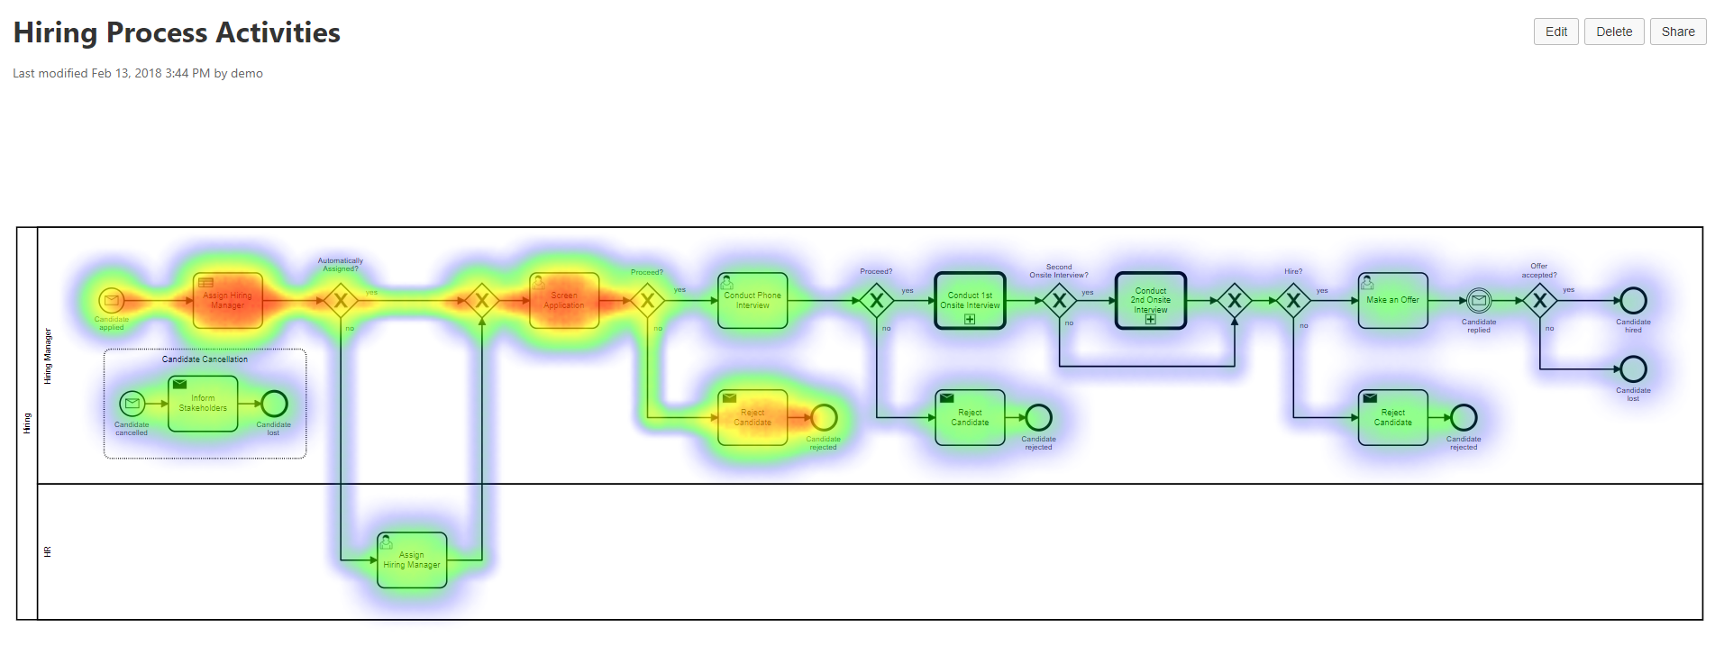
Workflow and Decision engines

Slide 9
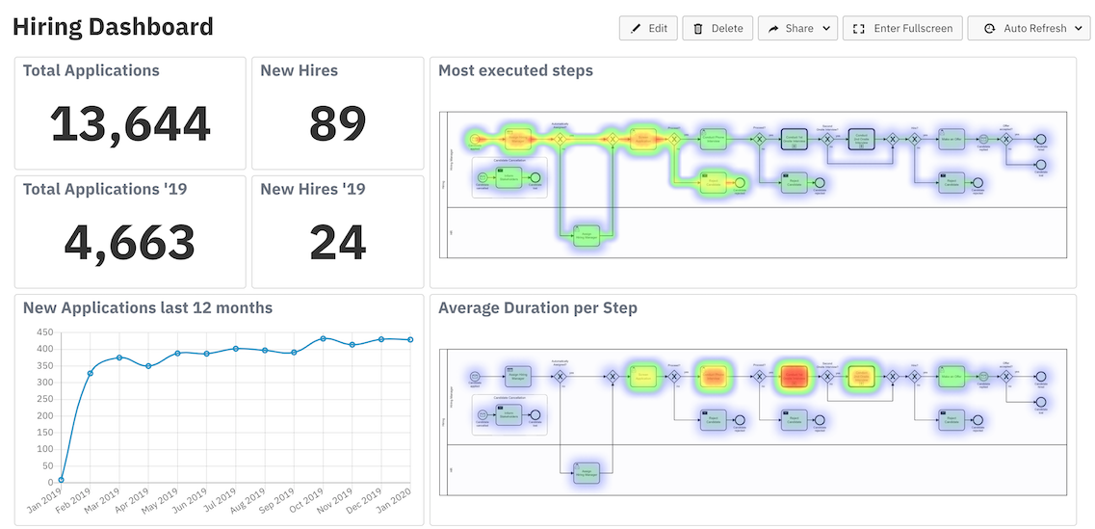
Optimize

Slide 10
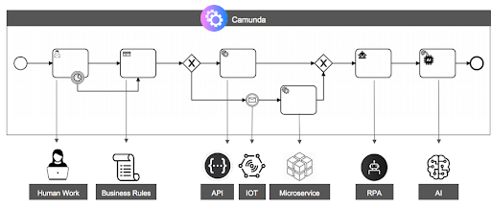
End-to-end Process Automation

Slide 11
Hvala na pažnji! ☺
Pitanja? Komentari?

