Slide 1

Self-supervised learning in the ‘wild’
Péter István
Bartos-Elekes Miklós
Tárnok Márton

Slide 2
Task
Investigate various open-source self-supervised learning methods
Select one or two classification datasets unrelated to ImageNet
Utilize the selected SSL methods to pretrain models on your chosen datasets.
Conduct a linear benchmark evaluation using a portion of ImageNet
Compare the performance of your pretrained models against those publicly available and trained on ImageNet

Slide 3
Concept
Two different methods:
Colorization
Jigsaw
Various training techniques and hyperparameter settings
Train a baseline model (VISSL framework [4])

Slide 4
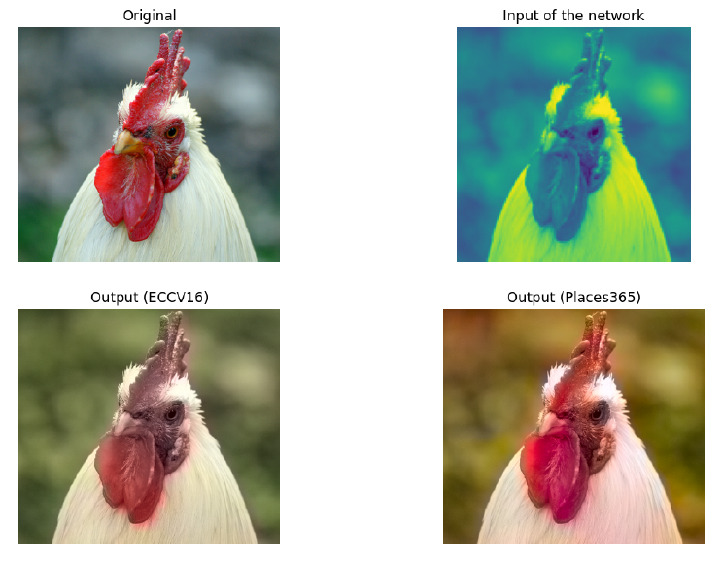
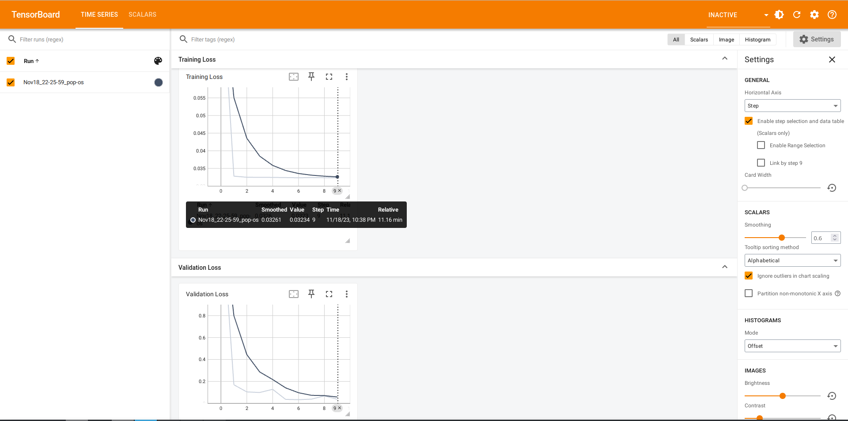
Colorization
Colorful Image Colorization [1]
Places365 dataset [2]
Resolution:128x128
35 hours of training, 10 epochs
Split the model into backend and head, frozen the weights and merged with the ResNet50
Notes:
we opted for the Places365 dataset due to its comparable size and complexity, although it differs from Imagenet.

Slide 5
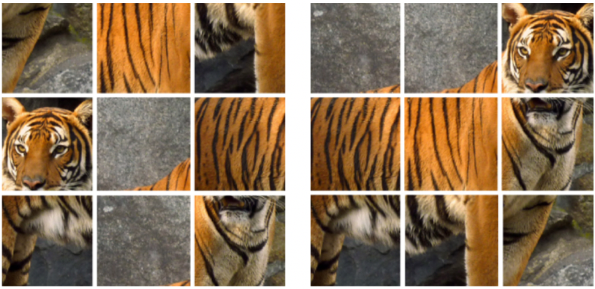
Jigsaw - 1
Dividing into 3x3 tiles, random permutations
Pretraining on non-ImageNet: Places365 [2]
Linear benchmark evaluation:
Loading and freezing the pretrained weights
Fully connected classification layer
Tiny ImageNet dataset, 200 classes
Initial experiments: VISSL (unsuccessful)

Slide 6

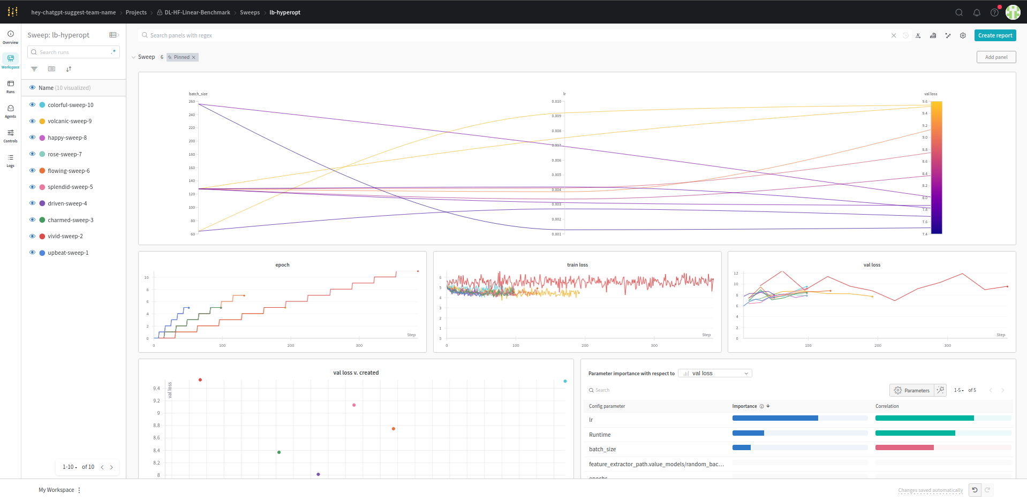
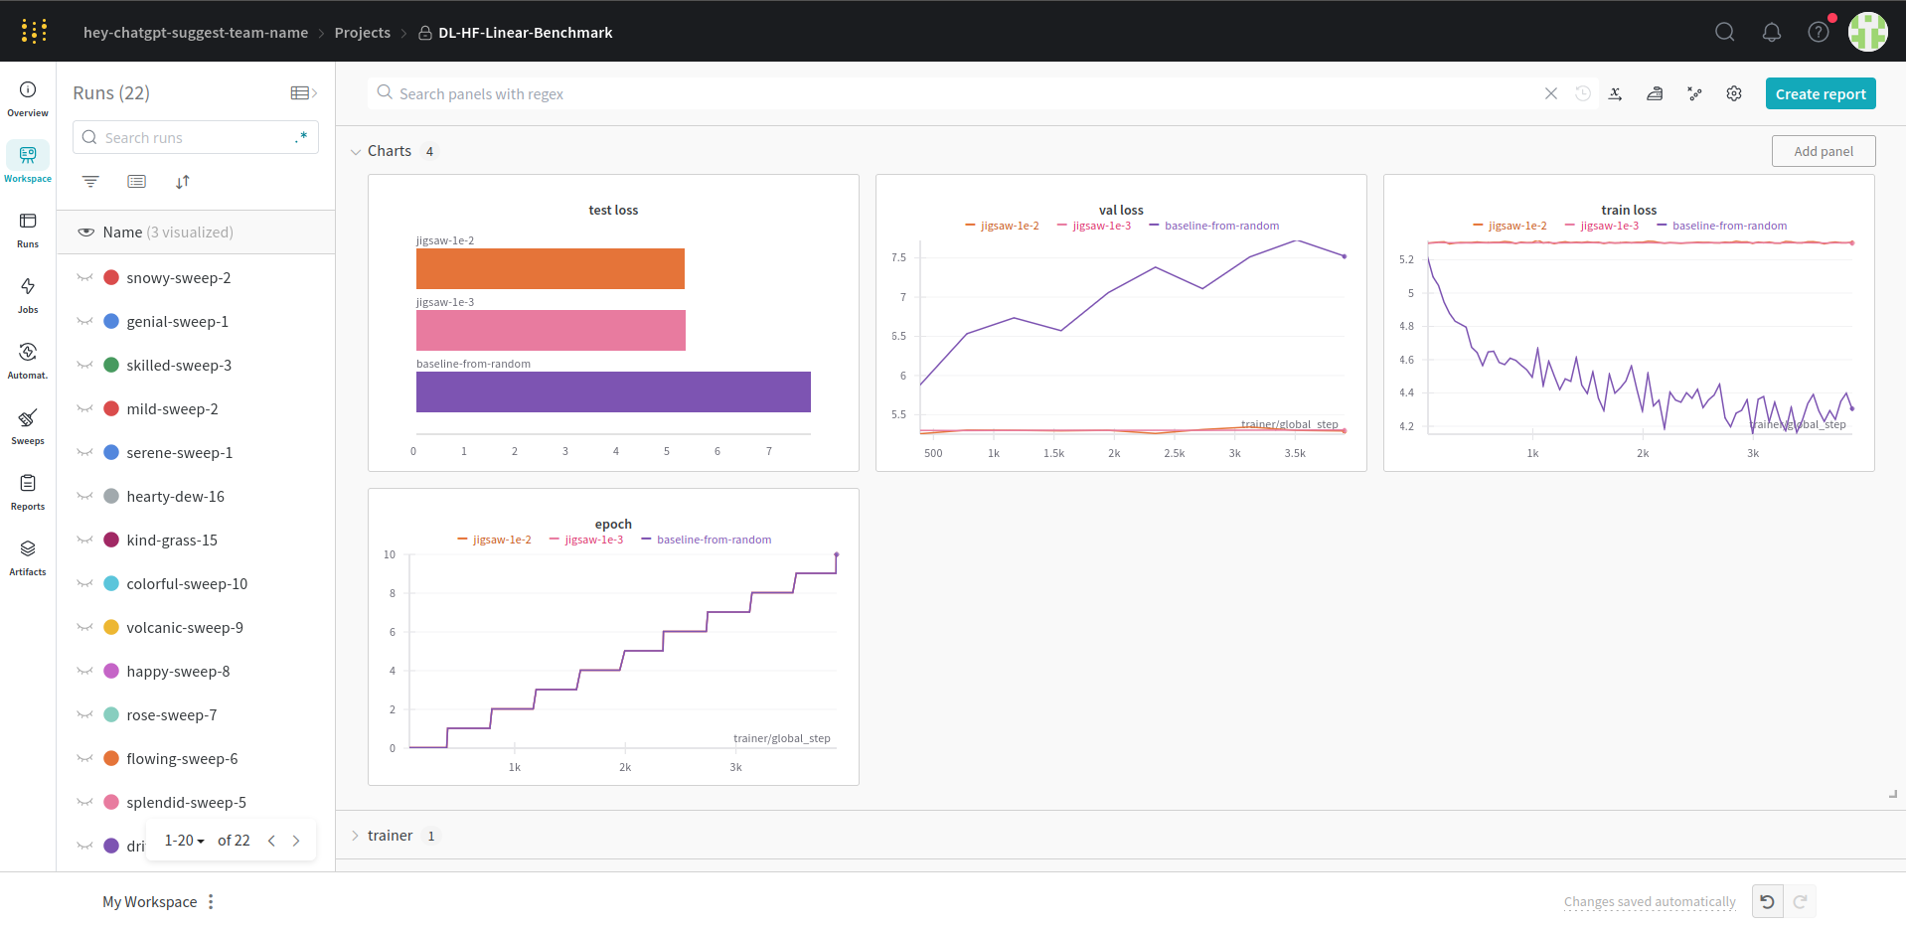
Jigsaw - 2
Our own implementation loosely based on [5]:
Convolutional backbone for each tile
Fully connected layer per-tile
Global fully connected layer
Output: one-hot representation of a permutation
Additions: BN, poolings etc.
Customizable: # of conv. filters, layer width
Customizable: # of possible permutations, tiles (2x2 or 3x3)
Implemented linear benchmark evaluation
Torch, Lightning, WandB, hyperopt with Sweeps
Heavy technical constraints due to HW limitations - POC

Slide 7
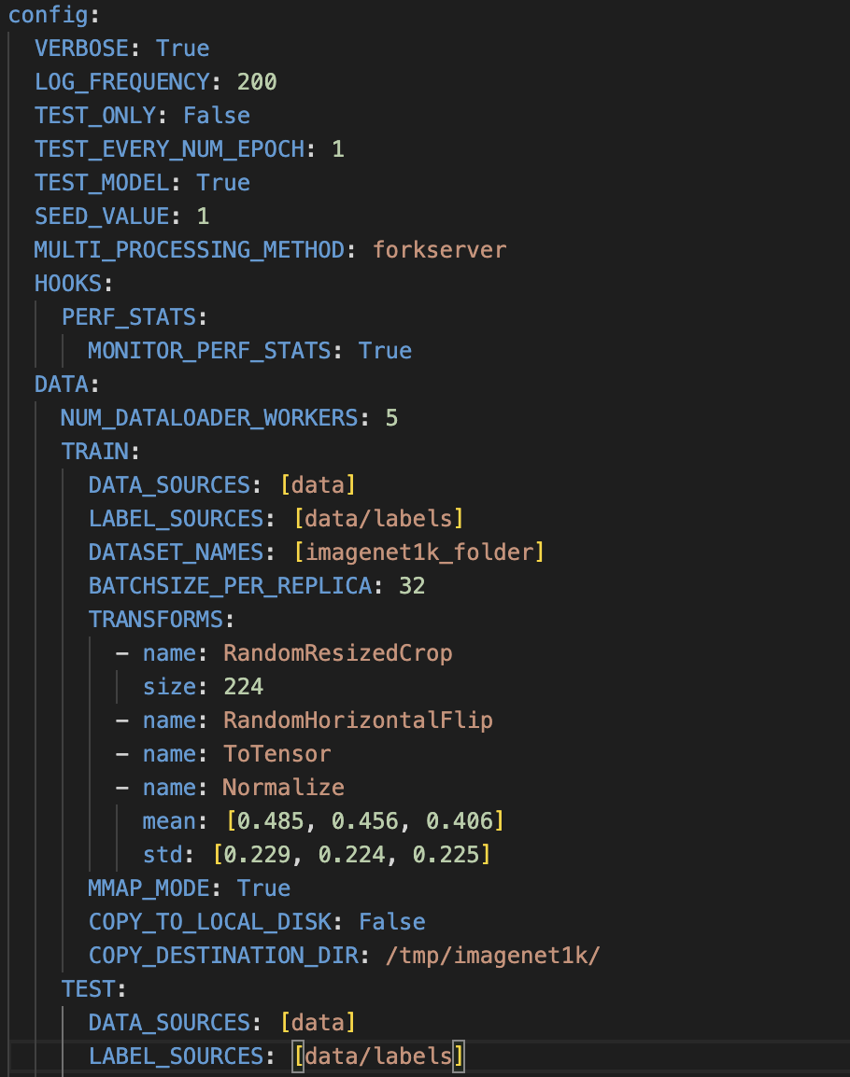
VISSL Baseline
Facebook AI Research
Model ZOO
JIGSAW problem
Configfile based setting
Error during training

Slide 8
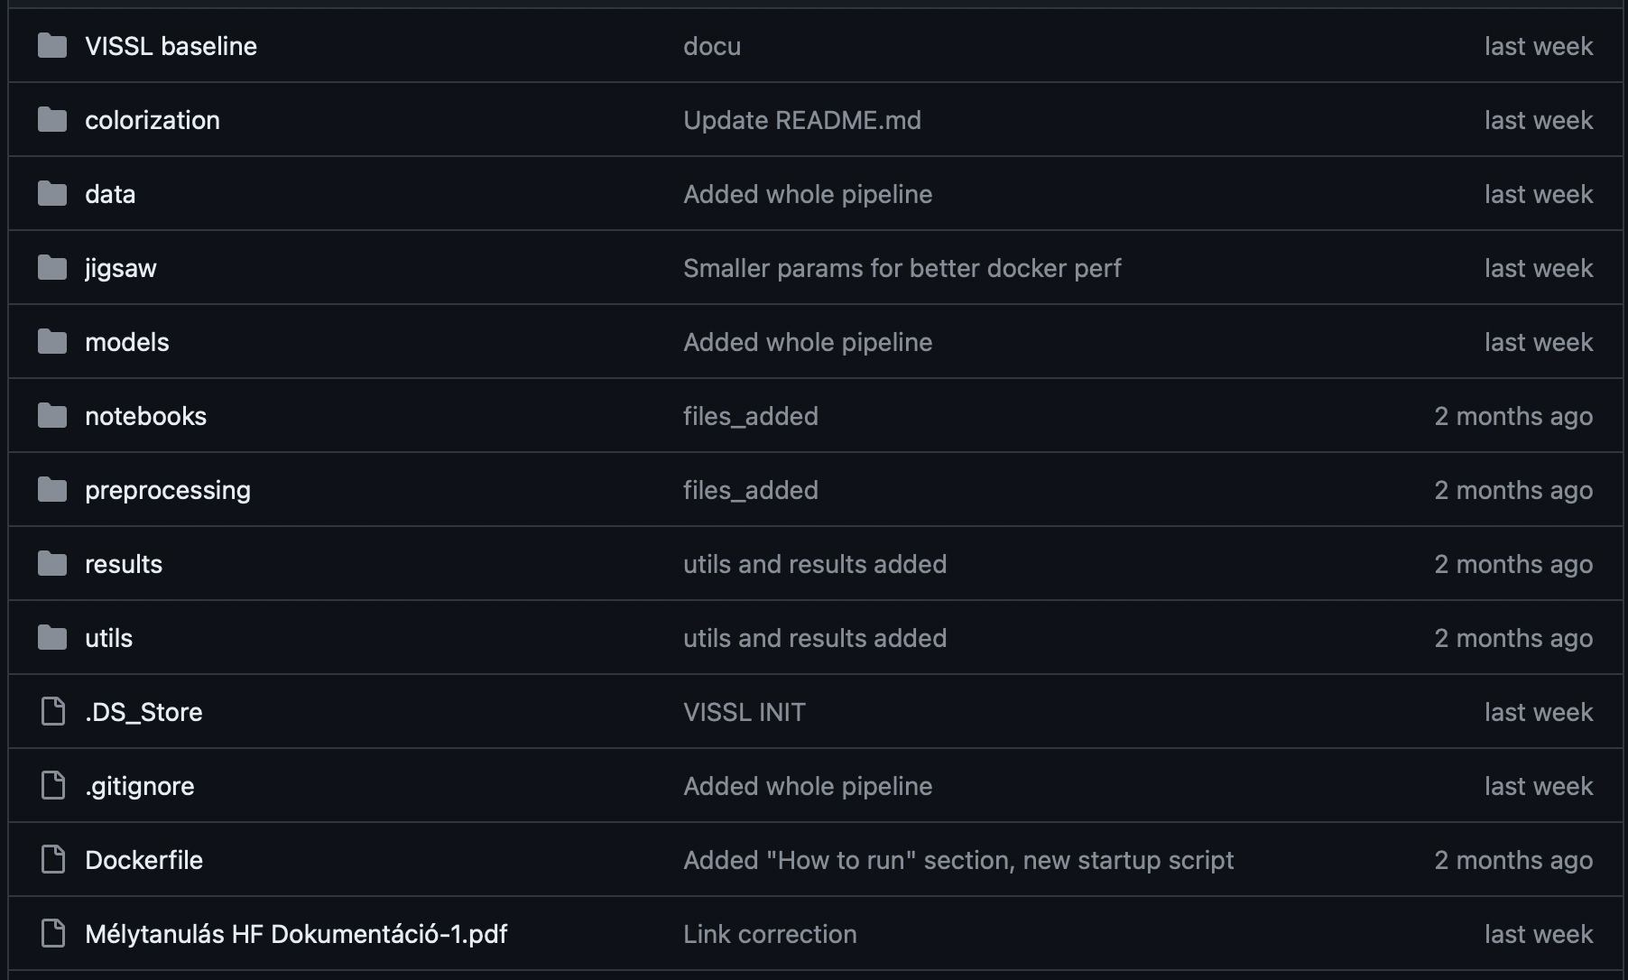
Structure of the project
Each project in different folders (Colorization, JIGSAW, VISSL)
Seperate:
Dataloading and pre-proccessing
Training
Evaluation
Environement (Docker)
Some global features are in the root

Slide 9
Results
Descending loss
Proof of concept pipeline
Trained models available for inference
Containerization, reproducibility

Slide 10
Summary
Gained experience in SSL
Two different type of frameworks
Future possibilities:
Integrating both methods
Concatenate both feature extractors: better "ensemble" features

Slide 11
Refrences
Zhang, R., Isola, P. and Efros, A.A., 2016. Colorful Image Colorization. Available at: arXiv:1603.08511
http://places.csail.mit.edu
Goyal, P., Mahajan, D., Gupta, A. and Misra, I., 2019. Scaling and Benchmarking Self-Supervised Visual Representation Learning.: Available at: <https://arxiv.org/pdf/1905.01235.pdf>
VISSL Team, n.d. VISSL: A library for state-of-the-art self-supervised learning from images. Available at: https://vissl.ai
Mehdi Noroozi, Paolo Favaro: Unsupervised Learning of Visual Representations by Solving Jigsaw Puzzles. Available at: https://arxiv.org/abs/1603.09246v3

