Slide 1
Security protocol analysis using the Tamarin Prover
David Basin, Cas Cremers, Jannik Dreier, Ralf Sasse

Slide 2
Morning overview
Model checking and verification
For security protocols:
The Tamarin Prover
  Modeling
  Attacks and proofs
  Algorithm intuition
  In practice
Hands-on session

Slide 3
Afternoon overview
Recap
Induction
State space reduction by sources lemmas
Equational theories and adversary rules
Observational equivalence

Slide 4
Problem
How do we know if a protocol is secure?
  Traditional: Smart people stare at it
More structured approach:
Specify threat model & intended property
  Stare at the protocol, try to find attack.
  Write the proof
Can formal methods help?
  Model checking, verification

Slide 5
Trace properties
For now: trace properties (but more later!):
  ∀ tr ∊ traces(System) . P(tr)
All
system
traces
Bad traces
not P(tr)
Intersection empty?

Slide 6
Symbolic security analysis
Idea: make transition system
  with protocol participants
  with adversary controlling network
Encode property
  Authentication:
  In all traces, if an initiator completes, there exists a responder with…
  Secrecy:
  There is no trace in which Adversary learns k
And check!
Unfortunately, this turns out to be undecidable

Slide 7
The Tamarin Prover
Symbolic analysis tool for systems in presence of a Dolev-Yao style network adversary
Recent highlights:
  Group key exchange protocols
  ARPKI
  TLS 1.3 (See talk tomorrow at TLS:DIV !)
Notes:
I will get back to the „symbolic“ part near the end of the talk, and try to explain some of the implications.

Slide 8
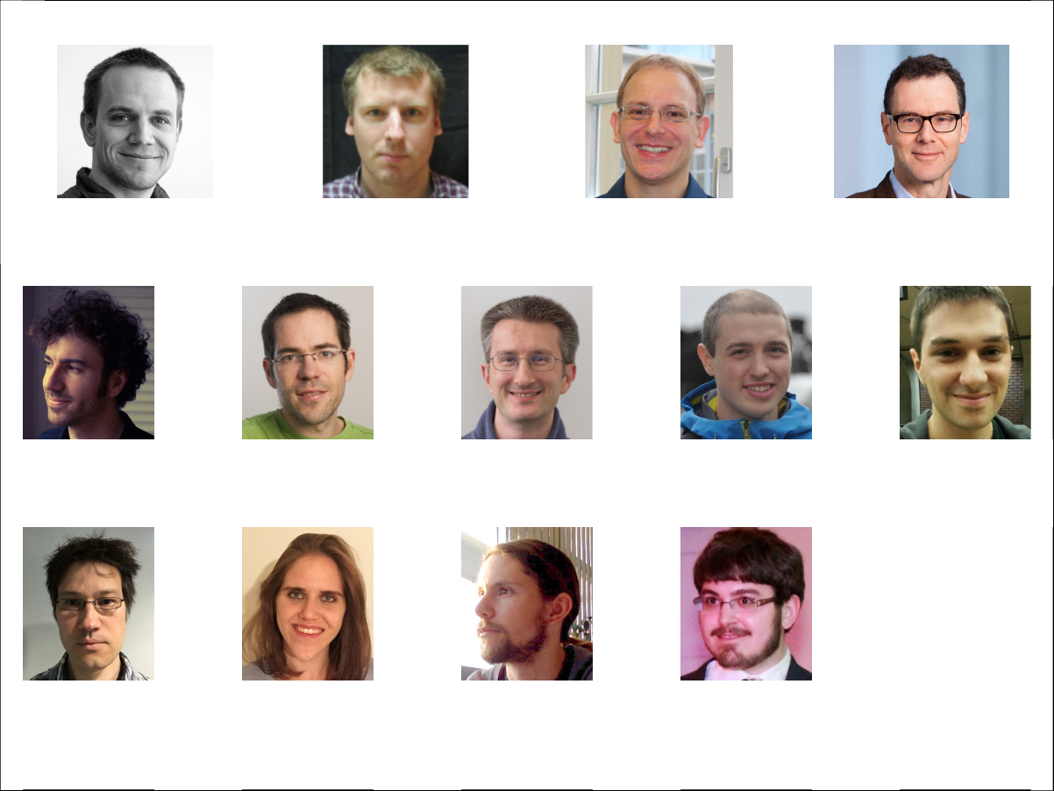
Simon Meier
Benedikt Schmidt
Cas Cremers
David Basin

Slide 9
Simon Meier
Benedikt Schmidt
Cas Cremers
David Basin
Robert Kunneman
Steve Kremer
Ralf Sasse
Jannik Dreier
Cedric Staub
and more soon!
Sasa Radomirovic
Lara Schmid
Charles Dumenil
Kevin Milner

Slide 10
Cas Cremers
David Basin
Ralf Sasse
Jannik Dreier

Slide 11
What can Tamarin do for you?
Rapid prototyping
Finding attacks before you start a proof effort
Provide a symbolic proof
Explore alternative designs/threat models quickly

Slide 12
Selected case studies
AKE
  Naxos
  Signed DH
  KEA+
  UM
  Tsx
Group protocols
  GDH
  TAK
  (Sig)Joux
  STR
ID-based AKE
  RYY
  Scott
  Chen-Kudla
Loops
  TESLA1 & 2
Non-monotonic global state
  Keyserver
  Envelope
  Exclusive secrets
  Contract signing
  Security device
  YubiKey
  YubiHSM
PKI with strong guarantees
  ARPKI (also global state)
Transparency
  DECIM (also global state)
TLS 1.3
  Rev 10, 10+, and current

Slide 13
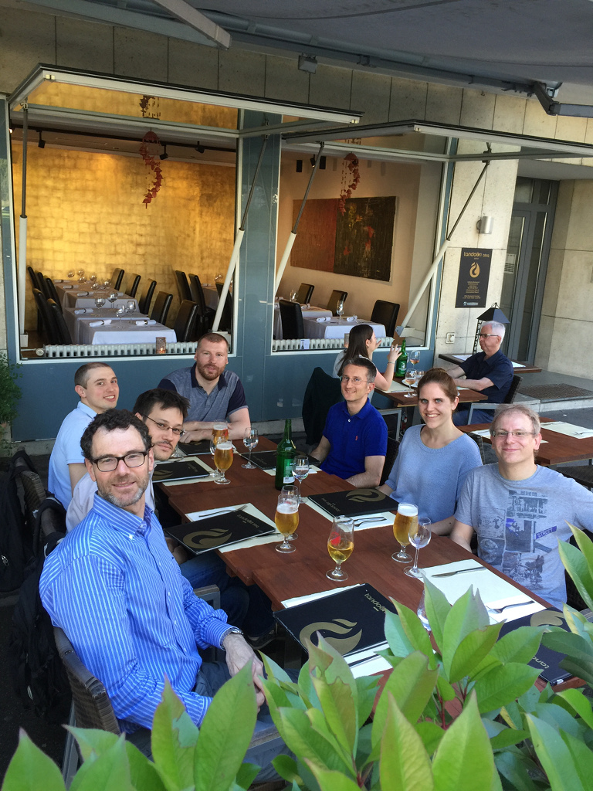
Resources & documentation
Sources on github
100+ page manual
Plenty of examples/case studies
Algorithm details in theses, papers

Slide 14
Demo
Notes:
Demo is also about when it does not terminate, etc, and about HEURISTICS !

Slide 15
Tamarin: high-level
Modeling protocol & adversary done using multiset rewriting
  Specifies transition system; induces set of traces
Property specification using fragment of first-order logic
  Specifies “good” traces
Tamarin tries to
  provide proof that all system traces are good, or
  construct a counterexample trace of the system (attack)
Notes:
Mention we’ll give Naxos examples

Slide 16
Modeling in Tamarin
Multiset rewriting; surprisingly similar to “oracles”
Basic ingredients:
  Terms (think “messages”)
  Facts (think “sticky notes on the fridge”)
  Special facts: Fr(t), In(t), Out(t), K(t)
State of system is a multiset of facts
  Initial state is the empty multiset
  Rules specify the transition rules (“moves”)
Rules are of the form:
  l --> r
  l --[ a ]-> r
Notes:
Reminder:
Multiset == bag; elements can occur multiple times
If whiteboard, sketch simple example? [problem: generic transition system maybe not as helpful as actually showing Naxos]

Slide 17
The model
Term algebra
  enc(_,_), dec(_,_), h(_,_),
  _^_, _⁻¹, _*_, 1, …
Equational theory
  dec(enc(m,k),k) =E m,
  (x^y)^z =E x^(y*z),
  (x⁻¹)⁻¹ =E x, ...
Facts
  F(t1,...,tn)
Transition system
  State: multiset of facts
  Rules: l –[ a ]→ r
Tamarin-specific
  Built-in Dolev-Yao attacker rules
    In( ), Out( ), K( )
  Special Fresh rule:
    [] --[]--> [ Fr(x) ]
      With additional constraints on systems such that x unique

Slide 18
Semantics
Transition relation
  S –[a]→_{R} (( S \# l ) ∪# r )
  where l –[a]→ r is a ground instance of a rule and l ⊆# S
Executions
  Exec( R) = { [ ] –[a₁]→ … –[a_{n}]→ S_{n}
  | ∀n . Fr(n) appears only once on rhs }
Traces
  Traces( R) = { [a₁,…,a_{n}]
  | [ ] –[a₁]→ … –[a_{n}]→ S_{n} ∈Exec( R) }

Slide 19
Semantics: example 1
‘c’ constant
Rules
  rule 1: [ ] –[ Init() ]→ [ A('5') ]
  rule 2: [ A(x) ] –[ Step(x) ]→ [ B(x) ]
Execution example
    [ ]
    –[ Init() ]→ [ A('5') ]
    –[ Init() ]→ [ A('5'), A('5') ]
    –[ Step('5') ]→ [ A('5'), B('5') ]
Corresponding trace
    [ Init(), Init(), Step('5') ]

Slide 20
Semantics: example 2 (persistent facts)
‘c’ constant
Rules
  rule1: [ ] –[ Init() ]→ [ !C('ok'), D('1') ]
  rule2: [ !C(x), D(y) ] –[ Step(x,y) ]→ [ D(h(y)) ]
Execution example
    [ ]
    –[ Init() ]→ [ !C('ok'), D('1' ) ]
    –[ Step('ok','1' ) ]→ [ !C('ok'), D(h('1') ) ]
    –[ Step('ok',h('1') ) ]→ [ !C('ok'), D(h(h('1')) ) ]
Corresponding trace
    [ Init(), Step('ok', '1'), Step('ok', h('1')) ]

Slide 21
Tamarin tackles complex interaction with adversary
Your protocol
modeled with
rewrite rules
DY-style adversary
a.k.a.
The network
Out(t)
In(t)
Notes:
Do I need to show the built-in rules for Out/In (DY adversary?)

Slide 22
The Naxos protocol
lkA A’s long-term priv. key
g^lkA A’s long-term pub. key
eskA A’s eph. priv. key

Slide 23
Modeling Naxos
lkA A’s long-term priv. key
g^lkA A’s long-term pub. key
eskA A’s eph. priv. key
Notes:
Take lots of time here to explain the protocol

Slide 24
Modeling Naxos
lkA A’s long-term priv. key
g^lkA A’s long-term pub. key
eskA A’s eph. priv. key
‘c’ constant
~t t has type fresh
rule Init_1:
let exI = h1(<~eskI, ~lkI >)
hkI = 'g'^exI
in
[ Fr( ~eskI ) ] --> [ Out( hkI) ]
Notes:
Take lots of time here to explain the protocol

Slide 25
Modeling Naxos
lkA A’s long-term priv. key
g^lkA A’s long-term pub. key
eskA A’s eph. priv. key
‘c’ constant
~t t has type fresh
$t t has type public
!F F is persistent
rule generate_ltk:
let pkA = 'g'^~lkA
in
[ Fr(~lkA) ] --> [ !Ltk( $A, ~lkA ), !PK( $A, pkA), Out(pkA) ]
rule Init_1:
let exI = h1(<~eskI, ~lkI >)
hkI = 'g'^exI
in
[ Fr( ~eskI ), !Ltk( $I, ~lkI ) ] --> [ Out( hkI) ]
Notes:
Take lots of time here to explain the protocol

Slide 26
Modeling Naxos
lkA A’s long-term priv. key
g^lkA A’s long-term pub. key
eskA A’s eph. priv. key
‘c’ constant
~t t has type fresh
$t t has type public
!F F is persistent
rule generate_ltk:
let pkA = 'g'^~lkA
in
[ Fr(~lkA) ] --> [ !Ltk( $A, ~lkA ), !PK( $A, pkA), Out(pkA) ]
rule Init_1:
let exI = h1(<~eskI, ~lkI >)
hkI = 'g'^exI
in
[ Fr( ~eskI ), !Ltk( $I, ~lkI ) ] --> [ Out( hkI) ]
rule Init_2:
[ In( Y ) ] --> []
Notes:
Take lots of time here to explain the protocol

Slide 27
Modeling Naxos
lkA A’s long-term priv. key
g^lkA A’s long-term pub. key
eskA A’s eph. priv. key
‘c’ constant
~t t has type fresh
$t t has type public
!F F is persistent
rule generate_ltk:
let pkA = 'g'^~lkA
in
[ Fr(~lkA) ] --> [ !Ltk( $A, ~lkA ), !PK( $A, pkA), Out(pkA) ]
rule Init_1:
let exI = h1(<~eskI, ~lkI >)
hkI = 'g'^exI
in
[ Fr( ~eskI ), !Ltk( $I, ~lkI ) ] --> [ Out( hkI),
Init_1( ~eskI, $I, $R, ~lkI ,hkI) ]
rule Init_2:
[ Init_1( ~eskI, $I, $R, ~lkI , hkI), In( Y ) ] --> []
Notes:
Take lots of time here to explain the protocol

Slide 28
Property specification
first order logic interpreted over a trace
  False False
  Equality t1 =_{E} t₂
  Timepoint ordering #i < #j
  Timepoint equality #i = #j
  Action at timepoint #i A@#i

Slide 29
Property specification
lkA A’s long-term priv. key
g^lkA A’s long-term pub. key
eskA A’s eph. priv. key
‘c’ constant
~t t has type fresh
$t t has type public
!F F is persistent
l --[ a ]-> r
Actions stored as (action) trace
  Additionally:
  adversary knows facts: K()
rule Init_2:
let exI = h1(< ~eskI, ~lkI >),
kI = h2(< Y^~lkI, pkR^exI, Y^exI, $I, $R >)
in
[ Init_1( ~eskI, $I, $R, ~lkI , hkI), In( Y ), !Pk($R,pkR) ]
--[ Accept(~eskI, $I, $R, kI) ]-->
[]
Lemma trivial_key_secrecy:
''(All #i Test A B k. Accept(Test,A,B,k)@i => Not (Ex #j. K(k)@j ))''

Slide 30
Property specification
lkA A’s long-term priv. key
g^lkA A’s long-term pub. key
eskA A’s eph. priv. key
‘c’ constant
~t t has type fresh
$t t has type public
!F F is persistent
lkA A’s long-term priv. key
g^lkA A’s long-term pub. key
eskA A’s eph. priv. key
‘c’ constant
~t t has type fresh
$t t has type public
!F F is persistent
lkA A’s long-term priv. key
g^lkA A’s long-term pub. key
eskA A’s eph. priv. key
‘c’ constant
~t t has type fresh
$t t has type public
!F F is persistent
rule Ltk_reveal:
[ !Ltk($A, lkA) ] --[ LtkRev($A) ]-> [ Out(lkA) ]
lemma key_secrecy:
/*
* If A and B are honest, the adversary doesn't learn the session key
*/
"(All #i1 Test A B k.
(
Accept(Test, A, B, k) @ i1
&
not ( (Ex #ia . LtkRev ( A ) @ ia )
| (Ex #ib . LtkRev ( B ) @ ib )
)
)
==> not (Ex #i2. K( k ) @ i2 )
)"

Slide 31
eCK security model for key exchange
Adversary can
  learn long-term keys,
  learn the randomness generated in sessions,
  learn session keys
But only as long as the Test session is clean:
  No reveal of session key of Test session or its matching session, and
  No reveal of randomness of Test session as well as the long-term key of the actor, and
  If there exists a matching session, then something is disallowed
  If there is no matching session, then something else...

Slide 32
Specifying eCK
Lemma eCK_key_secrecy:
"(All #i1 #i2 Test A B k. Accept(Test, A, B, k) @ i1
& K( k ) @ i2 ==>
(
(Ex #i3. SesskRev( Test ) @ i3 )
| (Ex MatchingSession #i3 #i4 ms.
( Sid ( MatchingSession, ms ) @ i3
& Match( Test, ms ) @ i4)
& (Ex #i5. SesskRev( MatchingSession ) @ i5 ))
| [ ...andsoforth... ]
)"
end
If Test accepts and the adversary knows k, then the Test must not be fresh, i.e., “... reveal of session key of Test session or
its matching session”, or ...
Notes:
This needs to have the corresponding eCK text as well, so people can compare
Update lemma terminology where needed

Slide 33
Demo

Slide 34
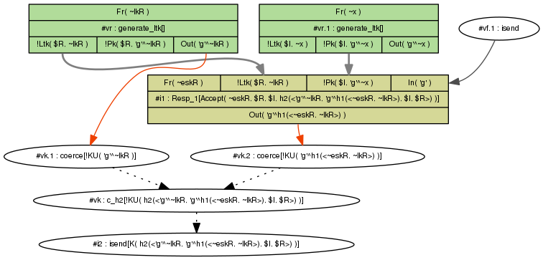
Reading Tamarin’s graphs
f

Slide 35
Algorithm intuition
Constraint solving algorithm
Main ingredients:
  Dependency graphs
  Deconstruction (decryption) chains
  Finite variant property (more this afternoon)
Invariant: if adversary knows M then either
  M was sent in plain
  Adversary can construct M by knowing subterms
  Adversary can deconstruct M …. from message sent by protocol rule

Slide 36
Basic principles
Backwards search using constraint reduction rules (27!)
Turn negation of formula into set of constraints
Case distinctions
  E.g.: Possible sources of a message or fact
Try to establish:
  no solutions exist for constraint system, or
  there exists a „realizable“ execution (trace)
If multiple rules can be applied: use heuristics

Slide 37
Demo
Notes:
Demo is also about when it does not terminate, etc, and about HEURISTICS !

Slide 38
How do I know my model is correct?
Lots of ways to cause errors
Look at the chains...
  (requires an understanding of the algorithm)
Executability
Break the protocol on purpose
Much easier to check these things than in manual proofs!

Slide 39
Heuristics?
If Tamarin terminates, one of two options:
  Proof, or
  counterexample (in this context: attack)
At each stage in proof, multiple constraint solving rules might be applicable
  Similar to “how shall I try to prove this?”
  Choice influences speed & termination, but not the outcome after termination
Complex heuristics choose rule
  user can give hints or override

Slide 40
Lemmas
When it doesn’t terminate…
Guide the proof manually; export
Write lemmas
  “Hints” for the prover
    They don't change the proof obligation, only help finding a proof
  Specify lemma that can be used to prune proof trees at multiple points
  ... more this afternoon and at TLS:DIV

Slide 41
Symbolic analysis for cryptographers
Fundamental differences
  Dolev-Yao attacker strong abstraction of Probabilistic Polynomial Time Turing Machine
  Terms are an abstract view of bitstrings
  No quantitative information (e.g. bounds)
Current algorithm limitations
  Limited equational theories, e.g., MQV style exponentiation tricky: we miss Kaliski’s UKS attack on MQV.
What we could do (but often don’t; ongoing work)
  Negotiation, weak crypto
  Small subgroup attacks
  DSKS attacks
  Length extension attacks

Slide 42
Hands-on session!
Take Naxos-simplified (not full eCK)
Remove
  First argument to KDF, check what happens
  Second etc.
Load more complex threat model version
  Do the same for the properties that held before
Load eCK model version

Slide 43
Discussion & solutions

Slide 44

Tamarin: Conclusions
Tamarin offers many unique features
  Unbounded analysis, flexible properties, equational theories, global state, …
  Enables automated analysis in areas previously unexplored
It has many other features I didn't touch on now (some this afternoon!)
  Induction, restrictions, reusable lemmas, heuristics tuning, …
  Tomorrow at TLS:DIV – TLS 1.3 analysis
  Many new features planned!
Tool and sources are free; development on Github
Cas.cremers@cs.ox.ac.uk

