Slide 1
Advanced modeling, properties, and state space reduction
David Basin, Cas Cremers, Jannik Dreier, Ralf Sasse

Slide 2
Overview
Recap
Induction
State space reduction by sources lemmas
Equational theories and adversary rules
Observational equivalence

Slide 3
Modeling in Tamarin
Multiset rewriting
Basic ingredients:
  Terms (think “messages”)
  Facts (think “sticky notes on the fridge”)
  Special facts: Fr(t), In(t), Out(t), K(t)
System state is a multiset of facts
  Initial state is the empty multiset
  Rules specify the transitions (“moves”)
Rules are of the form:
  l --> r
  l --[ a ]-> r
  == l --[ ]-> r
Notes:
Reminder:
Multiset == bag; elements can occur multiple times
If whiteboard, sketch simple example? [problem: generic transition system maybe not as helpful as actually showing Naxos]

Slide 4
Semantics
Transition relation
  S –[a]→_{R} (( S \# l ) ∪# r )
  where l –[a]→r is a ground instance of a rule and l ⊆# S
Executions
  Exec( R) = { ∅ –[a₁]→ … –[a_{n}]→ S_{n}
  | ∀n . Fr(n) appears only once on rhs }
Traces
  Traces( R) = { [a₁,…,a_{n}]
  | ∅ –[a₁]→ … –[a_{n}]→ S_{n} ∈Exec( R) }

Slide 5
Trace properties
For now: trace properties (but more later!):
  ∀ tr ∊ traces(System) . P(tr)
All
system
traces
Bad traces
not P(tr)
Intersection empty?

Slide 6
Induction
Proof goal:
  ? Not needed in formula, but will hold
Naive constraint solving does not work
Such properties are needed:
  “Reuse” lemmas
  “Sources” lemmas
Notes:
Why is this induction?
- start at empty state
- induction on length of trace
- for all FINITE-length traces there is a Start

Slide 7
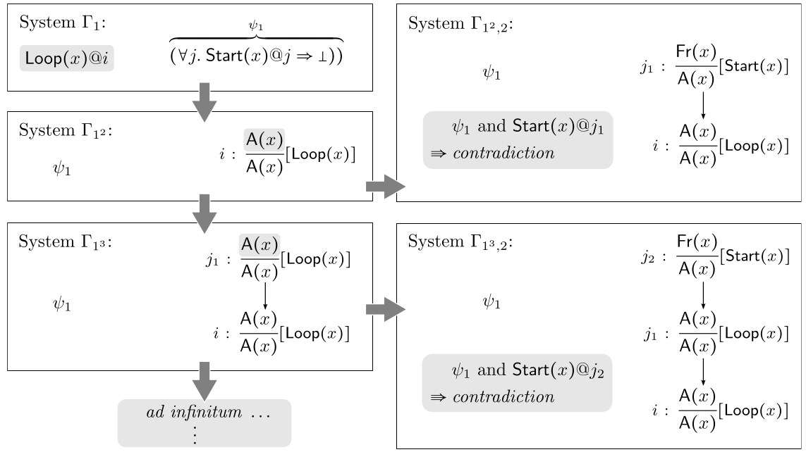
Constraint solving failure

Slide 8
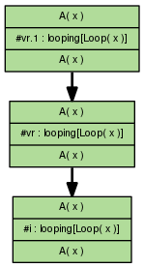
Demo
Notes:
Backwards search on loop showing exactly the problems from previous math notation slide in the tool.

Slide 9
Induction – on time points
Informally, induction works on previous slide
Formally, for IH
  Check if holds for empty trace
  Consider special last rule index on trace
      Assume holds at all non-last indices, and prove for last
Added constraint reduction rules for last atoms
Allows proof of previous example

Slide 10
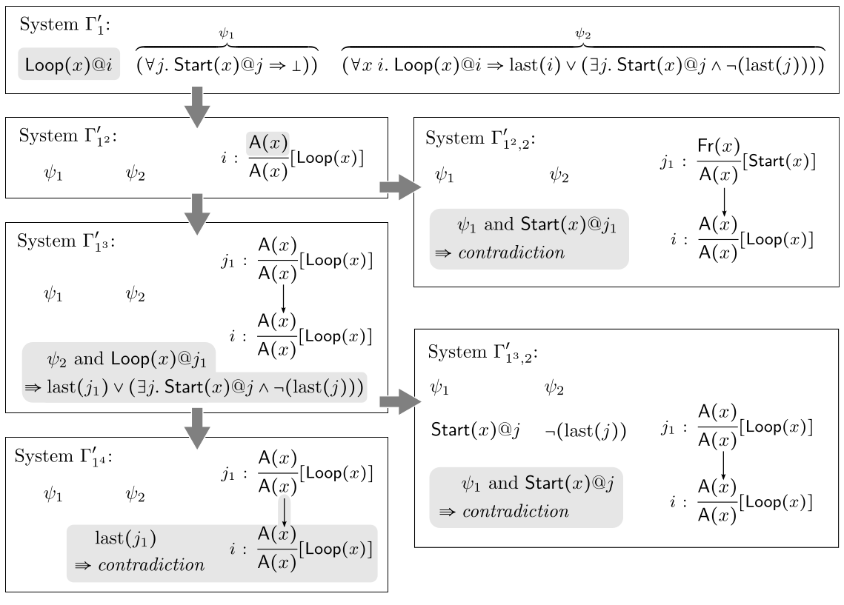
Example – solved by induction

Slide 11
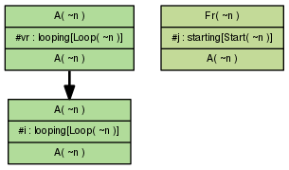
Demo – using induction
Notes:
Use induction instead of simplify and get this solution because for the non-last time point the IH holds.

Slide 12
Induction in general
Required for all “sources” lemmas
Often required for “reuse” lemmas
Helps for all looping constructs, used in e.g.:
  YubiKey
  TPM
  PKCS11
  Group protocols
  Counters

Slide 13
State space reduction
Pre-computation
Partial deconstructions
Sources lemmas

Slide 14
Precomputation
Idea: for all facts in rule premises compute their possible sources
sources are (combinations of) rules yielding such a fact as (part of the) result
Initial precomputations are called raw sources
Sometimes these precomputations are incomplete, and give partial deconstructions
GUI shows both raw and refined sources

Slide 15
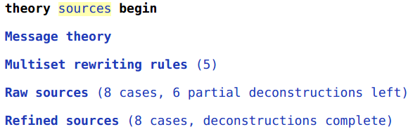
Demo
Notes:
Show top-left of GUI, particularly raw and refined sources.

Slide 16
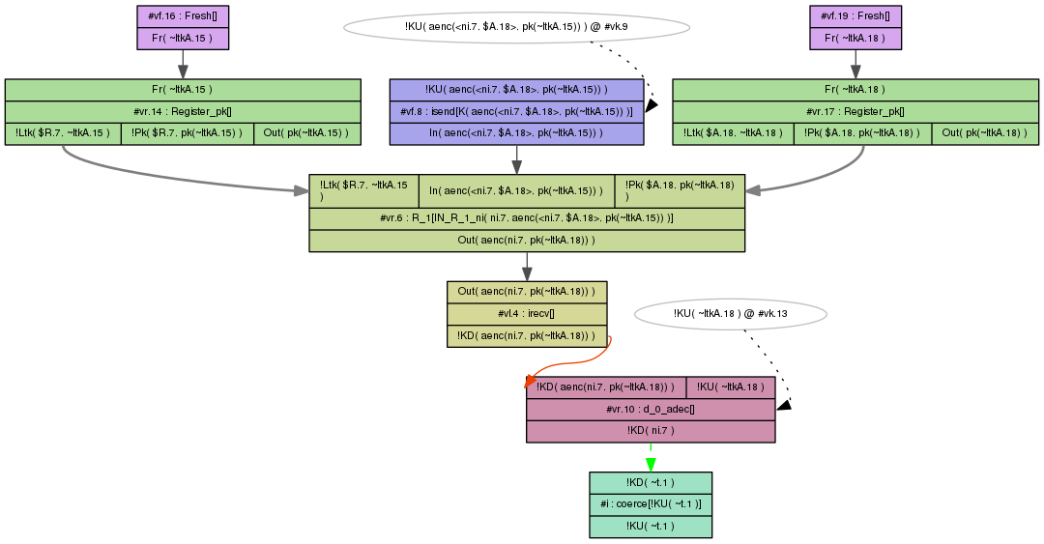
Partial deconstruction – derive any value

Slide 17
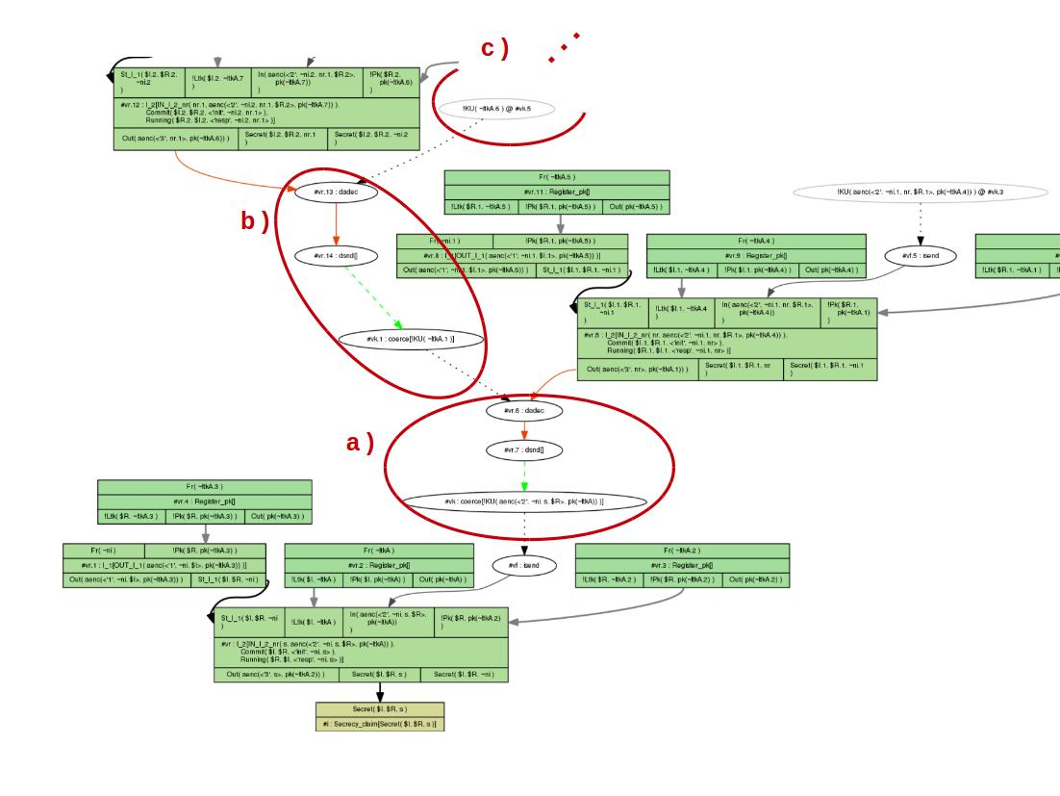
See demo for detail
Notes:
Only show demo after a couple more slides!

Slide 18
Partial deconstructions – issues
Proofs much more complicated
  Possibly non-termination due to partial deconstructions
Need to resolve such partial deconstructions
Claim (and then prove) such deconstructions are not possible, by sources lemma

Slide 19
Example protocol
1. I -> R: {ni,I}pk(R)
2. I <- R: {ni}pk(I)
rule I_1:
let m1 = aenc{~ni, $I}pkR in
[ Fr(~ni) , !Pk($R, pkR) ]
--[ OUT_I_1(m1) ]->
[ Out( m1 ) ]
rule R_1:
let m1 = aenc{ni, I}pk(ltkR)
m2 = aenc{ni}pkI in
[ !Ltk($R, ltkR) , In( m1 ), !Pk(I, pkI) ]
--[ IN_R_1_ni( ni, m1 ) ]->
[ Out( m2 ) ]
This looks like a decryption oracle for values ni

Slide 20
Really? Extract everything?
Realization: only values actually sent by legitimate party (whose private key must be compromised) or adversary-generated terms
  which are known to the adversary previously
lemma types [sources]:
" (All ni m1 #i.
IN_R_1_ni( ni, m1) @ i
==>
( (Ex #j. K(ni) @ j & j < i)
| (Ex #j. OUT_I_1( m1 ) @ j) ) ) "

Slide 21
Demo
Problems with partial deconstructions
Sources lemma removes partial deconstructions for refined sources
Automatic proof of sources lemma
Notes:
Sources-nolemma-load bottom to show repeated abuse of partial deconstruction
Sources – shows that deconstructions gone in refined sources, and sources lemma verified with induction

Slide 22
Sources lemmas
Explain where terms can come from or what their form must be
Tamarin actions in order:
Determine possible sources (raw)
Apply sources lemma to raw sources to get refined sources
Prove sources lemma WRT raw sources
Prove other lemmas WRT refined sources

Slide 23
Sources lemmas
Important for termination
Reduces state space to manageable size
See more in following hands-on session

Slide 24
Equational theories
Equational theories are used in symbolic protocol verification to model the algebraic properties of the cryptographic primitives.
Example (asymmetric encryption):
adec(aenc(m,pk(k),k) = m
Subterm convergent
  Right-hand side is subterm of left hand side (or constant)
Built-in: Diffie-Hellman, bilinear pairing, multiset
Recent extension: any FVP theory
  Example: blind signatures

Slide 25
Finite Variant Property
FVP is a property of an equational theory
  Theory must be confluent and terminating
  For all terms there is a bound so that all instantiations of the term reach their normal form in at most bound number of steps.
  Allows computation of complete set of variants
  Set of variants represents the term modulo theory
Any subterm-convergent theory has FVP
Built-ins are proven to have FVP as well

Slide 26
Protocol modulo equational theory
Inefficient to compute protocol execution modulo equational theory
Compute variants of rules modulo equational theory
Adversary: Construction and deconstruction rules
  Construction rules allow adversary to apply any operator
  Deconstruction rules represent applying those operators where the result changes modulo the equational theory
  e.g.: applying decryption operator to encrypted term with correct key
Adversary rules are automatically derived

Slide 27
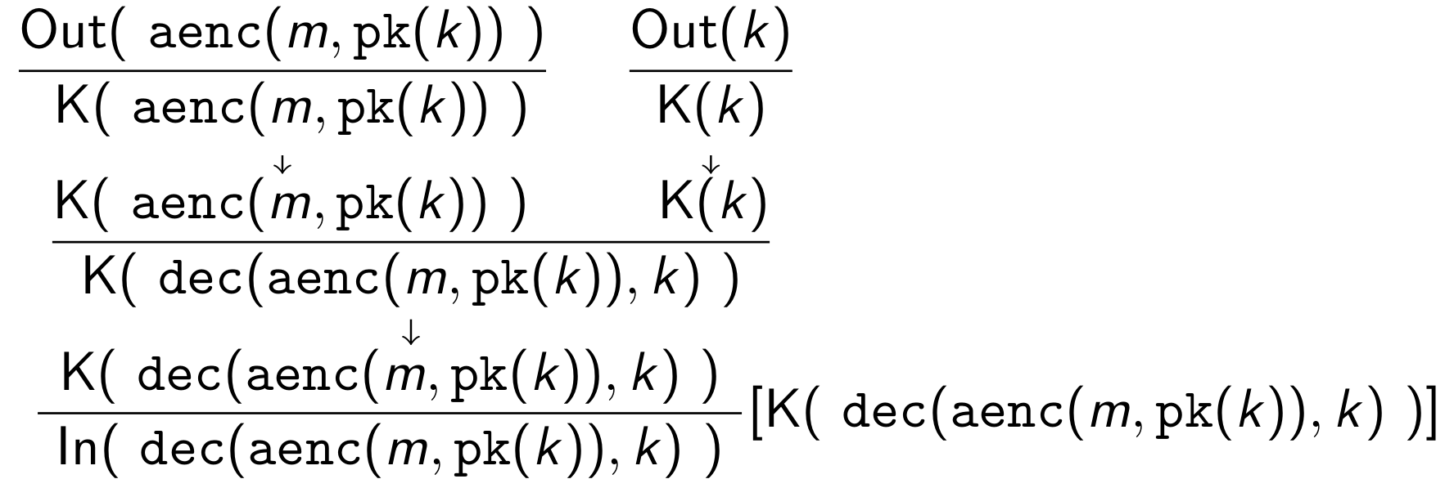
Message deduction
The adversary is specified using multiset rewrite rules
Example:

Slide 28
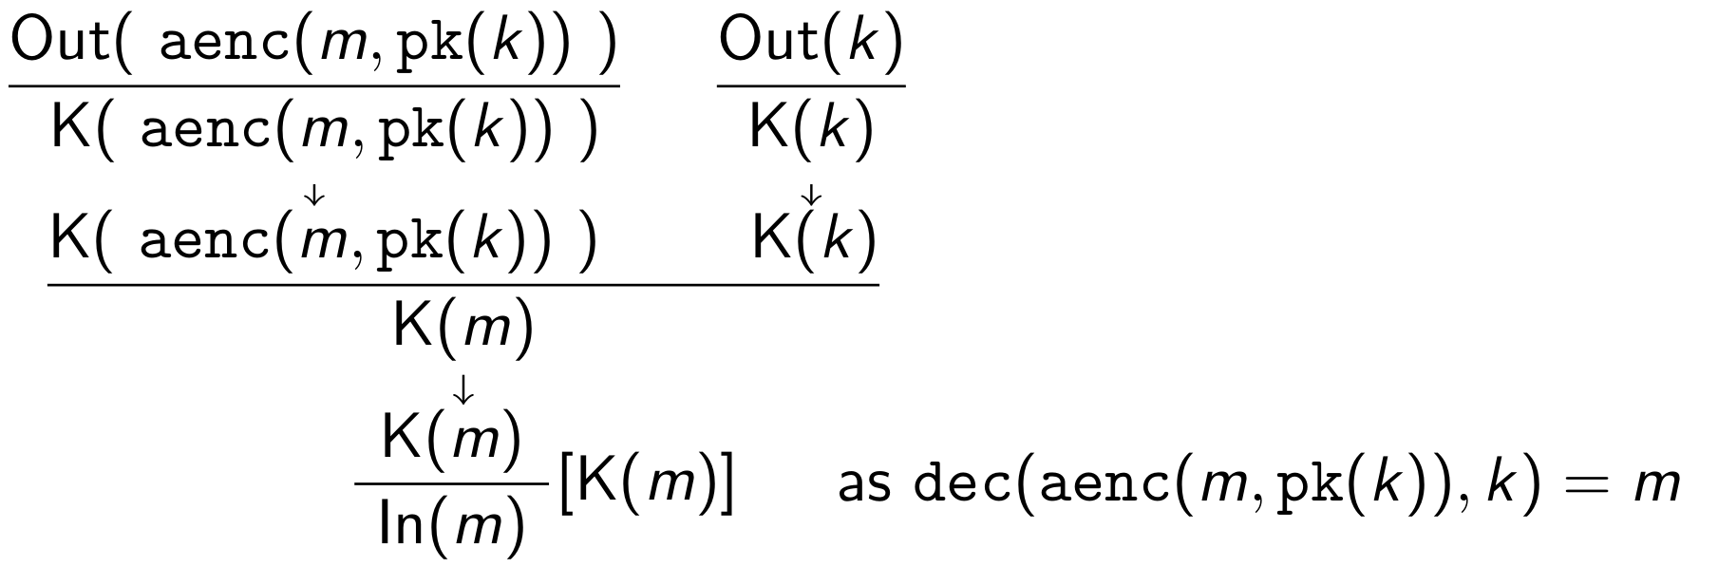
Message deduction
The adversary is specified using multiset rewrite rules
Example:

Slide 29
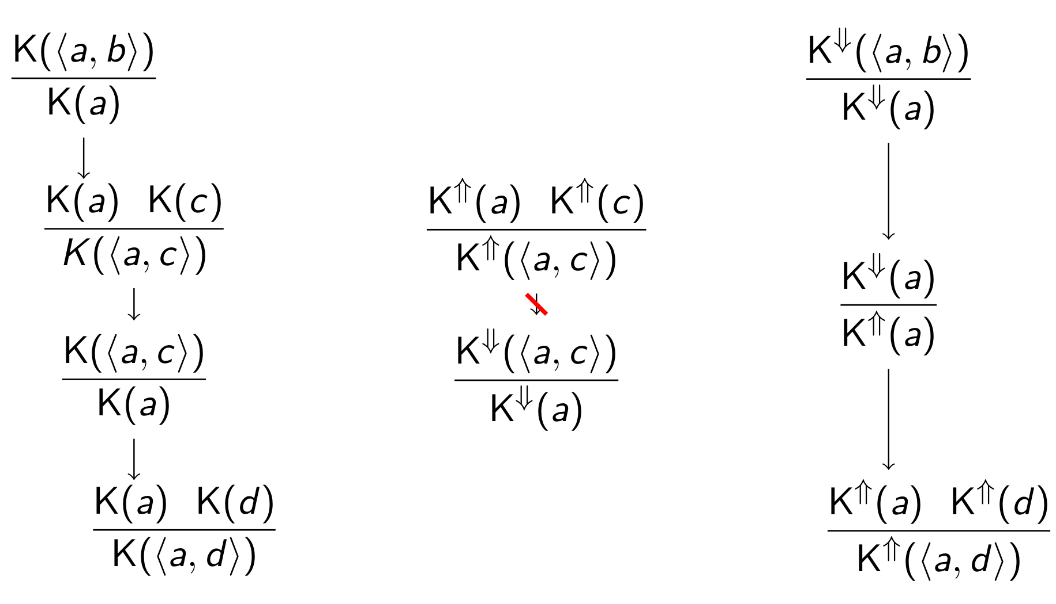
Prevent loops and redundant derivation
Split adversary knowledge into and

Slide 30
Normal deduction – equivalent to MD
Notes:
Proof normal forms!

Slide 31
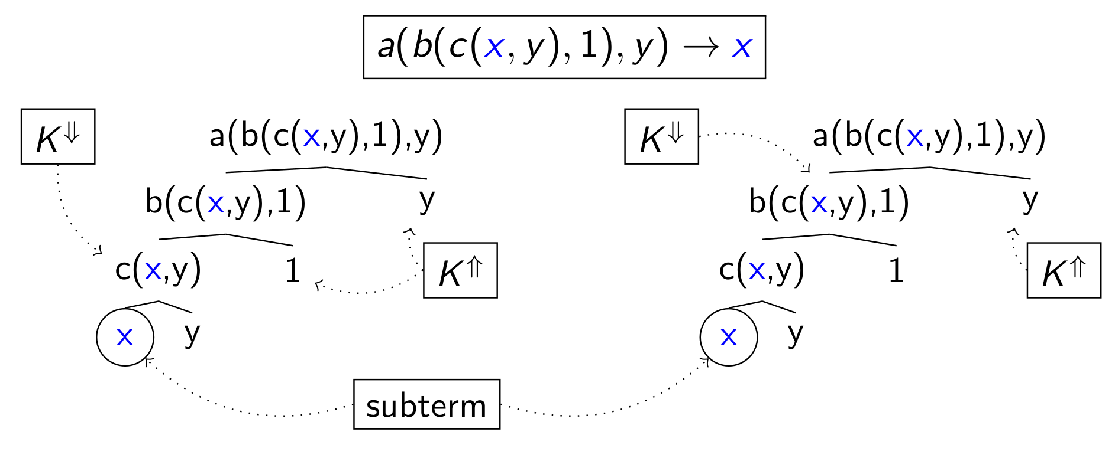
Deconstruction rules for subterm-convergent equations
Yields two deconstruction rules:

Slide 32
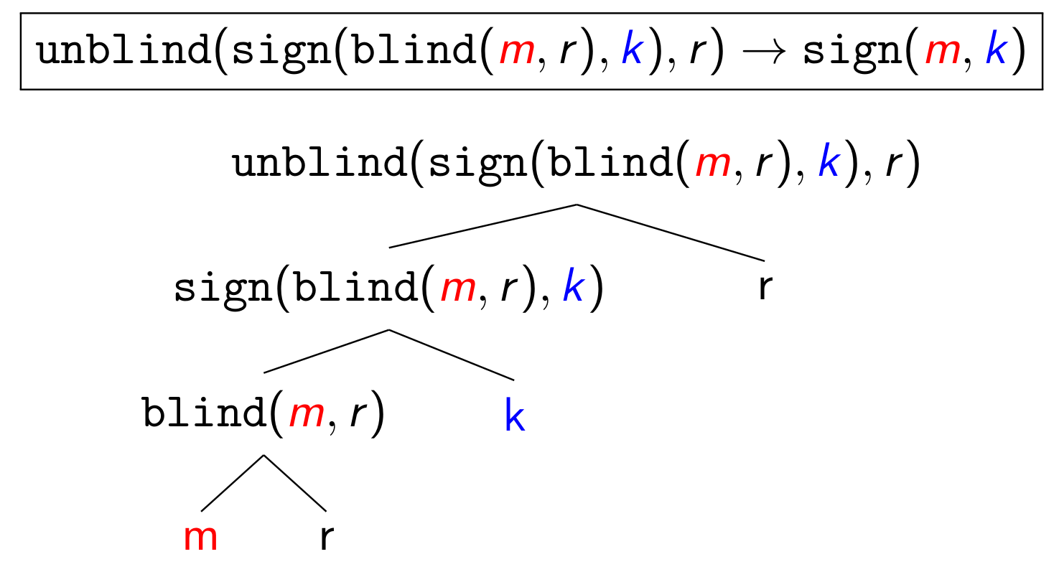
General deconstruction rule example
Yields two deconstruction rules (2nd twice):

Slide 33
Protocol by Fujioka, Okamoto, and Ohta [FOO92]
Protocol combines
  Blind signatures
  unblind(sign(blind(x,r),k),r) = sign(x,k)
  Commitments: open(commit(v,r),r) = v
to ensure:
  vote privacy (equivalence property)
  eligibility (trace property)
"All vote #j. VotePublished (vote) @ j ==>
(Ex r b #i. Registered(blind(commit(vote,r),b)) @ i
& #i < #j )"

Slide 34
FOO92
Runs in three phases:
  Eligibility check
  Voting
  Counting
Authorities:
  Administrator
  Collector
Assumption:
  Anonymous channel to the collector

Slide 35
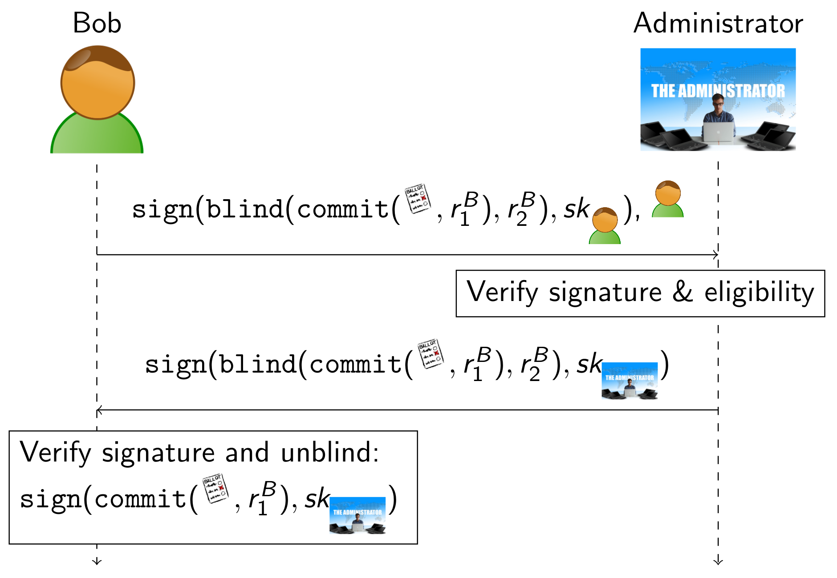
Eligibility check

Slide 36
Demo
Message theory
Multiset rewriting rules
Heuristics vs user-guided
Notes:
First show construction and deconstruction rules in the message theory
Multiset rewriting rules represent just the input theory
Using the sources lemma, demo is also about when it does not terminate, etc, and about HEURISTICS !

Slide 37
Restrictions
Restrictions exclude undesired traces
  Take care not to exclude attacks!
Safe to use for certain checks:
  Equality
  Inequality
  LessThan
  GreaterThan
  OnlyOnce
Use same format as lemmas
Essentially: Conditional Rewriting

Slide 38
Restriction Example
restriction once:
“All #i #j. OnlyOnce()@#i & OnlyOnce()@#j ==> #i=#j”
Rules
  rule 1: [ ] –[ OnlyOnce() ]→ [ A('5') ]
  rule 2: [ A(x) ] –[ Step(x) ]→ [ B(x) ]
Execution removed by restriction
    [ ]
    –[ OnlyOnce() ]→ [ A('5')]
    –[ OnlyOnce() ]→ [ A('5'), A('5') ]
    –[ Step('5') ]→ [ A('5'), B('5') ]
Execution still allowed
    [ ]
    –[ Init() ]→ [ A('5'), A('5') ]
    –[ Step('5') ]→ [ A('5'), B('5') ]

Slide 39
Restriction Example 2
restriction InEq:
“All x #i. Neq(x,x)@#i ==> F”
Rules
  rule 1: [ ] –[ A1() ]→ [ A('1') ]
  rule 2: [ ] –[ A2() ]→ [ A('2') ]
  rule 3: [ A(x), A(y) ] –[ Neq(x,y) ]→ [ B(x,y) ]
Execution removed by restriction – valid without restriction
    [ ]
    –[ A1() ]→ [ A('1')]
    –[ A1() ]→ [ A('1'), A('1') ]
    –[ Neq('1','1') ]→ [ B('1','1') ]
Execution allowed
    [ ]
    –[ A1() ]→ [ A('1')]
    –[ A2() ]→ [ A('1'), A('2') ]
    –[ Neq('1','2') ]→ [ B('1','1') ]

Slide 40

Observational equivalence
Two types of properties:
Trace properties
  (Weak) secrecy as reachability
  Authentication as correspondence
Observational equivalence

Slide 41
Why observational equivalence?
Consider classic Dolev-Yao adversary for deterministic public-key encryption:
Adversary can only decrypt if he knows the secret key
Consider a simple voting system:
  Voter chooses v=”Yes” or v=”No”
  Encrypt v using server’s public key pk(k):
  c = enc(v,pk(k))
  Send c to server
Is the vote secret?
  Dolev-Yao: Yes, adversary does not know server’s secret key
  Reality: No, encryption is deterministic and there are only two choices
    Attack: encrypt “Yes”, and compare to c

Slide 42
Observational equivalence vs reachability
Reachability-based (weak) secrecy is insufficient
Stronger notion: adversary cannot distinguish
  a system where the voter votes “Yes” from
  a system where the voter votes “No”
Observational equivalence between two systems
Can be used to express
  Strong secrecy
  Privacy notions

Slide 43
Running example
Auction system for a shout-out auction
Property: strong secrecy of bids
Property violated:
  Broadcast bid (e.g., A or B)
  Send “A” in first system
  Send “B” in second system
  Observer knows if he is observing first or second system
Property holds using shared symmetric key:
  Shared symmetric key k between bidder and auctioneer
  Send “{A}_{k}” in first system
  Send “{B}_{k}” in second system
  Observer has no access to k, does not know which system he observes

Slide 44
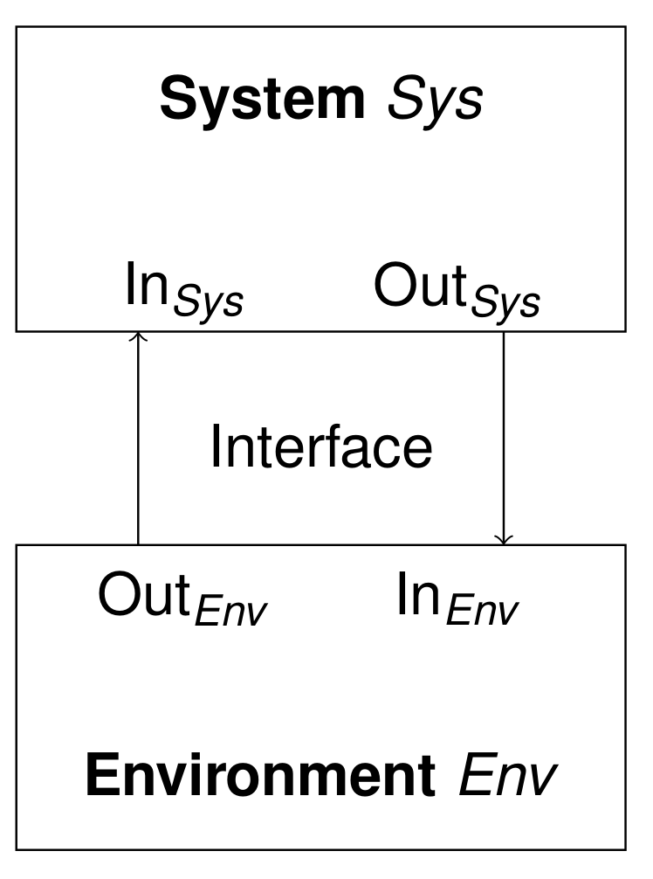
System and environment
We separate environment and system
  System: agents running according to protocol
  Environment: adversary acting according to its capabilities
Environment can observe:
  Output of the system
  If system reacts at all

Slide 45
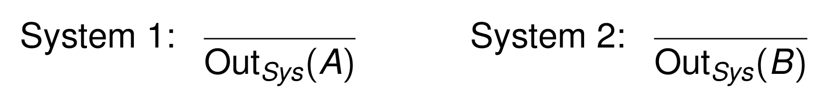
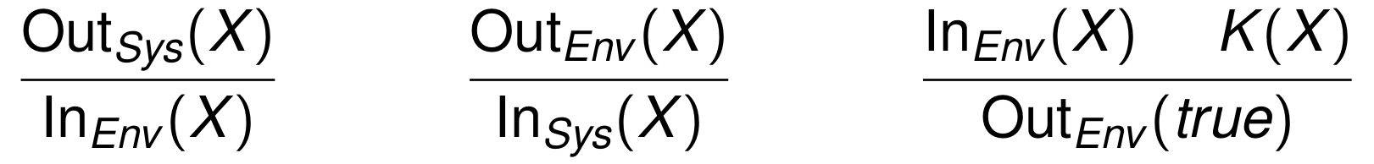
Defining observational equivalence
Two system specifications given as set of rules
  One rule per role action (send/receive)
  Running example shout-out auction:
Interface and environment/adversary rule(s):
  Last rule models comparison by the adversary
Each specification yields a labeled transition system
Observational equivalence is a kind of bisimulation accounting for the adversaries’ viewpoint and capabilities

Slide 46
Diff terms
General definitions of observational equivalence difficult to verify: requires inventing simulation relation
Idea: specialize for cryptographic protocols
  Consider strong bid secrecy:
    both systems differ in secret bid only, i.e.,
    both specifications contain same rule(s), which differ only in some terms
  Exploit this similarity in description and proof
Approach: two systems described by one specification – using diff-terms
  Running example
  Is equivalent to one rule with a diff-term

Slide 47
Approximating observational equivalence using mirroring
Both systems contain same rules modulo diff-terms
Idea: assume that each rule simulates itself
Compute mirrors of each execution into the other system
If the mirrors are valid executions, we have observational equivalence (sound approximation)

Slide 48
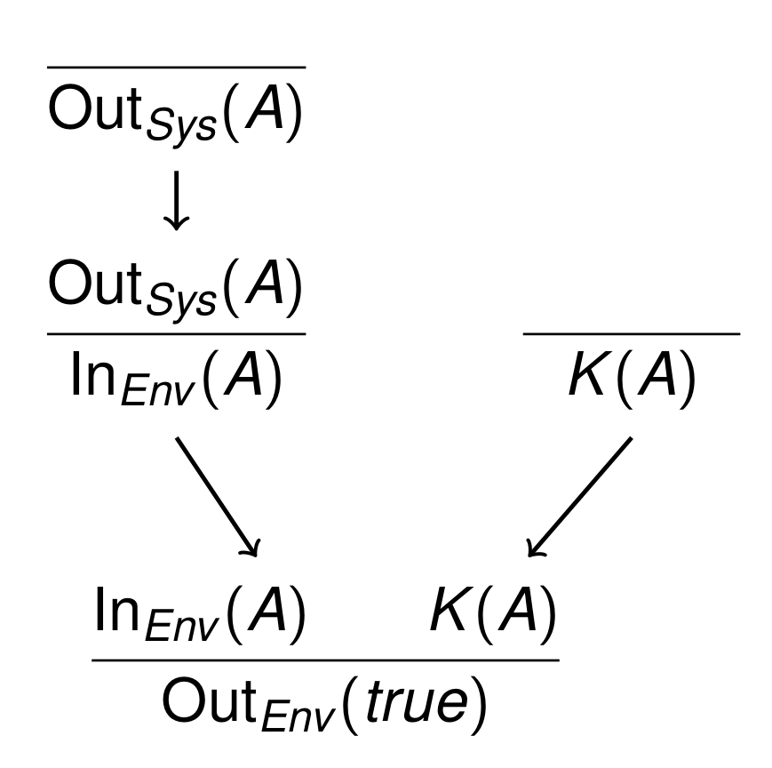
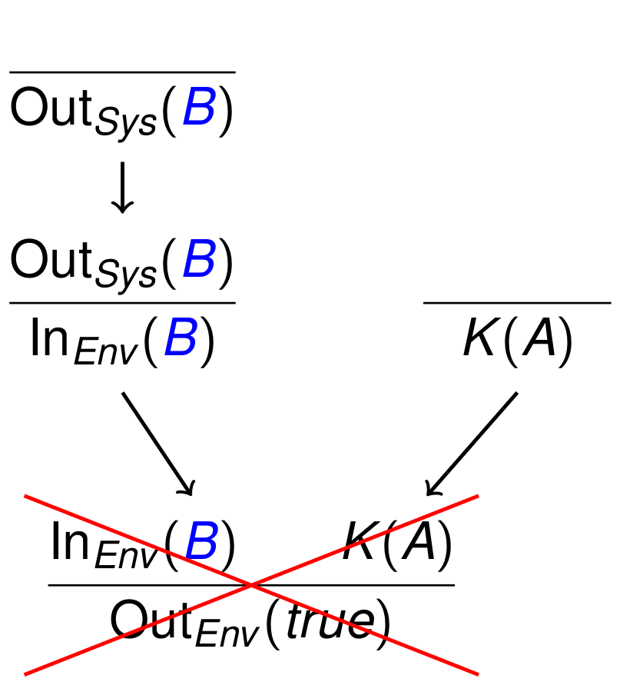
Invalid mirrors and attacks
Bidder picks A/B, observer compares to public value A
Counter example to observational equivalence

Slide 49
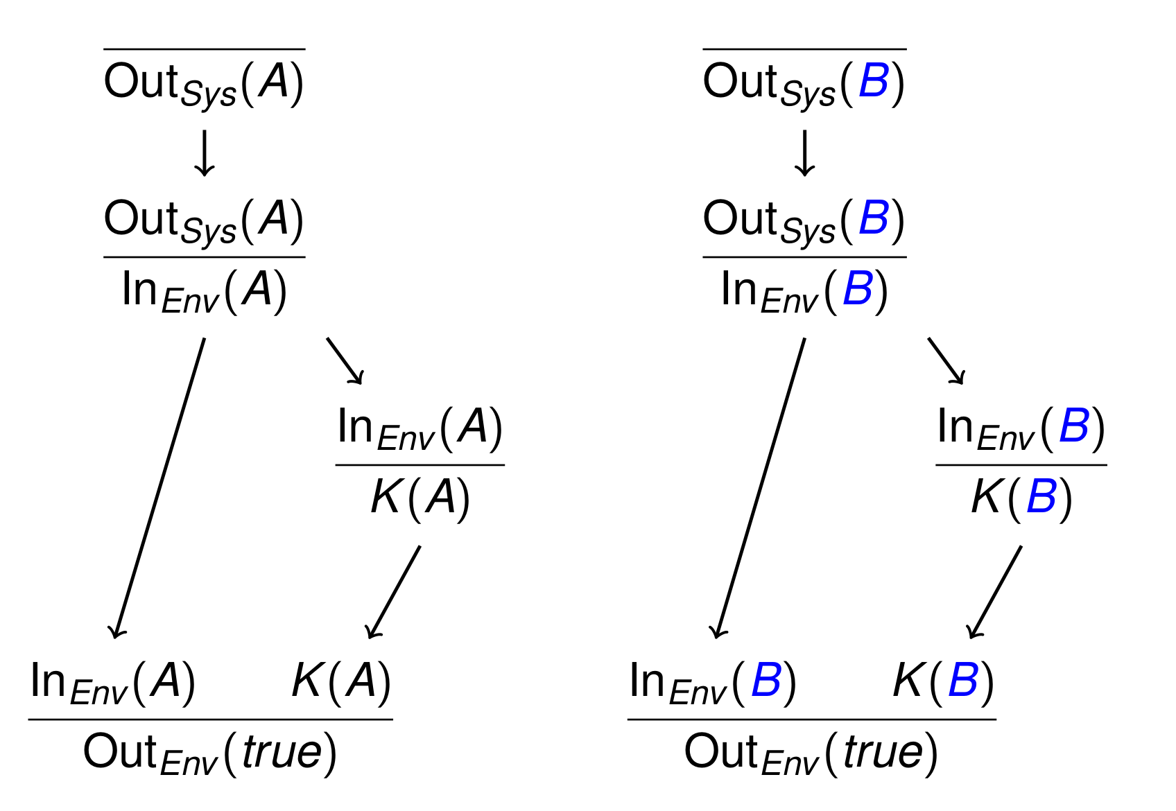
Valid mirror
Observer compares system output to itself
  All mirrors need to be valid for observational equivalence

Slide 50
Dependency graph equivalence
A diff-system is dependency graph equivalent if mirrors of all dependency graphs rooted in any rule on both sides are valid.
  Sound but incomplete approximation
  Efficient and sufficient in practice
Input:
  Protocol specification
  Property: equivalence given two choices for some term(s)
    Example: random value vs expected value
Output:
  Yes, observational equivalent
  No, dependency graph with invalid mirror
  Non-termination possible

Slide 51
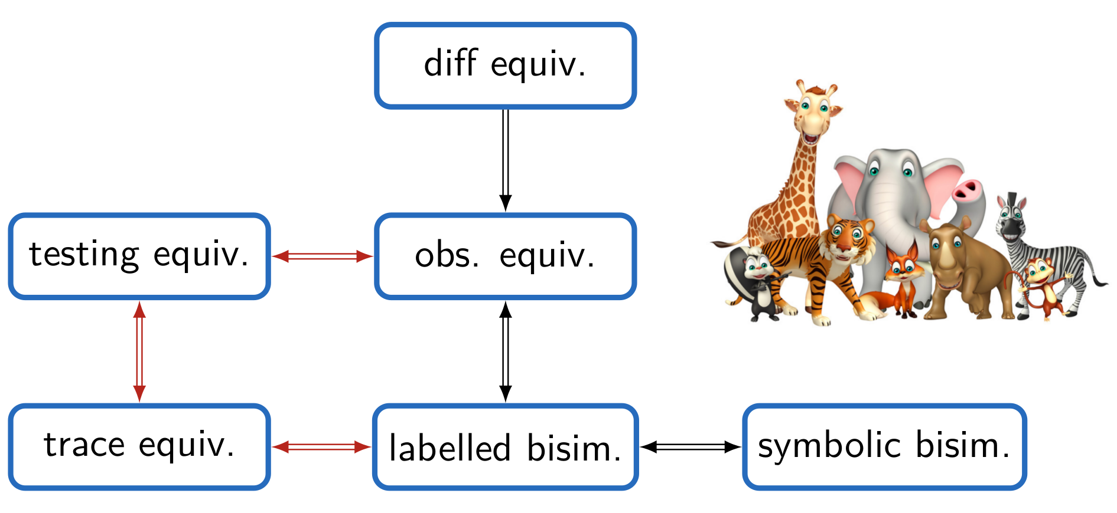
The equivalence zoo
Red arrows require assumptions: determinate processes + bounded sessions (no replication)

Slide 52
Case studies
Feldhofer’s RFID protocol
  Adversary cannot determine which RFID tag is communicating with reader
  Automatically verified in 1.6 seconds
Signed Diffie-Hellman key exchange
  Real-or-random secrecy of session key
  Needs manual guidance in one subcase
  Automatically completed proof in 2.5 minutes
TPM_Envelope
  Real-or-random secrecy
  Finds attack for deterministic encryption
    Despite previous proof wrt trace-based secrecy
  Recommendation: use probabilistic encryption

Slide 53
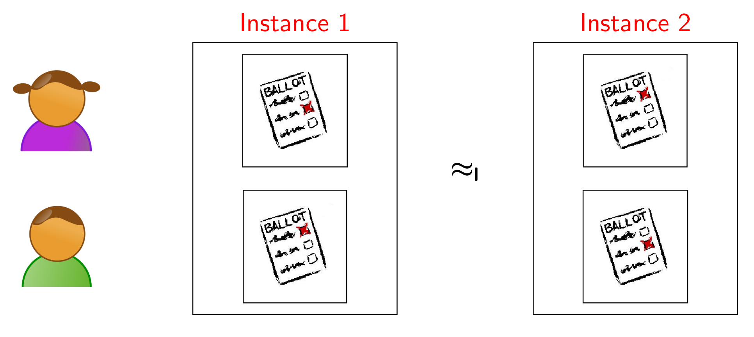
Vote privacy for FOO92
Eligibility verified previously
Vote privacy verified automatically as well

Slide 54
Case studies (II)

Slide 55
Large scale
TLS 1.3 analyzed with Tamarin at:
  v10
  v10+ (fixes to v10)
  current version
See tomorrow at TLS:DIV (room 107, 16:00)
Attack found: 18 messages, 3 modes
  Finding it manually unlikely

Slide 56
The future
Increasing scope
  Properties
    Much ongoing work on trace equivalence properties
Increasing precision
  Expanding supported equational theories
  Tamarin is already more precise than other tools, e.g., for Diffie-Hellman representation

Slide 57
Tamarin: Conclusions
Tamarin offers many unique features
  Unbounded analysis, (guarded) FOL properties, equivalence properties, equational theories, global state, …
  Enables automated analysis in areas previously out of scope
It has additional features we did not touch on today
  Reusable lemmas, heuristics tuning, …
Tool and sources are free; development on Github
Want to continue with Tamarin?
  https://tamarin-prover.github.io for news and publications
  https://github.com/tamarin-prover/tamarin-prover
ralf.sasse@inf.ethz.ch

Slide 58
Backup slides

Slide 59
Guarded Formulas
All formulas (lemma, restriction) must be guarded
  All variables quantified over must appear in terms
  Where F is a fact and and are vectors of variables such that
  i.e., all bound variables appear in the fact formula

Slide 60
Executability Lemmas
Executability lemmas are existential properties
These show the existence of some protocol trace satisfying the formula…
… instead of the usual case where all traces must satisfy the formula.
Heuristics tuned for verification
  Manual intervention needed more often for executability
lemma exec: exists-trace “...(formula)...”

Slide 61
Syntax Issues: Type Annotations
Mark timepoint (index) variables with a hashmark (#) in quantification.
We omit this in the slides, but it is required in the tool.
Example:

Slide 62
Syntax Issues: Type Annotations (ctd.)
Mark fresh values with ~
Mark public values with $
Be consistent! If a rule contains ~x, $x, and x that is interpreted as three different variables!
  You do get a warning about it, and should fix it.

Slide 63
Warnings on Loading a theory
Warnings give good information what is wrong:
  Mismatch of type: use of $x and x in same rule
  Using a fact name with different arities
  Guardedness problems in formula
Tamarin strict mode stops you from working with warnings, but is optional:
  Add command-line parameter: --quit-on-warning

Slide 64
Storing Proofs
Complete (or partial) proofs can be stored
  Click the “Download” button in top right
These can be reloaded like normal theories
  Proof is rechecked!

Slide 65
Eligibility check - FOO92
rule V_1:
let x = commit( $vote , ~r )
e = blind( x, ~b )
s = sign ( e , ~ltkV )
in
[ Fr( ~r ), Fr( ~b ), !Ltk( V, ~ltkV ) ]
--[ Created_vote_V_1(x), Created_commit_V_1(e) ]->
[ Out( <e,s> ), St_V_1( V, $vote, ~r, ~b ) ]
rule A_1:
let d = sign( e, ~ltkA )
in
[ In( <e,sign(e,~ltkV)> ), !AdminLtk( A, ~ltkA ), !Ltk( V, ~ltkV ) ]
--[ Registered(e), In_A_1(e) ]->
[ Out( <e,d> ) ]
rule V_2: // Check Admin_Signature & Check the commit
let e = blind(commit(vote,~r),~b)
d = sign(blind(commit(vote,~r),~b),~ltkA)
y = sign(commit(vote,~r),~ltkA)
x = commit(vote,~r)
in
[ In( <e,sign(e,~ltkA)> ), St_V_1( V, vote, ~r, ~b), !AdminLtk(A, ~ltkA) ]
--[ ]->
[ Out( <x,y> ), St_V_2( V, A, vote, ~r ) ]

Slide 66
Advanced modeling
Channels
Heuristics options

Slide 67
Some simple examples
Indistinguishability of probabilistic encryption
  Adversary cannot distinguish random value from encryption
  Automatically verified in 0.2 seconds
Decisional Diffie-Hellman
  Given algebraic properties of DH exponentiation as equational theory
  Adversary cannot distinguish g^{ab} from random g^{c}
    Given g^a and g^b
  Automatically verified in 15.2 seconds

