Slide 1
The
Correct Object Token
apple
Positional Information
is
Value Information
in
Box
Previous Query
Box Token
Content Gatherer Heads
F
,
.
.
V-Composition
.
V-Composition
Box
Query Box Token
Duplicate Token Heads
Induction Heads
Q-Composition
F
contains
the
Last Token
Positional Info Fetcher Heads
Object Value Fetcher Heads
Logits

Slide 2
The
apple
Correct Object Token
Positional Information
is
Value Information
in
Box
Previous Query
Box Token
F
Content Gatherer Heads
,
.
.
V-Composition
.
V-Composition
Box
Query Box Token
Duplicate Token Heads
Induction Heads
F
Q-Composition
contains
the
Last Token
Positional Info Fetcher Heads
Object Value Fetcher Heads
Logits

Slide 3
The
apple
Correct Object Token
Positional Information
is
Value Information
in
Previous Query
Box Token
Attention pattern
Box
F
Content Gatherer Heads
DCM
,
.
V-Composition
.
.
Box
Query Box Token
Duplicate Token Heads
V-Composition
F
Q-Composition
contains
the
Last Token
Positional Info Fetcher Heads
Object Value Fetcher Heads
Logits

Slide 4
The
apple
Correct Object Token
Positional Information
is
Value Information
in
Box
Previous Query
Box Token
F
Content Gatherer Heads
,
.
V-Composition
.
.
Box
Query Box Token
Duplicate Token Heads
V-Composition
F
Q-Composition
contains
the
Last Token
Positional Info Fetcher Heads
Object Value Fetcher Heads
Logits

Slide 5
The
apple
Correct Object Token
is
Positional Information
in
Value Information
Box
Previous Query
Box Token
F
Gather Box-Associated Info
,
.
V-Composition
.
.
V-Composition
Box
Query Box Token
Duplicate Token
F
Q-Composition
contains
the
Last Token
Fetch Positional Info
Fetch Object Value
Logits

Slide 6
The
apple
Correct Object Token
is
Positional Information
in
Value Information
Box
Previous Query
Box Token
F
Gather Box-Associated Info
,
.
V-Composition
.
.
V-Composition
Box
Query Box Token
Duplicate Token
F
Q-Composition
contains
the
Last Token
Fetch Positional Info
Fetch Object Value
Logits

Slide 7
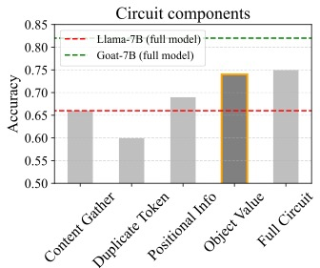
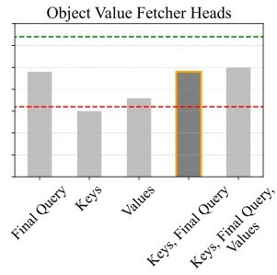
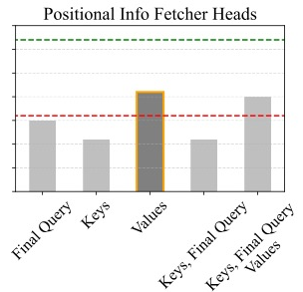
Goat-7B
Llama-7B
The
(a)
The
apple
apple
is
is
in
in
Box
Box Info
Box
Box Info
F
F
,
,
.
.
.
(c)
.
.
.
Box
Duplicate Token
Box
Duplicate Token
F
F
contains
Positional Info
Object Value
contains
Positional Info
Object Value
the
the
(b)

Slide 8
Goat-7B
Llama-7B
The
The
apple
apple
is
is
in
in
Box
Box Info
(a) Output patching
Box
Box Info
F
Q
K
V
F
Q
K
V
,
,
.
.
.
.
.
.
Box
Q
K
V
Box
Q
K
V
F
F
contains
Object Value
contains
Object Value
the
Q
K
V
Q
K
V
the
Q
K
V
Q
K
V
(b) Input patching

Slide 9
Goat-7B
Llama-7B
The
The
apple
apple
is
is
in
in
Box
Box Info
(a) Output patching
Box
Box Info
F
Q
K
V
F
Q
K
V
,
,
.
.
.
.
.
.
Box
Q
K
V
Box
Q
K
V
F
F
contains
Object Value
contains
Object Value
the
Q
K
V
Q
K
V
the
Q
K
V
Q
K
V
(b) Input patching

Slide 10
Goat-7B
Llama-7B
The
The
apple
apple
is
is
in
in
Box
Box Info
(a) Output patching
Box
Box Info
F
Q
K
V
F
Q
K
V
,
,
.
.
.
.
.
.
Box
Q
K
V
Box
Q
K
V
F
F
contains
Object Value
contains
Object Value
the
Q
K
V
Q
K
V
the
Q
K
V
Q
K
V
(b) Input patching

Slide 11
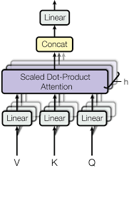
Q
K
V

Slide 12
Desiderata
Alternate
Original
Target
The book is in Box C, the boat is in Box W, the creature is in Box P, … Box W contains the ____
The document is in Box X, the pot is in Box T, the magnet is in Box A, … Box X contains the ____
(a) Object
boat
The stone is in Box X, the engine is in Box I, the bread is in Box H, … Box K contains the ____
The document is in Box X, the magnet is in Box A, the cross is in Box K, … Box A contain the ____
(b) Label
cross
The cup is in Box M, the pipe is in Box K, the computer is in Box Q, … Box Q contains the ____
The document is in Box X, the pot is in Box T, the bill is in Box M, … Box A contains the ____
(c) Position
bill

Slide 13
Desiderata
Alternate
Original
Target
The book is in Box C, the boat is in Box W, the creature is in Box P, … Box W contains the ____
The document is in Box X, the pot is in Box T, the magnet is in Box A, … Box X contains the ____
boat
(a) Object
The stone is in Box X, the engine is in Box I, the bread is in Box H, … Box K contains the ____
The document is in Box X, the pot is in Box T, the cross is in Box K, … Box A contain the ____
cross
(b) Label
The cup is in Box M, the pipe is in Box K, the computer is in Box Q, … Box Q contains the ____
The document is in Box X, the pot is in Box T, the bill is in Box M, … Box A contains the ____
bill
(c) Position

Slide 14
Group A (L23 H3)
Path-Patching
A
Attention flow
Q
Group B (L14 H27)
Attention strength
B
Attention heads
in circuit
V
Group C (L10 H3)
C
V
Group D (L8 H21)
D
…
C
C
C
C
the
apple

Slide 15
A
B
C
D
…
M
…
M
the
the
bill

Slide 16
A
B
C
D
…
…
the
apple
is
in
Box
M
Box
M
the
,
contains

Slide 17
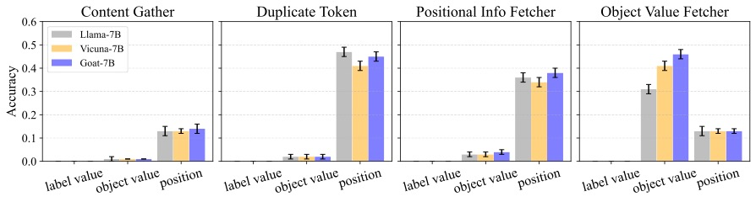
Alternate
(A) Value fetcher
(B) Position transmitter
A
0.6
0.5
Llama-7B
Vicuna-7B
B
0.4
Goat-7B
Llama-7B
Chance
(Position)
Accuracy
C
0.3
0.2
D
0.1
, -
…
Box -
0
is -
Box -
F -
the -
the -
in -
F -
label
value
position
label
value
position
stone -
contains -
Patching
Original
label
value
position
(C) Position detector
(D) Structure reader
A
stone
0.6
0.5
B
0.4
Llama-7B
Accuracy
0.3
C
0.2
D
0.1
, -
…
Box -
0
Box -
M -
the -
the -
in -
C -
is -
label
value
position
label
value
position
apple -
contains -

Slide 18
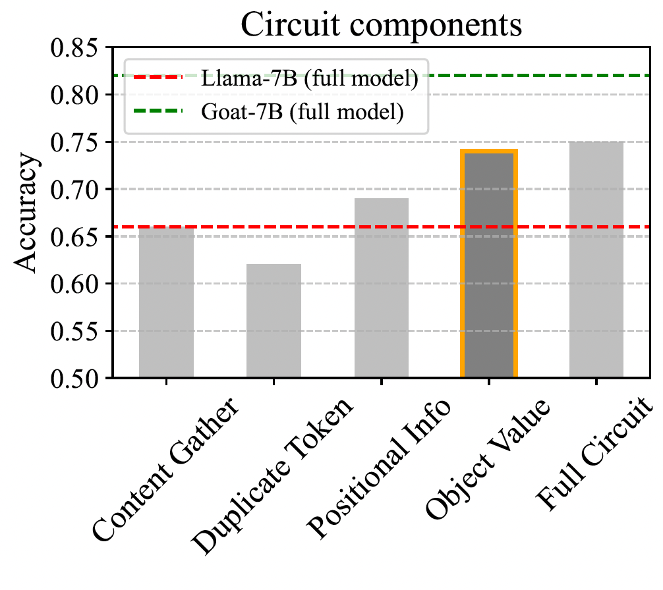
(a) Circuit groups
Q K V
Llama-7B (full)
Q K V
Goat-7B (full)
Goat-7B
Q K V
Input patching
(b), (c)
Q K V
, -
…
Box -
is -
Box -
C -
the -
the -
in -
C -
apple -
contains -
Structure
reader
Position
detector
Position transmitter
Value
fetcher
Full
circuit
Output patching
(a)
(b) Value fetcher
(c) Position transmitter
Q K V
Q K V
Llama-7B
Q K V
Q K V
, -
…
Box -
is -
Box -
C -
the -
the -
in -
C -
apple -
contains -
Final Q
V
K+Final Q+V
Final Q
V
K+Final Q+V
K
K+Final Q
K
K+Final Q

Slide 19
A
B
C
D
…
M
…
the
M
the
bill
A
B
C
D
…
M
…
the
M
the
bill

