Slide 1

Concurrency problems
Tamar Twena-Stern

Slide 2
Agenda
Why do we have concurrency In Node.js in our servers
Lazy Initialization
Lock an object shared by multiple asynchronous functions
Update the same object concurrently

Slide 3
Node.js - No Concurrency In Theory
On theory , Node.js should not have concurrency problems
Single threaded with event loop
Code Never interrupted inside the event loop

Slide 4
In Practice – Multiple Race Conditions
You don’t have concurrency only if :
your critical section is completely Synchronous
Not Recommended – Bad Practice
Your critical section is running on the event loop alone – with no other requests / code paths
Not Realistic – Your server must support multiple requests

Slide 5
In Practice – Multiple Race Conditions
In Practice :
Multiple Requests on Server
Asynchronous code inside the critical section will cause events from other requests / code paths to run in between
If your objects can be updated between multiple requests You have race conditions
Other code paths might update the same objects

Slide 6
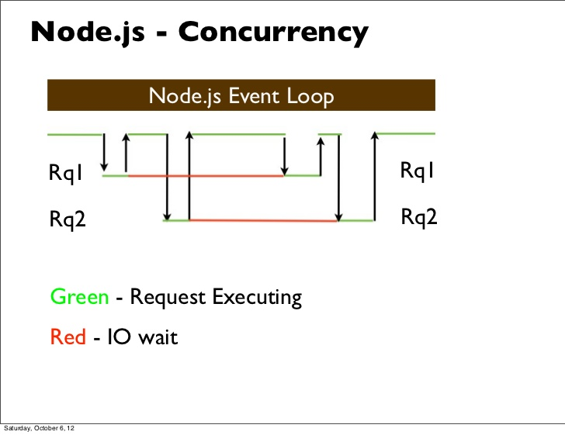
Node.js Concurrency Explained

Slide 7
The Correct Term Is Race Conditions
Concurrency is multiple threads accessing the same objects
We do not have concurrency
Event loop is running on a single thread
We have Race conditions –
Multiple Requests can update the same object
Create data inconsistencies
We must protect our objects

Slide 8


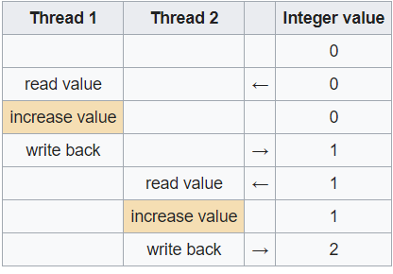
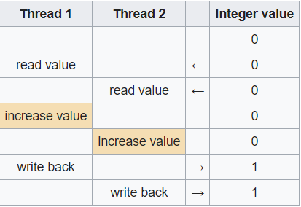
Race Conditions
Arises in software when a system depends on a series of operations of threads / processes to happened in a specific order
In a traditional system that works with threads, both series can happen

Slide 9
How Race Conditions happen in Node
Same objects are updated between multiple requests paths
It is hard to control the exact ordering that the event loop perform operations
Asynchronous operations will cause
Event loop will stop current event and start executing others
Can cause to switch between different requests paths

Slide 10
Asynchronous Operations That We Don’t Expect
Using a function that uses timers in it’s internal implementation
SetInterval
SetImmediate
SetTimeout
I/O operations in the function internal implementation
Usage a function from third party library – internal implementation performs asynchronous operations

Slide 11
How To Solve Concurrency Problems In Node
Node.js programming paradigms are different
Utilize mechanisms for concurrency and implement them in Node.js
Implement lock
Implement critical section
Take general patterns and use them as they are
Optimistic locking
Transactions (if supported)
And more …

Slide 12
Lazy Initialization

Slide 13
Problem statement
Delaying specific operation until the first time it is needed
Creation of an object
Calculation of a value.
Other expensive operation
Avoid repeating the operation the next time it is needed
Initialize a member by key on an internal cache container

Slide 14
Object Oriented Use cases
Singleton design/anti pattern
Factory method
Caching layers
Returning immutable objects
And more …

Slide 15
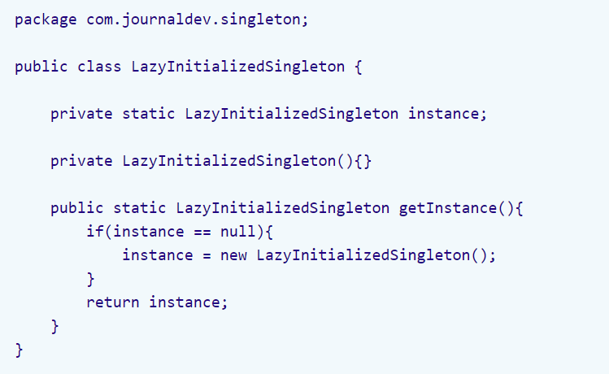
Lazy Initialization Usage – Java Singleton (Anti) Pattern

Slide 16
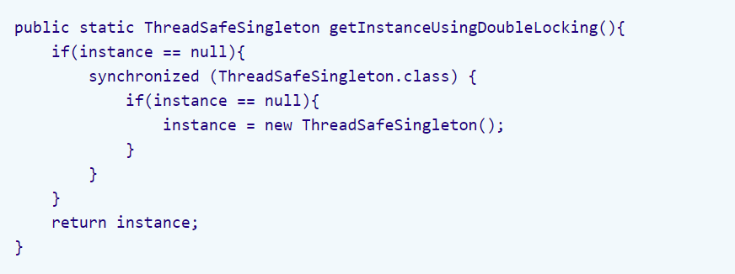
Example : Java Thread Safe Singleton (Anti) Pattern

Slide 17
Lazy Initialization Concrete Usage In Node.js
Example : Caching layer implementation
Need to initialize results from DB according to a specific key
Initialize each key only once
For multiple code paths in real server – Initialization can happen twice very easily
Prevent consumers to change the objects received from cache

Slide 18
Concurrency Problem Deep Dive
2 requests intend to initialize the same value
Event loop schedule 2 DB queries in parallel
Initialization Flow starts for first query
value == null check is passed
Async operation in init flow
Event loop stops current flow, start execute other events
Initialization Flow starts for second query

Slide 19
Concurrency Problem Deep Dive - Continue
Initialization flow starts for second query
Value == null check is passed
Built in async operation in init flow
Event loop stops current flow, start execute other events
Flow for initialization first query resumes
First query initialize value in cache
Flow for initialization of second query resumes
Value initialized twice

Slide 20
Bad Solution – Critical Code Completely Synchronous
Make the critical code completely synchronous with no I/O operations or timers
This is not a good solution because
Bad performance – blocking the event loop
You would have to use other modules / third party libraries
We must implement everything by ourselves – or verify the implementation of all the libraries that we depend on
Bottom line - You cannot control the implementation of every code you use

Slide 21
Solution – Using Promise To Implement Locking
Promise wraps an a-synchronous operation
Have callback for success – then
Callback for failure - catch
On first invocation – store promise in memory container
All events that will hit the key will receive the same promise
The asynchronous operation will be performed once
Store value on then callback or return it if already exist

Slide 22
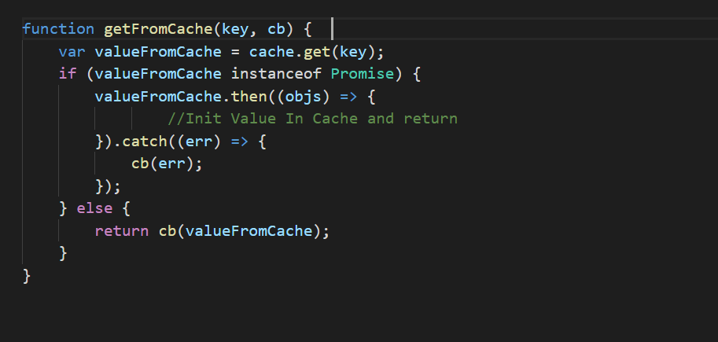
Promises Concurrent Code Example

Slide 23
Keep Your Objects Immutable

Slide 24
JavaScript Objects Immutability
Immutability is a general pattern for concurrency
Nobody can change immutable objects
Simplest approach - deep clone the return object.
When all the consumers will receive a clone of the object they will not be able to change the original objects
Objects will be concurrently safe.
Must do in the cache implementation we discussed

Slide 25
Cloning objects in JavaScript
Json.Stringify
Loadash provides deep object cloning
And more …

Slide 26
Lock An Object Shared By Multiple Asynchronous Functions

Slide 27
Problem Statement
Specific entity in DB
Has Property ‘interest rate’
Execution of a specific function do an asynchronous calculation and use the property ‘interest rate’
To keep business consistency – we must prevent the ‘interest rate’ to be changed in the middle of the computation
Other Requests update the ‘interest rate’ in the middle of calculation
Locking of the entity is required

Slide 28
Timeline Events
Update Request to Interest Rate
End Update Request
Start Interest Calculation
End Interest Calculation

Slide 29
Single Node – Lock Object + Sticky Session
If your DB would support transactions we can use them
But a lot of DBs does not support
The solution here will be combined from 2 parts
Single Node –
locking the object in memory
requests that will try to access the object will wait
Extend Solution for multi Node –
sticky session on the object
All updates will arrive to the same node

Slide 30
Possible Solution - Lock Object Between Asynchronous Functions
Maintain a version to the object on application layer
Update version on each object update
Lock the object in memory by version number as the lock key
Events with different keys will run on the event loop
Events with the same key will be blocked and wait until lock is finished

Slide 31
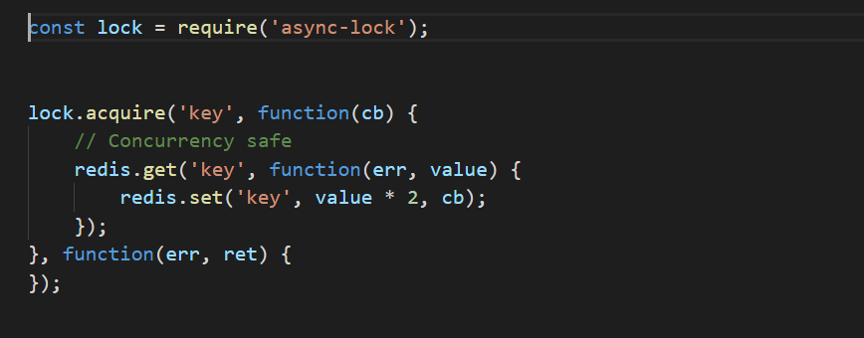
Async-lock – Critical Section In Node.js
Lock the object by the version number on 2 places :
Object Update
A-synchronous computation

Slide 32
Sticky Session – To Complete The Solution In Cluster
We must combine it with sticky session
Async lock will only provide memory lock in the same node
Requests that will arrive to different nodes will perform the update
Sticky session – A routing pattern in which all requests are routed to the same node

Slide 33
Updating the same Object Concurrently

Slide 34
Problem Statement
2 requests intend to update sane record
First request starts the update flow
Event loop stop the flow on async operation
Second request starts the update flow
Event loop stop the flow on async operation
First request resume the flow and update
Second request resume the flow and Update
Overriding Updates

Slide 35
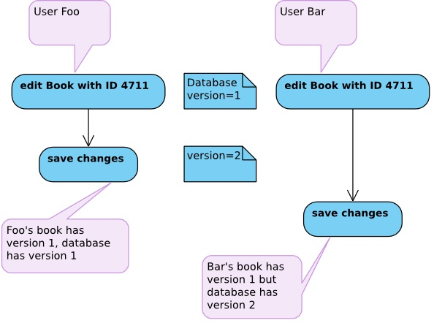
Solution – Optimistic Locking

Slide 36
Optimistic Locking Implementation
Implementation in 2 layers :
On application layer :
Maintain a version for each entity
Update the version on every entity update
On DB layer : Execute the following query for atomic update
‘update …. Where version = %current_version’

Slide 37
Optimistic locking - Cons
Will guaranty consistency
Out of the box cluster support
Well utilized pattern
Lots of examples and implementations

Slide 38
Optimistic Locking - Cons
Updates with a non updated version will fail - exception
You can take a design decision that the caller will handle the exception
If, by design, you want no failures – then updates will have to wait –
Utilize async-lock library + sticky session for example
DB Transactions – Not applicable for every DB

Slide 39
Questions ?

