Slide 1

Node.js performance
Tamar Twena-Stern

Slide 2
Agenda
General Tips
Node.js Programming patterns to support good performance
Node.js recommended cluster configuration
Promises performance
JavaScript code optimizations

Slide 3
General Performance Tips – Application
General tips for every language :
Make sure your logs are on error mode
Use more efficient data structures – prefer HashMaps over arrays
Use cache wherever you can
Optimize your database queries –
Analyze your Db queries
Index you DB
Return only Needed fields and not entire table/collection
Limit amount of results

Slide 4
Node.js Programming Patterns That Support Good Performance

Slide 5
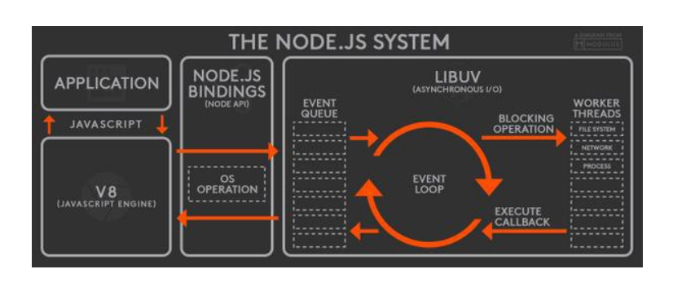
The Event Loop - Reminder

Slide 6
Why Synchronous Operations Are Bad ?
Small number of threads to handle many clients
One thread for event loop
Constant amount of threads in workers pool
Benefit :
The server spend more time and memory working on clients actual work
Not paying space and time overheads for threads

Slide 7
Each Thread is critical !
Blocked Thread :
Long callback (event loop)
Long task (worker pool)
If thread is blocked - cannot handle requests from any other client.
You have small number of Threads – and each blocked thread will give you severe performance hit.

Slide 8
Conclusions
Avoid synchronous operations
Use the worker pool efficiently –
Write parallel code and Not serial
Schedule parallel asynchronous operations as mu as You can
I/O
Timers
etc
Make sure that each total work assign to each client is Small

Slide 9
Avoid Synchronous API

Slide 10
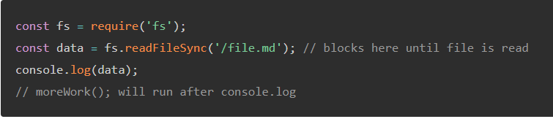

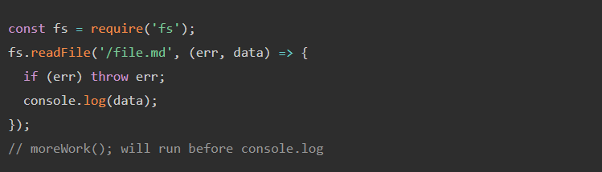

Always work with asynchronous API

Slide 11
Avoid Serial Code

Slide 12
What Is Serial Code?
Run functions one after another.
Asynchronous operations are executed one by one.
Schedule of the asynchronous operations is done one by one
You wait until one asynchronous operation will finish – and only then execute the other one

Slide 13
Why To Avoid Serial Code ?
The way that the event loop is build
In Node.js there is no parallel code execution
You always schedule asynchronous operations one by one
You can execute asynchronous operations in parallel with the worker thread pool
Attention – real parallel execution happened only if you have multi core CPU
When writing serial code :
You do not use the advantages of the worker pool.

Slide 14
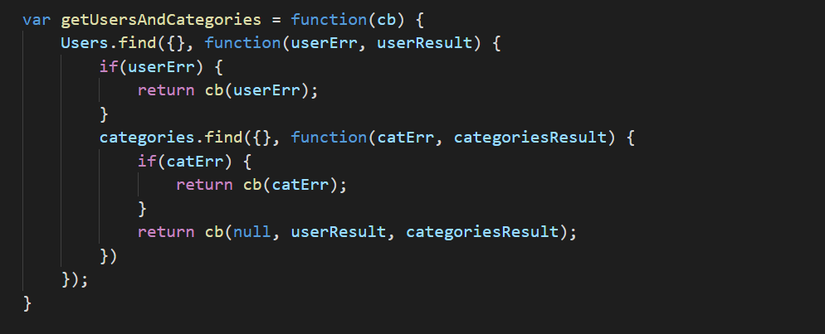
Serial Code Example - CallBacks

Slide 15
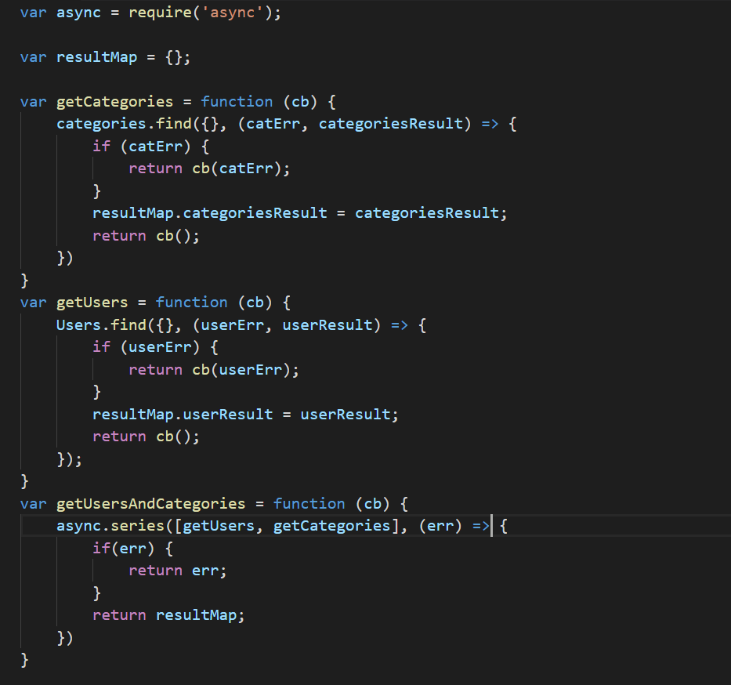
Serial Code Example – async.series

Slide 16
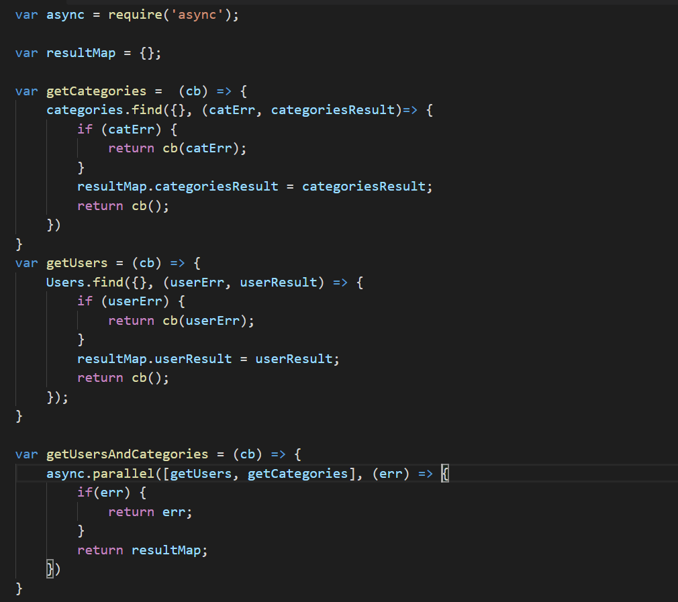
Callbacks Solution – async.parallel

Slide 17
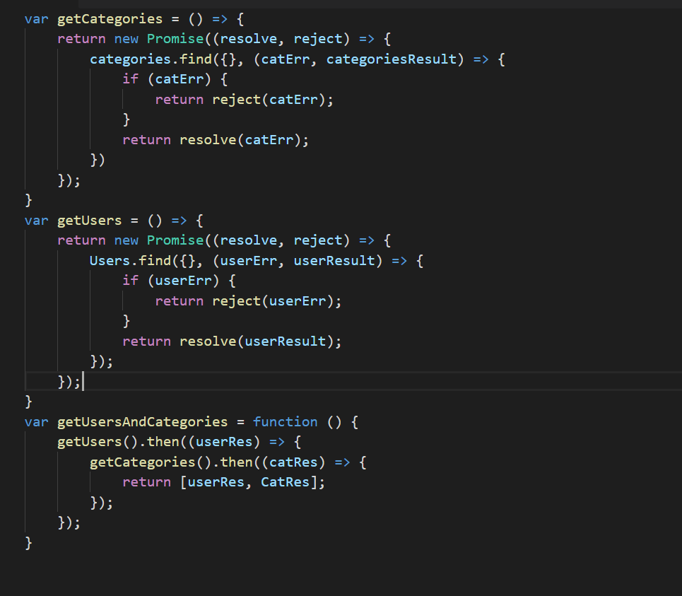
Serial Code Example - Promises

Slide 18
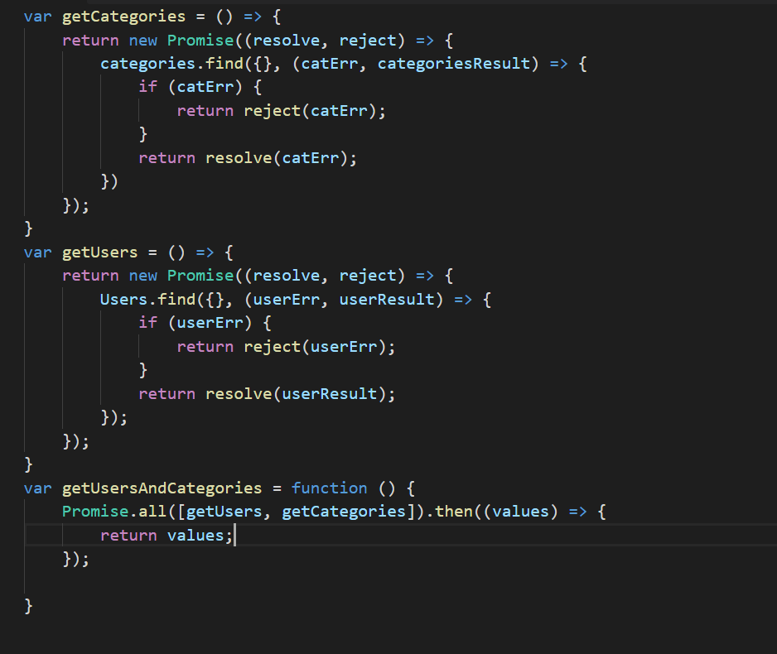
Promises Solution - Run promises In Parallel Whenever You Can

Slide 19
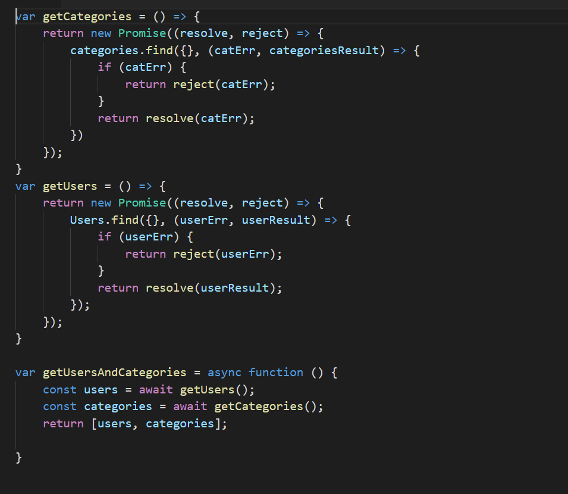
Writing Serial Code With Async / Await

Slide 20
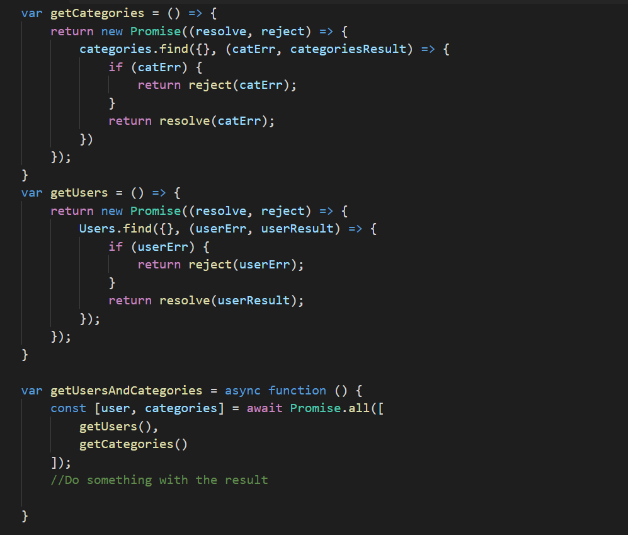
Async / Await Parallel Code

Slide 21
Summary
Always look at your code and look for functions that you can run in parallel.
Try to run as much code in parallel as you can.
Try to re-structure your code in order to execute as much asynchronous operations in parallel

Slide 22
Handle More Load with Your Node.js server cluster

Slide 23
We Must Use More Then One Process
Node.js is single process with event loop.
It will utilize only one CPU of the machine
There is a limitation to the load that one process can handle – no matter how strong the machine is
If we want to utilize the entire power of the CPUs of the machine – we have to use more processes

Slide 24
Possible Multi Process Setups – Option 1
Using the Cluster Module
Master Process will span child processes
Master Process will be responsible to load balance the requests to the worker process.
All processes listen to the same port
The number of worker processes is equal to the number of the CPUs in the machine

Slide 25
Possible Multi Process Setup – Option 2
Using IPTable module to load balance the requests
Setup several docker containers
Containers listening on different ports
each Container is mapped to one CPU
IPTables will listen on port 80 and will redirect to containers.

Slide 26
Possible Multi Process Setup – Option 3
Using a load balancer to load balance the requests
Setup several docker containers
Each container listening on different port
Each one mapped to one CPU
We can use Ngnix or HAProxy as load balancer.

Slide 27
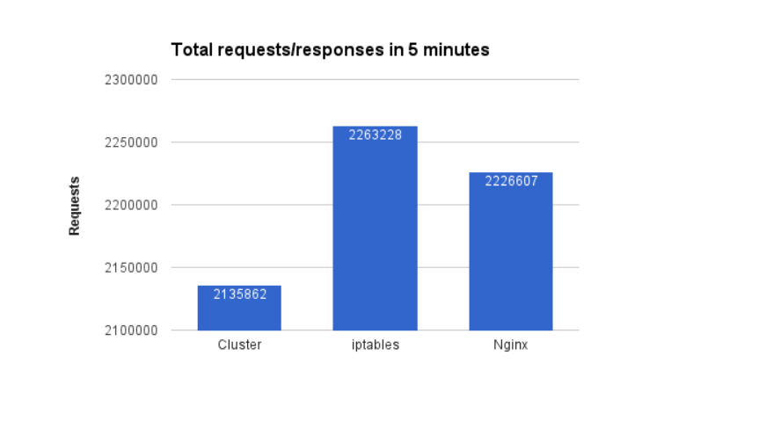
Request Load Comparison

Slide 28
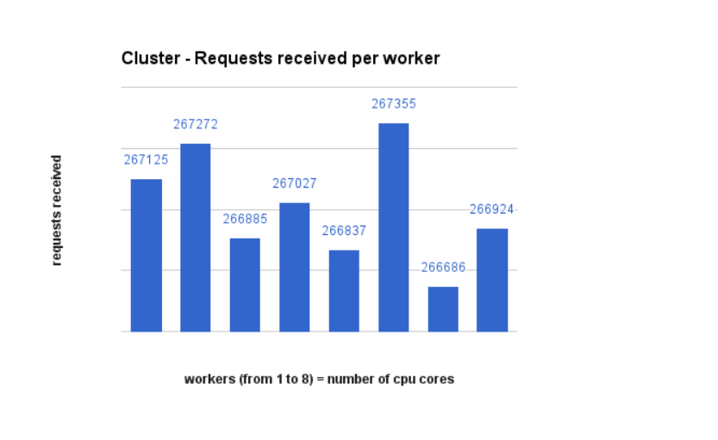
Number Of Requests Per Process – Cluster Module

Slide 29
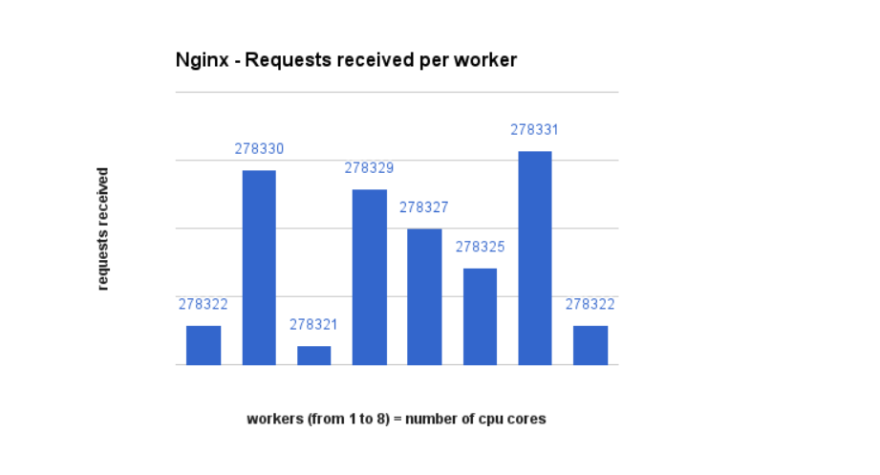
Number Of Requests Per Process - Nginx

Slide 30
Why Cluster Module Handles Less Load
In the cluster module, the master process is responsible for load balancing the requests.
This will not come without a price :
The Master process will handle much less load.
The master process will waste the CPU on load balancing
The master process will usually use much more memory then other processes.

Slide 31
Conclusion
If you want to squeeze performance –
Use load balancer
Do not the cluster module
Load balancer routing performance will always be better then cluster module
Cluster module is an easy ,out of the box solution
Does not require other software or much integration

Slide 32
Promises Performance

Slide 33
Promises - Overview
Since ES6 – promises became the standard in node.js programming
It event became wider with async / await in ES7
The recommendation is to write everything with promises
Which promise library will give me the best performance?
What is the overhead on callbacks ?

Slide 34
Code Demo – Performance : Native Promises vs Bluebird Promises

Slide 35
Bluebird Promises Are Much Faster
Allocate space much more efficiently
Use much less memory
Much more optimize
Current Recommendation – always prefer to use bluebird and not native promises.

Slide 36
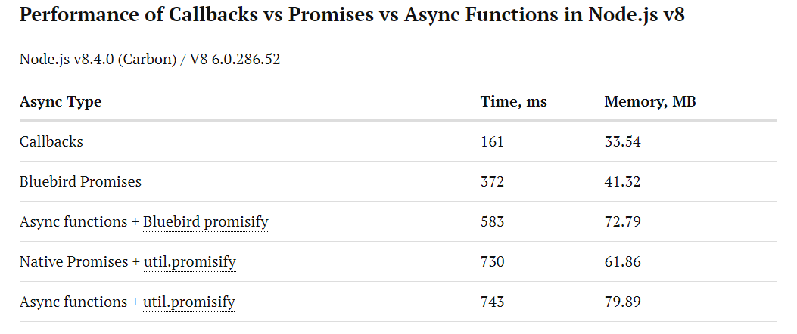
Callbacks vs Promises vs Async / Await

Slide 37
Conclusions
Promises and async await are adding overhead
The recommendation is to write mostly with promises and async await
Use Bluebird promises
In case you need to ‘fight for every millisecond’
Remove promises
Go back to callbacks

Slide 38
JavaScript Code Optimizations

Slide 39
Always Prefer Native Libraries
Always prefer native v8 libraries
Prefer them over client libraries such as :
Loadsh
Jquery
etc
Those libraries contain code to support multiple browsers
Not needed in Node.js server programming
Exception : Bluebird promises

Slide 40
For vs forEach() Loops
Use foreach() while iterating on arrays
Prefer not to use the for loop
Foreach() Prevent you from iterating empty elements in the array.

Slide 41
Demo – For vs forEach()

Slide 42
Put Common Code In Functions
Hot Code – function or object which continuously being used
The JIT compiler in v8 engine stores the binary version of a continuously used function or object
If the contract is not changed – v8 will optimize
Huge performance boost

Slide 43
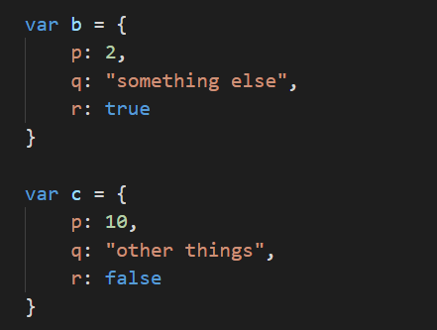
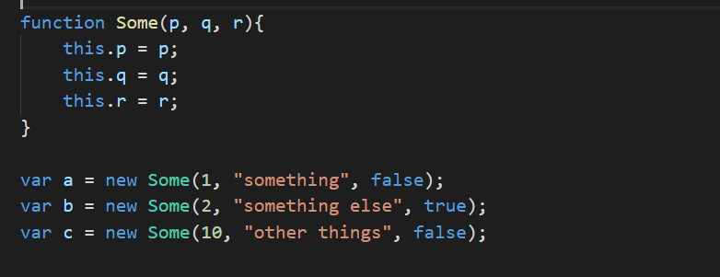
Create Class For Similar Objects

Slide 44
Avoid Using Delete
Used to delete a property from an object.
When using delete on an object :
JIT compiler invalidate the binary of the object’s class for this instance
JIT compiler treats the object separately from the class
Big performance hit

Slide 45
Avoid Using Dynamic Properties
Dynamic property is a property that you add to the object on the fly.
When using it the same thing happened as in delete operator :
JIT compiler invalidate the binary of the object’s class for this instance
JIT compiler treats the object separately from the class
Big performance hit

Slide 46
Introduction To JavaScript Arrays
Arrays In Traditional Languages :
1000
1001
1002
1003
1004
1005
JavaScript Arrays
1000
2021
918
3388

Slide 47
Use Typed Arrays
ArrayBuffer and TypedArrays introduced in ES6.
If the array contains the same types, the JIT compiler will allocate continuous memory, like in traditional languages
Insertion and read will become much faster
You will get better performance

Slide 48
Demo – Typed Arrays vs Old Arrays Performance

Slide 49
Low Priority Jobs

Slide 50
Low Priority Jobs
As a principal, Node.js is not the optimal framework for background jobs in the same process.
Try to make your background job as lightweight as possible
Prefer to put your background jobs in a different process
If they are in different processes – Make sure the messages on the IPC channel are lightweight
Large messages will cause performance hit due to serialization

Slide 51
Questions ?

