Slide 1
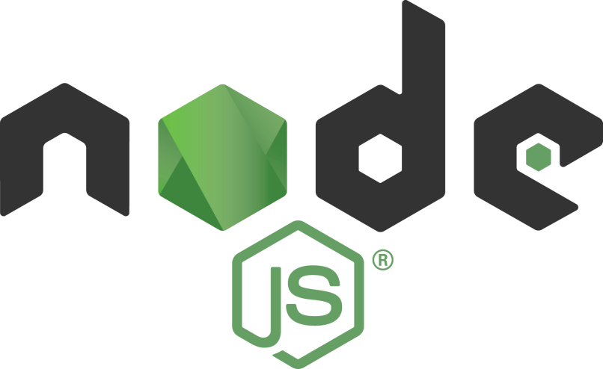
Node.js Security Tips
Tamar Twena-Stern

Slide 2


About me
Software engineer – Manager and Architect
Now writing awesome code at bitsrc.io
Former
leader of Edgeverve CTO group in Israel, Oecloud.io Architect
CTO at a start up of my own
Performance team leader at NCR
Passionate about NodeJS!

Slide 3
Contact Me @
Tamar.twena@gmail.com
https://www.linkedin.com/in/tamarstern/

Slide 4
The Node.js Framework
Server side platform for developing servers
Web
Mobile
Enterprise
Open source, cross platform
Enables to build fast and scalable network applications

Slide 5
Traditional Approach
thread
request
client
Server
request
thread
request
thread

Slide 6
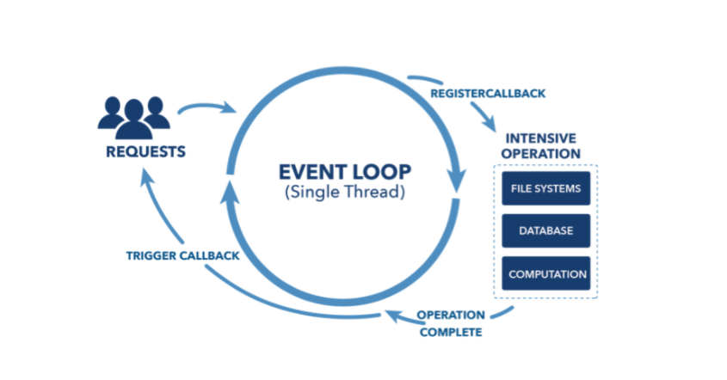
Presenting Different Approach – Node.js Event Loop

Slide 7
What is an attack ?

Slide 8
Now , Let’s Hack some Code
Notes:
I am sure that most of you are familiar with terms like sql injection, and probably you heard the pharse Eval is evil, but what I want to do today is walk you through some of the basic examples to places where you might not have expected to see a security vulnerbility

Slide 9
Eval is Evil
Notes:
Lets start with the canonical example, the famous source of evil, eval is evil

Slide 10
Eval Function
Eval – a function in JavaScript which is used for evaluate code.
You can put an expression\JavaScript Code in your eval function
Eval will evaluate your code
You will get the result of the evaluation
Notes:
What eval is doing is converting a sting, any string, to an executable code.

Slide 11
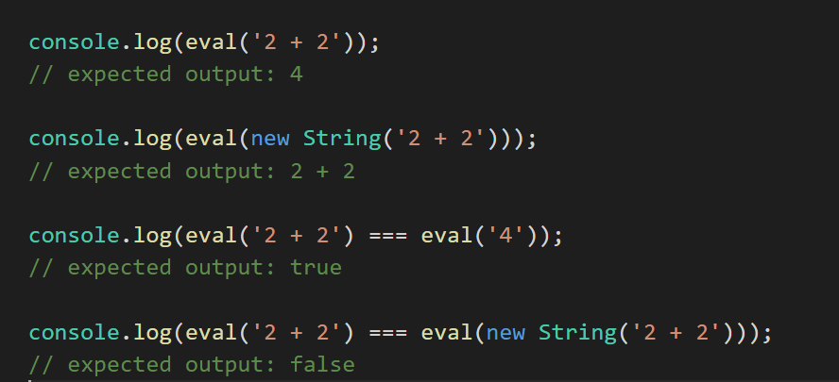
Eval Code Sample

Slide 12
Denial Of Service Attack
Attacker seeks to make the service unavailable to it’s intended users
For Eval function , the most common attack type is achieved by :
Inject a script that will cause a CPU intensive operation and cause the server to be too busy in performing it
Notes:
Not to be confused with distributed denial service attack, we will get to it later on.

Slide 13
Demo – Denial Of Service Attack Using Script Injection To Eval

Slide 14
Don’t Use Eval
Eval can open your application to multiple kind of attacks.
injection attacks.
Denial of service attacks
And more
If the expression that Eval is handling is coming from the input that you get you application will be exposed to multiple attacks

Slide 15
More JavaScript Built In Functions That Use Eval
The following functions use eval in their implementation :
setInterval
setTimeout
New Function(string)
Exposed to the same attacks that Eval is exposed to.
Make sure that you use the same defending methods here too.

Slide 16
Preventing The Attack

Slide 17
General (Cross Language) Solutions:
The following solutions are valid for other languages too and not special to javaScript.
Make sure that if you do use eval:
The expression is not come from the user input
You will use escaping techniques on the expression
You will use blacklist or whitelist approach on the expression
Notes:
ESLint is a very good tool to find huge amount of problems in your code that is lurking there

Slide 18
ESLint Security Plugin
When you have very big code repositories , it will be hard to detect a user input that directly arrives to eval.
Code can be complicated, and the developer’s input on this might not be enough.
ESLint – The most popular syntax check utility for JavaScript
Has a security plugin that can help you detect those problems

Slide 19
Demo – Identifying The Vulnerability With ESLint Security Plugin

Slide 20
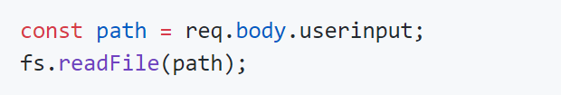
More ESLint important Security Rules

Slide 21
Defending Denial Of Service Attacks That Are Caused By Flooding The System

Slide 22
Denial Of Service Attack
Attacker seeks to make the service unavailable to it’s intended users
Lets look at the second common way to cause a denial of service attack :
Flooding the resource by sending multiple requests
Notes:
You may recall the previos denial of service attack, this one is using another vector of attacks

Slide 23
Defending Denial Of Service attack
Rate Limiting :
Recognize the request’s source ip
Block the requests if too many requests are coming from the same IP within specific time window
Can also help in preventing brute force password guessing attacks –
multiple requests are sent to a specific endpoint to guess the password

Slide 24
Demo – Use Rate Limit On A Single Node.js Server
Notes:
Rate limit module is counting the number of times a given ip has called any of the routes

Slide 25
Rate Limiting Techniques
On a single server – middleware using one of the node.js modules exists.
To support cluster :
Implement a Redis instance
Store in Redis the count of the requests per ip
Check on Redis if limit exceeded – if it does, return an error
Notes:
We need a unified storage that will used by all of the nodes in the cluster. One such way is

Slide 26
Password Brute Force Attacks

Slide 27
Preventing Password Brute Force Attacks By Username
You can limit login routes per request ip, and also per username and password.
Limiting login routes per username can be very helpful to prevent password brute force attacks
In many attacks, using only IP parameter is not enough – since requests can come from multiple IPs.

Slide 28
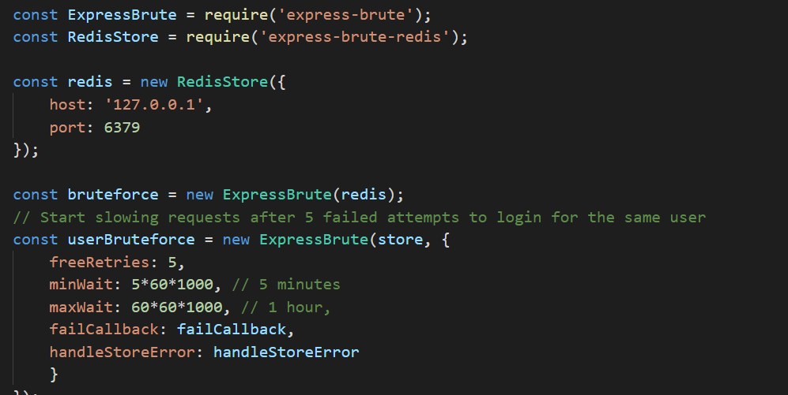
Express-brute Code Sample

Slide 29
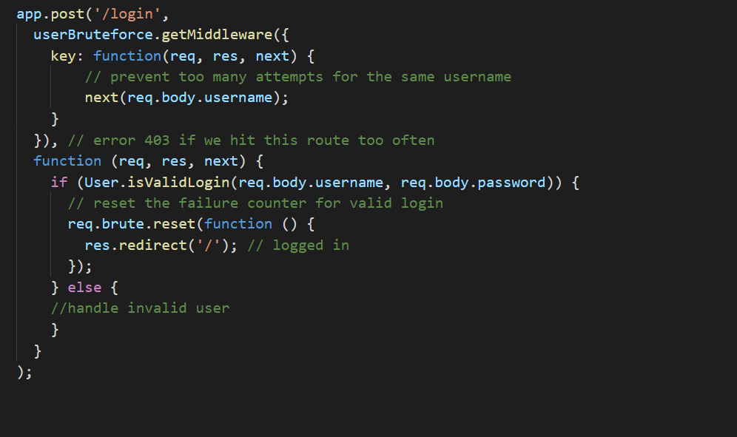
Express-brute Code Sample

Slide 30
Validating User Input On Request

Slide 31
Node.js Request Input Validation
The most common use of Node.js is to build a REST api using express library.
Most developers writing the REST layer using Express library.
Usually, input is taken from request body or url query .
In most cases, input is transferred to the next layer in the pipeline as it received from user.

Slide 32
Injection Attack - Definition
Specific class of software attacks
Allows the attacker to supply untrusted input to a program
The input will get processed as part of the execution of the software
The input can cause damage to the software
Example :
SQL injection
Command injection

Slide 33
Demo – Injection Attack
Notes:
Put a breakpoint on the query and show the perfectly valid mongo db query in the debugger

Slide 34
How To Defend The Attack
Express is a framework that enables the developer to add middlewares to the pipeline
Almost all functionalities in Express applications is added with middlewares.
It is crucial to add a middleware that performs input validations on the requests that arrives to the server.
You can write one yourself – or use one of the known middlewares exists.

Slide 35
Demo – User Input Validations Using Express middleware

Slide 36
Other Capabilities Of Express Validator
Multiple built in functionality :
Optional parameters
Validating hex colors
Matching a url or a constant value
Validating numbers
Provide a schema to the validator to create any rule based validation required to your application
Notes:
Another slide – to use json schema

Slide 37
Demo – Using Escape To Prevent Query Injection

Slide 38
Escape Native JavaScript Function
Native JavaScript function
Encodes special characters
Can be used to sanitize the input you give to the DB
You can wrap each parameter to protect from query injections.
Can be used for escaping HTMLs , JavaScript scripts and too.

Slide 39
Child Processes And Command Injections

Slide 40
Introduction
Ability to spawn a child process
Enables to access operating system functionality by running system commands in a child process
Control child process’s input stream
Listen to the child process’s output stream

Slide 41
Demo – Code Which Vulnerable For Command Injection

Slide 42
How To Defend This Attack
Prefer Using Spawn Or execFile methods – that limit you to execute one command
Always validate and sanitize user input.
Limit permissions of parent and child process , by using the appropriate identities in your system.

Slide 43
Questions ?

Slide 44
Contact Me @
Tamar.twena@gmail.com
https://www.linkedin.com/in/tamarstern/

