Slide 1
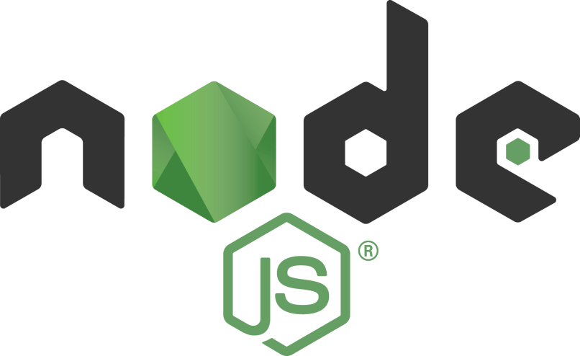
Node.js performance
Tamar Twena-Stern

Slide 2


About me
Software engineer – Manager and Architect
Now writing awesome code at bitsrc.io
Former
leader of Edgeverve Development group in Israel, Oecloud.io Architect
CTO at a start up of my own
Performance team leader at NCR
Passionate about NodeJS!

Slide 3
Contact Me @
Tamar.twena@gmail.com
https://www.linkedin.com/in/tamarstern/

Slide 4
Agenda
General Tips
Node.js Programming patterns to support good performance
Node.js recommended cluster configuration
Promises performance
JavaScript code optimizations

Slide 5
General Performance Tips
Logs on error level == ERROR
Efficient data structures
Cache
Optimize your database queries –
Index your DB
Return only Needed fields
Limit amount of results

Slide 6
Node.js Architecture In A Nutshell

Slide 7
Traditional Approach
thread
request
client
Server
request
thread
request
thread

Slide 8
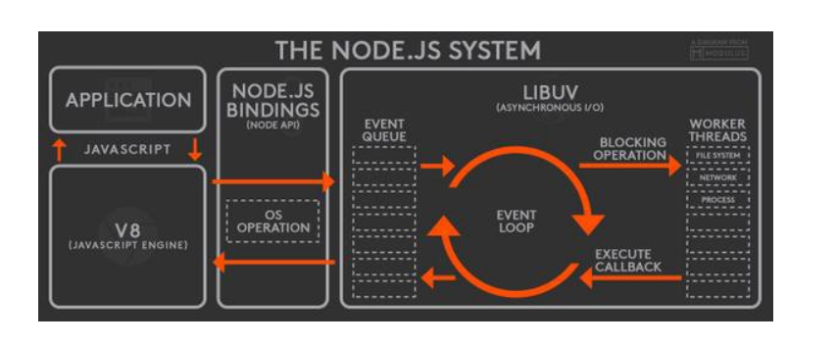
The Event Loop

Slide 9
Node.js Programming Patterns That Support Good Performance

Slide 10
Avoid Synchronous API

Slide 11
Why Synchronous Operations Are Bad ?
Small number of threads to handle many clients
One thread for event loop
Constant amount of threads in workers pool

Slide 12
Each Thread is critical !
Blocked Thread :
Long Synchronous Operation(event loop)
Long task (worker pool)
If thread is blocked - cannot handle requests from any other consumer.

Slide 13
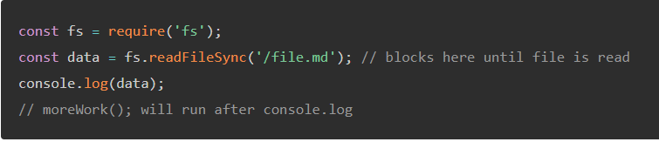

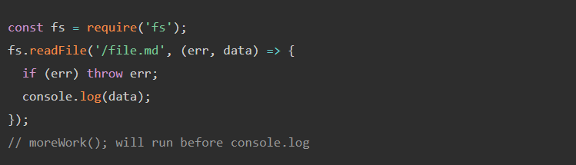

Always work with asynchronous API

Slide 14
Demo – Synchronous operation vs asynchronous operation

Slide 15
Avoid Sequential IO Operations

Slide 16
What Are Sequantial IO Operations?
IO operations are executed one by one.
Waiting until one IO operation will finish to start the next

Slide 17
Why To Avoid Sequential IO Operations?
The way that the event loop is build.
In Node.js there is no parallel code execution.
You always schedule asynchronous operations one by one.
You can execute asynchronous operations in parallel with the worker thread pool.
Attention – real parallel execution happened only if you have multi core CPU.
When writing Sequential IO operations:
You do not use the advantages of the worker pool.

Slide 18
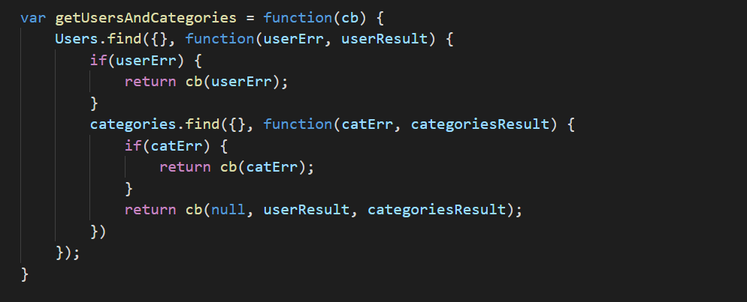
Sequential IO operations Example – ES5 CallBacks

Slide 19
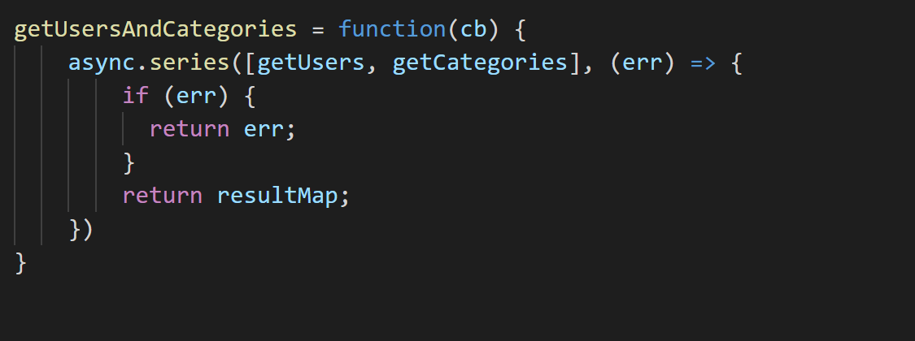
Sequential IO operations Example – ES5 - async.series

Slide 20
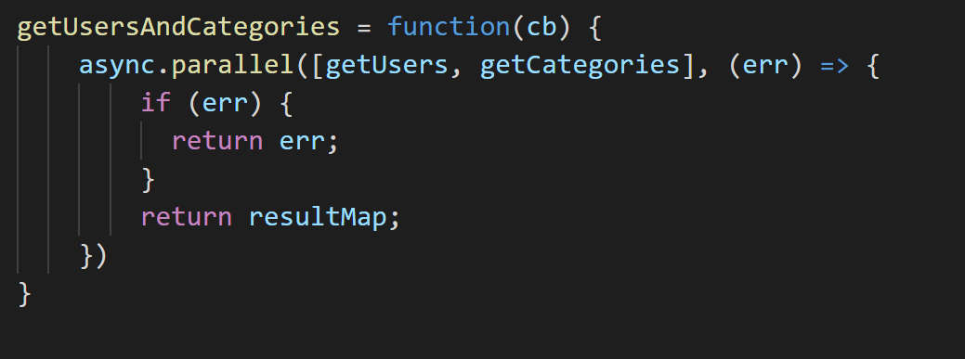
Solution - Parallel Code – ES5 - async.parallel

Slide 21
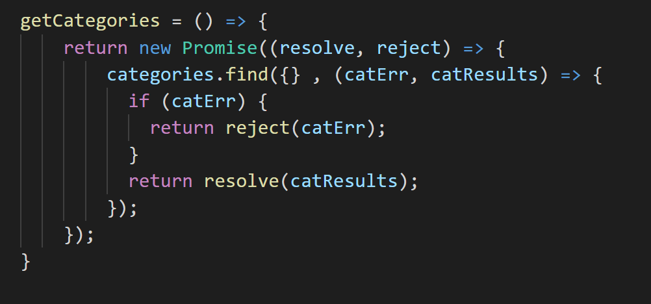
Sequential IO operations Example – ES6 - Promises

Slide 22
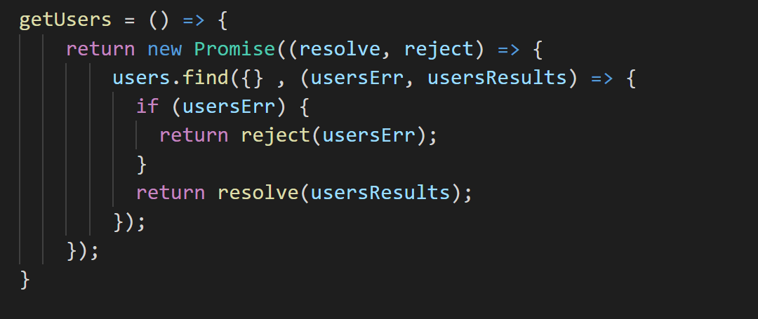
Sequential IO operations Example Continue – ES6 - Promises

Slide 23
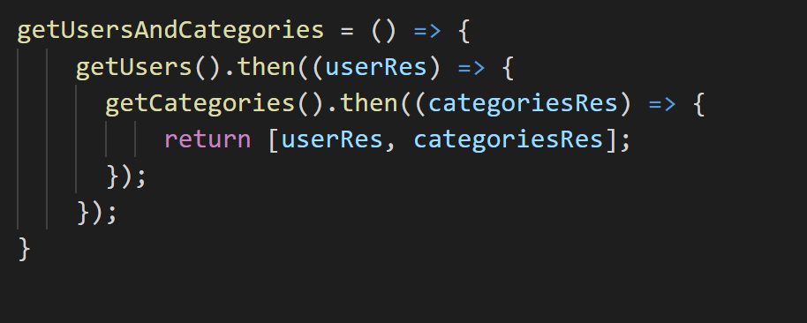
Sequential IO operations Example – ES6 – The Problem

Slide 24
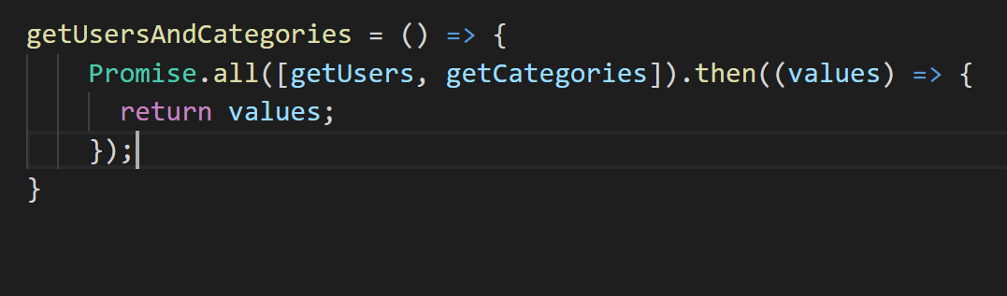
Promises Parallel Code Solution – ES6

Slide 25
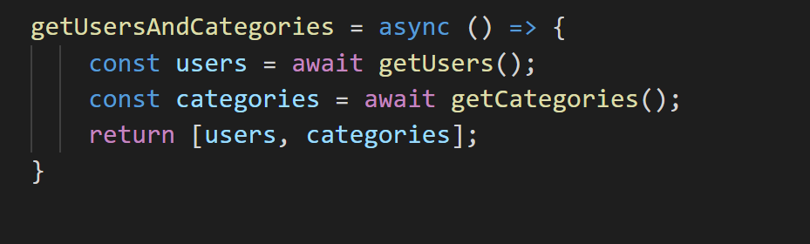
Sequential IO operations With Async / Await – ES7

Slide 26
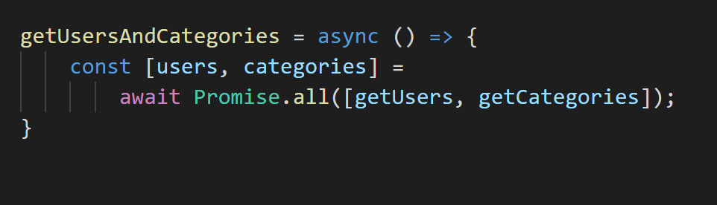
ES7 – Solution - Async / Await Parallel Code

Slide 27
Demo – Sequential IO operations vs Parallel Code

Slide 28
Summary
Always look for functions that you can run in parallel.
Try to run as much code in parallel as you can.
Try to re-structure your code in order to execute as much IO operations in parallel as you can

Slide 29
Handle More Load with Your Node.js server cluster

Slide 30
We Must Use More Then One Process
Node.js is single process with event loop.
It will utilize only one CPU of the machine
There is a limitation to the load that one process can handle
To utilize the entire power of the CPUs of the machine – we must have more processes running

Slide 31
Possible Multi Process Setups
Node.js cluster module
Docker Containers + IPTables
Docker Containers + NGNIX / HAProxy

Slide 32
The Cluster Module
Client1
Client2
Client3
Master is the main process. Responsible to spawn workers + distribute requests between workers
Master
Worker processes Responsible to return the response to client
Worker
Worker
Worker

Slide 33
The Cluster Module
Using the Cluster Module
Master Process will spawn child processes
Master Process will be responsible to load balance the requests to the worker process.
All processes listen to the same port
The number of worker processes is equal to the number of the CPUs in the machine

Slide 34
NGNIX + Docker Containers
Using a load balancer to load balance the requests
Setup several docker containers .
Each container listening on different port.
Each one mapped to one CPU.
We can use Ngnix or HAProxy as load balancer.

Slide 35
NGNIX / HAProxy + Docker Containers
Container
NGNIX
Container
Each Container listening to a different port and mapped to a cpu
Container

Slide 36
IPTables + Docker Containers
Using IPTable module to load balance the requests
Setup several docker containers
Containers listening on different ports
each Container is mapped to one CPU
IPTables will listen on port 80 and will redirect to containers.

Slide 37
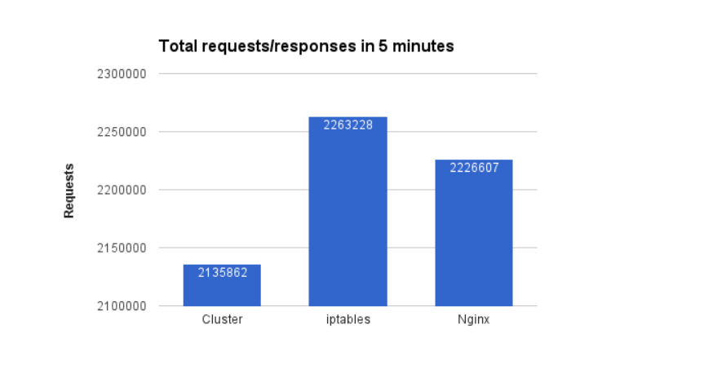
Request Load Comparison

Slide 38
Why Cluster Module Handles Less Load
The master process is responsible for load balancing the requests.
Master will handle much less load.
Master will waste the CPU on load balancing
Master will use much more memory then other processes.

Slide 39
Conclusion
To squeeze throughput– Use load balancer.
Load balancer routing performance will always be better.
Cluster module is an easy ,out of the box solution.
Does not require other software or much integration.

Slide 40
Promises Performance

Slide 41
Promises - Overview
Promises and async await are everywhere.
Which promise library will give me the best performance?
What is the overhead on callbacks ?

Slide 42
Code Demo – Performance : Native Promises vs Bluebird Promises

Slide 43
Bluebird Promises Are Currently Faster
Allocate space much more efficiently
Use less memory
More optimize
Prefer to use bluebird and not native promises.

Slide 44
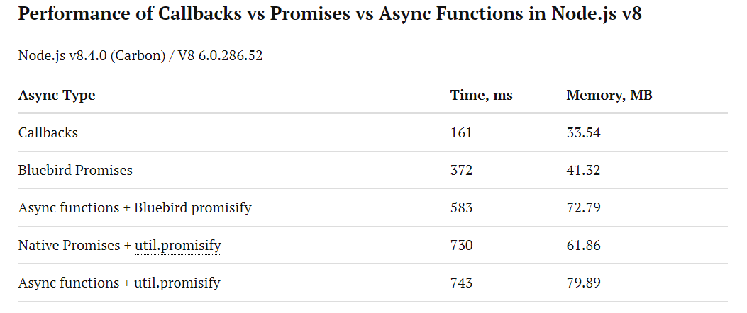
Callbacks vs Promises vs Async / Await

Slide 45
Conclusions
Promises and async await are adding overhead
Write with promises and async await
In case you need to ‘fight for every millisecond’
Remove promises
Go back to callbacks

Slide 46
JavaScript Code Optimizations

Slide 47
Always Prefer Native Libraries
Always prefer native v8 libraries
Prefer them over client libraries such as :
Loadsh
Jquery
etc
Those libraries contain code to support multiple browsers
Not needed in Node.js server programming
Exception : Bluebird promises

Slide 48
For vs forEach() Loops
Use foreach() while iterating on arrays
Prefer not to use the for loop
Foreach() Prevent you from iterating empty elements in the array.

Slide 49
Demo – For vs forEach()

Slide 50
Put Common Code In Functions
Hot Code – function or object which continuously being used
The JIT compiler stores the binary version of a continuously used function or object
If the contract is not changed – v8 will optimize

Slide 51
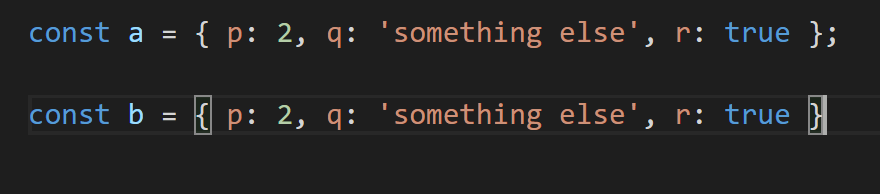
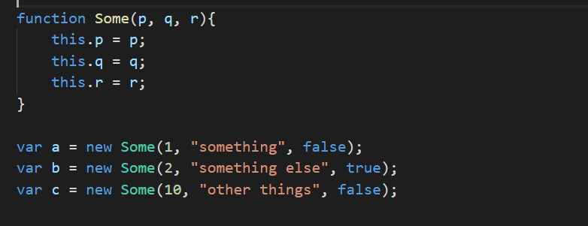
Create Class For Similar Objects

Slide 52
Demo – Using classes for objects

Slide 53
Avoid Using Delete
When using delete on an object :
JIT compiler invalidate the binary of the object’s class for this instance
JIT compiler treats the object separately from the class

Slide 54
Avoid Using Dynamic Properties
Dynamic property is a property that you add to the object on the fly.
When using it the same thing happens as in the delete operator example.

Slide 55
Introduction To JavaScript Arrays
Arrays In Traditional Languages :
1000
1001
1002
1003
1004
1005
JavaScript Arrays
1000
2021
918
3388

Slide 56
Use Typed Or Homogenous Arrays
ArrayBuffer and TypedArrays introduced in ES6.
If the array contains the same types, the JIT compiler will allocate continuous blocks of memory
Insertion and reading will become much faster

Slide 57
Demo – Typed Arrays vs Old Arrays Performance

Slide 58
Low Priority Jobs

Slide 59
Low Priority Jobs
Node.js is not the optimal framework for background jobs in the same process.
Try to make your background job as lightweight as possible
Prefer to put your background jobs in a different process

Slide 60
Questions ?

Slide 61
Contact Me @
Tamar.twena@gmail.com
https://www.linkedin.com/in/tamarstern/

