Slide 1
Working with sequence diagrams
2016.07.06
Tamás Palágyi

Slide 2
Agenda
UML sequence diagrams in general
Creating/updating sequence diagrams quickly
An example sequence diagram
Sequence diagrams mini training

Slide 3
Sequence diagram
A great tool during analysis and design visualizing system behavior, the flow of logic.
It makes easy review of complex application logic possible that would be hard or even impossible at source code level.

Slide 4
Sequence diagram is not something completely new…

Slide 5
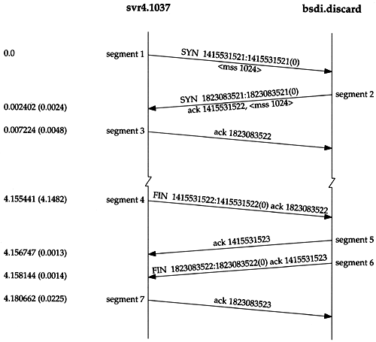
Time Line diagrams / TCP flow diagrams

Slide 6
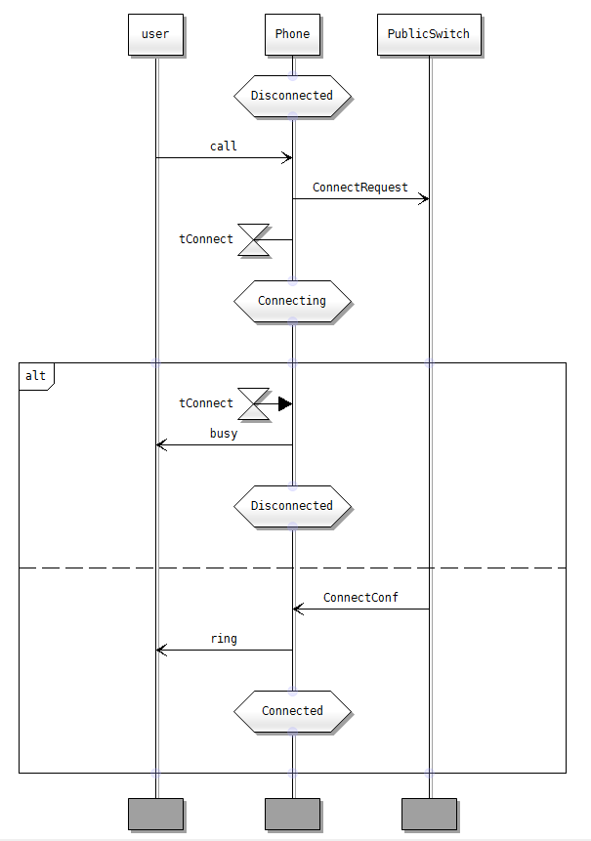
Message Sequence Chart (1993, part of SDL, defined by ITU-T)

Slide 7
Unified Modelling Language
UML 1.0 (1997)
UML 2.0 (2005)
UML 2.5 (2015)

Slide 8
The taxonomy of structure and behavior diagrams
Diagram
Structure
Diagram
Behavior
Diagram
Profile
Diagram
Class
Diagram
Composite Str.
Diagram
Component
Diagram
Deployment
Diagram
Object
Diagram
Package
Diagram
Activity
Diagram
Interaction
Diagram
Use Case
Diagram
State machine
Diagram
Sequence
Diagram
Communication
Diagram
Interaction Overview
Diagram
Timing
Diagram

Slide 9
UML 2.5 sequence diagram example <demo>

Slide 10
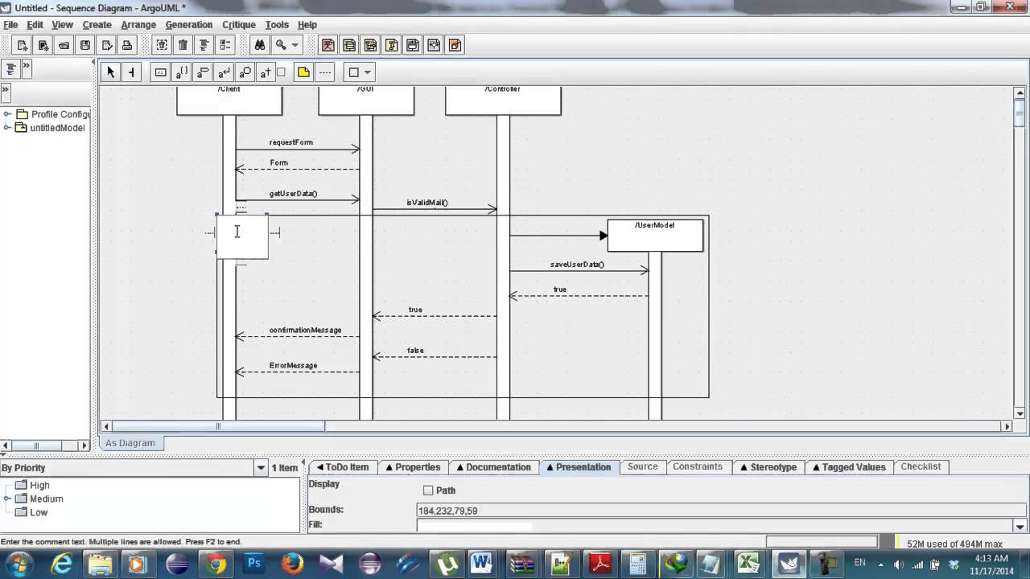
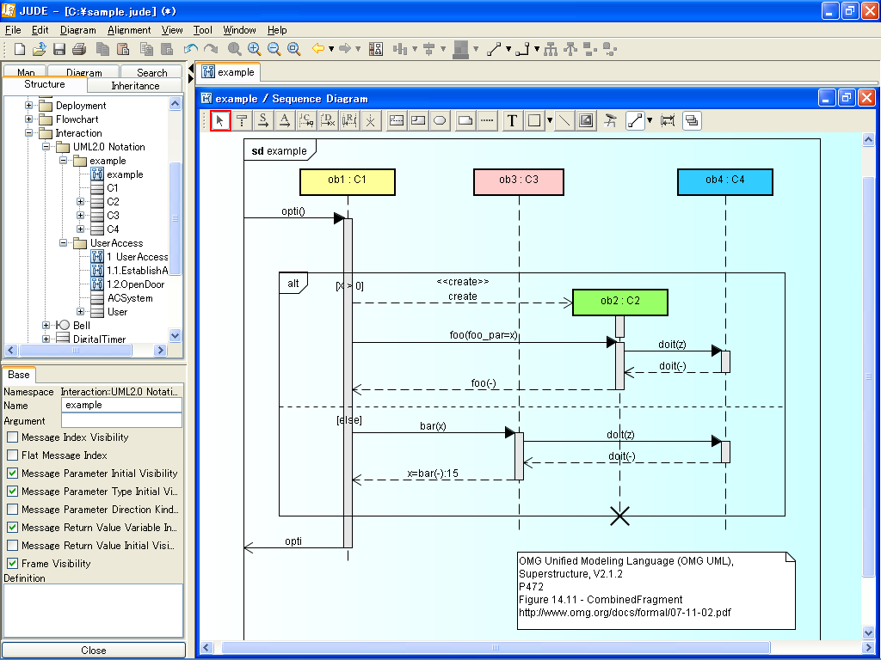
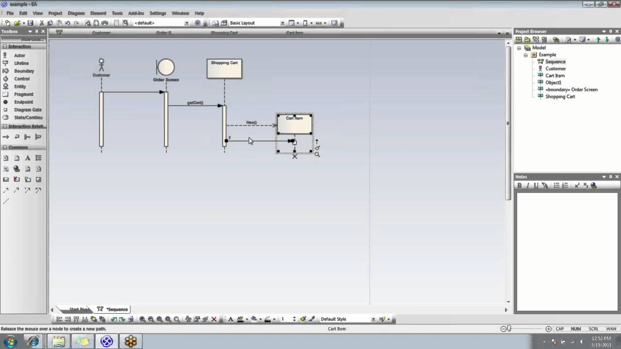
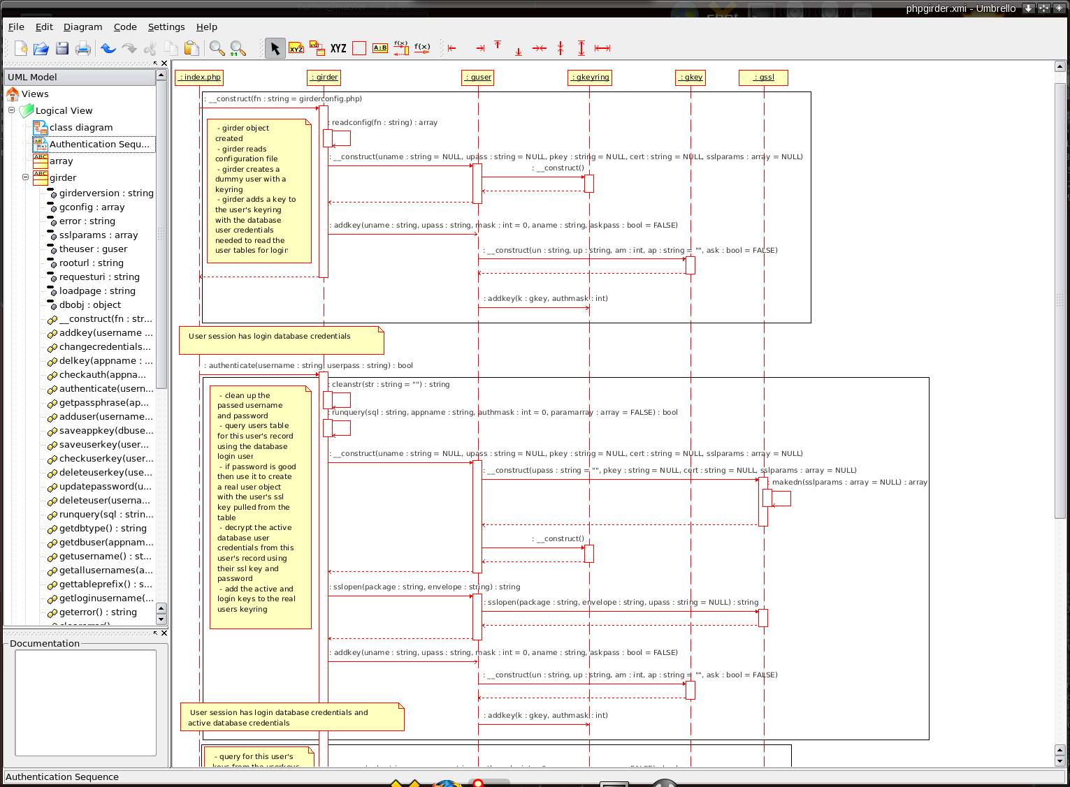
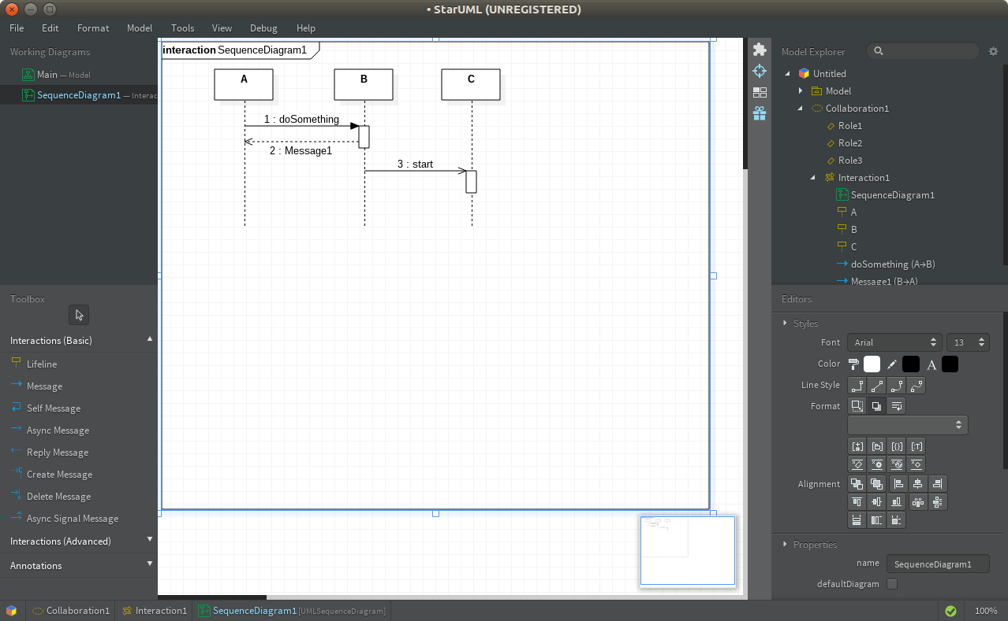
Graphical tools

Slide 11
Describing behavior with pseudo code
s:Service
db:Database
c:Calculator
s:a=db.getA
s:b=db.getB
s:r=c.add(a, b)

Slide 12
Quick Sequence Editor
http://sdedit.sourceforge.net/index.html
Author: Markus Strauch

Slide 13
Benefits
Really quick editing (after you learnt the tool)
Possible diff sequence diagrams
svn diff --diff-cmd='meld' :

Slide 14
Complex example <demo>

Slide 15
Creating UML 2.5 sequence diagrams with Quick Sequence Editor

Slide 16
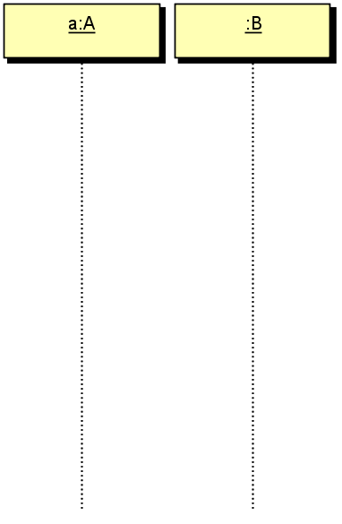

Lifeline
a:A
b:B[a]

Slide 17
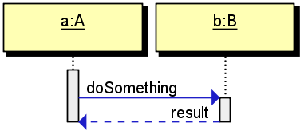
Simple synchronous message
a:A
b:B
a:result=b.doSomething

Slide 18
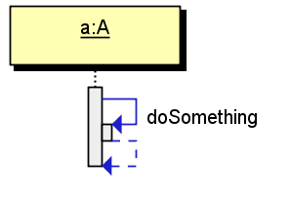
Stacking (1/3)
a:A
a:=a.doSomething

Slide 19
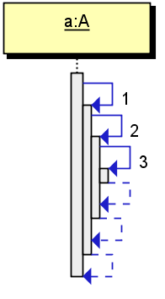
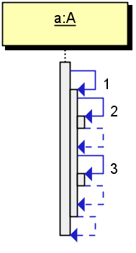
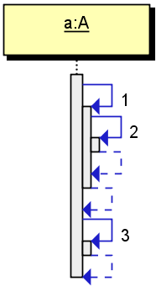
Stacking (2/3)
a:A
a:=a.1
a:=a.2
a:=a.3
a:A
a:=a.1
a:=a.2
a[1]:=a.3
a:A
a:=a.1
a:=a.2
a[2]:=a.3

Slide 20
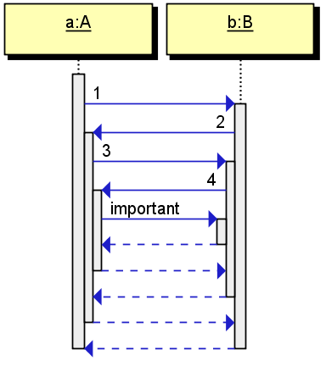
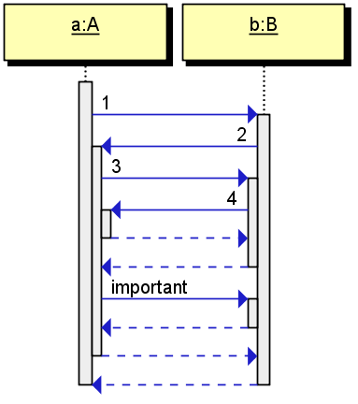
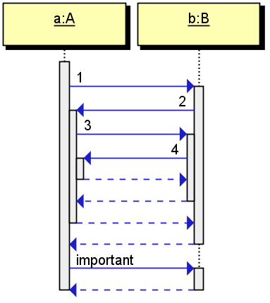
Stacking (3/3)
a:A
b:B
a:=b.1
b:=a.2
a:=b.3
b:=a.4
a:=b.important
a:A
b:B
a:=b.1
b:=a.2
a:=b.3
b:=a.4
a[1]:=b.important
a:A
b:B
a:=b.1
b:=a.2
a:=b.3
b:=a.4
a[2]:=b.important

Slide 21
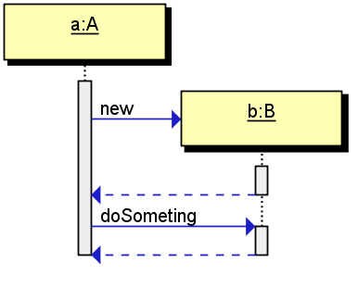
Constructing an object
a:A
/b:B
a:=b.new
a:b.doSomething

Slide 22
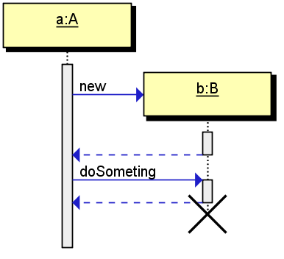
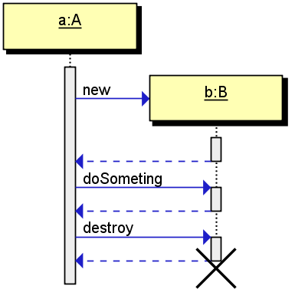
Destruction
a:A
/b:B[x]
a:=b.new
a:b.doSomething
a:A
/b:B
a:=b.new
a:b.doSomething
a:=b.destroy

Slide 23
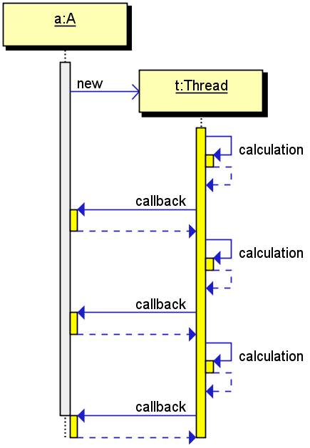
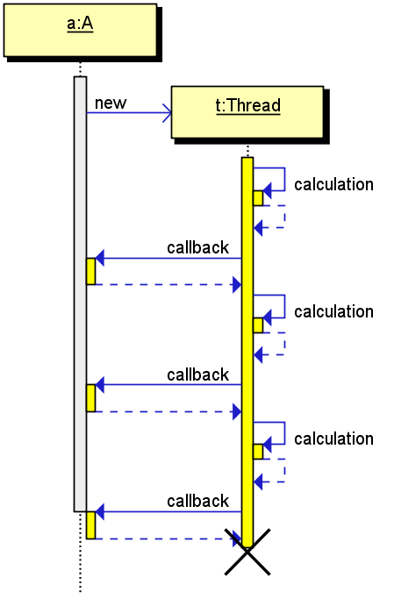
Thread / asynchronous call (5/1)
a:A
/t:Thread
a:>t.new
t:t.calculation
t[1]:a.callback
t:t.calculation
t[1]:a.callback
t:t.calculation
t[1]:a.callback
a:A
/t:Thread[x]
a:>t.new
t:t.calculation
t[1]:a.callback
t:t.calculation
t[1]:a.callback
t:t.calculation
t[1]:a.callback

Slide 24
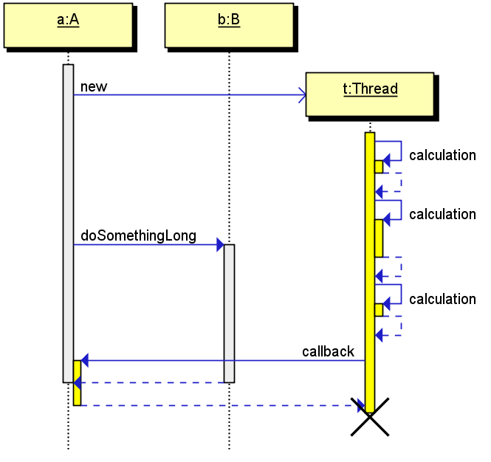
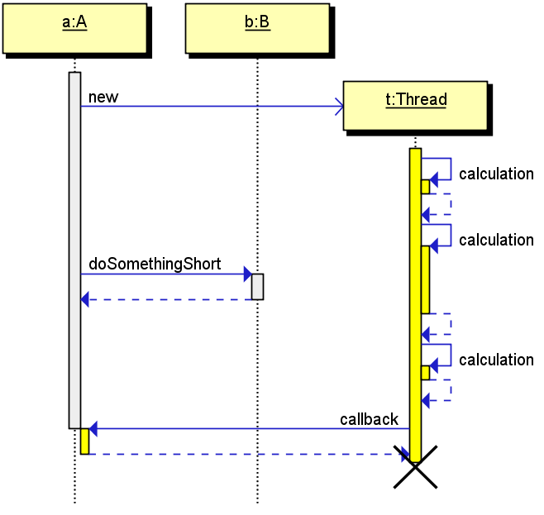
Thread / asynchronous call (5/2)
a:A
b:B
/t:Thread[x]
a:>t.new
t:t.calculation
t[1]:t.calculation
a:=b.doSomethingLong
t[1]:t.calculation
t[1]:a.callback
a:A
b:B
/t:Thread[x]
a:>t.new
t:t.calculation
t[1]:t.calculation
a:=b.doSomethingShort&
t[1]:t.calculation
t[1]:a.callback

Slide 25
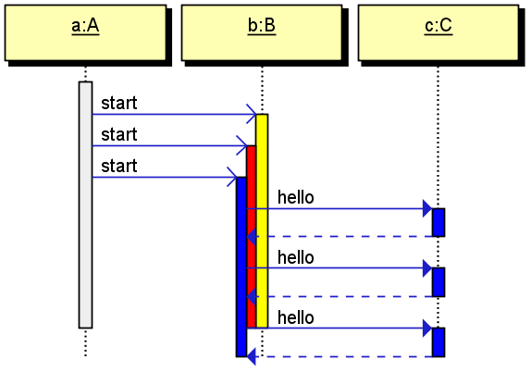
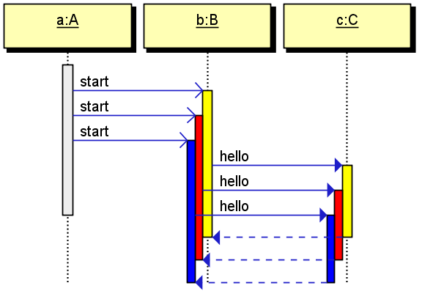
Thread / specifying the thread (5/3)
a:A
b:B
c:C
a:>b.start
a:>b.start
a:>b.start
b:=c.hello
b:=c.hello
b:=c.hello
a:A
b:B
c:C
a:>b.start
a:>b.start
a:>b.start
b[,1]:=c.hello
b[,2]:=c.hello
b[,3]:=c.hello

Slide 26
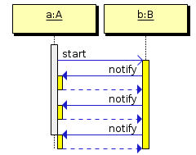
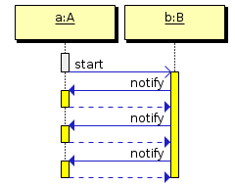
Thread / specifying the thread (5/4)
a:A
b:B
a:>b.start
b:=a.notify
b:=a.notify
b:=a.notify
a:A
b:B
a:>b.start
a:stop
b:=a.notify
b:=a.notify
b:=a.notify

Slide 27
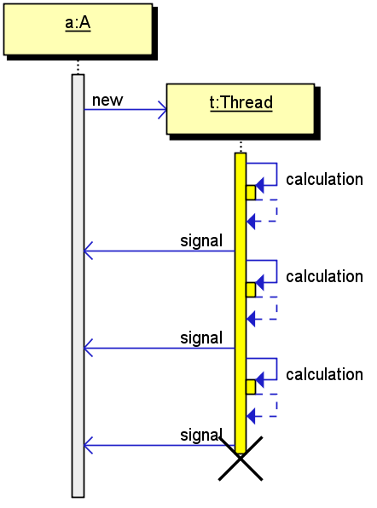
Thread / signals (5/5)
a:A
/t:Thread[x]
a:>t.new
t:t.calculation
t[1]:>a.signal&
t:t.calculation
t[1]:>a.signal&
t:t.calculation
t[1]:>a.signal&
Signals can indicate communication between threads but also a join operation at the end of the thread life.

Slide 28
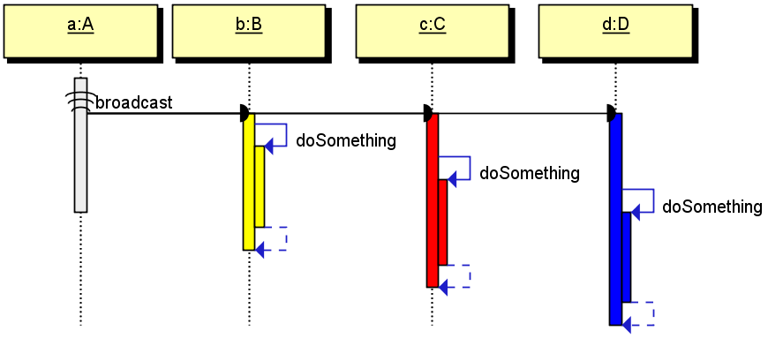
Broadcast message
a:A
b:B
c:C
d:D
a:{b,c,d}.broadcast
b:b.doSomething
c:c.doSomething
d:d.doSomething

Slide 29
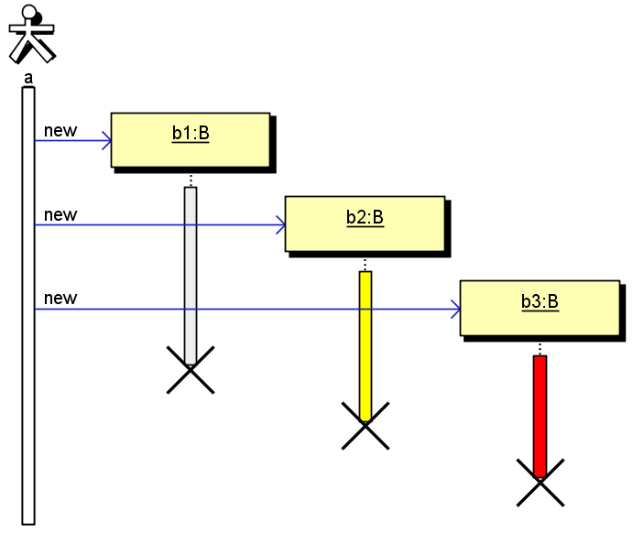
Actor
a:Actor
/b1:B[x]
/b2:B[x]
/b3:B[x]
a:=b1.new
a:=b2.new
a:=b3.new

Slide 30
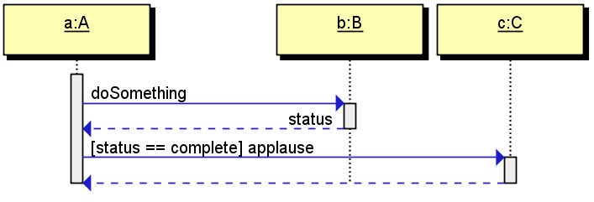
Guards (UML 1.x)
a:A
b:B
c:C
a:status=b.doSomething
a:=c.[status == complete] applause

Slide 31
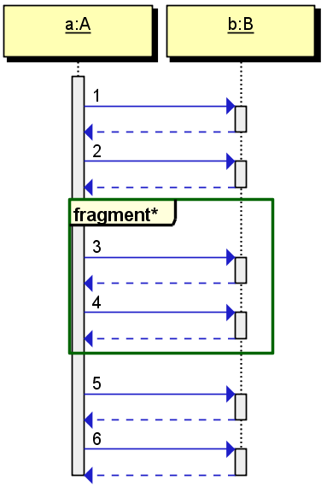
Combined fragment
a:A
b:B
a:b.1
a:b.2
[c:fragment*]
a:b.3
a:b.4
[/c]
a:b.5
a:b.6
* Combined fragment type comes here

Slide 32
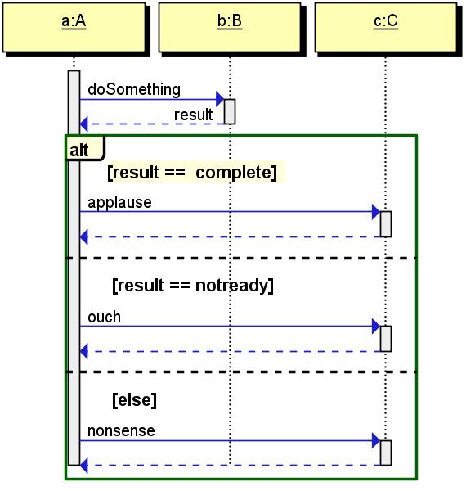
Combined fragments (1/12) – alternatives
a:A
b:B
c:C
a:result=b.doSomething
[c:alt result == complete]
a:c.applause
-- [result == notready]
a:c.ouch
-- [else]
a:=c.nonsense
[/c]

Slide 33
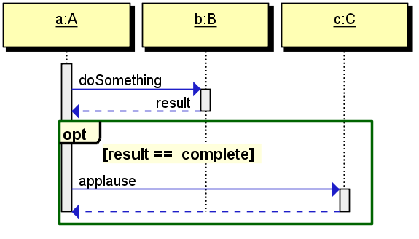
Combined fragments (2/12)– option
a:A
b:B
c:C
a:result=b.doSomething
[c:opt result == complete]
a:c.applause
[/c]

Slide 34
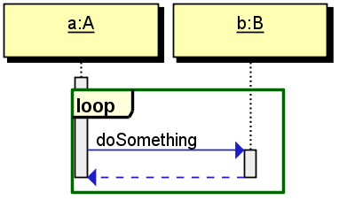
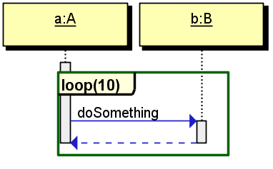
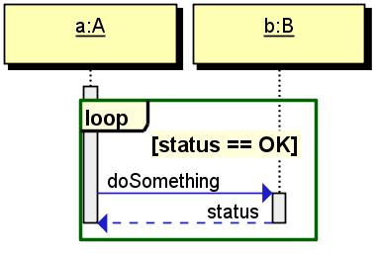
Combined fragments (3/12) - loop
a:A
b:B
[c:loop]
a:=b.doSomething
[/c]
a:A
b:B
[c:loop(10)]
a:=b.doSomething
[/c]
a:A
b:B
[c:loop status == OK]
a:status=b.doSomething
[/c]

Slide 35
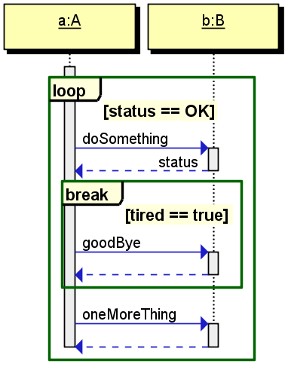
Combined fragments (4/12) – break
a:A
b:B
[c:loop status == OK]
a:status=b.doSomething
[c:break tired == true]
a:=b.goodBye
[/c]
a:=b.oneMoreThing
[/c]

Slide 36
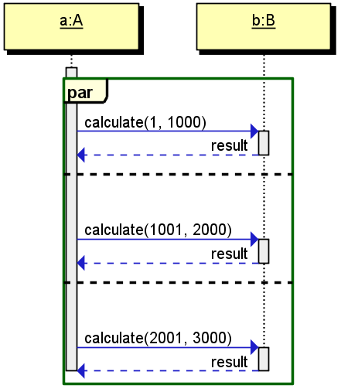
Combined fragments (5/12)– parallel
a:A
b:B
[c:par]
a:result=b.calculate(1, 1000)
--
a:result=b.calculate(1001, 2000)
--
a:result=b.calculate(2001, 3000)
[/c]

Slide 37
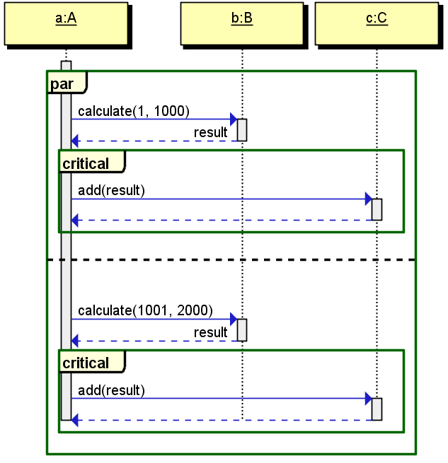
Combined fragments (6/12)– critical region
a:A
b:B
c:C
[c:par]
a:result=b.calculate(1, 1000)
[c:critical]
a:=c.add(result)
[/c]
--
a:result=b.calculate(1001, 2000)
[c:critical]
a:=c.add(result)
[/c]
[/c]

Slide 38
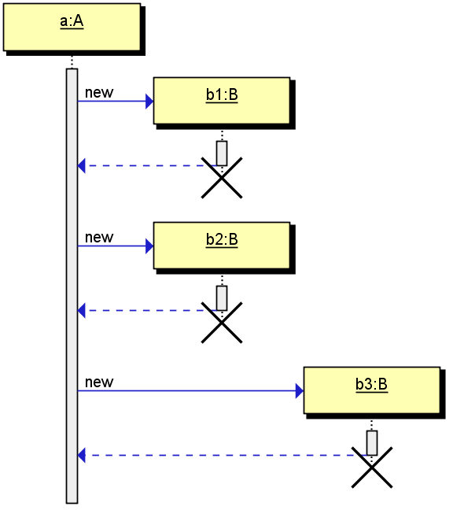
Reusing space
a:A
/b1:B[x]
/b2:B[xv]
/b3:B[x]
a:=b1.new
a:=b2.new
a:=b3.new

Slide 39
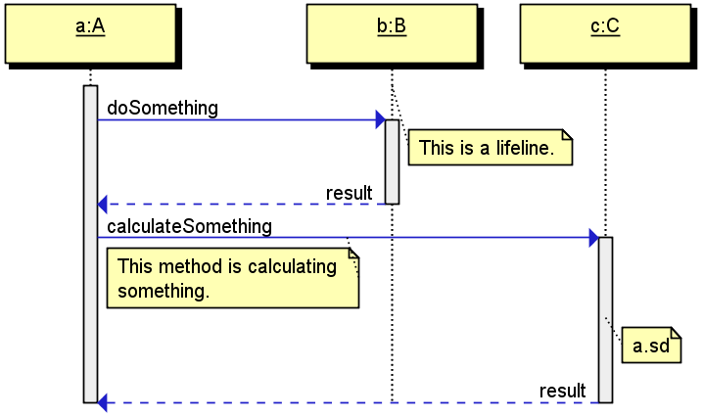
Notes & links
a:A
b:B
c:C
(1)b
a:result=b.doSomething
+1 b
This is a lifeline.
+1
(2)a:result=c.calculateSomething
+2 a
This method is calculating
something.
+2
(3)c
+3 c
link:a.sd
+3

Slide 40
Other text to UML tools (quick google search)
https://www.websequencediagrams.com/
http://plantuml.com/
http://modeling-languages.com/uml-tools/#textual
http://www.mcternan.me.uk/mscgen/

Slide 41
Thank you!

