Slide 1
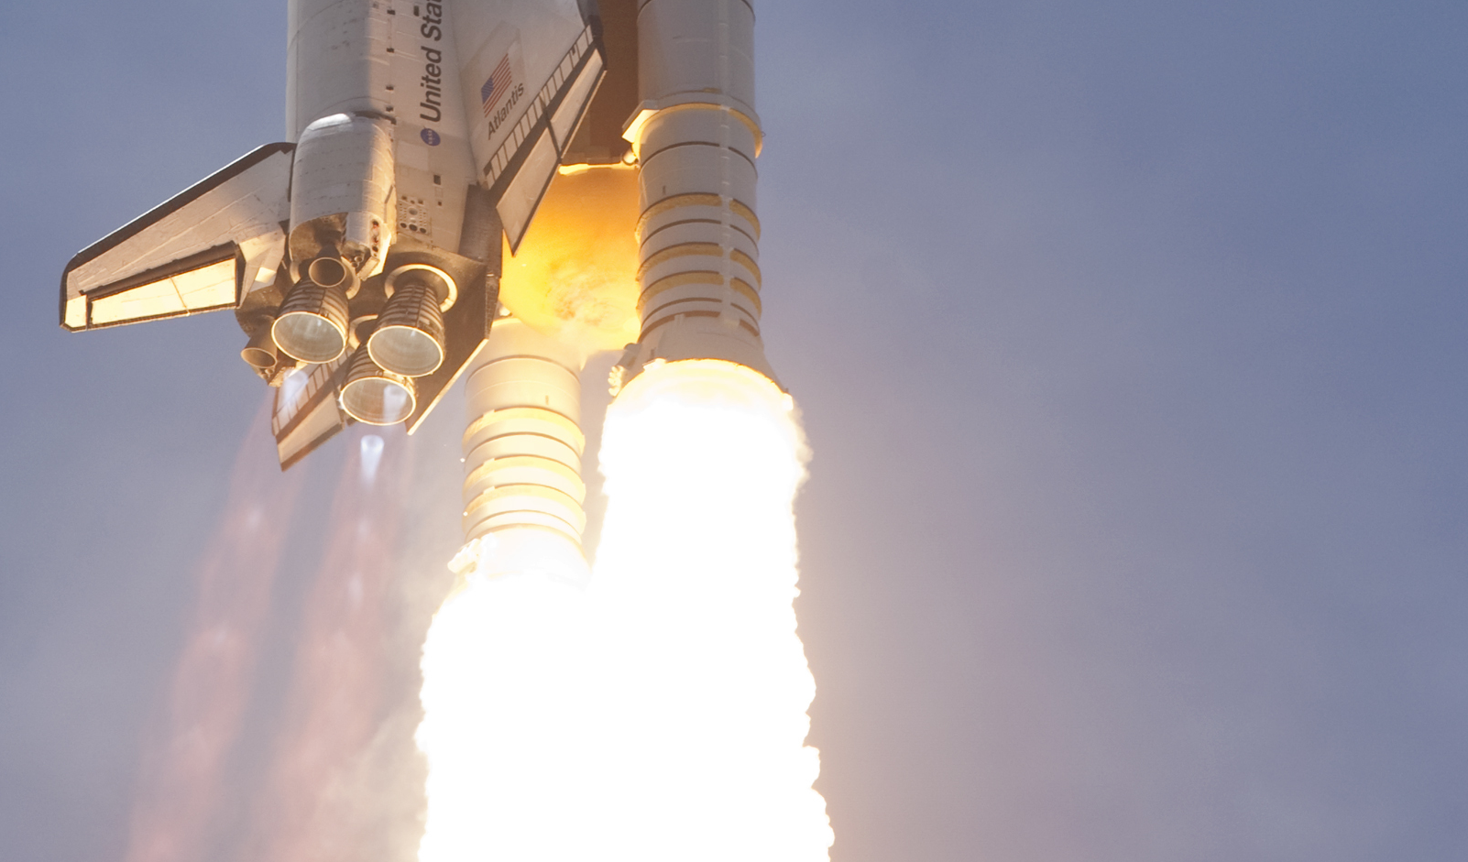
Compressible Flow Toolbox
https://www.nasa.gov/images/content/502050main_ssme_firing.jpg
https://www.nasa.gov/mission_pages/shuttle/flyout/ssme.html
Credit: NASA/Rusty Backer and Michael Gayle

