Slide 2
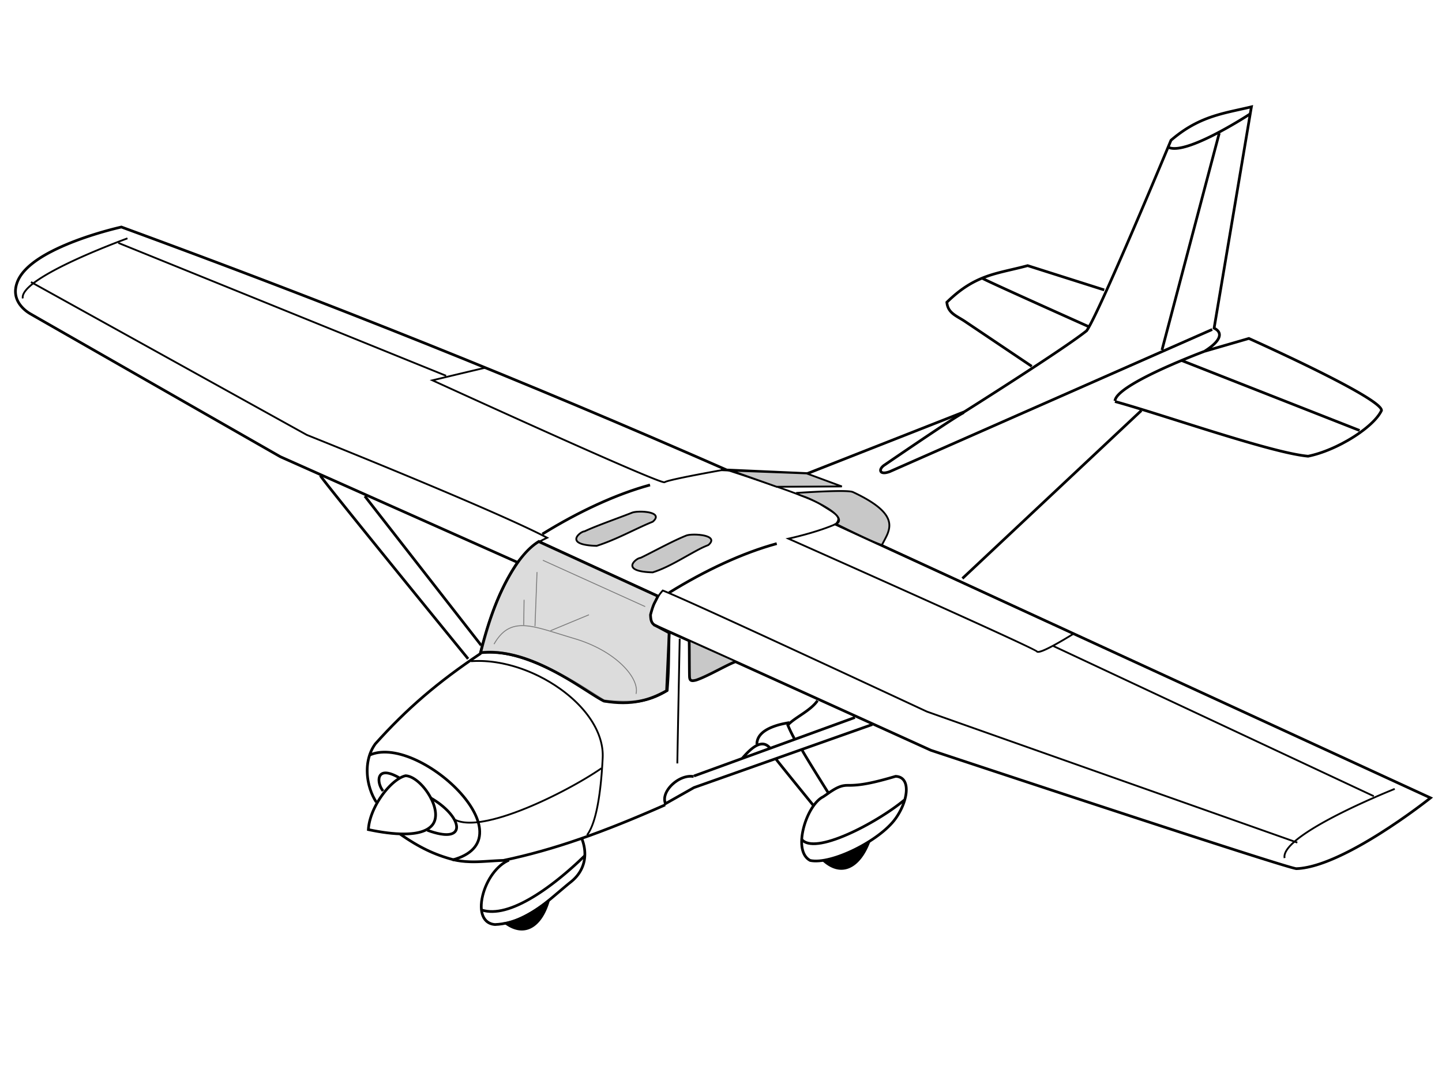
https://commons.wikimedia.org/wiki/File:Cessna_172_line_drawing_oblique.svg

Slide 3
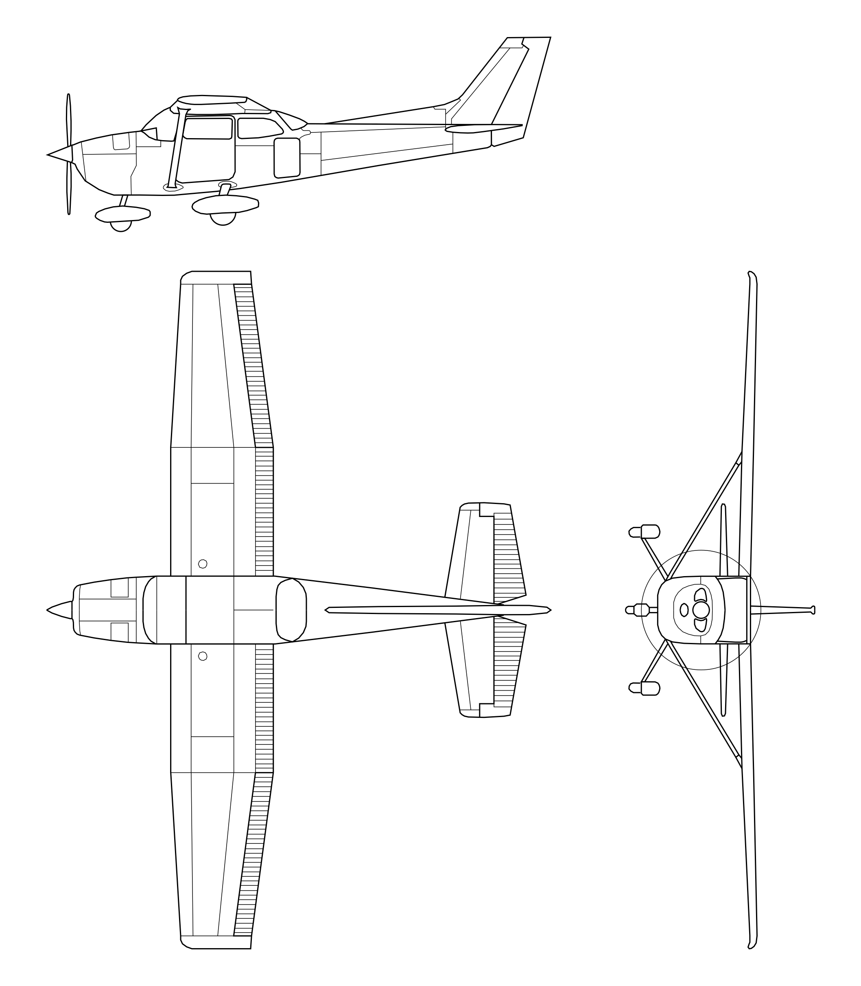
https://commons.wikimedia.org/wiki/File:Cessna_172.svg

Slide 4
https://commons.wikimedia.org/wiki/File:Cessna_172.svg

Slide 5
https://commons.wikimedia.org/wiki/File:Cessna_172.svg

