Slide 1
Backend
Backend showcase
Starter file (app.js)
Register & Verify Account
Login & Authentication
Password Request & Change
Product Schema
WishList
Orders
Reviews
Admin
Basic information
Adding a new product
Modifying a product
Deleting a product
Summary
Backend tests
Introduction
Login & Authentication
GET User session
GET products
GET a product by ID
Adding a product to WishList
GET WishList
Remove added product from WishList
Adding a new product
Modifying a product
Deleting a product
Request password change
Logout
Summary

Slide 2
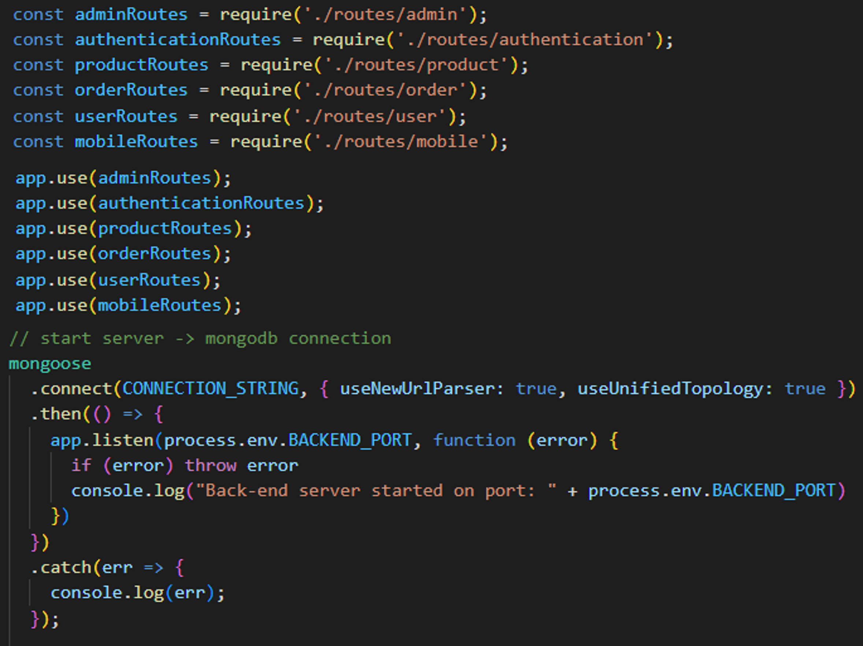
Backend showcase
Starter file (app.js)

Slide 3
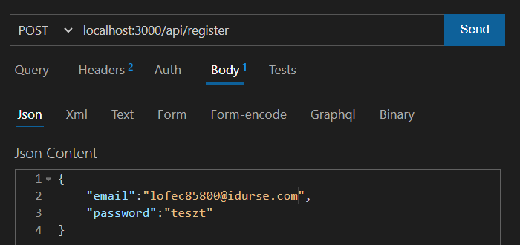
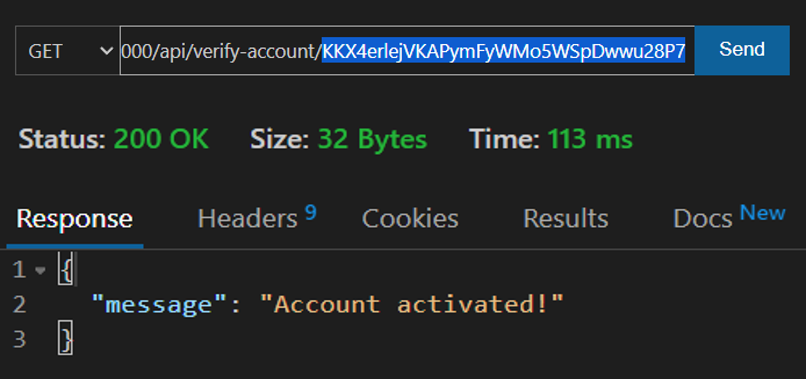
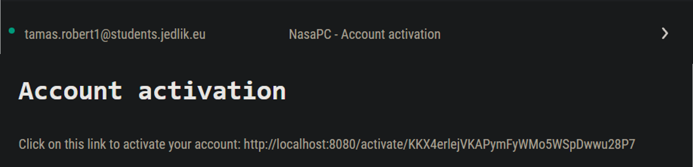
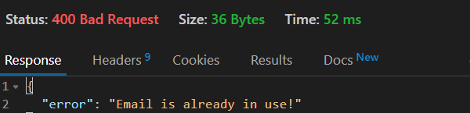
Backend showcase
Register & Verify Account
(Showcase)

Slide 4
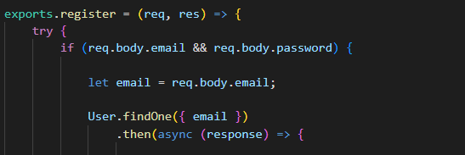
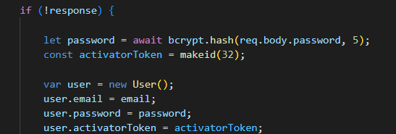
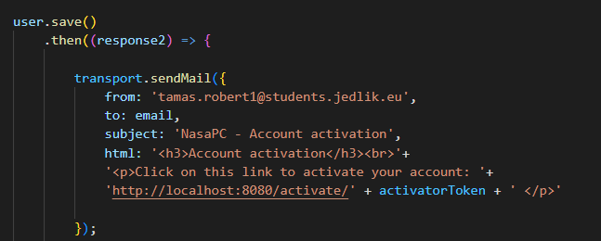
Backend showcase
Register & Verify Account
(Code)

Slide 5
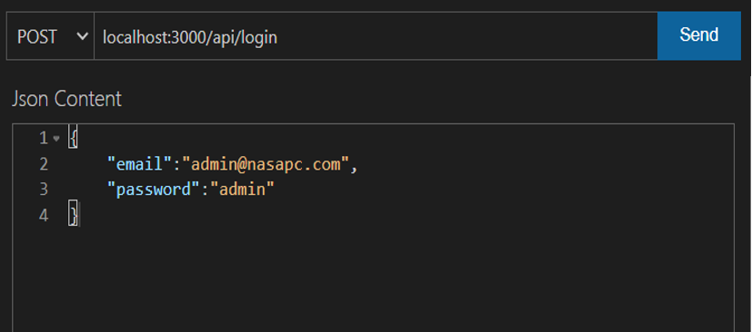
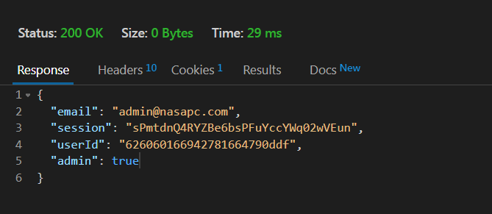
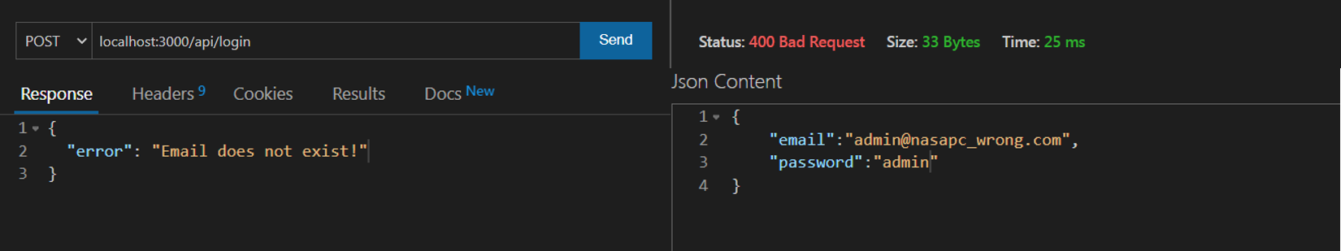
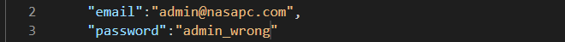
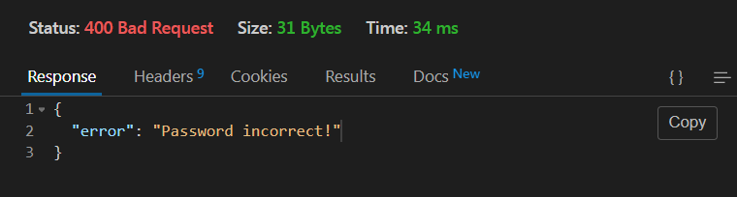
Backend showcase
Login & Authentication
(Showcase)

Slide 6
Backend showcase
Login & Authentication
(Code)

Slide 7
template
template
(template)

