Slide 1
RECAP

Slide 2
Processor Expert
Problem: No time to deal with the very low level
Solution: Blocks of an application with methods, events and properties

Slide 3
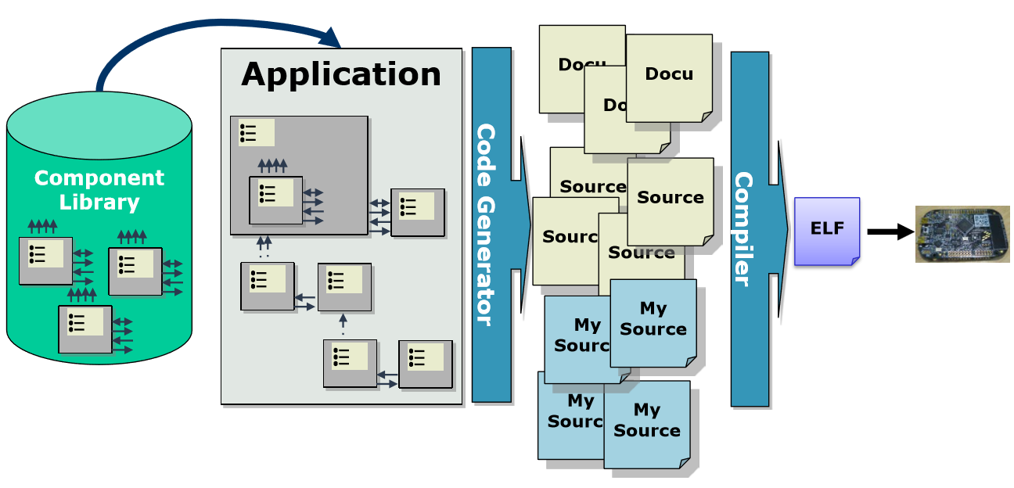
Component Model Development Flow

Slide 4
Project Structure
Problem: Requirements and Project Organization (many common system blocks)
Solution: Shared Resources

Slide 5
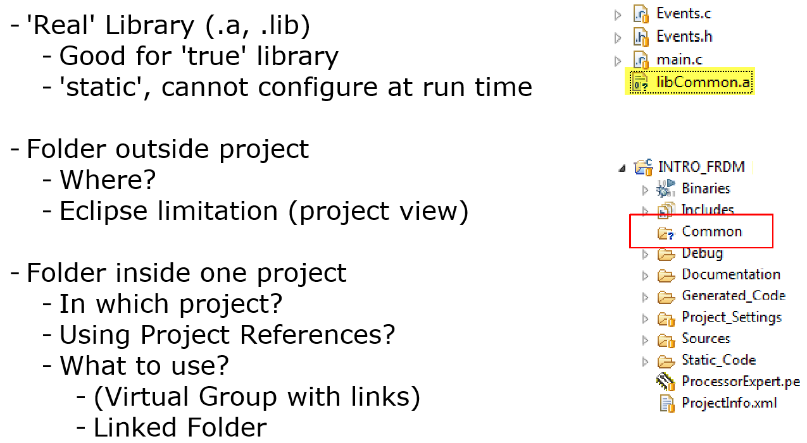
But where?

Slide 6
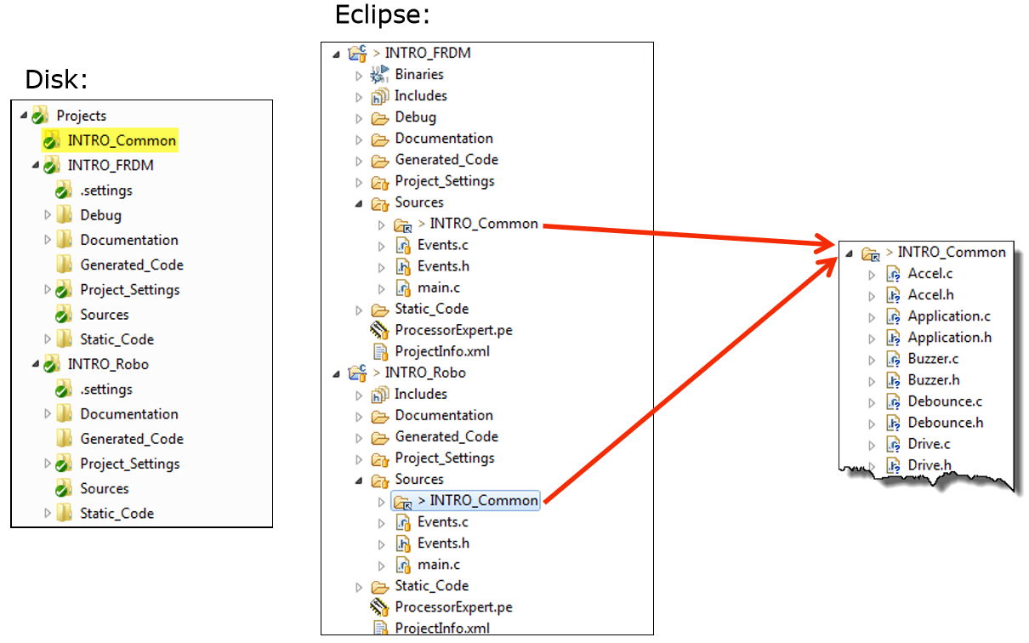
Common folders with links

Slide 7
Questions
Why shouldn’t you share the processor expert file?
Name three components you can add with processor expert.
What are the advantages and disadventages of linked folders?
Can you think of a different solution to share code / system blocks?

