Slide 1

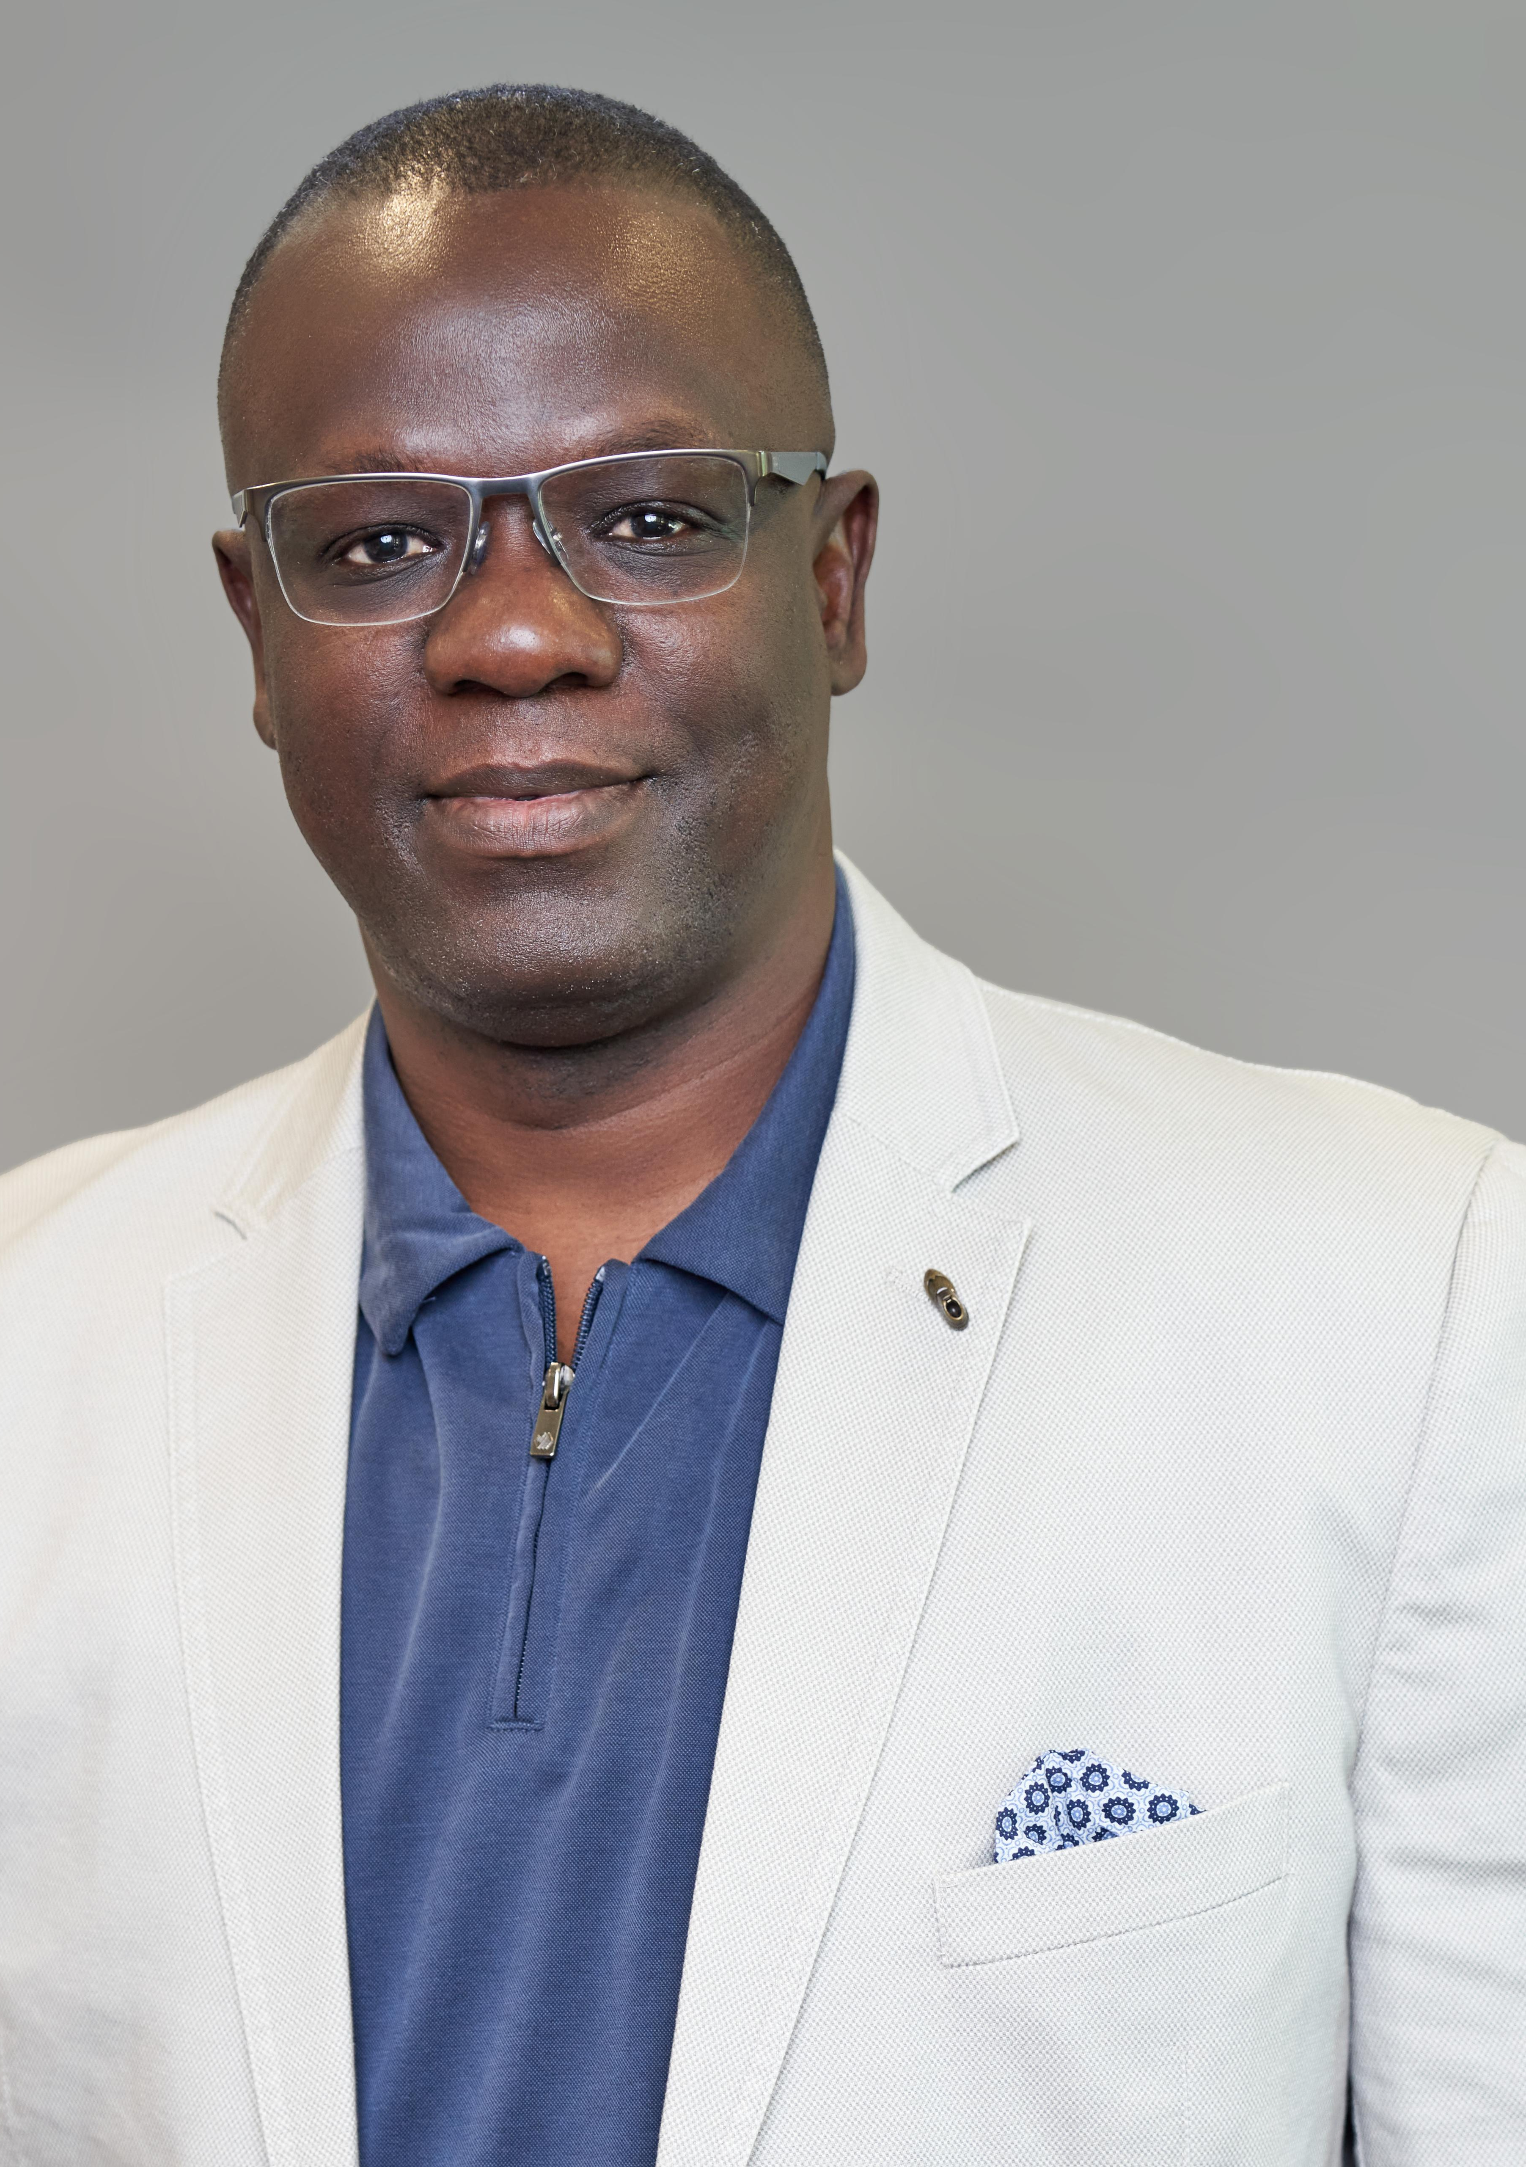







SLINT
LIVE · VIRTUAL
Sierra Leoneans in Technology
SLINT · AGENTIC AI WORKSHOP
Build & Deploy aLive AI-Powered Web App
Hands-on live coding with Agentic AI — from prompt to production, end to end.
Claude Code
GitHub
Vercel
Live App
AI CODING
VERSION
DEPLOY
PRODUCTION
DATE
TIME
LENGTH
Register — It’s Free
Sat · Jun 13
2:00 PM EST
45–90 min
HOSTED BY
Tamba Sheku Lamin
Register → bit.ly/slint-ai-workshop
Freefor members ·$10non-members · Zoom link emailed after verification.
Former President, SLINT
Co-Founder & Group CEO, TpGROUP (SL) Ltd · Sr. Technology Architect / FDE @ Accenture Song
Co-organized byCecil John& the SLINT Executive
slint.org
linkedin.com/in/tambalamin

