Slide 1







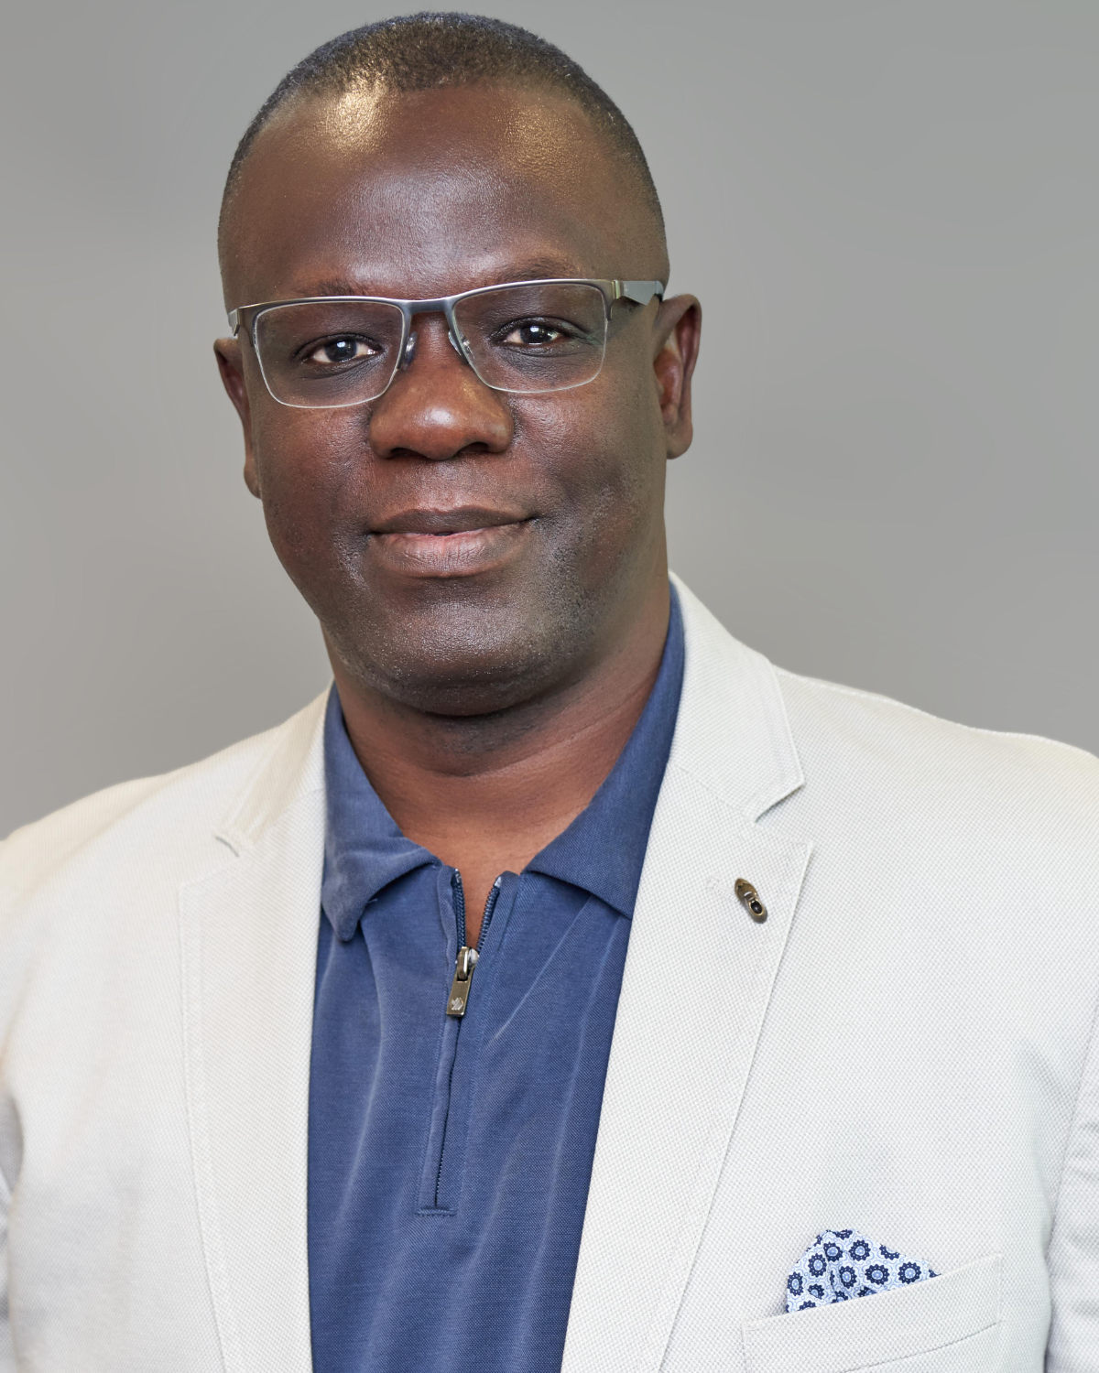

SLINT
LIVE · VIRTUAL
Sierra Leoneans in Technology
SLINT · AGENTIC AI WORKSHOP
Build & Deploy aLive AI-Powered Web App
A hands-on, live-coding session on Agentic AI and the AI-led software development lifecycle — watch a real app go from idea to the open web.
THE WORKFLOW · PROMPT → PRODUCTION
● Built live on stage
Claude Code
GitHub
Vercel
Live App
AI CODING
VERSION
DEPLOY
PRODUCTION
We’ll build Salone Explorer — a real Sierra Leone tour-guide app — and ship it to production during the session.
HOSTED BY
Tamba Sheku Lamin
Former President, SLINT
Co-Founder & Group CEO, TpGROUP (SL) Ltd · Senior Technology Architect / FDE @ Accenture Song
linkedin.com/in/tambalamin
DATE
TIME
LENGTH
Register — It’s Free
Sat · Jun 13
2:00 PM EST
45–90 min
Register → bit.ly/slint-ai-workshop
Freefor SLINT members ·$10non-members · Zoom link emailed after verification.
Co-organized byCecil John& the SLINT Executive
slint.org

