Slide 1
Unit testing with karma-jasmine

Slide 2
Unit Testing
Units in your source code are small individual testable parts of your application. Unit testing is a process in which these small units of your code are tested to ensure their proper operation.
AngularJs is designed to make unit testing easier but it also depends on how you organise the code. Unit testing an application where concerns are divided into small independent units is easy rather than a piece of code that does everything.
This guide requires node installed, as we will be using npm to setup karma and jasmine, if you don’t have node installed then before proceeding further, get node installed.

Slide 3
Karma
Karma is a test runner provided by the Angular team, Karma will execute your tests in multiple browsers which shall ensure that our application is compatible in all browsers.
https://karma-runner.github.io/0.8/intro/installation.html
https://github.com/karma-runner/grunt-karma

Slide 4
Jasmine
Jasmine is a javascript unit testing framework and will provide us with utilities to test our application. We can use any other javascript testing framework for our testing but we’ll stick to jasmine as it is the most popular.
https://jasmine.github.io/2.5/introduction
https://jasmine.github.io/api/edge/global.html

Slide 5
ngMock
The ngMock module provides support to inject and mock AngularJS services into unit tests. In addition, ngMock also extends various core AngularJS services such that they can be inspected and controlled in a synchronous manner within test code.
https://docs.angularjs.org/api/ngMock

Slide 6
Reporters
karma-junit-reporter
https://github.com/karma-runner/karma-junit-reporter
karma-coverage
https://github.com/karma-runner/karma-coverage
https://karma-runner.github.io/0.8/config/coverage.html
All available repoters:
https://www.npmjs.com/browse/keyword/karma-reporter

Slide 7
Configuration
karma.conf.js
karma init
Select Jasmine as your testing framework.
Select browser.
Specify the paths to your js and spec files. Eg. 'app/*.js', 'test/*.js‘.
After answering a few more questions you should be done.
Open up your karma.conf.js and add the location of angular.js in to the files array.
angular/angular.js
Add the location for ngMock just below that.
angular-mocks/angular-mocks.js

Slide 8
Testing Pattern
Describe your Test case/Object type name.
load app module
Inject and mock services as needed
Initialize your object.
Write your tests, expectations.

Slide 9
app.js – Main code
var myApp = angular.module('myApp',[]);
myApp.controller('HelloWorldController', ['$scope', function($scope) {
$scope.greeting = 'Hello World!';
}
]);

Slide 10
tests.js – Unit test code
describe(‘Hello World example ’, function() { //describe your test case name
beforeEach(module(‘myApp’)); //load module
var HelloWorldController, scope;
beforeEach(inject(function ($rootScope, $controller) { //inject mock services as need
scope = $rootScope.$new(); //mock a scope
HelloWorldController = $controller('HelloWorldController', {$scope: scope}); //initialize the controller
}));
it('Says hello world!', function () { //Describe Test case
expect(scope.greeting).toEqual('Hello world!'); //test
});
});

Slide 11
Few basic required commands
npm init
npm install grunt --save-dev
npm install karma --save-dev ( Installed locally & Local Run Needed- ./node_modules/karma/bin/karma start ) or
npm install –g karma --save-dev ( Installed globally & cannot run/recognize the other local version node modules ) or
npm install -g karma-cli ( Installed globally & always run the local version ) preferable
npm install grunt-karma --save-dev
npm install karma-jasmine --save-dev
npm install jasmine-core --save-dev
npm install karma-firefox-launcher --save-dev
bower init
bower install angular -S
bower install angular-mock -S

Slide 12
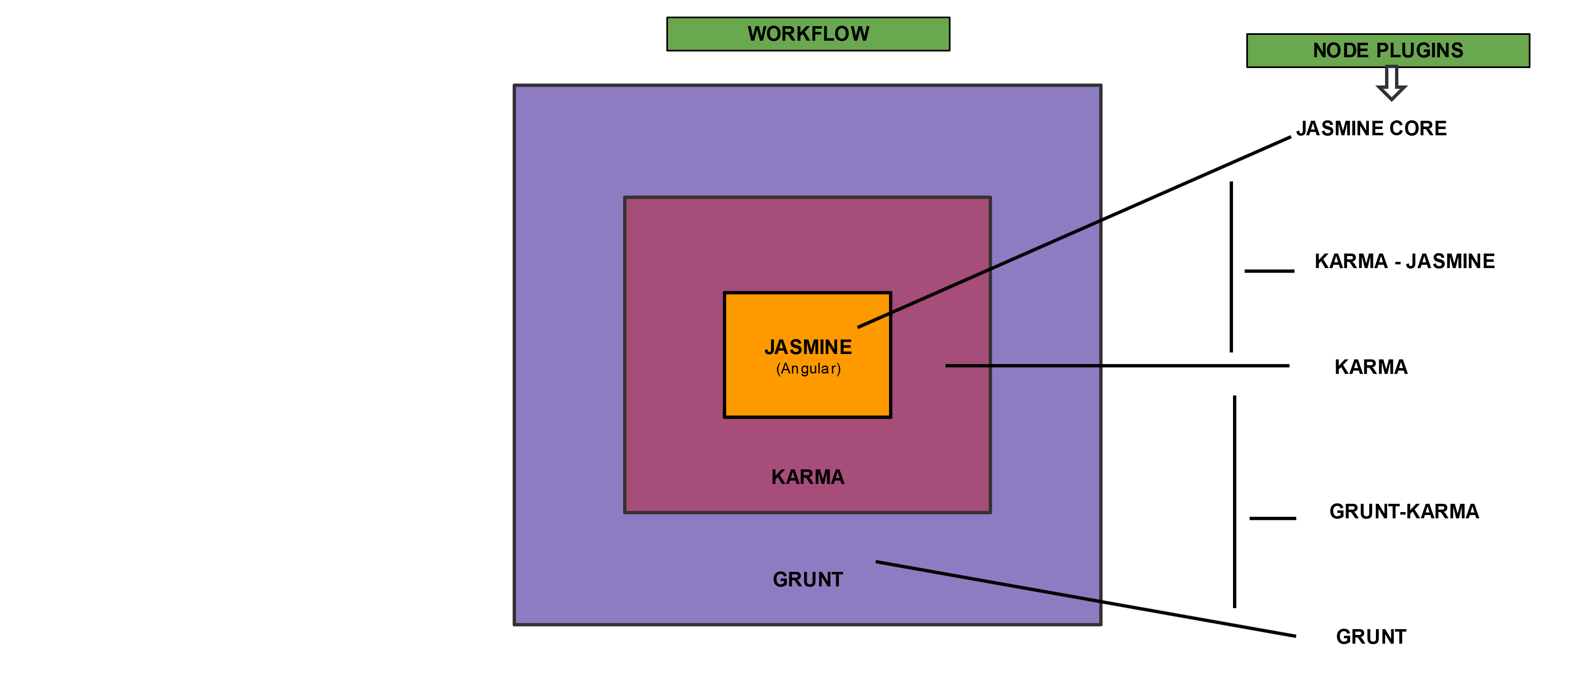
Test flow

