Slide 1
DeepTruth
AI-Powered Deepfake Detection System
Multi-Modal Detection | Image · Video · Audio
Tameem El Fakharany
2026

Slide 2
Executive Summary
🎯 Problem
Deepfake media (images, video, audio) is increasingly difficult to detect with the human eye, posing serious risks to trust and security.
💡 Solution
DeepTruth is a full-stack web application that uses state-of-the-art AI models to detect deepfakes across image, video, and audio modalities.
🏗️ Architecture
5-stream hybrid neural network (CLIP + EfficientNet-B4 + Frequency + SRM + GramStyle) with cross-attention fusion for image detection.
📊 Results
98.0% average accuracy on image detection (Real: 98.7%, Fake: 97.2%). Audio model trained on ASVspoof, WaveFake, MLAAD datasets.
🚀 Status
Core detection pipeline complete. Backend (FastAPI) + Frontend (Next.js) fully operational. Ongoing: improving real-photo false positive rate.

Slide 3
System Architecture
Full-Stack Web Application
Frontend
Backend
Image Model
Video Model
Audio Model
Next.js 14
FastAPI
DeepTruthHybridV2
LipNet (TF)
Wav2Vec2
Image / Video / Audio upload interface Real-time results Heatmap visualization
REST API endpoints Model inference Face detection JWT authentication
5-stream PyTorch model, 98% accuracy Face crop pipeline
Frame-based analysis Temporal transformer ONNX export ready
Speech deepfake detection 16kHz waveform input

Slide 4
Model 1: DeepTruthHybridV2 — Image Detection
CLIP ViT-B/16
Cross-Attention Fusion
Stream 1
→
512-d
Semantic understanding of image content
1280-d fused representation Multi-head attention across 5 streams Image Head → 512 → 256 Binary Output (Real / Fake)
Stream 2
EfficientNet-B4
→
512-d
Visual feature extraction from face regions
Output
Stream 3
Frequency (FFT+Wavelet)
→
256-d
→
P(Real) P(Fake) Threshold: 0.50 Fake Type Classification (10 categories)
Detects GAN/diffusion frequency artifacts
Stream 4
SRM Noise Residual
→
128-d
Splicing & manipulation noise patterns
Stream 5
Gram Style Matrix
→
128-d
Texture consistency analysis

Slide 5
Model 2 & 3: Video & Audio Detection
Model 2 — LipNet Video Detector
Model 3 — Wav2Vec2 Audio Detector
Framework: TensorFlow / Keras Input: Video frames (MP4, AVI, MOV, MKV) Pipeline: 1. Extract frames from video 2. Apply 5-stream image analysis per frame 3. Temporal Transformer aggregates frame features 4. Binary classification (Real / Fake) Output: Fake probability + manipulation type Export: ONNX-ready for production deployment
Framework: PyTorch + HuggingFace Transformers Base Model: facebook/wav2vec2-base Input: Audio (WAV, MP3, FLAC, M4A, OGG) Resampled to 16kHz, 4-second clips Architecture: Wav2Vec2 feature extractor (frozen) → Mean pooling (768-d) → Classifier: 768→512→256→2 Threshold: 0.35 (tuned for audio under-prediction) Output: Fake probability + TTS/VC type

Slide 6
Datasets Used for Training
Fake Image Datasets (383,675 images)
Real Image Datasets (681,679 images)
• FaceForensics++
• FFHQ
Deepfakes, Face2Face, FaceSwap, NeuralTextures, DeepFakeDetection, FaceShifter
50,000 high-quality Flickr faces (from processed_faces.zip)
• GAN-Generated
• VGGFace2
StyleGAN2, GenImage GAN
625,789 real faces, 9,000+ identities Diverse lighting & angles
• Diffusion-Generated
• Extra Real
ADM, PNDM, DDIM, LDM variants
5,890 manually curated real photos
• DeepFaceLab
• Audio — ASVspoof 2019/2021
High-quality face swap
Anti-spoofing challenge dataset
• DALL-E / Midjourney
• Audio — WaveFake
AI image generation
GAN vocoder fake speech
• Stable Diffusion
• Audio — MLAAD
Open-source diffusion model
Multi-language audio deepfakes

Slide 7
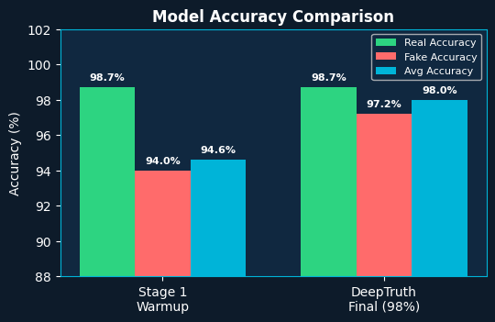
Training Results & Accuracy
Metric
Stage 1 Warmup
Final Model
Real Accuracy
98.7%
98.7%
Fake Accuracy
94.0%
97.2%
Avg Accuracy
94.6%
98.0%
AUROC
0.9948
~0.998
Training Epochs
Phase 1 only
Phase 1 only
Model Size
506 MB
519 MB
Threshold
0.50
0.50

Slide 8
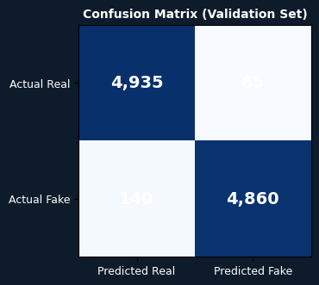
Confusion Matrix & F1 Score — Final Model
Metric
Real Class
Fake Class
Precision
0.9870
0.9868
Recall
0.9870
0.9720
F1 Score
0.9870
0.9793
Support
5,000
5,000
Overall Accuracy
97.95%
Macro F1
0.9793
AUROC
~0.998

Slide 9
Project Completion Status
Full-Stack Web Application (Frontend + Backend)
Complete
100%
Image Deepfake Detection Model (98% accuracy)
Complete
100%
Audio Deepfake Detection Model
Complete
100%
Video Deepfake Detection Model
Complete
90%
Face Detection Pipeline (multi-face support)
Complete
100%
Grad-CAM Heatmap Visualization
Complete
100%
User Authentication (JWT)
Complete
100%
Detection History & Database
Complete
100%
Real-Photo False Positive Reduction
In Progress
65%
ONNX Export & Deployment Optimization
In Progress
40%
Overall Project Completion: 88%

Slide 10
Challenges & Next Steps
Key Challenges
Next Steps
Phase 2 Fine-tuning Collapse
→ Add real phone/WhatsApp-style photos to training data
Unfreezing all backbone layers caused NaN losses and model collapse due to CLIP attention overflow in float16. Solution: Phase 1 only training.
→ Complete ONNX export for faster CPU inference
Real-Photo False Positives
Some real photos (compressed, beauty-filtered) score 90-100% fake. Requires WhatsApp/phone-style real photos in training data.
→ Improve video model accuracy with more training data
Training/Inference Mismatch
→ Deploy to cloud (AWS / GCP) for production use
Extra fake datasets (DALL-E, Midjourney) trained as full images but inference uses face crops — model doesn't generalize to these types.
→ Add batch processing for multiple file uploads
Label Convention Confusion
Model empirically outputs probs[1]=P(fake) despite architecture ambiguity. Fixed in inference.py with debug logging to verify.

