Slide 1
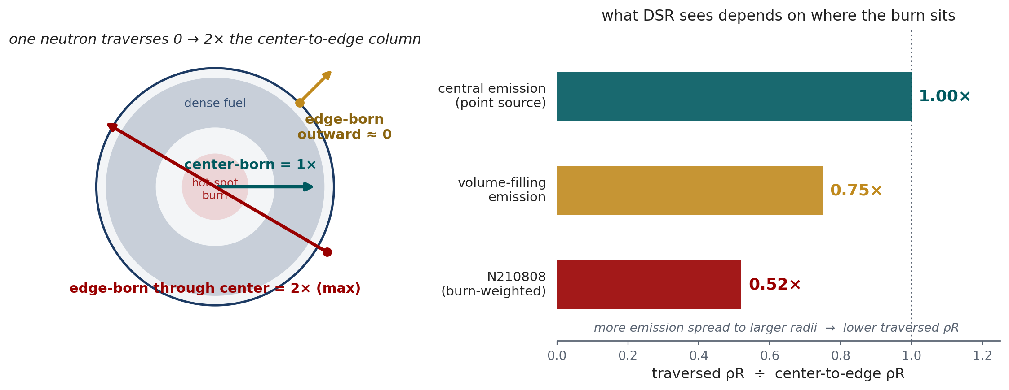

BACKUP · MAX Q1–Q2 · CHORD BOUND & SENSITIVITY
What DSR measures — the burn-weighted traversed ρR
DSR measures the emission-weighted, angle-averaged column the neutrons traverse — 0.30 vs 0.57 center-to-edge for N210808 (0.52×), not the total ρR.
The nuclear DSR↔ρR coefficient is robust; what moves is the total-ρR → DSR mapping via the profile shape and where the burn sits.
2D/3D, mix, preheat, shock mistiming change the profile → change that mapping (sign is geometry-dependent, not a fixed law).
YOC + DSR narrow the range but don’t uniquely pin total ρR — add Tion, burn width, spectral shape, and forward-model per shot to close it.
MECS
Prepared for Xcimer Energy | Prof. Tom Mehlhorn

Slide 2
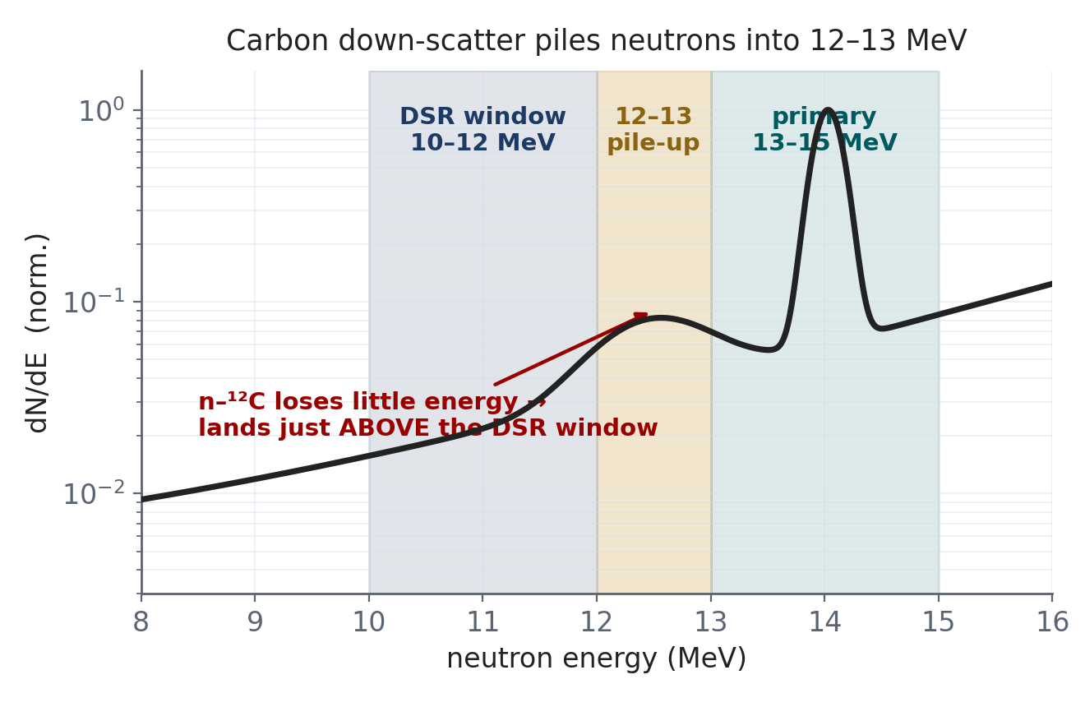
BACKUP · MAX Q3 · YIELD UNFOLD EXPONENT
The 4·DSR yield unfold is design-specific — HDC gives ≈ 5
NIF unfolds total yield from the measured 13–15 MeV yield:
Y_{total} = Y(13–15) · e^{(k·DSR)}
k ≈ 5.6
≈ 7%
our OpenMC transport (≈5.1–5.2 after DD/TT)
standard 4·DSR under-estimates total yield for this HDC target
Why > 4: n–¹²C elastic loses little energy per collision, so carbon piles 14 MeV neutrons into the 12–13 MeV band — out of the 13–15 primary window but above the 10–12 DSR window. That inflates scattered-out / DSR above the DT-only value of 4.
k = 4 is the bare-DT nominal; the effective value is design-specific. A DT-only source run would pin it exactly.
References: Crilly et al., Phys. Plasmas 25, 122703 (2018); Frenje, Plasma Phys. Control. Fusion 62, 023001 (2020); MRS absolute yield — Frenje et al., Rev. Sci. Instrum. 84, 073506 (2013).
Escaping spectrum — why the exponent inflates
MECS
Prepared for Xcimer Energy | Prof. Tom Mehlhorn

