Slide 1
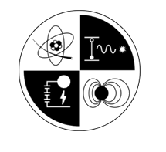
NEUTRONICS BRIEF
Neutron Diagnostics for Target Design
helios_postprocess → NeSST & OpenMC — multi-material scatter, DSR, and the N210808 validation
Prepared for Xcimer Energy | Prof. Tom Mehlhorn
MECS

Slide 2
Neutron diagnostics, now in the pipeline
1
Birth spectrum
Burn-weighted N(E) built from the Helios ion-temperature and reaction-rate profiles.
Runs automatically
Fires as STEP 5b of run_analysis — no extra command.
Console block, _summary.txt, comparison-PDF rows, and a saved figure.
NeSST-optional — never blocks the rest of the pipeline.
2
Down-scatter → ρR
First-principles DSR from ENDF/B-VIII.0 elastic cross sections via NeSST — not an empirical fit.
3
Synthetic nTOF
Time-of-flight trace at the detector plus the apparent ion temperature.
MECS

Slide 3
Multi-material scatter — D + T + carbon
N210808 target — HDC (diamond) ablator, no foam · composition read per layer from the RHW
Fuel fractions read from the deck
Not hand-set — N210808 fuel is equimolar DT (50:50 by atom, 40:60 by mass).
HDC ablator carbon now in the scatter
Via NeSST C12 (elastic + the 4.4 MeV inelastic) — previously missing.
Two DSRs reported
Fuel DSR (the ρR diagnostic) and total DSR (with the HDC carbon).
Layer | material | w_D | w_T | w_C
DT gas / ice | D + T fuel | 0.40 | 0.60 | 0.00
HDC shell | carbon (diamond) | 0.00 | 0.00 | 1.00
The carbon the neutrons scatter off is the HDC shell — no foam in this target. (A wetted-foam design would instead show a mixed D+T+C foam layer.)
MECS

Slide 4
How the result is computed — model & equations
birth spectrum → per-layer areal density → single scatter (NeSST / ENDF) → primary depletion → DSR & nTOF
1
Birth spectrum (Helios source)
4
Deplete the primary
Gaussian @ 14.06 MeV, ΔE_FWHM = 177·√Ti keV + TT R-matrix continuum (Brune).
I(E) → I(E)·T(E), T = transmission (D+T & C) — scattered neutrons LEAVE the peak (number-conserving).
2
Per-species areal density
5
Down-scatter ratio → ρR
ρR_x = ∫ ρ(r)·w_x dr (RHW composition × Helios, neutron-weighted; x = D, T, C).
DSR = ∫N(10–12) / ∫N(13–15); ρR = coeff · DSR (coeff is first-principles).
3
Single scatter — NeSST, ENDF/B-VIII.0
6
Synthetic nTOF
N_sc(E) = A_1S·K(E); A_1S = ρR·σ̄/m̄. D,T elastic + (n,2n); C elastic + inelastic.
t(E) = t0 + d/v(E), v = c·β (relativistic); dN/dt = dN/dE · |dE/dt|.
Implementation: all logic is in our helios_postprocess routines. NeSST is used unmodified (public API + its l_n2n switch). Data: ENDF/B-VIII.0; TT: Appelbe/Brune R-matrix.
MECS

Slide 5
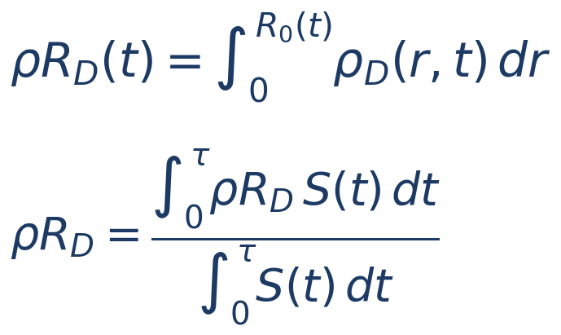
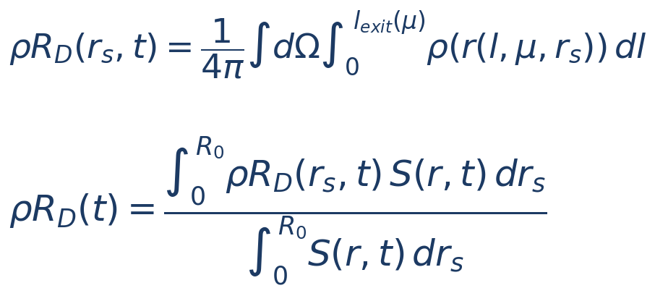
Two ways to define ρR — Method 1 vs Method 2
After Kyle Keipper, “Areal Density of Deuterium – Two Methods.” Both burn- and time-averaged; the difference is spatial.
METHOD 1 · CENTER-TO-EDGE
METHOD 2 · EMISSION-WEIGHTED, ANGLE-AVERAGED
Neutrons assumed produced at r = 0 · isotropic
Radial distribution of production · isotropic
The full radial column ∫₀ᴿ ρ_D dr — the classic areal-density metric, and the largest ρR a neutron could see.
What a neutron actually traverses — the density it crosses depends on its birth radius r_s, where it is along the track, and its angle μ to the outward radial.
Why it matters: DSR responds to the Method-2 (traversed) ρR. Method 1 (center-to-edge) over-predicts it — the pipeline now uses Method 2.
MECS

Slide 6
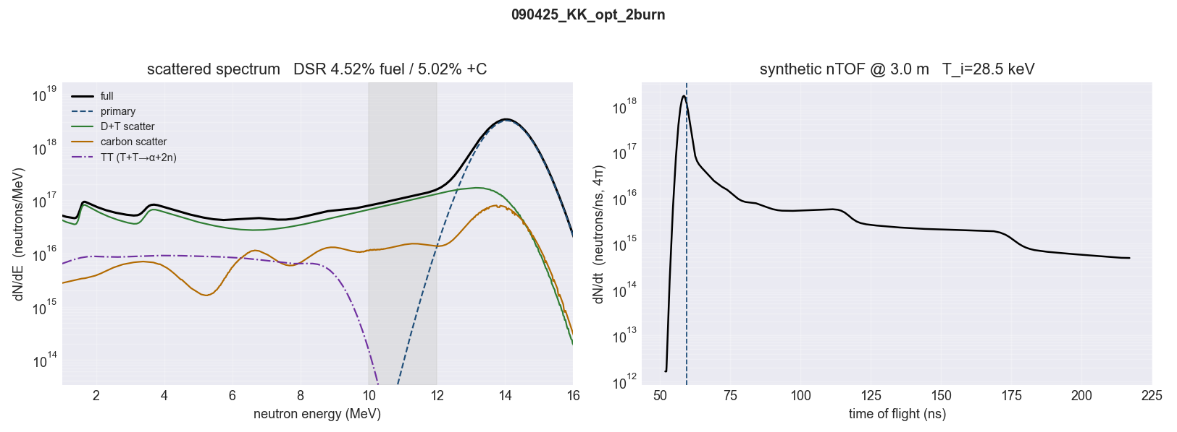
N210808 validation — pipeline output (Method-2 ρR)
4.5% → 5.0%
D 0.30 · T 0.45 · C 0.66
1.03 × Y
DSR fuel → total (traversed)
traversed (Method 2) ρR (g/cm²)
escaping (primary depleted + n,2n)
Clean-1D over-igniting burn (Y = 15.6 vs 1.37 MJ), so ρR/DSR run high — but the traversed 4.5% is far closer to the published 2.87% than the center-to-edge 10%.
MECS

Slide 7
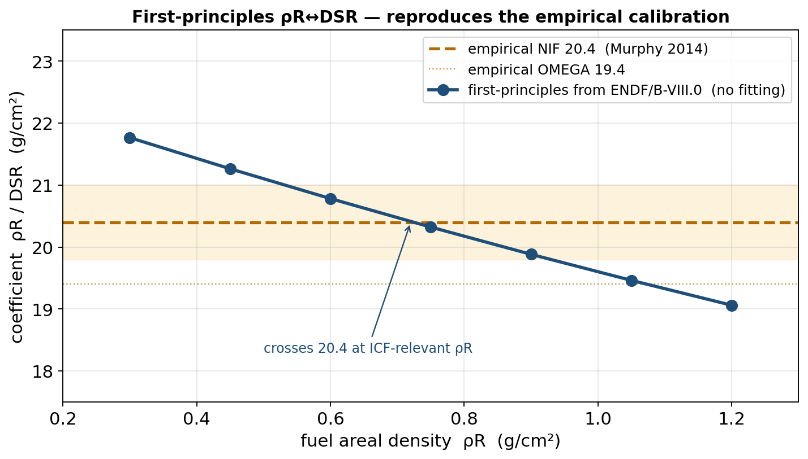
First-principles ρR ↔ DSR — no fitting
The usual conversion is empirical
ρR = 20.4 × DSR (NIF, Murphy 2014) — a calibrated constant.
We derive it from cross sections
A_1S = ρR·σ̄/m̄ from ENDF/B-VIII.0 — no free parameters.
Depletion lands it on 20.4
Using the measured (attenuated) primary, our ENDF coefficient matches 20.4 at ICF-relevant ρR.
The residual slope
is the single-scatter limit — full transport (OpenMC) closes it (next slides).
MECS

Slide 8
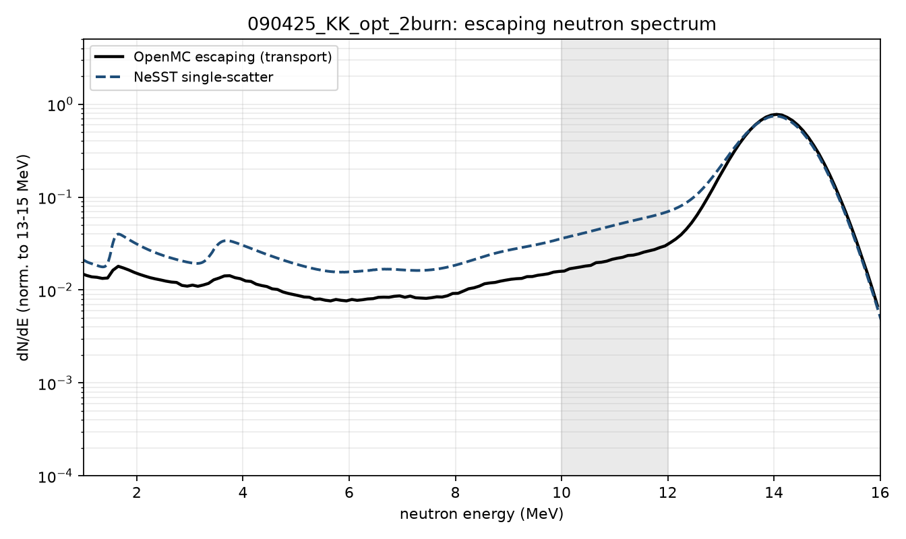
N210808 — OpenMC transport confirms the choice
NeSST with the center-to-edge (Method 1) ρR gives DSR ~10%. OpenMC transport and Method 2 give what neutrons traverse — ρR ~0.3, DSR ~4.3% (≈ the pipeline's 4.5%).
4.3%
10.1%
DSR — traversed (OpenMC)
DSR — center-to-edge (M1)
Abu-Shawareb (NIF): “the areal density…is emission weighted to larger radii” — DSR tracks the traversed ρR. Pipeline now feeds NeSST the Method-2 ρR (→ DSR ≈ 4.5%, matching OpenMC).
MECS

Slide 9
The absolute-yield unfold is design-specific
NIF unfolds total yield from the measured 13–15 MeV yield via Y_total = Y(13–15) · e^(4·DSR). We reproduced this from the OpenMC escaping spectrum.
k ≈ 5.6
≈ 7%
effective exponent (our transport)
standard 4·DSR unfold under-estimates total yield for this HDC target
vs the DT-calibrated 4
Why the exponent runs high
n–¹²C elastic scattering loses little energy per collision (heavy nucleus), so the carbon ablator pushes 14 MeV neutrons mainly into the 12–13 MeV band — out of the 13–15 MeV unscattered window, but above the 10–12 MeV DSR window. That inflates scattered-out / DSR above the DT-only value of 4.
After backing out the ~1–2% DD/TT source content the exponent is still ~5.1–5.2 — robustly above 4. A DT-only source run would pin it exactly.
MECS

Slide 10
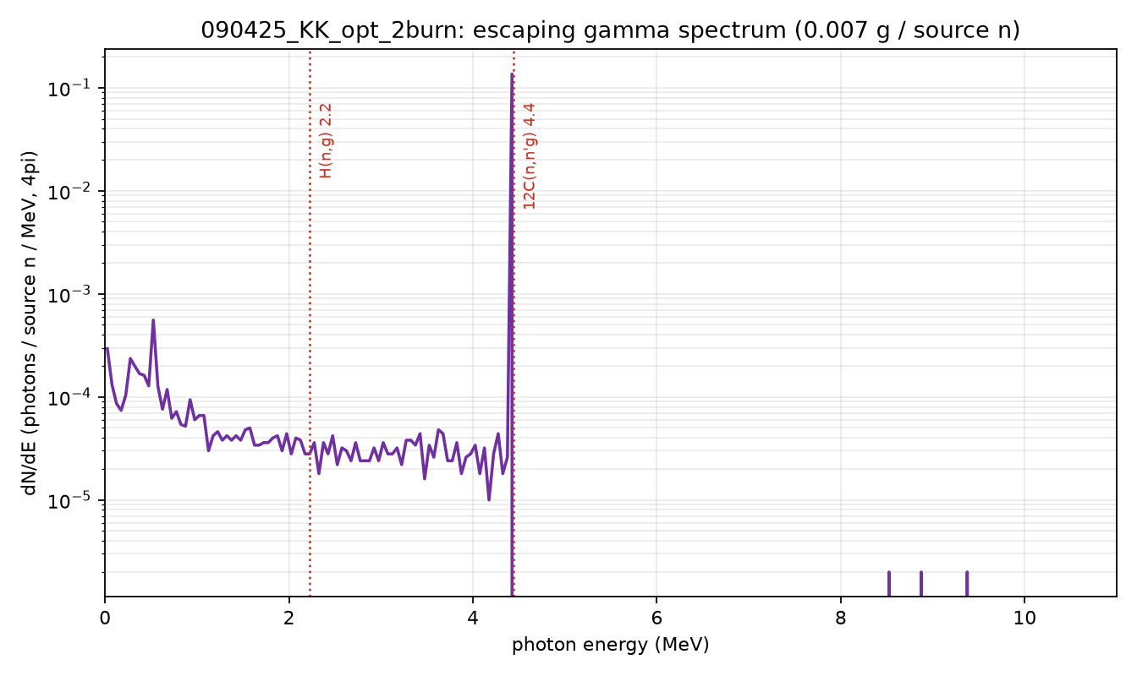
Escaping gammas — the carbon fingerprint
Full-physics run, photons on
0.0070 escaping photons per source neutron.
Dominated by carbon
The ¹²C(n,n′γ) 4.4 MeV inelastic line outweighs the H(n,γ) 2.2 MeV capture line ~540:1.
A clean HDC-ablator diagnostic
The 4.4 MeV line is a quantitative signature of the ablator carbon — an extra handle beyond the neutron spectrum.
MECS

Slide 11
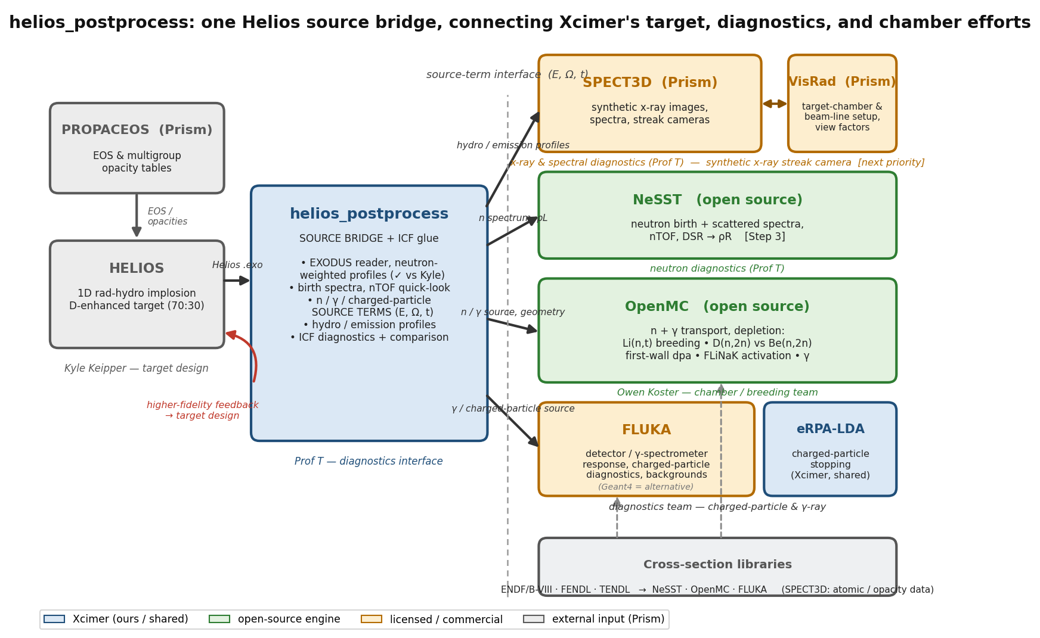
How it connects to the team
A source-term bridge from Helios to the tools each Xcimer team already uses — neutron, x-ray, chamber, and charged-particle.
MECS

Slide 12
Where this goes next — the transport hand-off
The diagnostics above are single-scatter. The next step is to hand a complete birth source to full-transport codes and close the loop on TBR, damage, and detector response.
helios_postprocess (source)
OpenMC (chamber)
FLUKA (detectors)
Birth source: DT 14.06 + DD 2.45 + TT continuum
Exact per-channel yields · (n,2n) multiplication
RHW geometry & material map · number-conserving
→
Neutron transport through blanket & first wall
Tritium breeding ratio (TBR)
First-wall dpa, activation, shielding
Detector & diagnostic response
γ and charged-particle transport
nTOF instrument forward model
How this fits with Kyle's neutronics work
Same starting point. Both chains begin with the Helios run. Kyle owns target design + birth-source extraction (neutronics_output.py) — we reproduce his source term to 0.00%, so the pipelines are anchored to the same numbers.
What we add. within-target scattering — depleted escaping spectrum, DSR→ρR, synthetic nTOF — plus a multi-channel, number-conserving source. Kyle's OpenMC deck consumes exactly this source; we feed his chamber model, not duplicate it.
Division of labor. helios_postprocess = in-target diagnostics + transport-ready source; OpenMC (Kyle / Owen) = chamber, TBR, damage; FLUKA = detector & γ. One source term, three consumers.
MECS

Slide 13
Summary & next steps
DELIVERED
NEXT
Birth → DSR → nTOF in run_analysis; multi-material scatter (carbon, RHW-read).
OpenMC full-physics transport validated on both machines; Helios→OpenMC source/geometry bridge.
DSR switched to the emission-weighted (Method-2) ρR — pipeline now reports 4.5%, matching OpenMC (4.3%); center-to-edge over-predicts (10%).
Yield-unfold exponent ≈ 5 (not 4) for carbon ablators; carbon 4.4 MeV γ signature.
Degraded / under-igniting N210808 to map the Method-1/2 gap and unfold exponent vs yield.
Hand the multi-channel source to OpenMC (TBR, dpa — Kyle / Owen) & FLUKA (detectors).
DT-only source run; settle which ρR the empirical DSR↔ρR calibration is tied to.
Synthetic x-ray streak-camera image (SPECT3D).
Caveat: N210808 shown is a clean-1D over-igniting snapshot (Y≈15.6 vs 1.37 MJ) — demonstrates the method and the corrections, not an experimental match.
MECS

