Slide 1

Introduction to Flask

Slide 2
Framework for building web applications in Python
Can you give me the homepage for myfantasticsite.com?
Here you go!
Hello world
GET https://myfantasticsite.com
<!DOCTYPE html>
<html>
<body>
<h3>Hello world</h3>
</body>
</html>
The browser (client)
The web application (server)
Notes:
That’s really ALL a web application is doing — taking requests from a client, and giving back appropriate responses

Slide 3
Before writing a Flask application . . .
Install Python
Python comes with a package manager called pip
Install virtualenv
pip install virtualenv
Create a directory for your web application
mkdir hello
Activate virtualenv inside your application directory
python -m venv venv

Slide 4
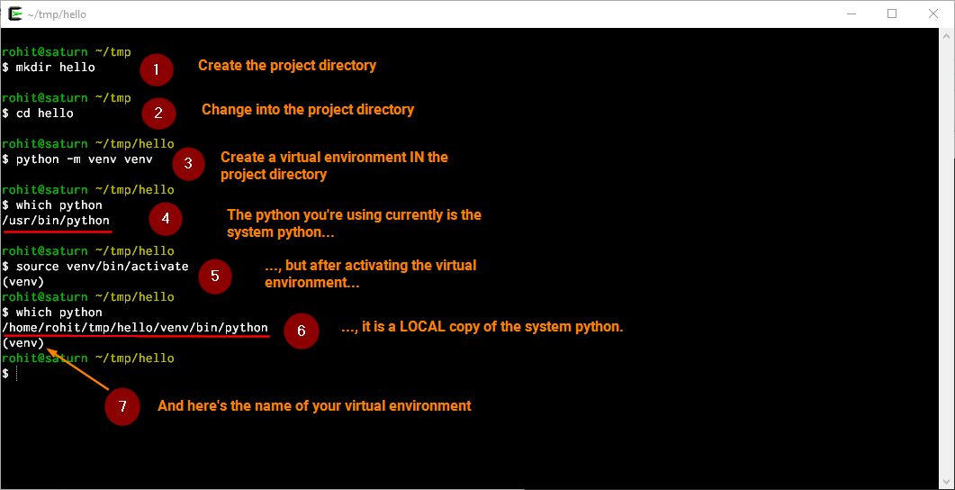
Before writing a Flask application . . .

Slide 5
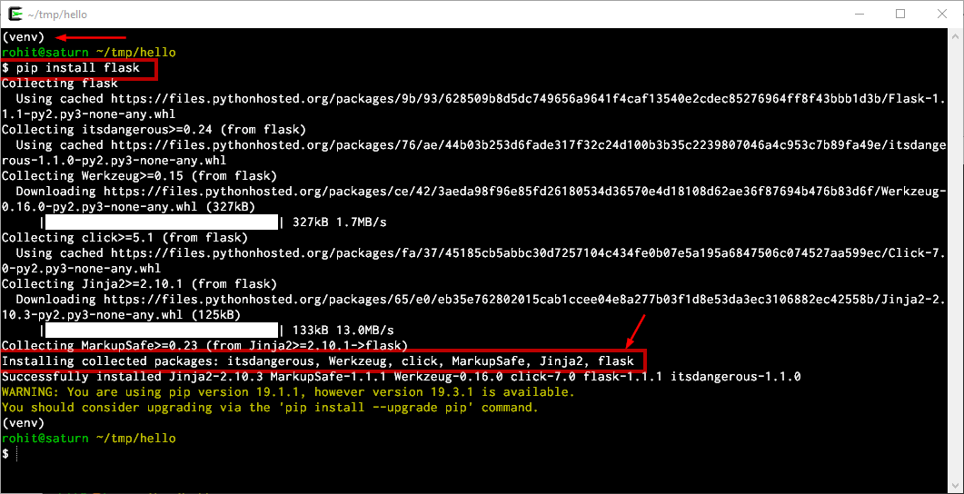
pip install flask

Slide 6
Writing your first Flask application
Create a file called main.py in your project directory . . .
. . . and edit it in your favorite text editor
from flask import Flask
app = Flask(__name__)
app.run(debug=True)

Slide 7
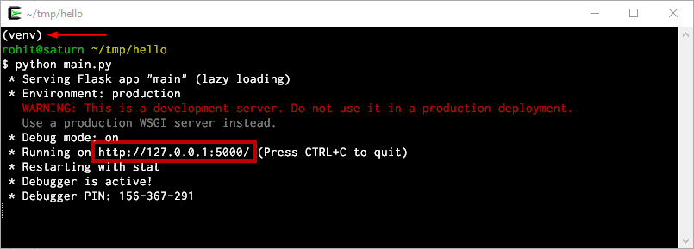
Running your Flask application
Run main.py, and visit http://localhost:5000/ in your browser
Note the /. That’s the route
Notes:
What do you see?

Slide 8
Defining routes
The web server is running at http://localhost:5000, but you didn’t tell it what to return when someone visits the / route
To do that, you have to add a function for the / route
Flask uses Python decorators to define routes
There can be any number of routes in your application

Slide 9
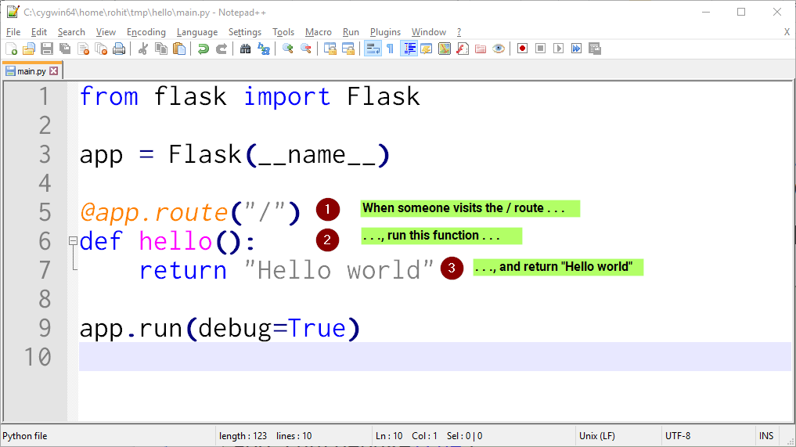
Defining routes
Notes:
Any questions?

Slide 10
Any questions so far?

Slide 11
Quiz time
Redefine the / route, so it says Welcome to my fantastic application!
Define a new route that says Hello world
Routes don’t have to return only single line strings. Define another route that returns a proper HTML response that contains the Hello world text

Slide 12
Resources
Flask documentation — https://palletsprojects.com/p/flask
The Flask Mega Tutorial — https://blog.miguelgrinberg.com/post/the-flask-mega-tutorial-part-i-hello-world ⭐
Explore Flask ebook — http://exploreflask.com/en/latest
More Flask resources — https://www.fullstackpython.com/flask.html

