Slide 1


About Me
4 חודשים לפני
🏥 מאבטח/מוקד ביטחון – בית חולים נהריה
לאחר 5 שנים כמאבטח בבית חולים נהריה החלטתי לשנות כיוון לגמרי ללא שום ידע ורקע בתכנות. נרשמתי לתוכנית לוחמים להייטק לקורס פיתוח תוכנה
היום
תאמר
💻 סטודנט לפיתוח תוכנה
סטודנט לפיתוח תוכנה
Cyberproמכללת
האתגר היה עצום נכנסתי לקורס עם אפס ניסיון קודם וזה דורש ממני למידה עצמית מעבר לשעות הלימוד
📍 יאנוח גת/רמת גן
המטרה
📚 קורס לפיתוח תוכנה
🚀 מפתח תוכנה מלא
🌐 עברית ערבית ואנגלית
אני מאמין שדרך עבודה קשה ובניית פרויקטים אמיתיים ניתן לצמוח מהר יותר ולהשיג מטרות שלא חשבתי עליהם לפני כמה חודשים

Slide 2

Smart Campus Assistant
Capstone Project 2026
AI-Powered Q&A System for Campus Life
FastAPI
Gemini AI
PostgreSQL
Docker
Presented by: Tamer

Slide 3




How the Idea Was Born
1
2
3
4
The Problem
The Idea
Tech Choices
The Result
Students search multiple sources for campus info: exam times, room availability, staff hours. Scattered and inefficient
FastAPI for a fast backend, Google Gemini for AI, PostgreSQL for data, Docker for deployment
What if one system answered any campus question in natural language? A chatbot connected to the real campus database
A full-stack system that answers in Hebrew and English, classifies questions by category, and remembers conversation context

Slide 4
System Architecture
Frontend (Jinja2 SSR + CSS)
index.html · chat.html · admin.html · edit.html · base.html
FastAPI Backend (main.py)
include_router(admin) · include_router(ask_route) · Static files mount
Routes Layer
POST /ask · GET /admin?table= · POST /admin/faq/add · POST /admin/staff/add
Services Layer (ai_service.py)
get_ai_category_and_answer() · Google Gemini 2.5-flash · Structured prompt
Data Layer (SQLAlchemy ORM)
ExamSchedule · Facility · StaffMember · FAQ → PostgreSQL

Slide 5
Database Models — campus.py (SQLAlchemy ORM)
ExamSchedule
table: exam_schedules
Facility
table: facilities
• id: Integer (PK)
• id: Integer (PK)
• course_name: String
• name: String
• exam_date: DateTime
• location: String
• room_number: String
• status: String (default='Active')
StaffMember
table: staff_members
FAQ
table: faqs
• id: Integer (PK)
• office_location: String
• id: Integer (PK)
• name: String
• office_hours: String
• category: String
• role: String
• email: String
• question_topic: String
• answer_text: Text

Slide 6
AI Service — ai_service.py (Google Gemini 2.5-flash)
6 Prompt Rules:
User Question + Conversation History
1
LANGUAGE - Reply in the same language as the question
Fetch All DB Data (4 tables)
2
COMPREHENSIVE SCAN - Read all DB tables before answering
Build Structured Context Prompt
3
CONTEXT AWARENESS - Use full conversation history
Gemini 2.5-flash API Call
4
QUESTION PRIORITIZATION - Last message takes priority
Parse CATEGORY + ANSWER response
5
HELPFUL FALLBACK - Suggest alternatives if not found
6
SMART INFERENCE - Map vague terms to real data

Slide 7
API Endpoint — POST /ask (ask_route.py)
Client
FastAPI
POST /ask { question, history }
FastAPI
AskRequest
Pydantic schema validation
AskRequest
run_in_threadpool
Non-blocking DB access
run_in_threadpool
ai_service
fetch_all_data(db) -> 4 tables
ai_service
Gemini API
Structured prompt with full context
Gemini API
Client
AskResponse

Slide 8
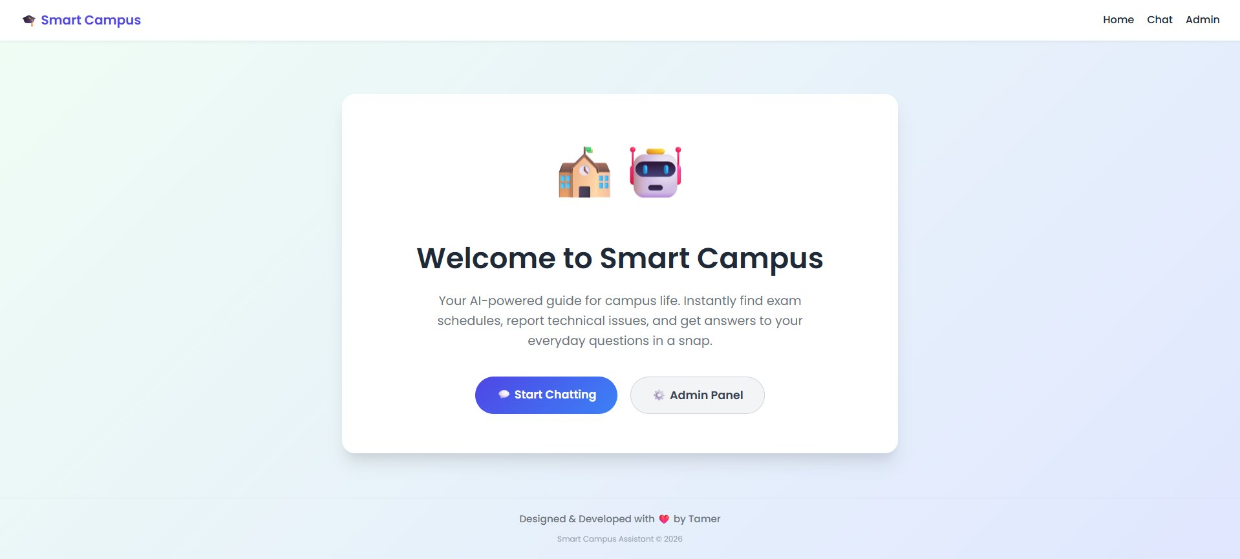
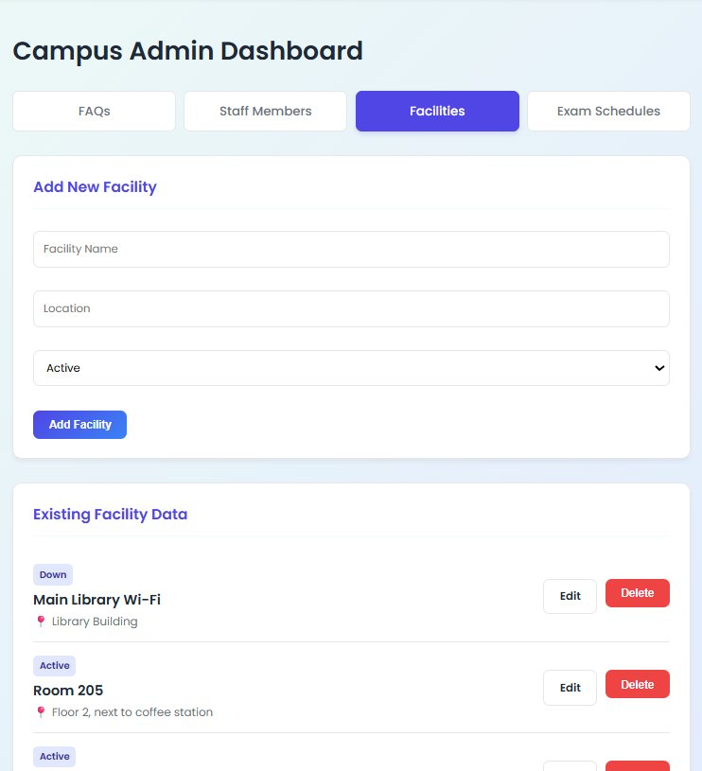
User Interface — Live Screenshots
Home Page — index.html
Admin Dashboard — Facilities Tab
• Floating hero card with campus + robot icons
• Start Chatting / Admin Panel buttons
• Gradient background + Poppins font
• 4 tables: FAQs / Staff / Facilities / Exams
• Full CRUD: Add / Edit / Delete per table
• Status badge (Active / Down)

Slide 9
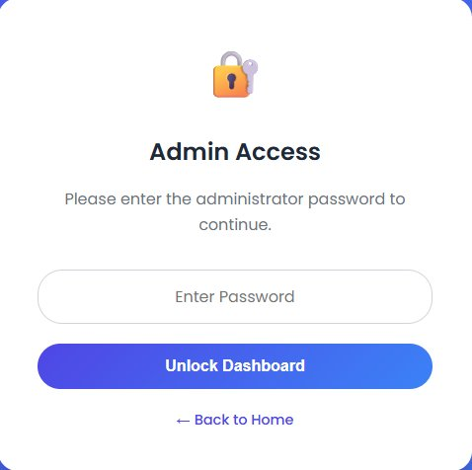
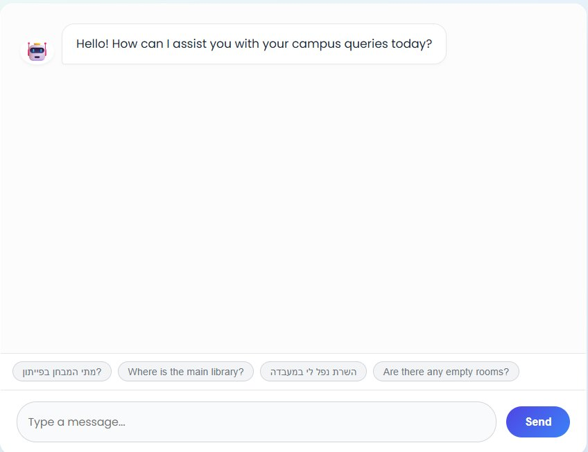
Security & Chat Interface — Live Screenshots
Admin Access — Lock Screen
Chat Interface — Quick Prompts
• Password gate with sessionStorage
• Unlock Dashboard button
• Back to Home navigation
• Greeting message on load
• 4 quick-prompt chips in Hebrew and English
• Type a message input + Send button

Slide 10
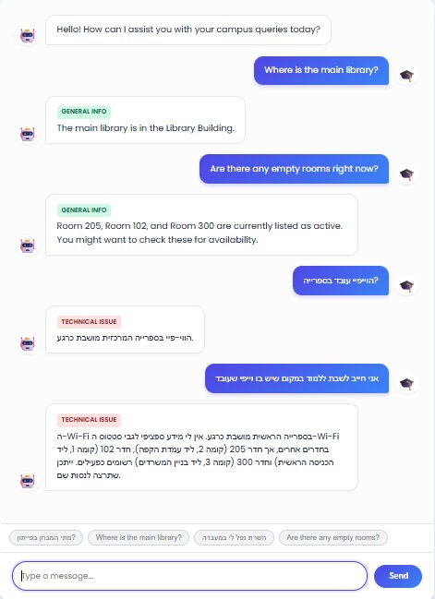
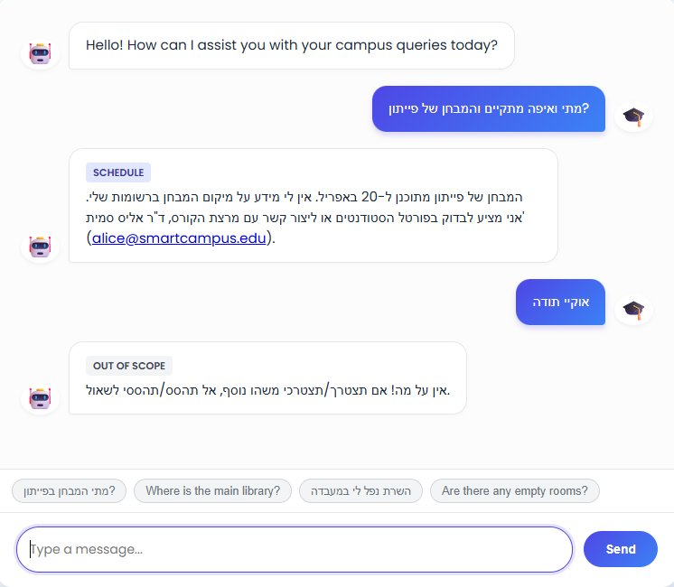
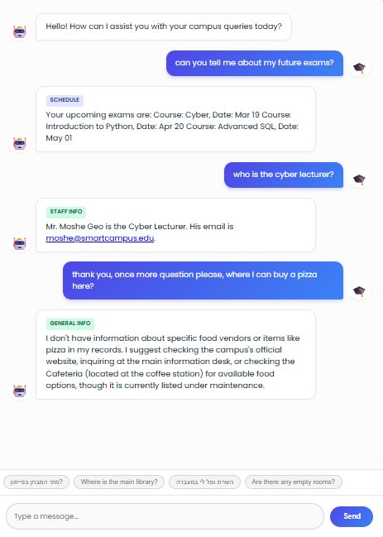
AI in Action — Real Conversations
Hebrew + English Responses
Schedule, Staff & General Info
Out of Scope + Follow-up

Slide 11

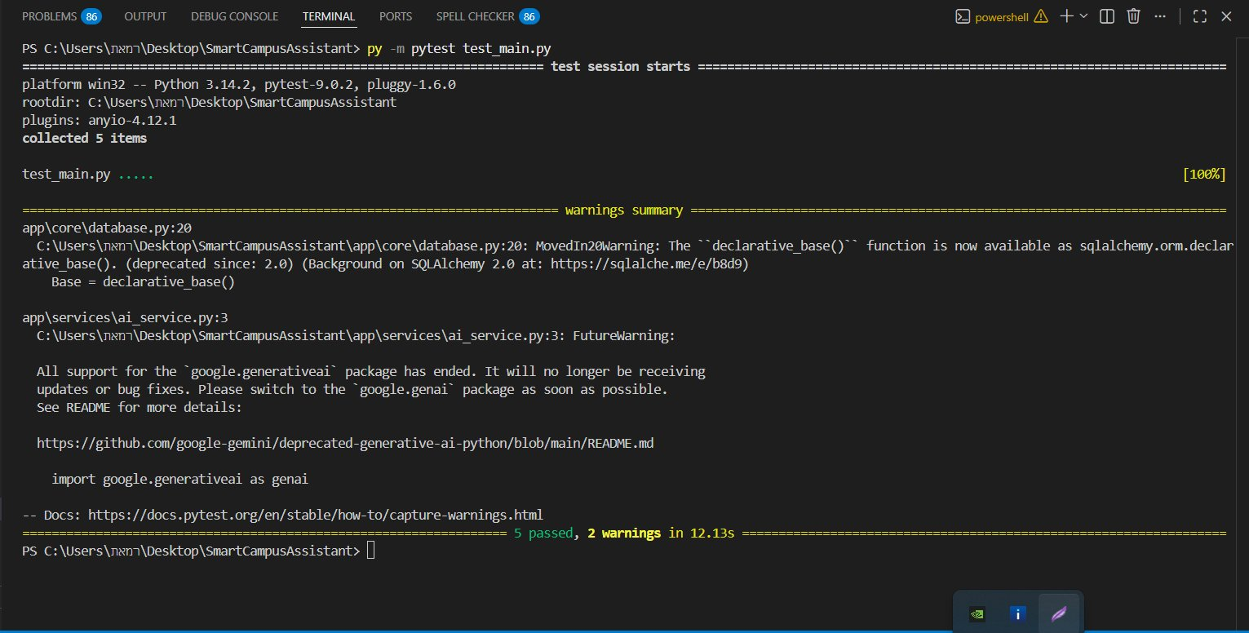
Docker & Testing — Dockerfile + pytest
5 passed in 12.13s
Multi-Stage Dockerfile
Stage 1 — Builder:
FROM python:3.12-slim
pip wheel -> /app/wheels
Stage 2 — Runner:
COPY wheels from builder
COPY application code
EXPOSE 8000
CMD uvicorn app.main:app
Benefit: smaller image size,
no build tools in production
✅ test_ask_valid_question — status 200, answer + category returned
✅ test_ask_empty_question — edge case: empty input handled
✅ test_ask_english_question — multi-language support confirmed
✅ test_ask_out_of_scope — category returns 'Out of Scope'
✅ test_response_time_metric — response_time field in JSON

Slide 12





Tech Stack — requirements.txt + Real Implementation
FastAPI
Google Gemini 2.5-flash
SQLAlchemy ORM
Async routing, Jinja2 SSR, StaticFiles, Uvicorn
google-generativeai · ai_service.py · Prompt eng
PostgreSQL (prod) · psycopg2 · dotenv
Jinja2 + CSS
Docker
pytest + TestClient
SSR templates · Poppins font · CSS custom properties
Multi-stage build · python:3.12-slim · Port 8000
5 automated tests · edge cases · multilang coverage

Slide 13
Project Roadmap — 4-Stage Plan
Stage A
Stage B
Stage C
Stage D
SRS & PM
Project Mgmt
AI Development
Infrastructure
System Requirements Document
UML Diagrams
Work Plan & Scope
Agile Methodology & Backlog
User Cases & User Stories
Gant Chart & Deliverables
FastAPI backend
Gemini integration
Prompt engineering
Admin CRUD
Version Control (Github)
Professional README File
Docker deployment
Cloud & CI/CD
✅ Completed
✅ Completed
✅ Completed
⏳ In Progress

Slide 14
Challenges, Reflection & Future Roadmap
⚡ Challenges & Delays
🔍 What I Would Improve
🚀 Next Steps
Prompt Accuracy
Full Auth System
Stage D — Infrastructure
Finding the right System Prompt balance so Gemini returns a valid Category + Answer format without breaking language rules
Replace the simple password gate with OAuth2 and role-based permissions for lecturers, students, and admins
Complete full cloud deployment (AWS / Google Cloud) and set up an automated CI/CD pipeline
Async DB Sync
Switch to RAG
PDF File Support
Ensuring non-blocking data fetching inside FastAPI using run_in_threadpool to avoid slowing down user response time
As data grows, move to Vector Search (Vector DB) instead of sending the entire DB in the prompt - saves tokens and improves accuracy
Allow students to upload syllabi and lecture notes - AI will answer questions based on their content
Learning Docker
React Frontend
Personal Schedule API
Implementing a multi-stage build from scratch with no prior background - required significant self-study to reach an optimized image
Replace Jinja2 with React for a smoother SPA experience without full-page reloads on every interaction
Connect to the college's timetable API so students can query their own personal schedule through chat

Slide 15
Thank You!
Smart Campus Assistant — What Was Built:
FastAPI + Gemini 2.5-flash
4 SQLAlchemy DB Models
Full Admin CRUD Panel
Docker Multi-stage Build
5 Automated Unit Tests
Hebrew + English AI Chat
Questions & Answers
Github: https://github.com/tamerab1/Smart_Campus_Project | Smart Campus Assistant © 2026

