Slide 1


Detecting Fraud in the Graph
Graph neural networks + XGBoost, running entirely on one NVIDIA GB10
24.4 million card transactions · 589,000 scored per second · a regulator-grade explanation for every decision · no cloud, no network
MONEY20/20 MIDDLE EAST · RIYADH · 14–16 SEPTEMBER 2026
Notes:
Open by putting a hand on the box. The hardware is the story: this entire system runs on one desktop machine, disconnected.

Slide 2
ONE MACHINE
Four financial-services demos, all on-device
Fraud detection
Graph neural network + XGBoost scoring card transactions in real time, with a Shapley explanation behind every decision.
589,528 txn/sec · F1 0.958
Portfolio optimisation
Mean-CVaR optimisation on NVIDIA cuOpt — robust tail-risk allocation fast enough to iterate on, not batch overnight.
18x vs CPU · same optimum
Document intelligence
Arabic financial document extraction into tables, text and a knowledge graph — the KYC and trade-finance back office.
on-device OCR + LLM
Loan origination
A 7B vision-language model reading identity and income documents, with a state machine driving approval and deterministic cross-document fraud checks.
fine-tuned Qwen2.5-VL-7B
No cloud. No network at run time. One NVIDIA GB10 on the table.
02 / 24
Notes:
Set the frame: this is a platform claim, not one demo. Then go deep on fraud.

Slide 3
THE PROBLEM
One fraud in every 819 transactions
A model that says “never fraud” is 99.88% accurate — and worthless.
In the IBM TabFormer dataset: 24,386,900 transactions, 29,757 of them fraudulent. A base rate of 0.122%.
Extreme imbalance breaks conventional accuracy thinking.
The cost of a miss and the cost of a false alarm are wildly asymmetric, and both are business decisions, not model settings.
Fraud does not look unusual on its own row.
The fraudulent transactions in this dataset are mostly ordinary amounts at ordinary times. Nothing in the row screams fraud.
So the signal is not in the transaction. It is in the relationships around it.
03 / 24
Notes:
Set up the imbalance honestly and early. It is the reason the rest of the approach exists.

Slide 4
WHAT THE DATA SAYS
The strongest fraud signals are entities, not amounts
Correlation with the fraud label, measured during preprocessing of all 24.4M rows:
Merchant state
35.9%
Merchant identity
34.9%
Merchant city
32.5%
Postal code
15.0%
Merchant category (MCC)
12.7%
Card / cardholder
6.6%
Day of month
0.3%
Month
0.2%
Where and with whom — not when, and not how much. That is a graph problem.
04 / 24
Notes:
These numbers came out of our own preprocessing run, not a paper. They justify the architecture.

Slide 5
THE APPROACH
Model the transaction graph, then classify
1 Build the graph
Cardholders, transactions and merchants become nodes. Every payment becomes edges: user → transaction → merchant. 301,524 training transactions across 4,873 cardholders and 42,942 merchants.
2 Learn the neighbourhood
A GraphSAGE network aggregates each transaction's neighbourhood into an embedding — so a transaction is represented by the company it keeps, not just its own fields. 2 hops, 32 hidden channels.
3 Classify and explain
XGBoost scores the embeddings, and Shapley value sampling attributes each decision back to human-readable feature groups. Every score arrives with its reasons.
Temporal split, not random: train before 2018, validate on 2018, test after. It is a backtest.
05 / 24
Notes:
The temporal split matters to anyone who has been burned by leakage. Say it unprompted.

Slide 6
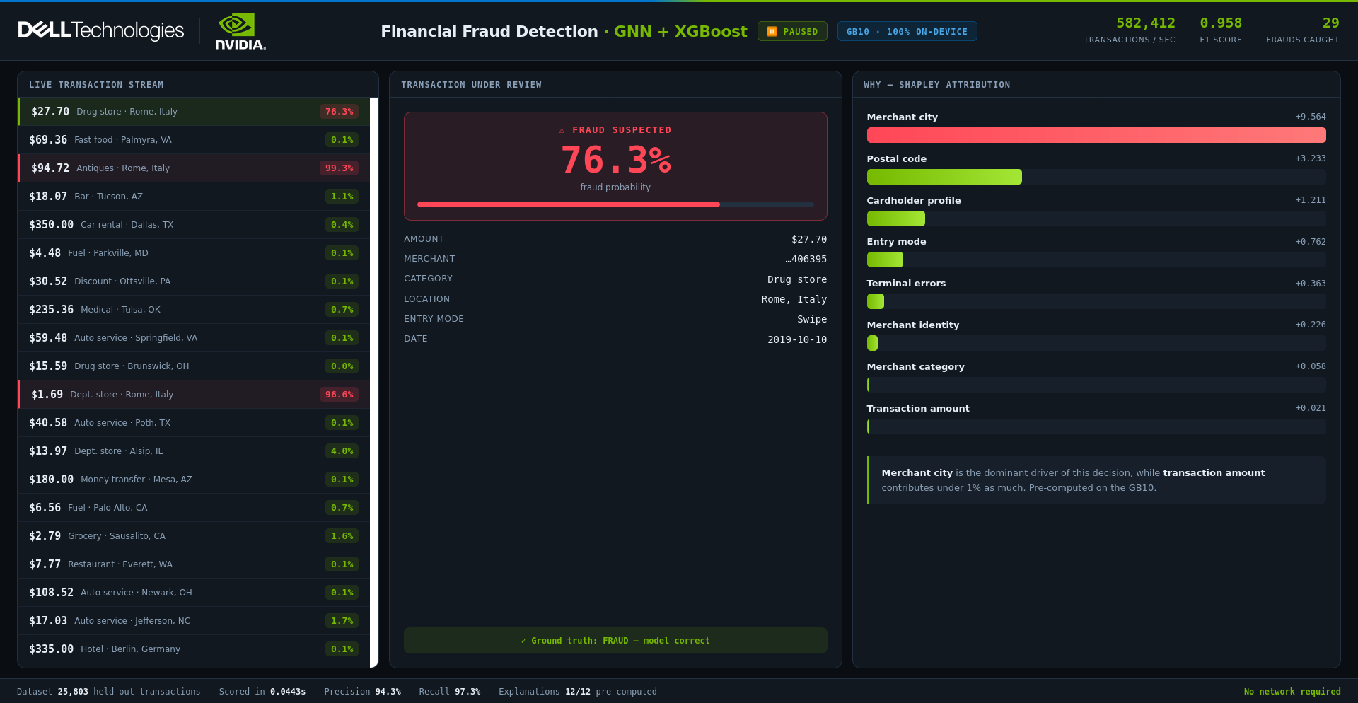
THE DEMO
What the booth screen shows
Left: transactions scoring in real time. Centre: the flagged transaction and its real details. Right: why it was flagged.
06 / 24
Notes:
Live output from the running system, captured on the GB10 - not a mockup. Everything on this slide is reproducible on the stand.

Slide 7
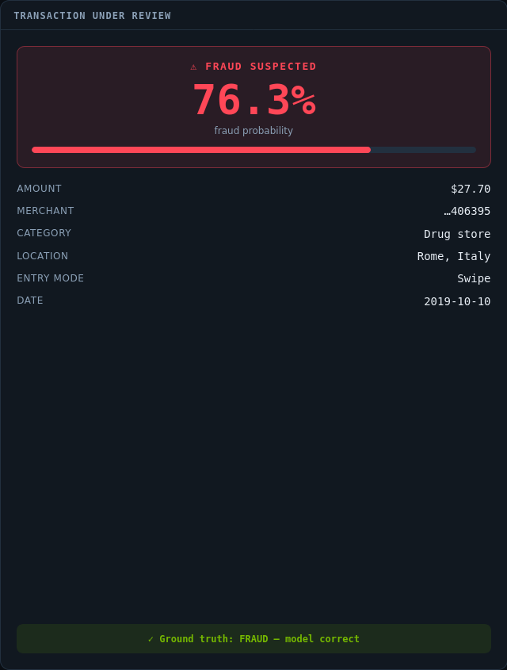
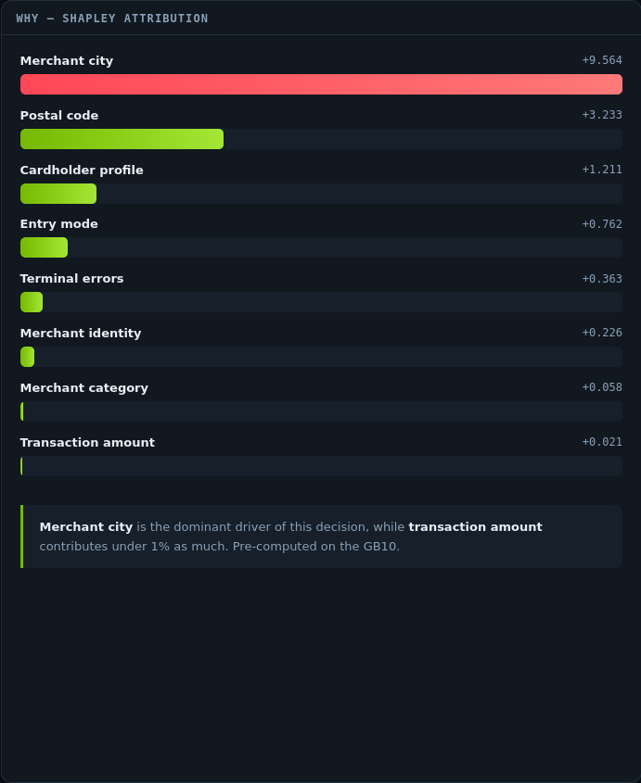
THE MOMENT
An ordinary amount, flagged at 99.5%
Read the bars, not the numbers.
Merchant city dominates the decision. Postal code follows. Transaction amount contributes under 1% as much — a sliver.
A rules engine watching for large or unusual amounts never sees this transaction.
The fraud is not in the payment. It is in the company the payment keeps.
07 / 24
Notes:
This is the emotional centre of the pitch. Let the bar chart do the talking: full-width red at the top, a sliver at the bottom for amount.

Slide 8
MEASURED ON THE BOX
Performance on a single NVIDIA GB10
589,528
transactions scored per second
25,803 in 0.044 s
0.958
F1 score
precision 94.3% · recall 97.3%
41.7 s
to preprocess 24.4M rows
graph construction on GPU
23.0 s
to train end to end
GNN + XGBoost
3.3 s
per live explanation
Shapley, computed on demand
9.4 s
full power-cycle recovery
container restart to serving
Portfolio optimisation: 18x vs CPU on a 51,502-variable LP. Document intelligence: full OCR, graph and vector pipeline on the same machine.
08 / 24
Notes:
Every figure here was measured on this machine. None of it is from a datasheet.

Slide 9
WHY EXPLAINABILITY IS THE PRODUCT
A score a bank cannot justify is a score it cannot use
Every decision carries its reasons.
Shapley attribution runs per transaction, not as a dataset-level feature-importance chart. “Why was this card declined?” has an answer.
Attribution is grouped into human language.
Not 38 anonymous encoded columns — merchant city, postal code, entry mode, terminal errors, transaction amount.
It supports the conversation with the regulator and the customer.
Adverse-action explanation, dispute handling, model risk documentation and audit all need the same thing: a defensible reason.
It also exposes the model's mistakes.
The demo displays ground truth on every transaction, including its 123 false positives and 56 misses. Confidence, not concealment.
09 / 24
Notes:
In SAMA-regulated institutions this is the difference between a pilot and production.

Slide 10
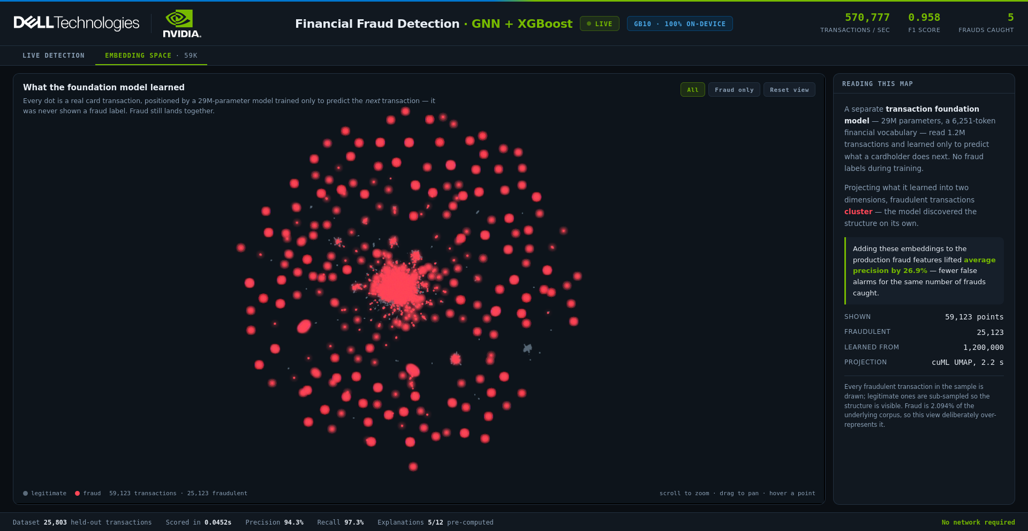
BEYOND SUPERVISED LEARNING
A foundation model for spending
29M parameters. A 6,251-token financial vocabulary. Trained only to predict a cardholder's next transaction — never shown a fraud label.
Fraud clusters anyway.
Adding these embeddings to the production fraud features lifted average precision by 26.9% — fewer false alarms at the same catch rate.
Embeddings alone score far worse than plain features. They complement feature engineering; they do not replace it.
59,123 transactions from a 1.2M corpus · projected with cuML UMAP in 2.2 s on the GB10
10 / 24
Notes:
The GenAI angle. Say plainly that embeddings complement rather than replace - a data scientist will ask, and the honest answer is the stronger one.

Slide 11
Where this applies
The demo is card fraud. The architecture is a pattern for any problem where the answer lives in relationships.
11 / 24
Notes:
Transition: stop selling the demo, start selling the pattern.

Slide 12
USE CASE 01
Payment fraud at authorisation
Score every card transaction in the authorisation window, with the reason attached.
WHAT CHANGES
Nothing — this is the demonstrated system.
THE GRAPH
Cardholder → transaction → merchant.
WHY GRAPH WINS
Catches ordinary-looking amounts at compromised merchants that amount-and-velocity rules miss.
OPERATIONAL FIT
Sub-millisecond scoring leaves budget for the rest of the authorisation path.
STATUS Demonstrated today
12 / 24
Notes:
Be explicit about what is built versus what is architecturally adjacent. Credibility depends on not blurring the two.

Slide 13
USE CASE 02
Money laundering and mule networks
Find the structure, not the suspicious individual: layering chains, mule rings, circular flows.
WHAT CHANGES
Node types become accounts and counterparties; edges become transfers with amount and timing.
THE GRAPH
Account → transfer → account, across institutions where data sharing permits.
WHY GRAPH WINS
Mule networks are invisible per-account and obvious as a subgraph. This is the canonical GNN case.
OPERATIONAL FIT
Batch scoring over a transfer window; explanations support the STR narrative.
STATUS Strong architectural fit — not yet built
13 / 24
Notes:
Be explicit about what is built versus what is architecturally adjacent. Credibility depends on not blurring the two.

Slide 14
USE CASE 03
Merchant and acquirer risk
Score the merchant, not just the payment: onboarding risk, transaction laundering, bust-out patterns.
WHAT CHANGES
Predict on the merchant node instead of the transaction node.
THE GRAPH
Merchant ↔ shared cardholders, terminals, beneficial owners, settlement accounts.
WHY GRAPH WINS
Fraudulent merchants are identifiable by who they share customers and infrastructure with.
OPERATIONAL FIT
Daily or weekly re-scoring; feeds portfolio monitoring and onboarding decisions.
STATUS Same node-prediction pattern
14 / 24
Notes:
Be explicit about what is built versus what is architecturally adjacent. Credibility depends on not blurring the two.

Slide 15
USE CASE 04
Account takeover and synthetic identity
Detect accounts that behave like a network artefact rather than a person.
WHAT CHANGES
Add device, session and identity-attribute nodes to the graph.
THE GRAPH
Customer ↔ device ↔ session ↔ shared attributes (address, phone, employer).
WHY GRAPH WINS
Synthetic identities are built from recombined real attributes — the reuse is only visible across accounts.
OPERATIONAL FIT
Real-time at login and step-up; explanations justify the friction applied.
STATUS Requires additional data sources
15 / 24
Notes:
Be explicit about what is built versus what is architecturally adjacent. Credibility depends on not blurring the two.

Slide 16
Demo two — Portfolio optimisation
The same box, a different discipline: robust tail-risk allocation on NVIDIA cuOpt.
16 / 24
Notes:
Transition. This widens the conversation from fraud ops to treasury and wealth.

Slide 17
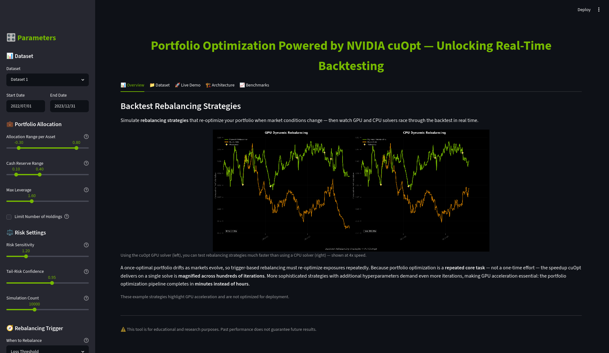
PORTFOLIO OPTIMISATION
Robust allocation, fast enough to iterate
Mean-CVaR asks a harder question than mean-variance: on the worst 5% of days, how much do I lose? Answering it means simulating tens of thousands of futures.
11.7 s
GPU · cuOpt
211.7 s
CPU · CVXPY
18x
faster, same optimum
500 assets × 50,000 scenarios — an LP with 51,502 variables.
Rebalancing is a repeated task, not a one-off. Across hundreds of backtest solves, that gap turns an overnight job into a morning's work.
17 / 24
Notes:
Lead with the cuOpt solve, never with scenario generation - cuML KDE is not faster than sklearn at demo scale. And never demo below ~500 assets: at toy sizes the GPU loses.

Slide 18
Demo three — Document intelligence
Arabic financial documents into structured data — on the same box, still offline.
18 / 24
Notes:
The back-office story. Strongest regional differentiator of the three.

Slide 19
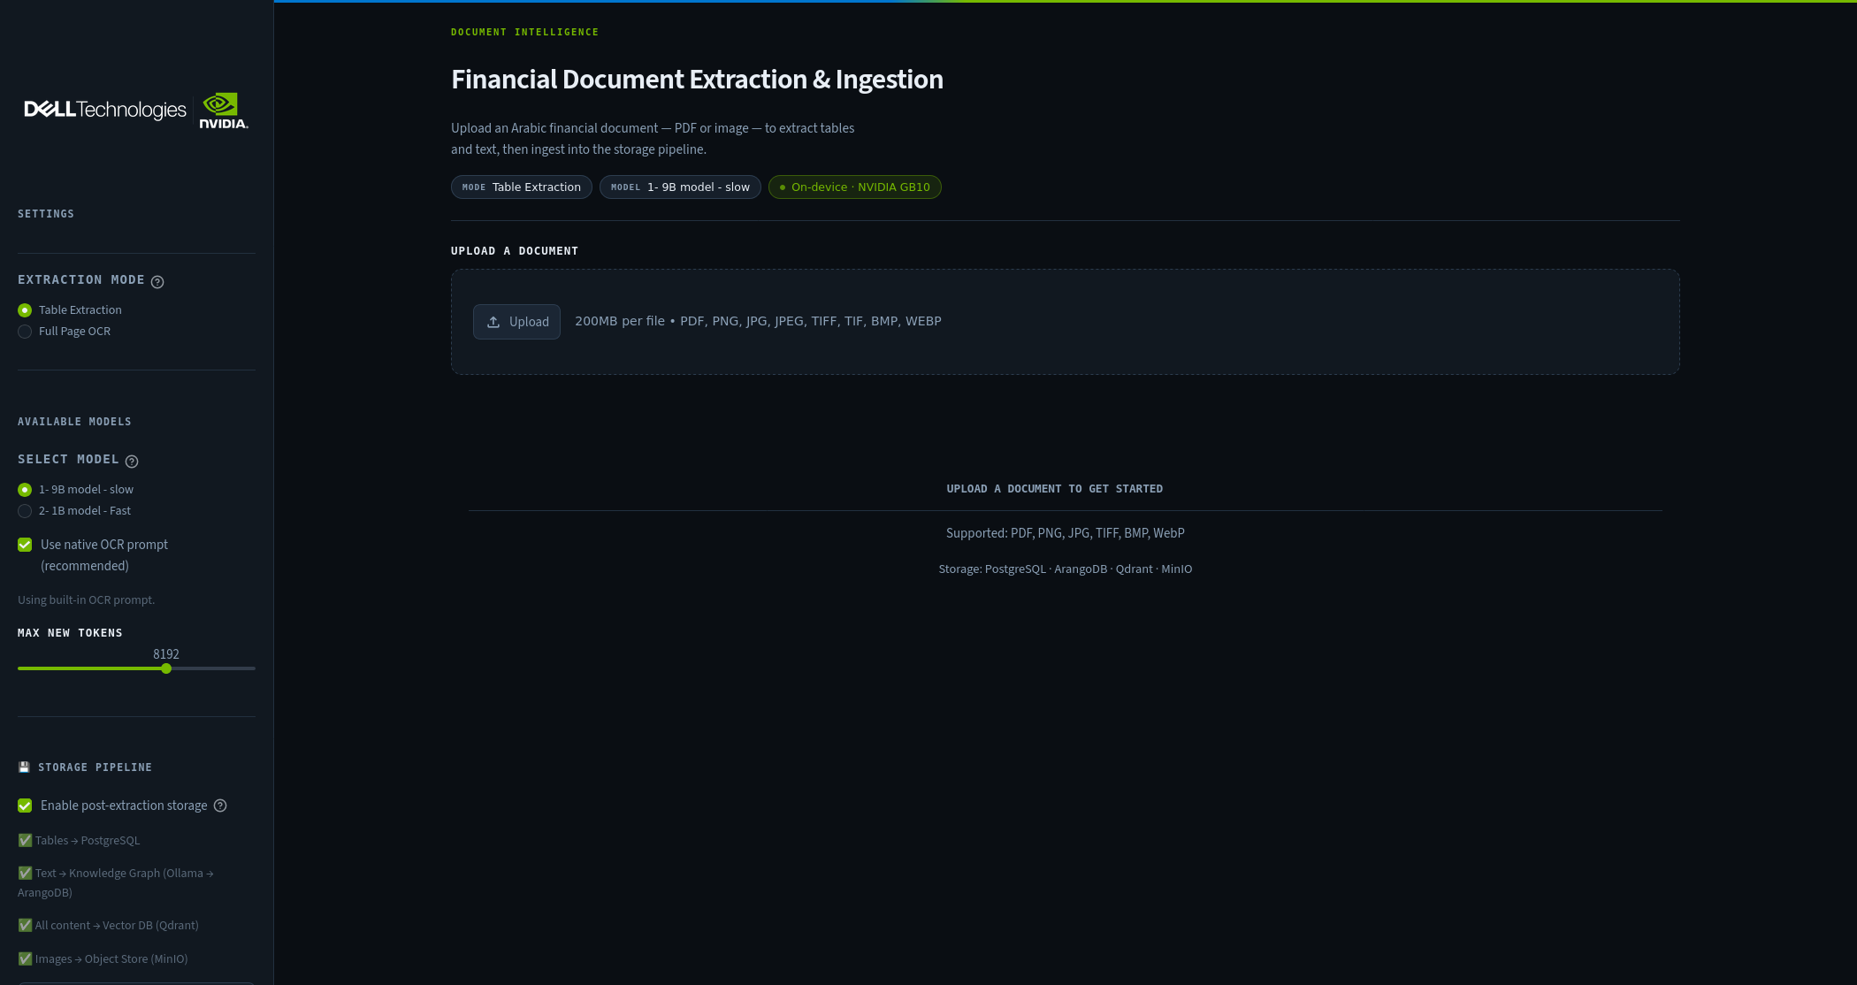
DOCUMENT INTELLIGENCE
Arabic documents into tables, text and a graph
KYC files, trade-finance paperwork and account-opening packs arrive as scans — often in Arabic, often as tables no rules engine can read.
The pipeline
· Layout detection and OCR on the page
· Tables → PostgreSQL, structured and queryable
· Text → knowledge graph (Ollama → ArangoDB)
· All content → vector store (Qdrant) for retrieval
· Source images → object store (MinIO)
Every model runs on the GB10. No document leaves the building.
19 / 24
Notes:
Arabic table extraction is the differentiator - most vendors on that floor will not have it.

Slide 20
Demo four — Loan origination
A vision-language model reading the documents a loan officer reads, and a state machine making the decision auditable.
20 / 24
Notes:
Retail banking. Pairs naturally with document intelligence - same box, deeper workflow.

Slide 21
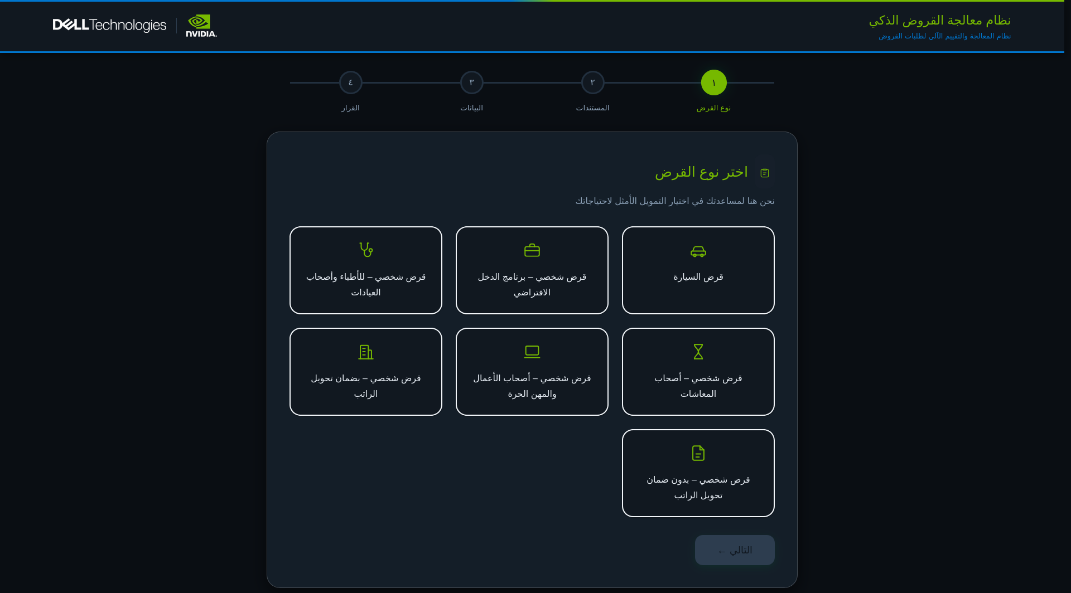
LOAN ORIGINATION
From document upload to an auditable decision
01 Capture
Applicant uploads identity and income documents.
02 Read
A fine-tuned 7B vision model reads each one natively — no OCR-then-parse, no per-template rules.
03 Cross-check
Deterministic validation across documents: name, employer, declared income.
04 Decide
A state machine walks the approval path and records why.
Fine-tuned on Egyptian documents: LoRA r=64, 4 epochs, eval loss 0.139, on Qwen2.5-VL-7B-Instruct.
The cross-document checks are arithmetic, not model output — so the model can be wrong without the decision being unsafe.
21 / 24
Notes:
The deterministic cross-document check is the strongest point for a regulated buyer: the model extracts, but the decision rests on arithmetic that cannot hallucinate. Adapter status is visible at /health - confirm it says '+ LoRA' before demoing.

Slide 22
WHY IT RUNS ON ONE BOX
Data residency without a cloud dependency
The entire system is on-device.
Dataset, preprocessing, training, inference and explanation all run on a single GB10. During the demo the network cable is unplugged and nothing changes.
No transaction data leaves the institution — or the Kingdom.
That removes the cross-border data-transfer question from the procurement conversation entirely, rather than answering it.
Deployable where the data already is.
A desktop-class box fits in a branch, a data centre rack, or a regional processing site without redesigning the estate.
Recovery is measured in seconds.
Full restart to serving in 9.4 seconds, with automatic restart on power loss.
22 / 24
Notes:
For Saudi institutions this is often the deciding factor, ahead of model quality.

Slide 23
WHAT WE ARE NOT CLAIMING
The caveats, stated first
These metrics come from a rebalanced benchmark, not production conditions.
The held-out set runs at 8.09% fraud; the true base rate is 0.122%. At the real rate, false-positive economics change materially. Any pilot must be re-measured on live distributions.
Training undersamples the majority class.
A 0.1 fraud ratio with computed class weights. Standard practice for extreme imbalance, and a deliberate modelling choice rather than a hidden one.
The dataset is public and synthetic-adjacent.
IBM TabFormer, Apache 2.0. It demonstrates the method; it is not a proxy for any institution's own fraud patterns.
A production deployment needs the surrounding system.
Case management, feedback loops, model monitoring, champion/challenger and drift detection are all out of scope for this demo.
23 / 24
Notes:
Volunteering this early buys more trust than it costs. Risk teams will find it anyway.

Slide 24
NEXT STEPS
From demo to pilot
Run it on your data.
The pipeline is three commands and roughly a minute of compute for a dataset this size. The graph schema adapts to your transaction model.
Choose the use case with the clearest data.
Payment fraud and merchant risk need only data an issuer or acquirer already holds. AML and identity graphs need more sourcing.
Measure at the true base rate from day one.
Agree the false-positive budget with the fraud operations team before tuning anything.
Deploy where the data lives.
One GB10 per site, or scale up the same containers on larger NVIDIA infrastructure — the stack is identical.
Built on the NVIDIA AI Blueprint for Financial Fraud Detection · IBM TabFormer dataset (Apache 2.0) · running on NVIDIA GB10
24 / 24
Notes:
Close on the box again. Offer to run their schema through it.

