Slide 1
Fraud Detection Case Study
Tamer Tahamoqa

Slide 2
Download links
GitHub repository: link
Data and trained models Google Drive: link

Slide 3
Outline
Utilized Software Packages
Data Exploration
Modeling Experiments
Baseline
SMOTE
Adding Temporal Features
Main Insights and Deliverables
Next Steps

Slide 4
Utilized Software Packages
Workstation with Ubuntu 18.04 environment
Python 3.12 environment
Jupyter Notebook (for code development and running)
Pandas (reading and modifying comma separated files)
Scikit-learn (for data engineering and training machine learning models)
Autogluon (open-source AutoML framework by AWS)
Dython (associations plot)
Seaborn (plots)
Utilized ChatGPT5 for brainstorming ideas and for some code generation

Slide 5
Data Exploration
Stages
Basic descriptive statistics
Specifying column types: target, numerical columns, and categorical columns
Checking for erroneous values in the columns
Cleaning extra ‘ character in categorical columns
Checking "Fraud" label distribution
Feature Associations plot
Checking columns with high correlation with target column

Slide 6
Data Exploration
Basic descriptive statistics
Data contains 594,643 records
Data contains 10 columns
step: unit of time (records for the same customer can have the same step)
customer: customer id
age: Age of customer - categorical values
gender: Age of customer - categorical values
zipcodeOri: Zip code of transaction (only one value in the data)
merchant: merchant id
zipMerchant: Zip code of merchant (only one value in the data)
category: transaction category
amount: Amount of the purchase
fraud: target label (non-fraudulent vs fraudulent)
No null values were found
No duplicate values were found

Slide 7

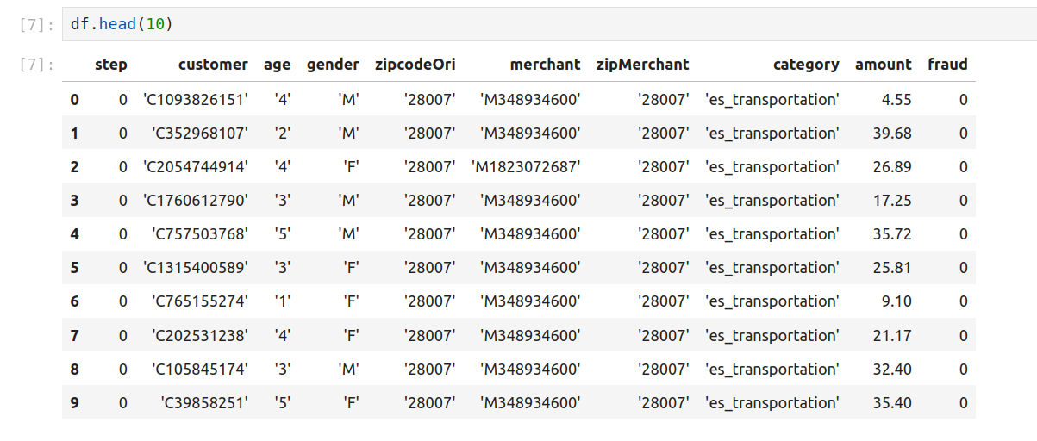
Data Exploration

Slide 8
Data Exploration
Specifying column types:
Target
fraud
Numerical columns
step
amount
Categorical columns
customer
age
gender
zipcodeOri
merchant
zipMerchant
category

Slide 9
Data Exploration
Checking for erroneous values in the columns
Only found one extra erroneous ‘ character in categorical columns
Cleaned it
Did not find unreasonable numerical values
Assumed zero values for “amount” to be correct
Checking "Fraud" label distribution
High imbalance present in the target label
non-fraudulent: 587,443 records (98.79% of records)
fraudulent: 7,200 records (1.21% of records)

Slide 10
Data Exploration
Feature Associations plot
Associations plot by Dython framework
numerical-numerical metric: pearson metric
nominal-nominal metric: cramer metric
numerical-nominal metric: correlation ratio metric

Slide 11
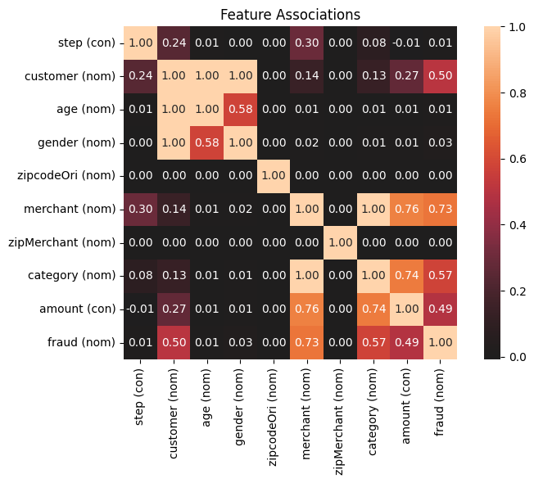
Data Exploration - Associations Plot

Slide 12
Data Exploration
Checking columns with high correlation with target column
amount
category
customer
merchant

Slide 13
Data Exploration
Checking columns with high correlation with target column
amount
fraudulent records tend to have significantly higher amount values
fraudulent
mean: 530.926551
median: 319.175
non-fraudulent
mean: 31.847230
median: 26.61
Statistical significance between the two amount distributions was verified with Kolmogorov–Smirnov (K–S) Statistical Test
KS-statistic: 0.8318216467148491
p-value: 0.0
Assuming 5% significance level -> null hypothesis of two distributions being the same is rejected (p-value < 0.05)

Slide 14
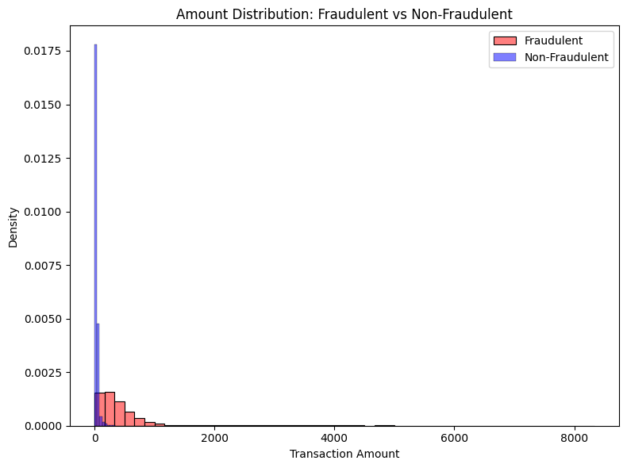
Data Exploration - Amount

Slide 15
Data Exploration
Checking columns with high correlation with target column
category
15 unique categories.
3 categories (20%) had no "fraudulent" transactions.
12 categories (80%) had at least one "fraudulent" transaction.
8 categories (53%) had >= 5% of their transactions as being fraudulent.

Slide 16
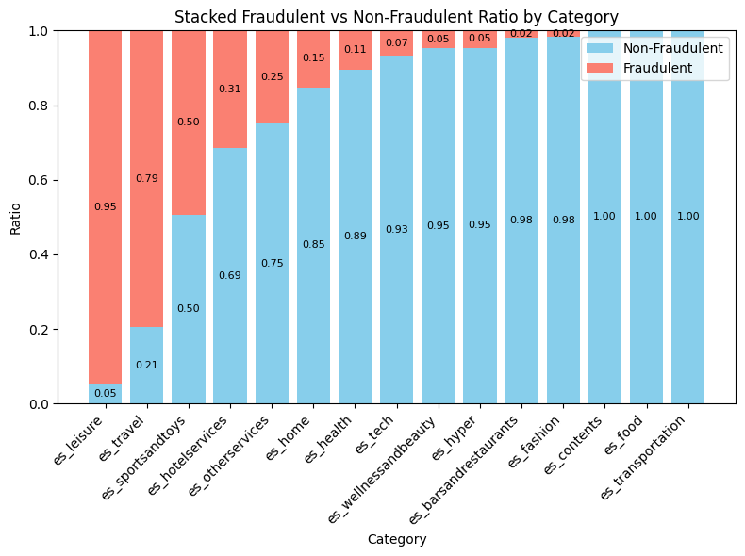
Data Exploration - Category

Slide 17
Data Exploration
Checking columns with high correlation with target column
customer
4,112 unique customers.
2,629 customer (63.9348%) had no "fraudulent" transactions.
1,483 customers (36.0651%) had at least one "fraudulent" transaction.
393 customers (9.56%) had >= 5% of their transactions as being fraudulent.

Slide 18
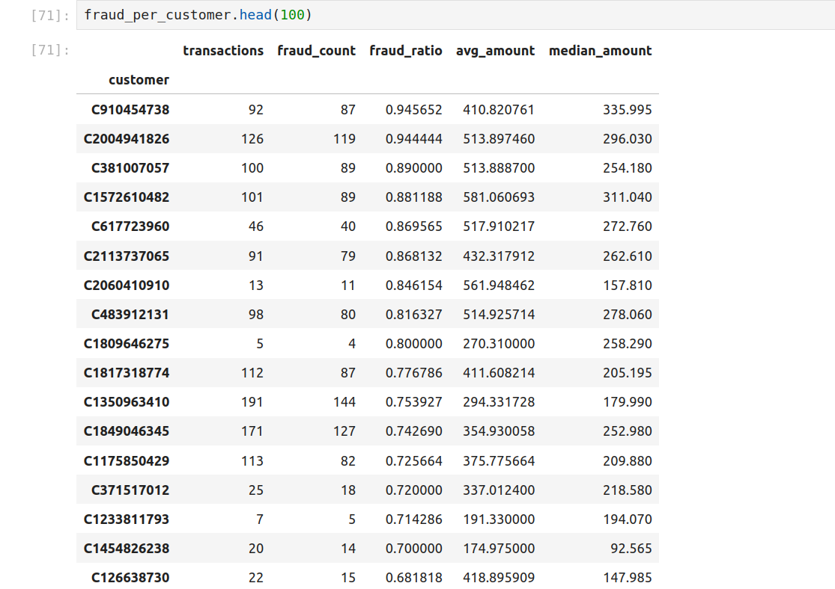
Data Exploration - Top fraudulent customers

Slide 19
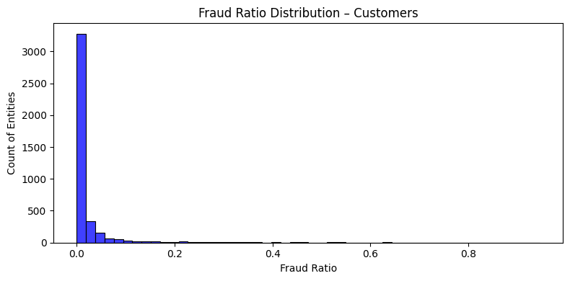
Data Exploration - Customer

Slide 20
Data Exploration
Checking columns with high correlation with target column
merchant
50 unique merchants.
20 merchants (40%) had no "fraudulent" transactions.
30 merchants (60%) had at least one "fraudulent" transaction.
25 merchants (50%) had >= 5% of their transactions as being fraudulent.

Slide 21
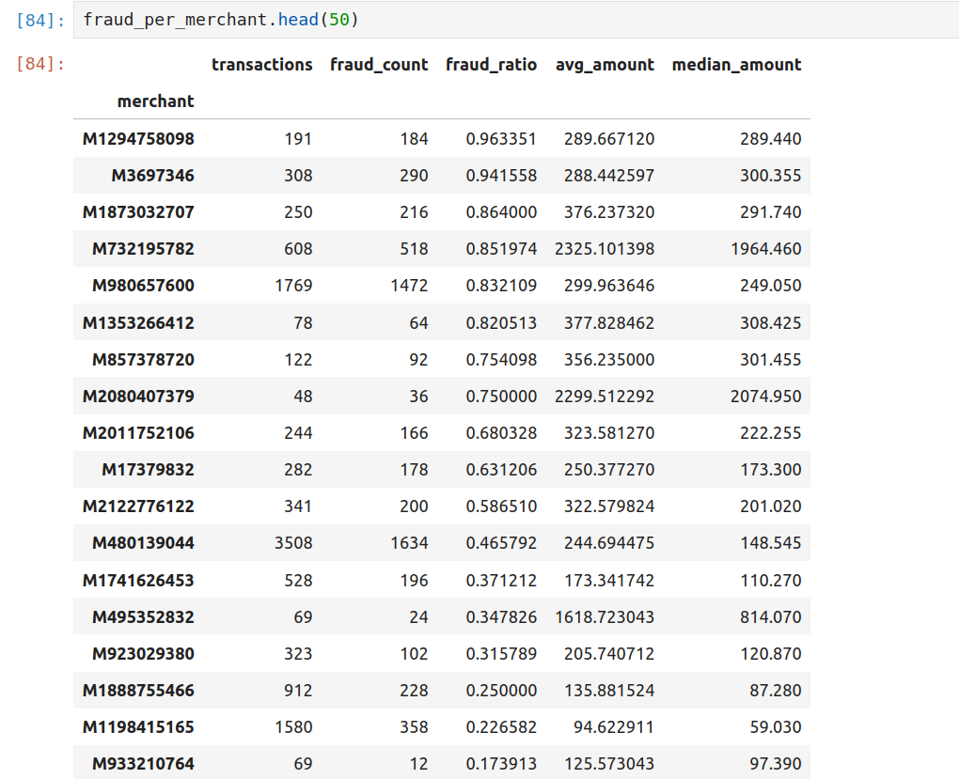
Data Exploration - Top fraudulent merchants

Slide 22
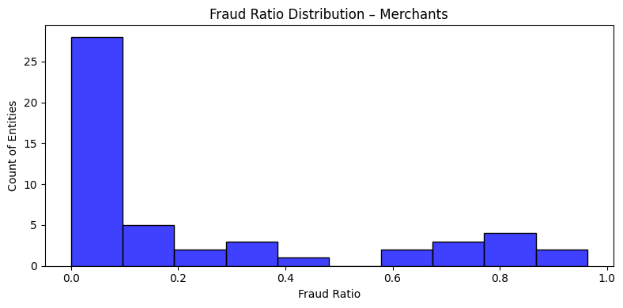
Data Exploration - Merchant

Slide 23
Data Exploration
General insights based on analysis:
High imbalance present in the "Fraud" target label
non-fraudulent: 587,443 records (98.7892% of records)
fraudulent: 7,200 records (1.2108% of records)
There is a general trend of higher amount values being positively correlated with being labeled as "fraudulent".
There are customers, merchants, and categories that have a very large ratio of fraudulent transactions.
Most likely due to having larger amount values.
Most likely related to the labeling logic of the data.

Slide 24
Data Exploration
General insights based on analysis:
Training/validation/test dataset splits will be conducted based on customer id, to avoid data leakage; one customer's transactions will only exist in either training, validation, or test, no overlapping records in the sets.
Columns most likely to be dropped:
customer (assuming id should not be included within the predictive model)
merchant (assuming id should not be included within the predictive model)
zipcodeOri (only one value)
zipMerchant (only one value)
Zero amount values assumed to be correct -> validation with the business regarding correct values of the data may be required

Slide 25
Modeling Experiments
Three modeling experiments were conducted
Baseline
SMOTE (Synthetic Minority Over-sampling Technique)
Adding Temporal Features (Time features per customer)
Three classification models were trained on each experiment
Logistic Regression (baseline)
XGBoost
Autogluon Tabular Predictor (ensemble of 12 models including XGBoost)
The data was split into an 80/10/10 train/validation/test split based on customer id.
StratifiedGroupKFold splitting method was used to ensure the ratios of fraud for all sets were as close to each other as possible.
An entire customer’s records would only be in only one of the sets.
Done to avoid data leakage.
The train, validation, and test sets, were the same for all experiments.

Slide 26
Modeling Experiments
Train/validation/test splits
Train
476,608 records
fraud label distribution
non-fraudulent: 470,978 (98.81%)
fraudulent: 5,630 (1.18%)
Validation
60,291 records
fraud label distribution
non-fraudulent: 59,787 (99.16%)
fraudulent: 504 (0.083%)
Test
57,744 records
fraud label distribution
non-fraudulent: 56,678 (98.15%)
fraudulent: 1,066 (1.84%)

Slide 27
Modeling Experiments
F1-score metric was chosen as the metric to judge model performance
No requirement was specified to focus on lowering either false positives (precision) nor false negatives (recall).
As such, f1-score was chosen as it is the harmonic mean of both classification metrics.
Logistic Regression and XGBoost model training utilized grid search training
The validation set was the predefined split for the hyperparameter combinations to be validated on
The hyperparameters also included adding class weights to mitigate class imbalance.
The best-performing model would be used on the test set as a final test
Autogluon Tabular Predictor has its own built-in hyperparameter search training.

Slide 28
Modeling Experiments
Baseline
No added features
Removing id columns (customer, merchant) and columns with only one value (zipcodeOri, zipMerchant)
One-hot-encoding categorical columns and standard scaling numerical columns

Slide 29
Modeling Experiments
SMOTE
Removing id columns (customer, merchant) and columns with only one value (zipcoOne-hot-encoding categorical columns and standard scaling numerical columnsdeOri, zipMerchant)
Adding SMOTE (Synthetic Minority Over-sampling Technique) to train set
k_neighbours parameter was set to 10 neighbours.
One-hot-encoding categorical columns and standard scaling numerical columns

Slide 30
Modeling Experiments
Adding Temporal Features
Adding temporal features on a per (customer, step) basis for the amount values: lags, accumulated values over specified step windows sizes: (7 steps, 30 steps).
25 additional features were added.
Null values were imputed via Iterative Imputation method (MICE-style).
Removing id columns (customer, merchant) and columns with only one value (zipcodeOri, zipMerchant)
One-hot-encoding categorical columns and standard scaling numerical columns

Slide 31
Modeling Experiments - Performance on Test Set
Model | F1-score | Recall | Precision | Accuracy
Logistic Regression - Baseline | 73.15% | 59.94% | 93.83% | 99.19%
XGBoost - Baseline | 73.06% | 60.79% | 91.53% | 99.17%
Autogluon - Baseline | 75.26% | 64.07% | 91.19% | 99.22%
Logistic Regression - SMOTE | 35.45% | 98.22% | 21.63% | 93.40%
XGBoost - SMOTE | 47.89% | 89.31% | 32.71% | 96.41%
Autogluon - SMOTE | 69.76% | 57.13% | 89.56% | 99.09%
Logistic Regression - Temporal | 81.86% | 74.95% | 90.18% | 99.39%
XGBoost - Temporal | 86.32% | 82.55% | 90.44% | 99.52%
Autogluon - Temporal | 87.65% | 84.24% | 91.35% | 99.56%

Slide 32
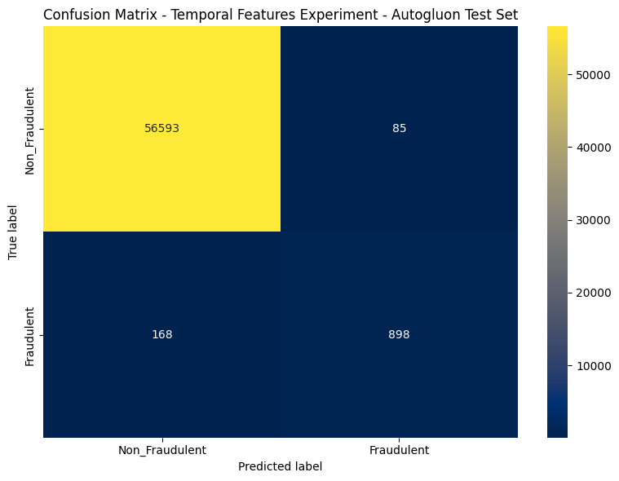
Modeling Experiments

Slide 33
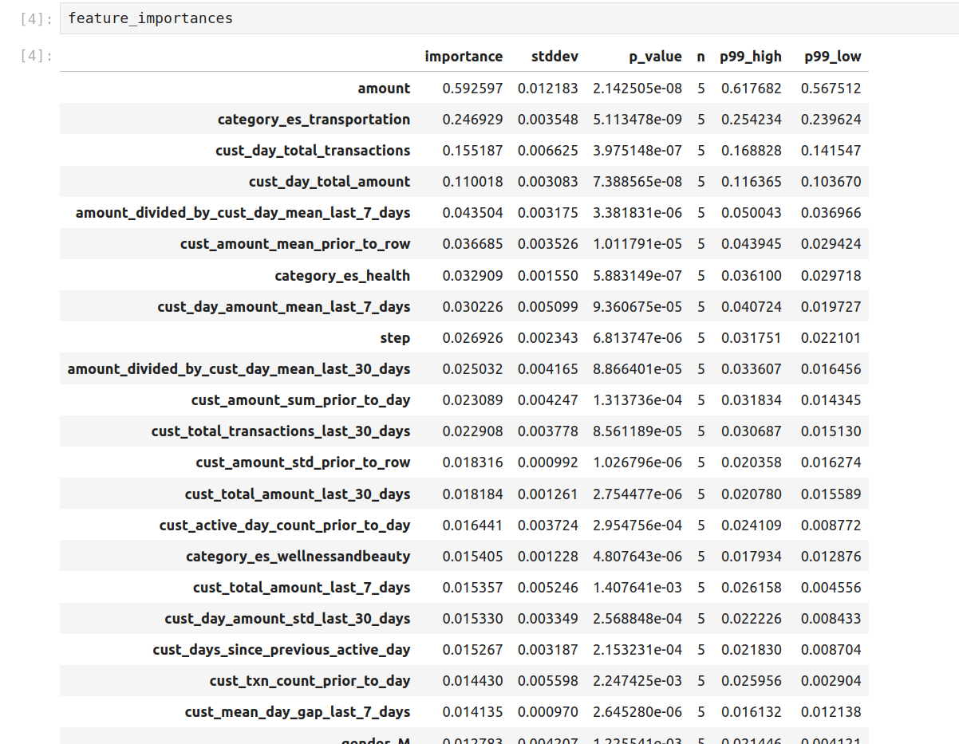
Modeling Experiments - Feature Importances

Slide 34
Main Insights and Deliverables
There are customers, merchants, and categories with very high fraud transaction ratios. A dedicated list could be provided to the business for additional analysis.
There is a clear statistical difference between the "Amount" values between non-fraudulent and fraudulent transactions: fraudulent transactions tend to higher higher amount values.
Main assumption is that the fraud labeling logic was heavily tied with the "Amount" values; this needs to be investigated with the business.

Slide 35
Main Insights and Deliverables
Modeling results
Train/validation/test splits were done on a customer basis, an entire customer's records could only be in only one set to avoid data leakage.
The same train/validation/test splits were shared across all modeling experiments for comparisons.
Three predictive models were used in progressing complexity:
Logistic Regression (baseline)
XGBoost
Autogluon Tabular Predictor (ensemble of 12 models including XGBoost)

Slide 36
Main Insights and Deliverables
Modeling results
Three modeling experiments were conducted:
Baseline (no feature additions)
SMOTE (adding SMOTE to train set)
Adding temporal features
The most important features tended to be the columns that had the most association with the "fraud" label as per the associations plot.
Adding temporal features improved model performance over the baseline, while SMOTE in its current configuration did not improve over the baseline.
The best-performing model in all three experiments was the Autogluon Ensemble.

Slide 37
Next Steps
Communicating with the business regarding the following:
Conducting a dedicated analysis on the most fraudulent entities (customers, merchants, categories) and validating the labeling logic for fraud.
Possibly being provided more fine-grained timestamps in order to improve temporal features; as they greatly improved model performance.
Validating column values are within correct ranges.
Applying an MLOps framework like an MLFlow environment to possibly accelerate future experiments.

Slide 38
Thank You

