Slide 1
Data Engineering Assignment 1 Question 1
Implementing a CSV to JSON Nifi pipeline.
Tamer tahamoqa 20208019

Slide 2
1. Docker-compose file modification
I imported the docker-compose.yml file from the ‘nifi’ directory of the ‘psut-data-eng’ github repository.
I added the ‘data’ folder as a shared volume for the ‘nifi’ service (line 18):
volumes:
- ./data:/opt/nifi/data
‘data/data’ would contain the csv file, ‘data/output’ would contain the generated json file

Slide 3
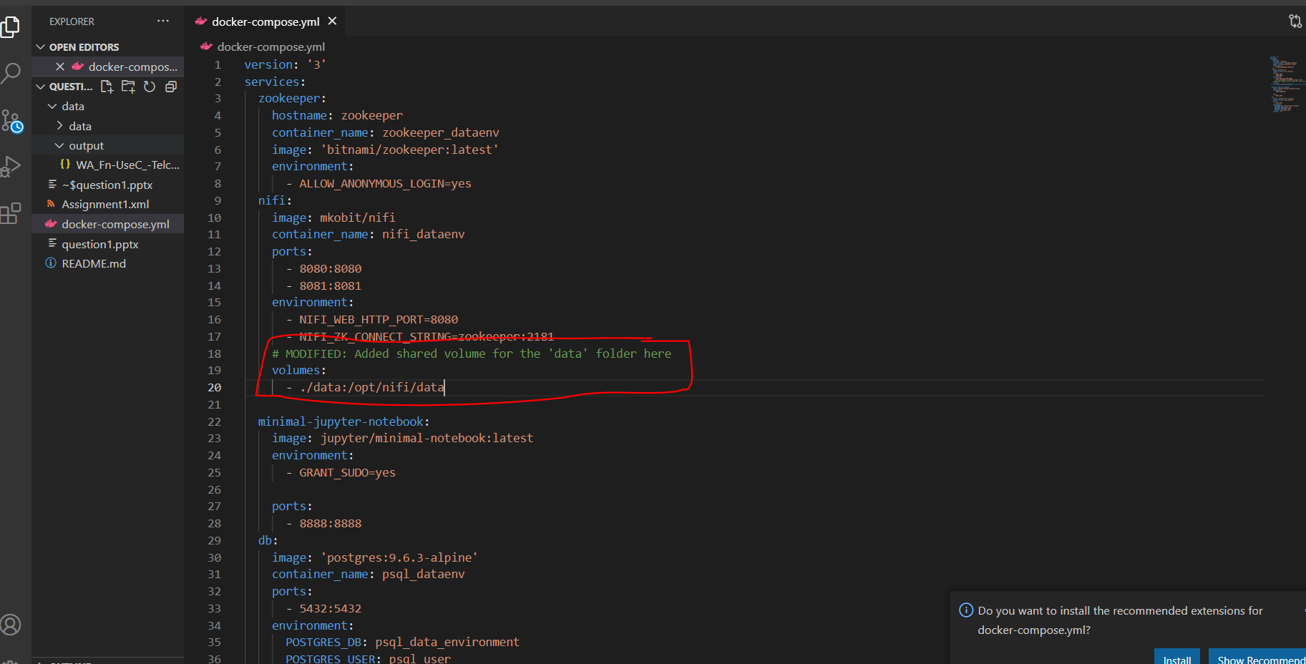
1. Docker-compose file modification

Slide 4
2. CSV file
I have imported the telco customer churn dataset from Kaggle and put it inside in the ‘data/data’ folder.
https://www.kaggle.com/blastchar/telco-customer-churn

Slide 5
3. NiFi pipeline implementation
I have used the following resources:
Cloudera tutorial: https://community.cloudera.com/t5/Community-Articles/Convert-CSV-to-JSON-Avro-XML-using-ConvertRecord-Apache-NiFi/ta-p/246607
YouTube video (at minute 56) relating on how to convert a csv file to json without specifying a schema: https://www.youtube.com/watch?v=N2iggpbaw90&t=3402s

Slide 6
3.1. Adding controller services
I added and enabled the CSVReader and JsonRecordSetWriter controller services.

Slide 7
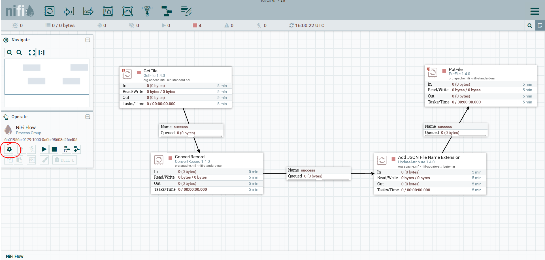
3.1. Adding controller services

Slide 8
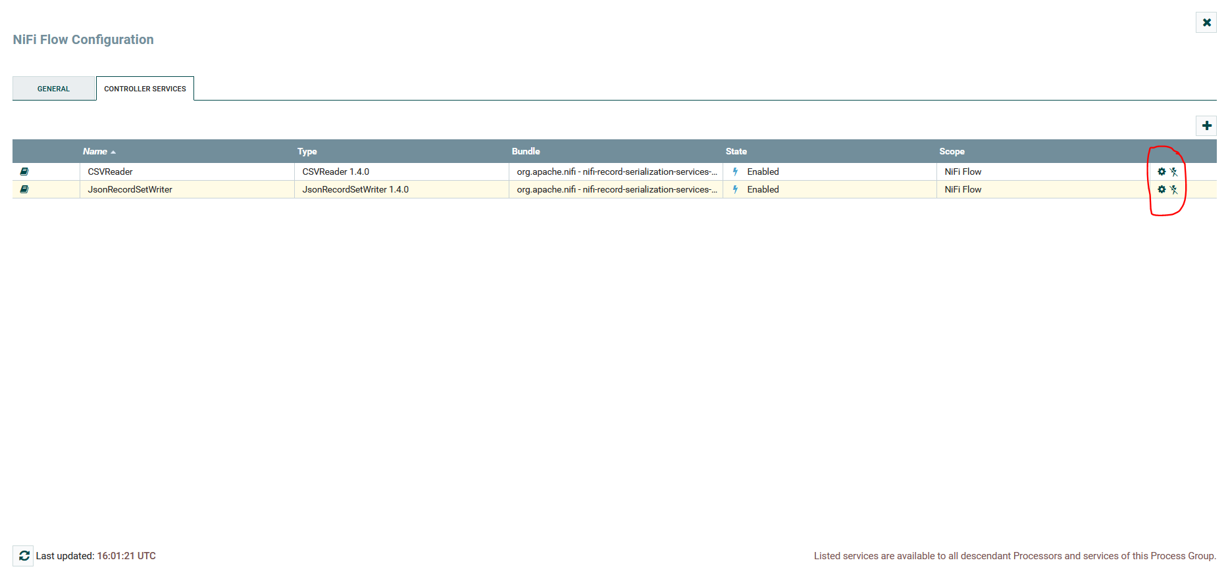
3.1. Adding controller services

Slide 9
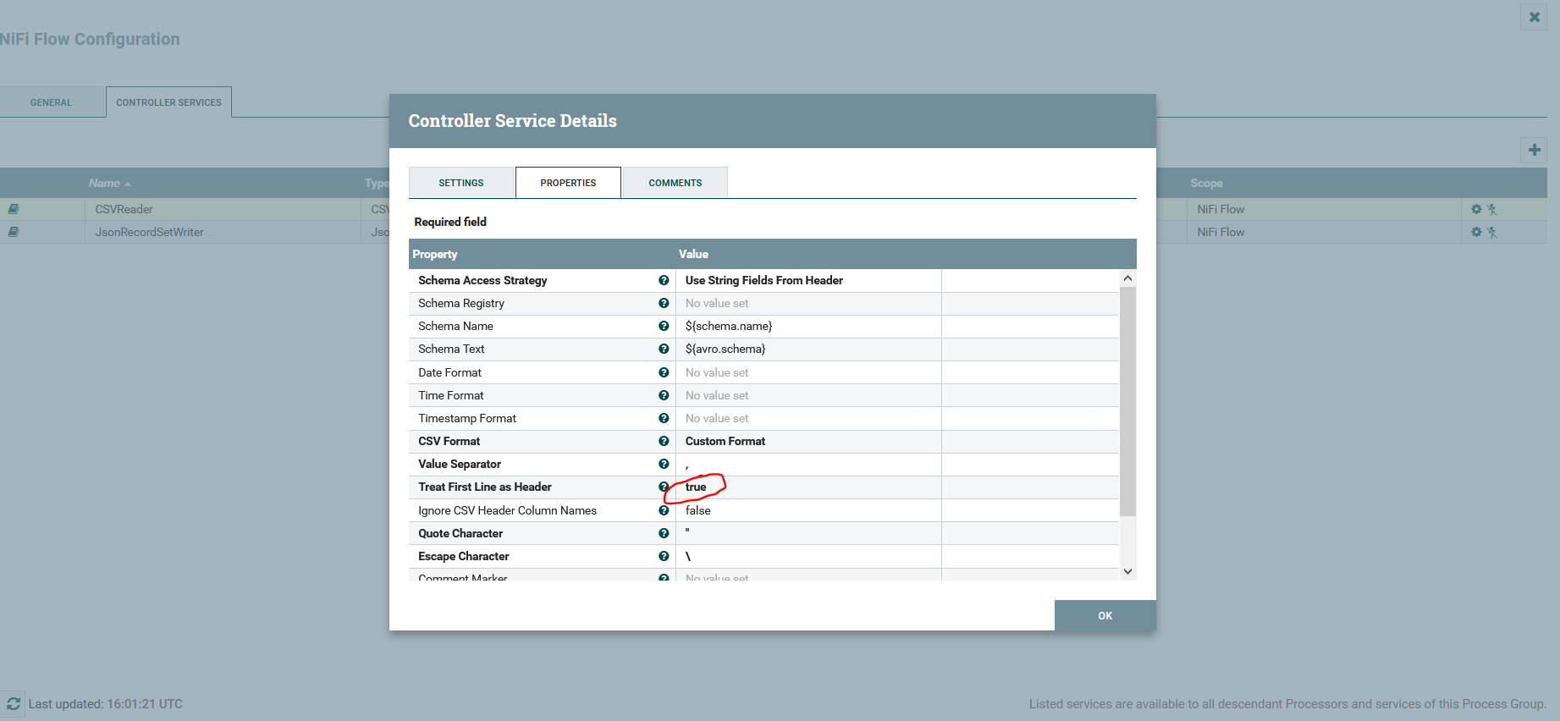
3.1. Adding controller services (CSVReader)

Slide 10
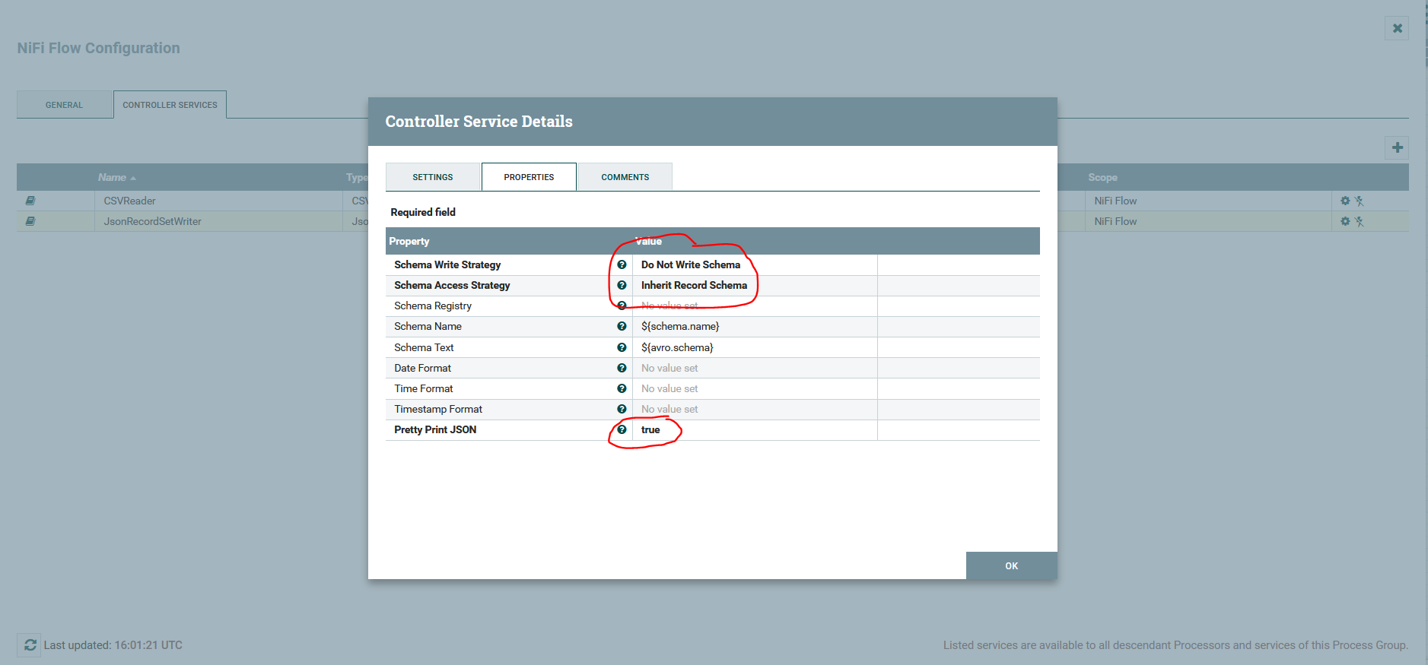
3.1. Adding controller services (JsonRecordSetWriter)

Slide 11
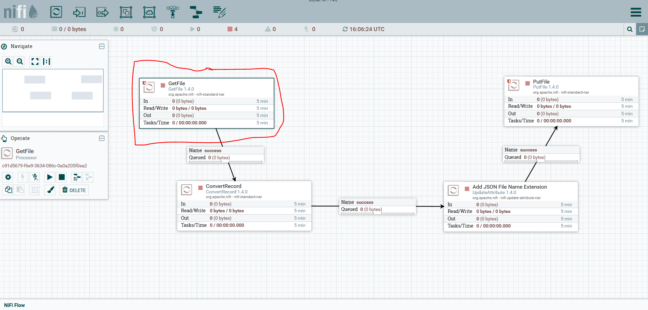
3.2. Adding GetFile NiFi Processor

Slide 12
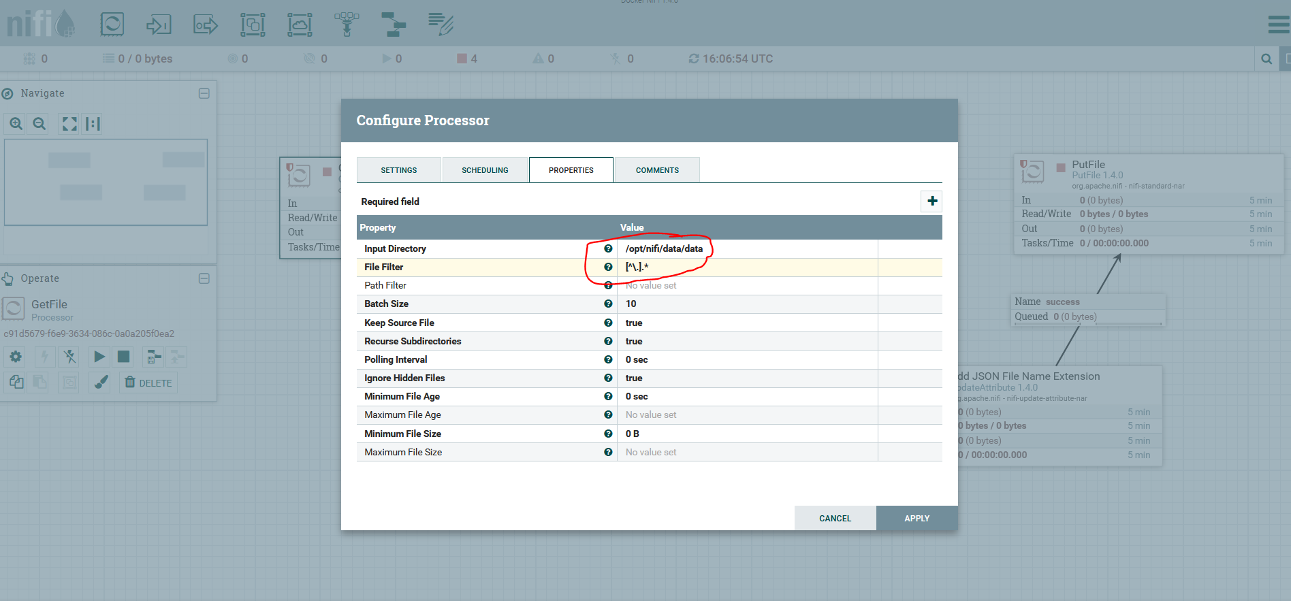
3.2. Adding GetFile NiFi Processor

Slide 13
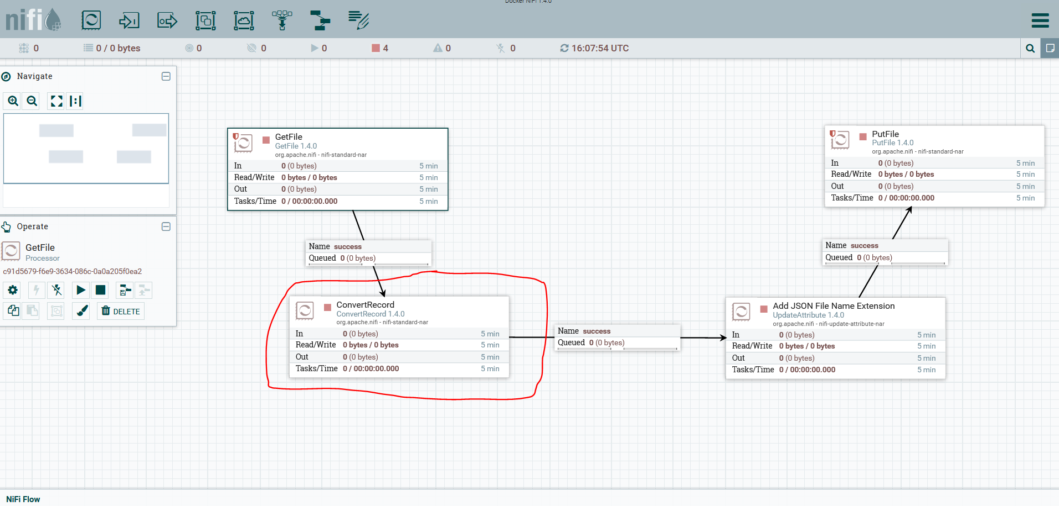
3.2. Adding ConvertRecord NiFi Processor

Slide 14
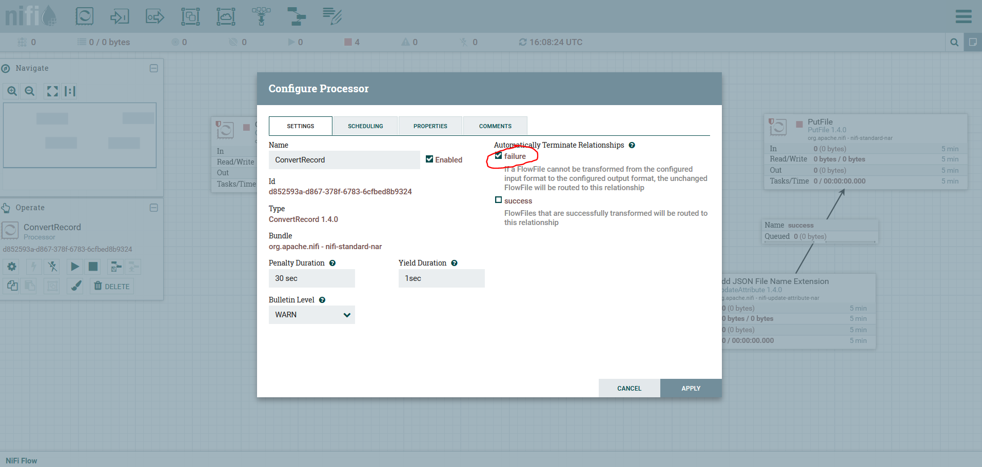
3.2. Adding ConvertRecord NiFi Processor

Slide 15
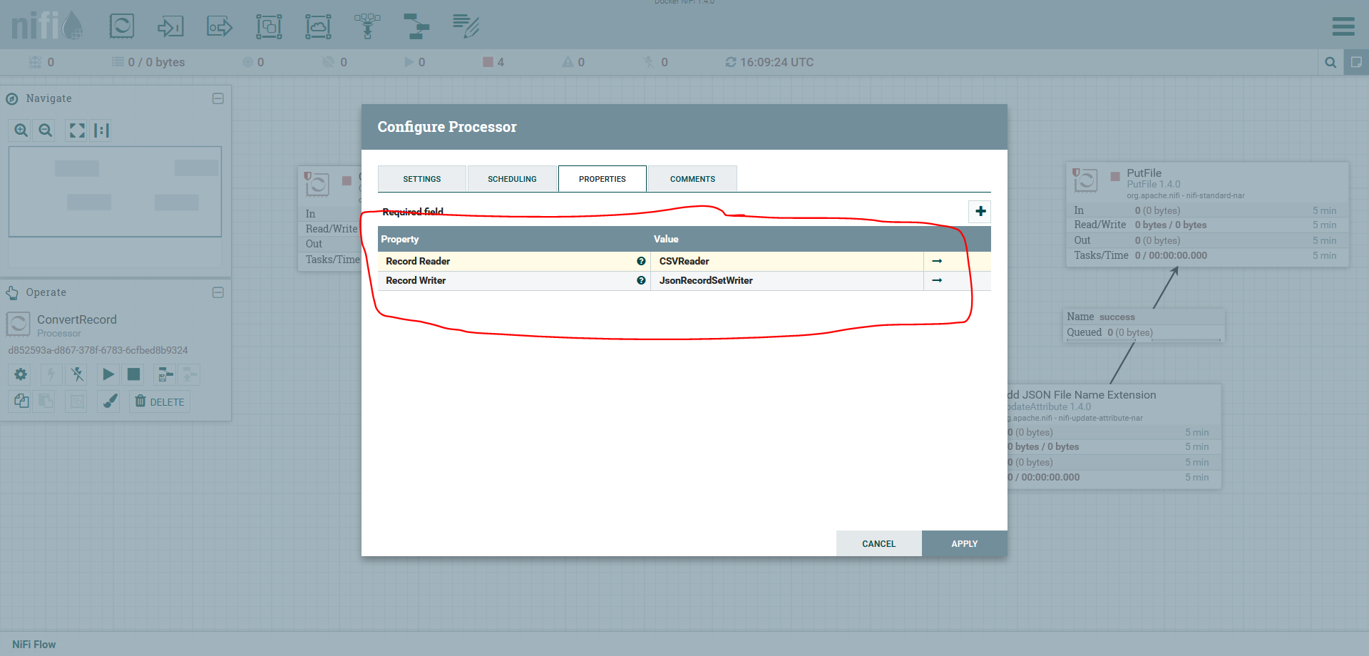
3.2. Adding ConvertRecord NiFi Processor

Slide 16
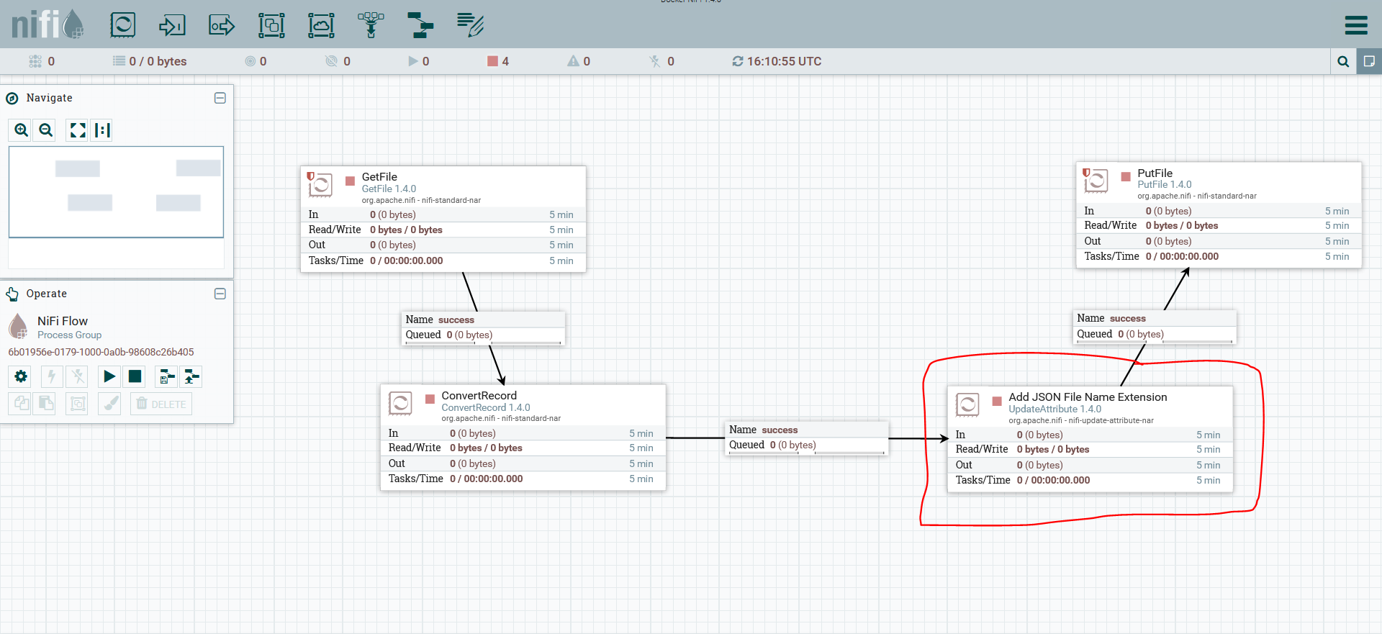
3.3. Adding UpdateAttribute NiFi Processor (To add .json file extension)

Slide 17
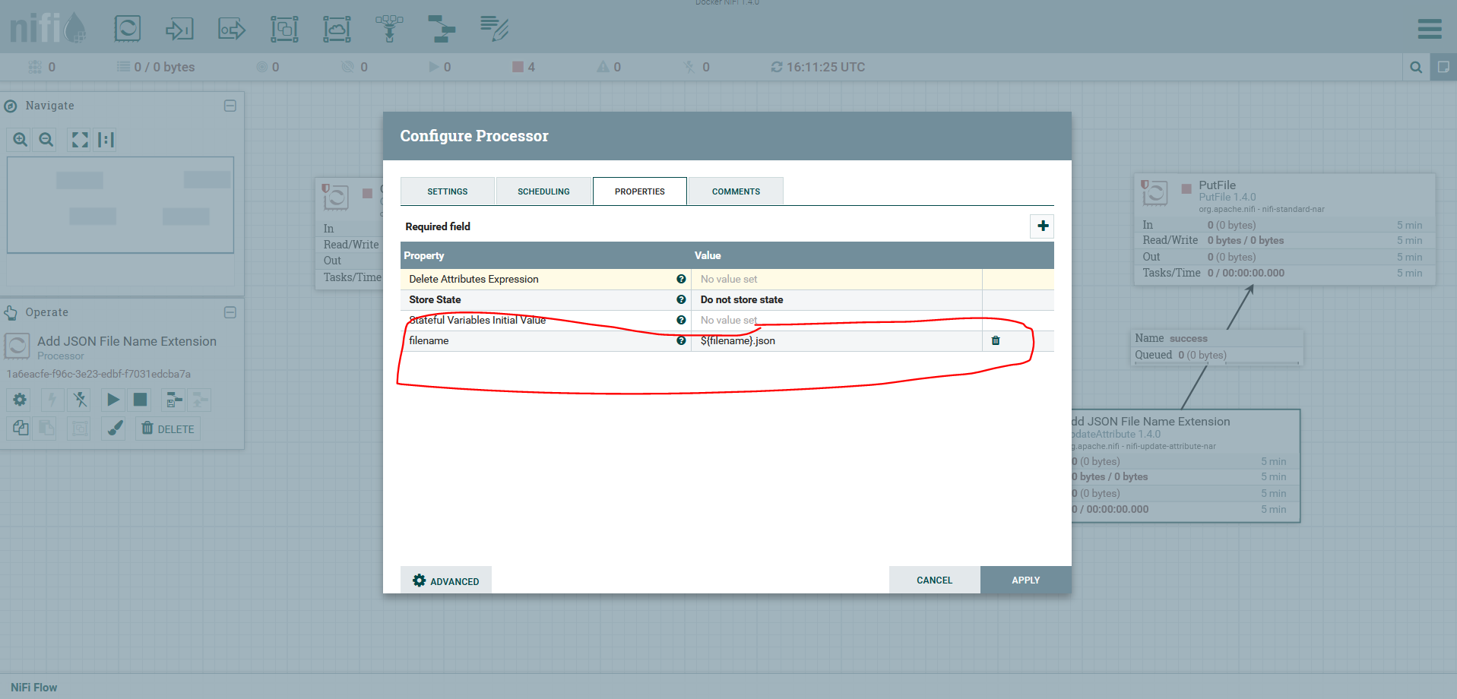
3.3. Adding UpdateAttribute NiFi Processor (To add .json file extension)

Slide 18
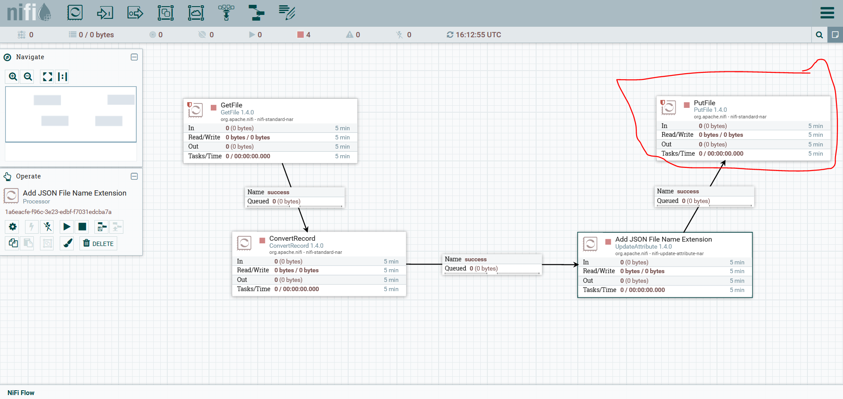
3.4. Adding PutFile NiFi Processor

Slide 19
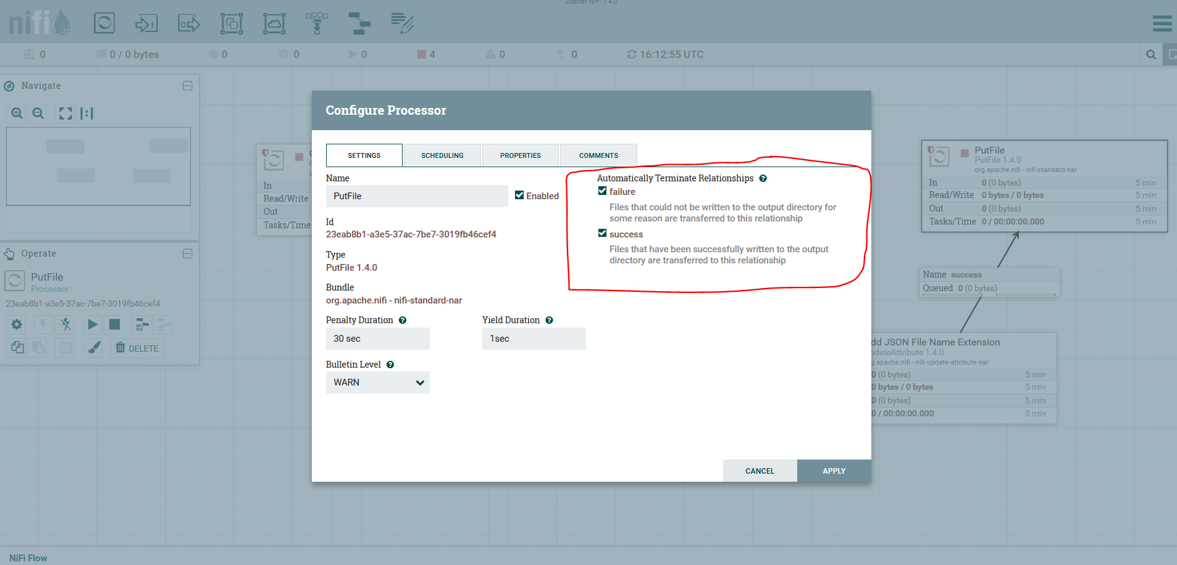
3.4. Adding PutFile NiFi Processor

Slide 20
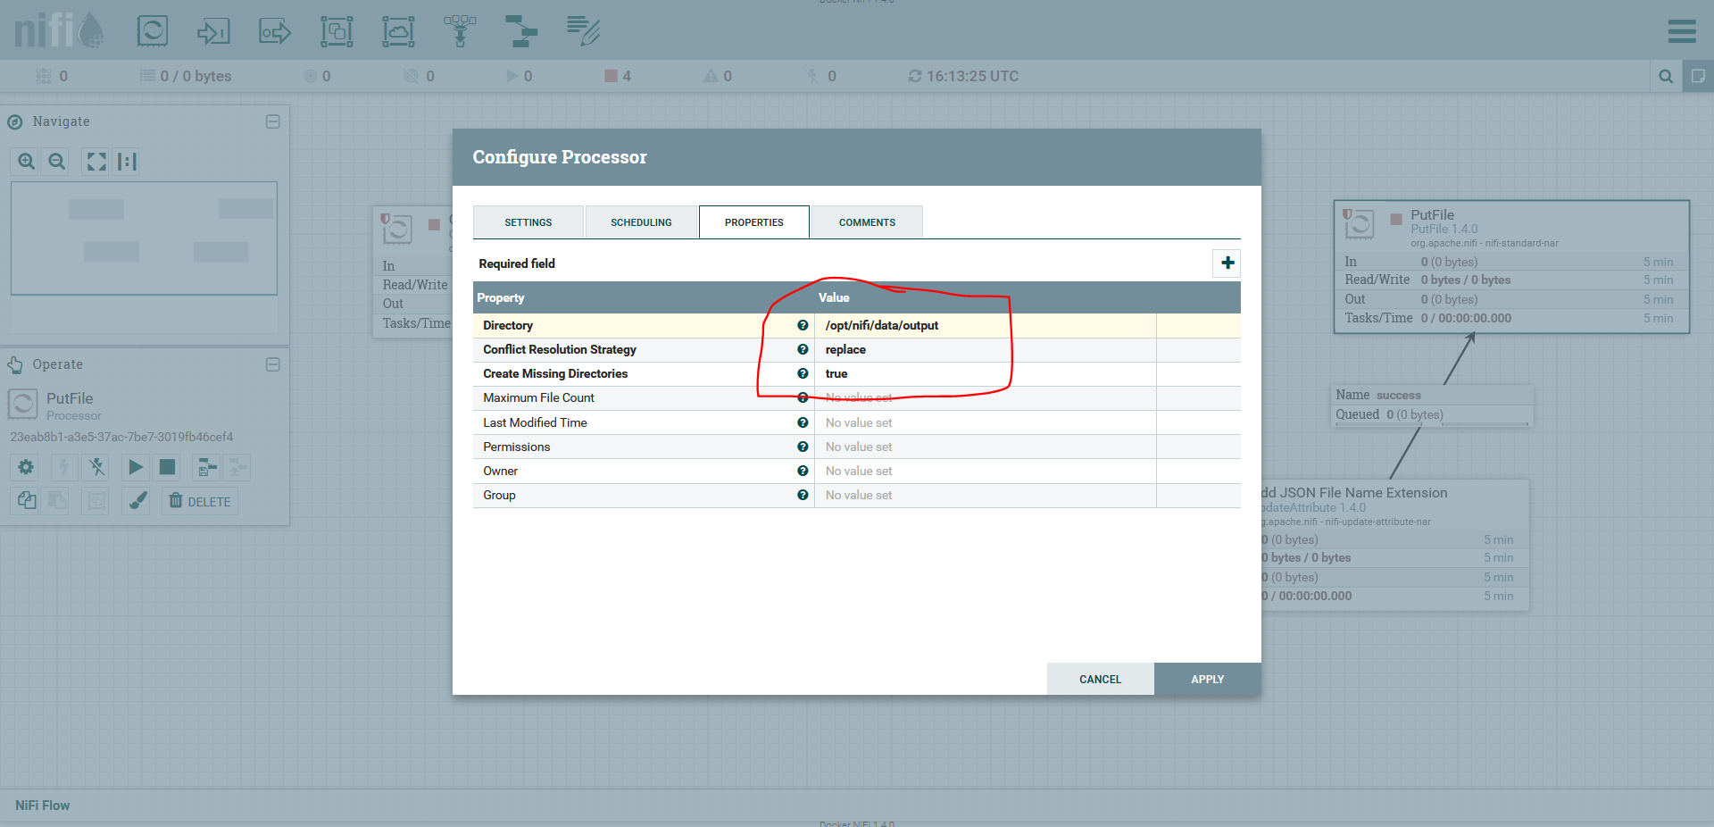
3.4. Adding PutFile NiFi Processor

Slide 21
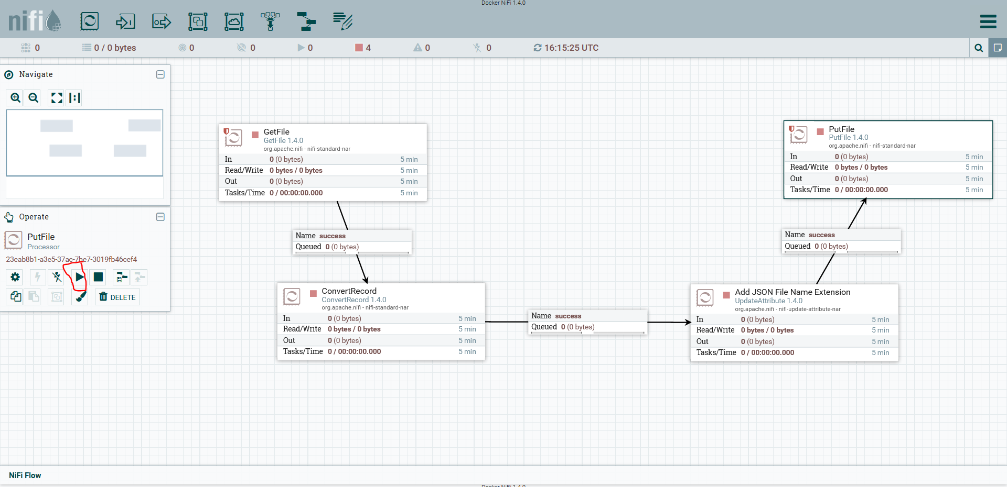
3.5. Running pipeline

Slide 22
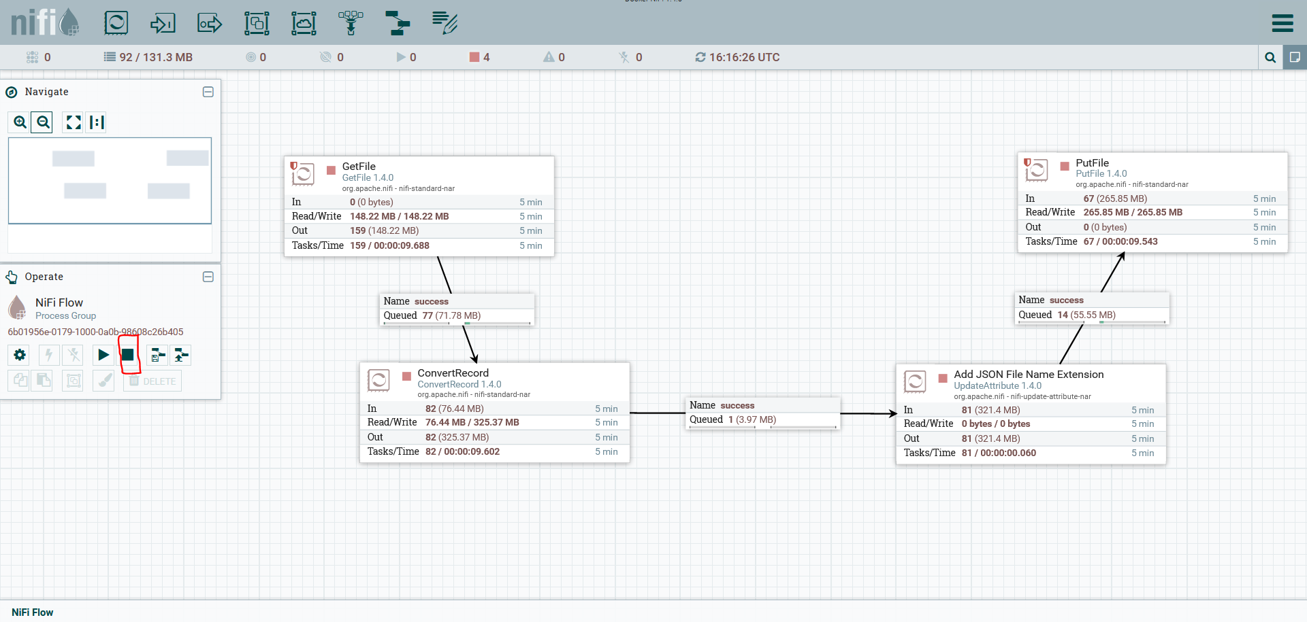
3.6. Stopping pipeline

Slide 23
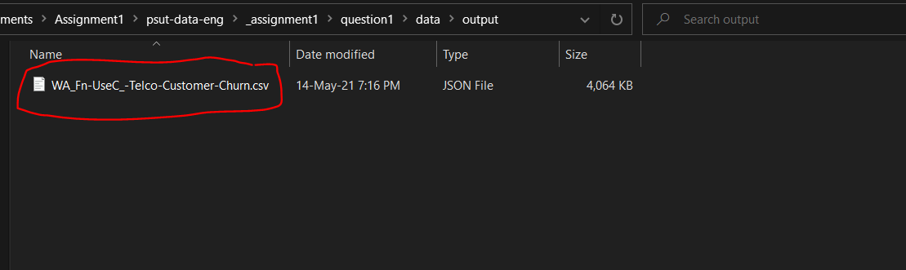
3.7. Output JSON file

Slide 24
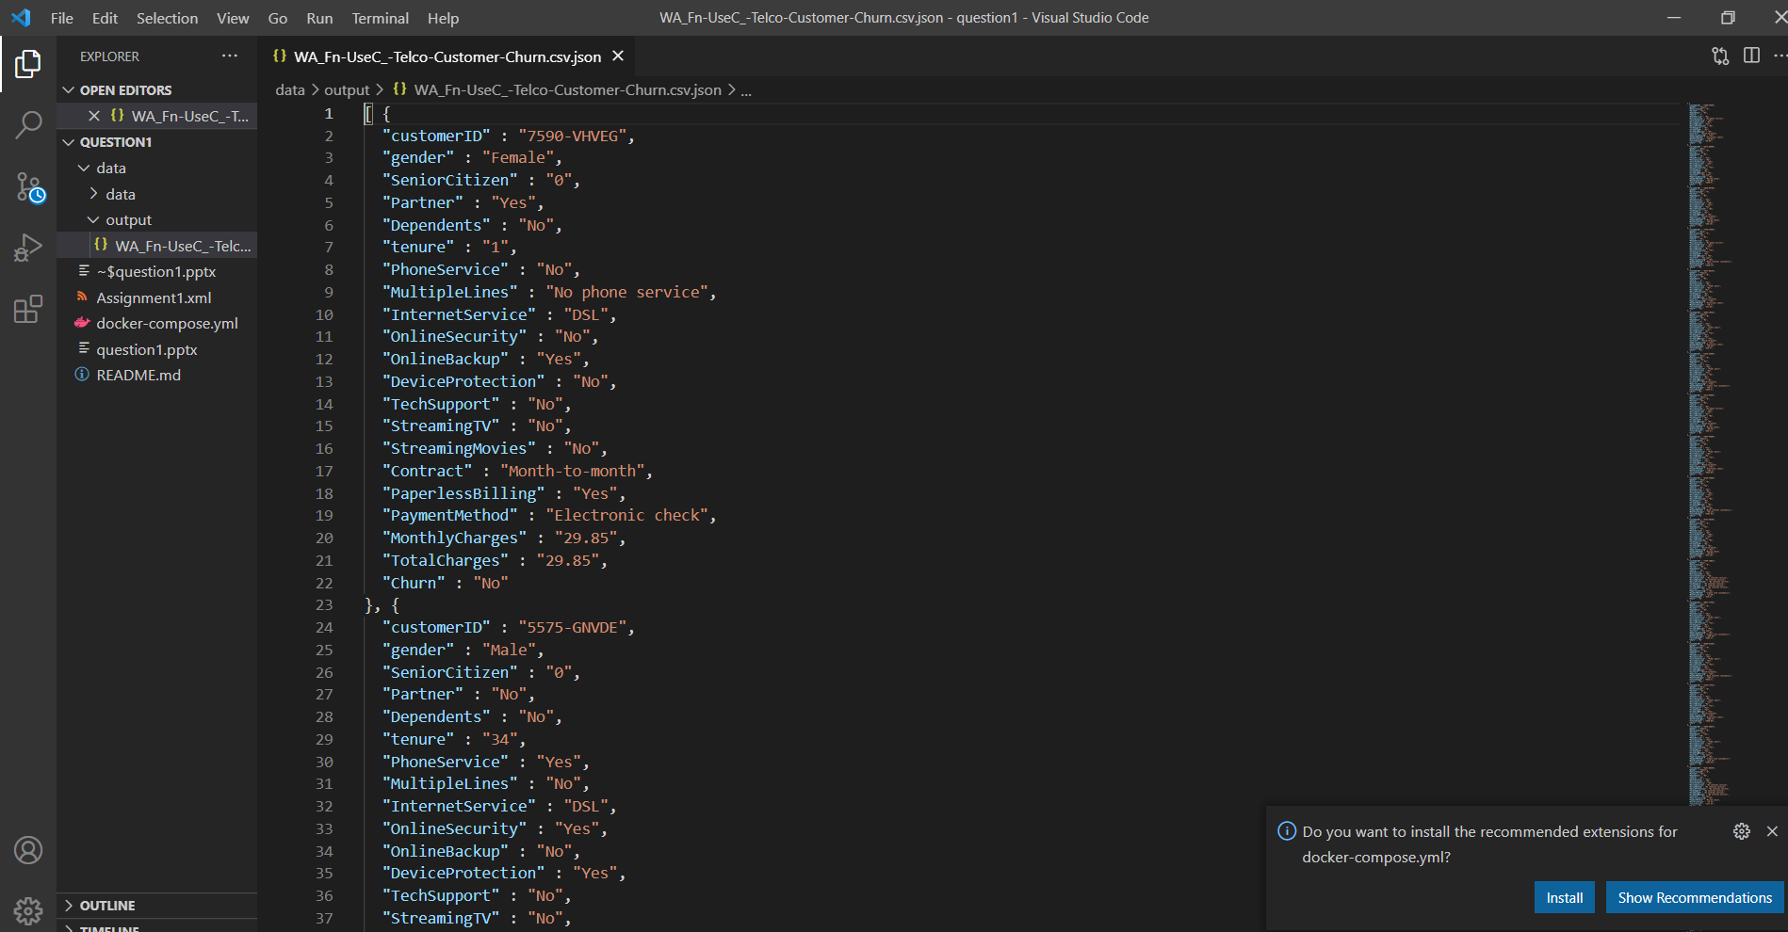
3.7. Output JSON file

Slide 25
Thank you

