Slide 1
Data Engineering Assignment 1 Question 2
Tamer tahamoqa 20208019

Slide 2
Objective
Implementing an Airflow pipeline where a csv file that is previously inserted into a PostgreSQL database would be read and converted into a JSON file whereby it would be pushed into a MongoDB database.

Slide 3
1- Setup
I combined the docker compose file from the postgresql-pgadmin-jupyter, mogo-mongo-express docker compose files into one docker compose file (in the parent directory of question 2 directory).
I tried also merging the airflow docker compose file but I had issues so I separated the two into separate directories where the airflow docker compose file is in the ‘airflow’ directory.
Two terminals must run the docker compose files separately, also due to connectivity issues I had to create a bash script to create a docker network for all created docker containers in order for them to communicate with each other in the create_docker_network.sh file.

Slide 4
2- Setting up postgresql
I navigated to localhost:8000 (user: 1234@admin.com, password: 1234) and added a new server:
name: postgres, Hostname/Address: postgres, Username: me, Password: 1234

Slide 5
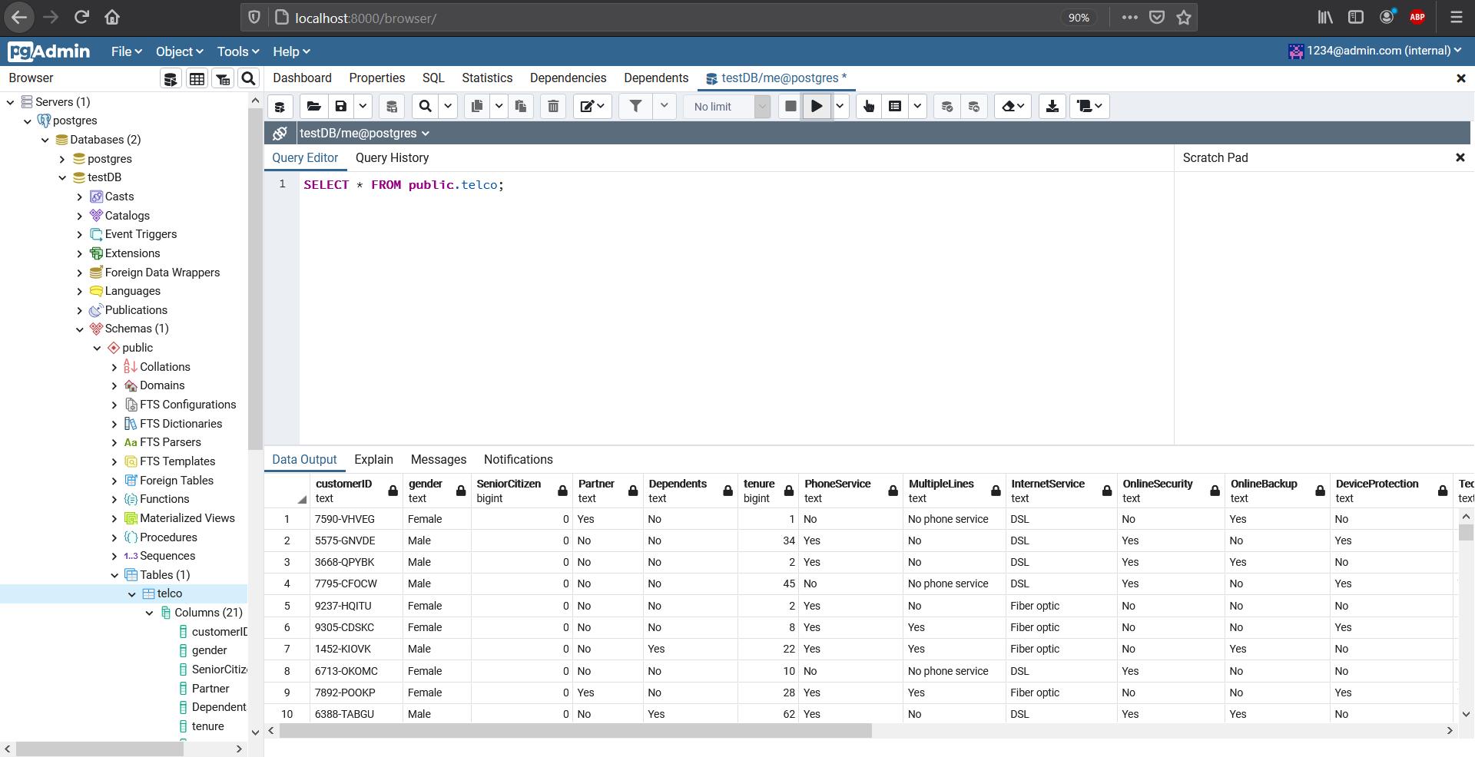
2- Setting up postgresql

Slide 6
3- Setting up mongodb
I navigated to localhost:8081 (mongo express) and created a new database with the name 'tamer' with collection 'telco'

Slide 7
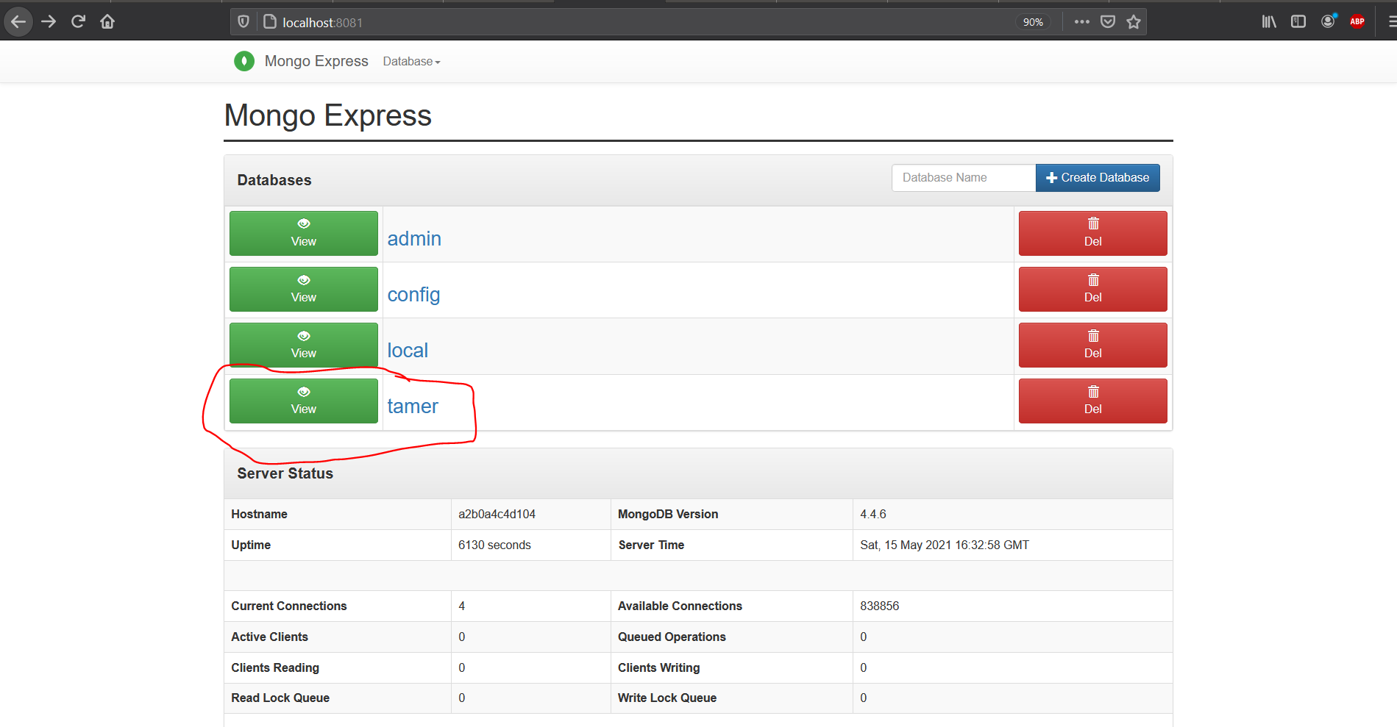
3- Setting up mongodb

Slide 8
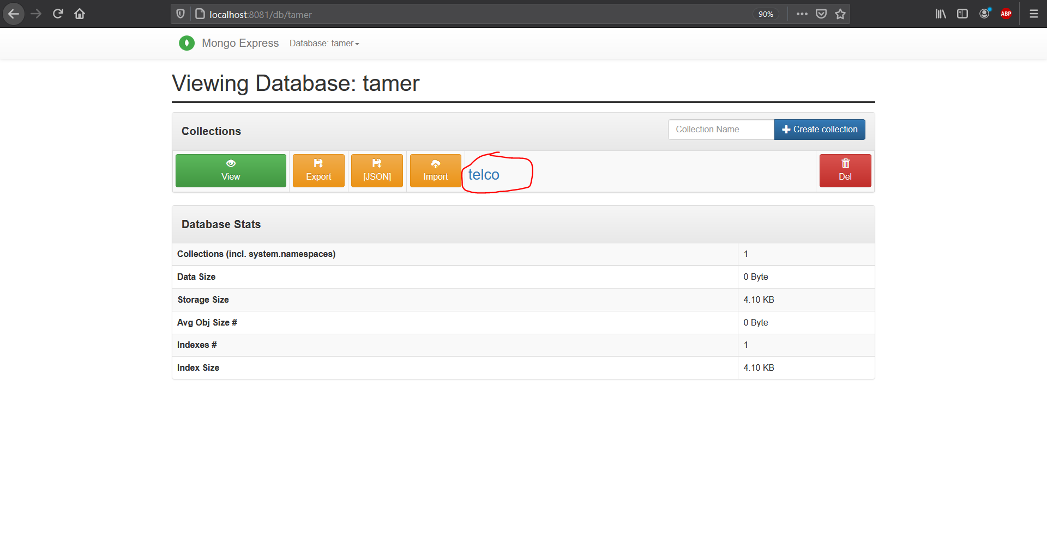
3- Setting up mongodb

Slide 9
3- Setting up mongodb
I navigated to localhost:8081 (mongo express) and created a new database with the name 'tamer' with collection 'telco'

Slide 10
4- Inserting csv file to postgresql database
I have imported the telco customer churn dataset from Kaggle and put it inside in the ‘notebooks’ folder.
https://www.kaggle.com/blastchar/telco-customer-churn
Then I ran the 1-Insert_csv_file_to_PostgreSQL.ipynb notebook in jupyterlab (localhost:8888)

Slide 11
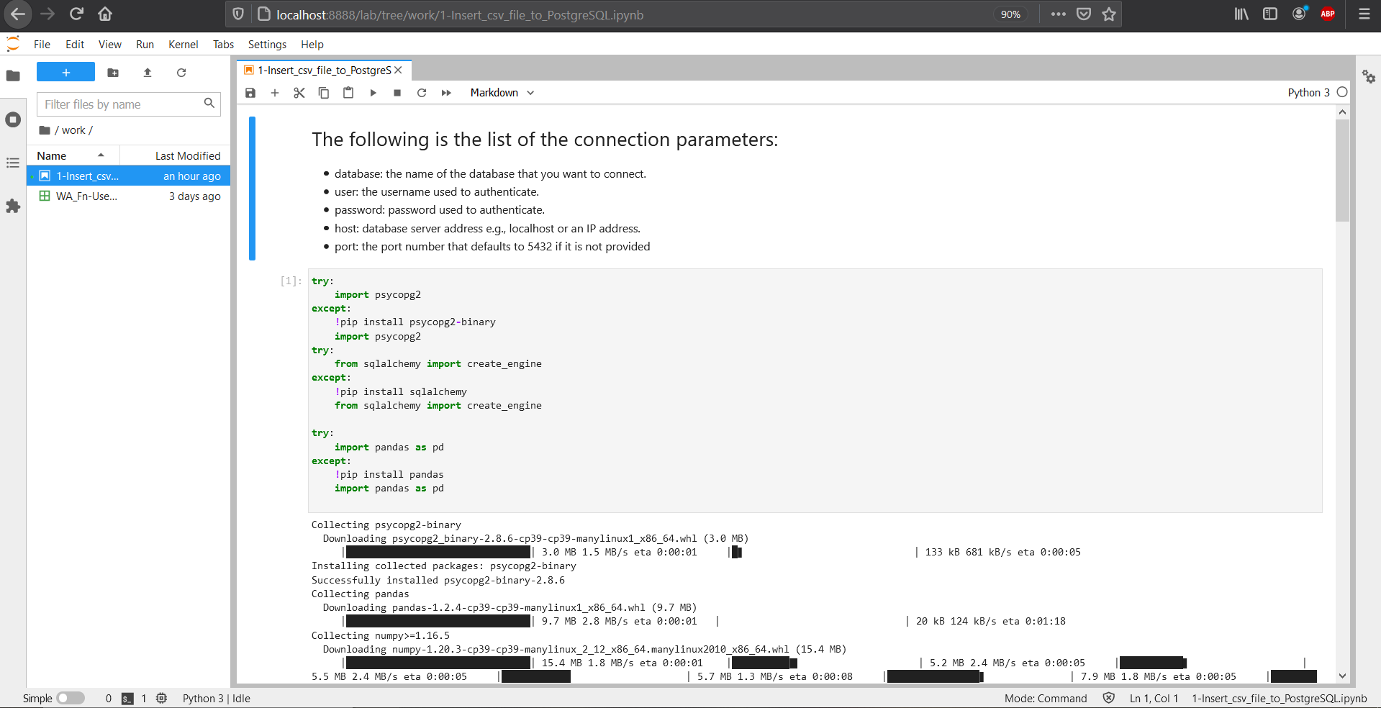
4- Inserting csv file to postgresql database

Slide 12
5- Airflow pipeline
I implemented the ‘dag_postgresql_to_mongodb’ dag in dag_postgresql_to_mongodb.py in the ‘airflow/dags’ directory.

Slide 13
5- Airflow pipeline
I navigated to localhost:8080 (username: airflow, password: airflow) and iteratively fixed issues until the dag ran correctly.

Slide 14
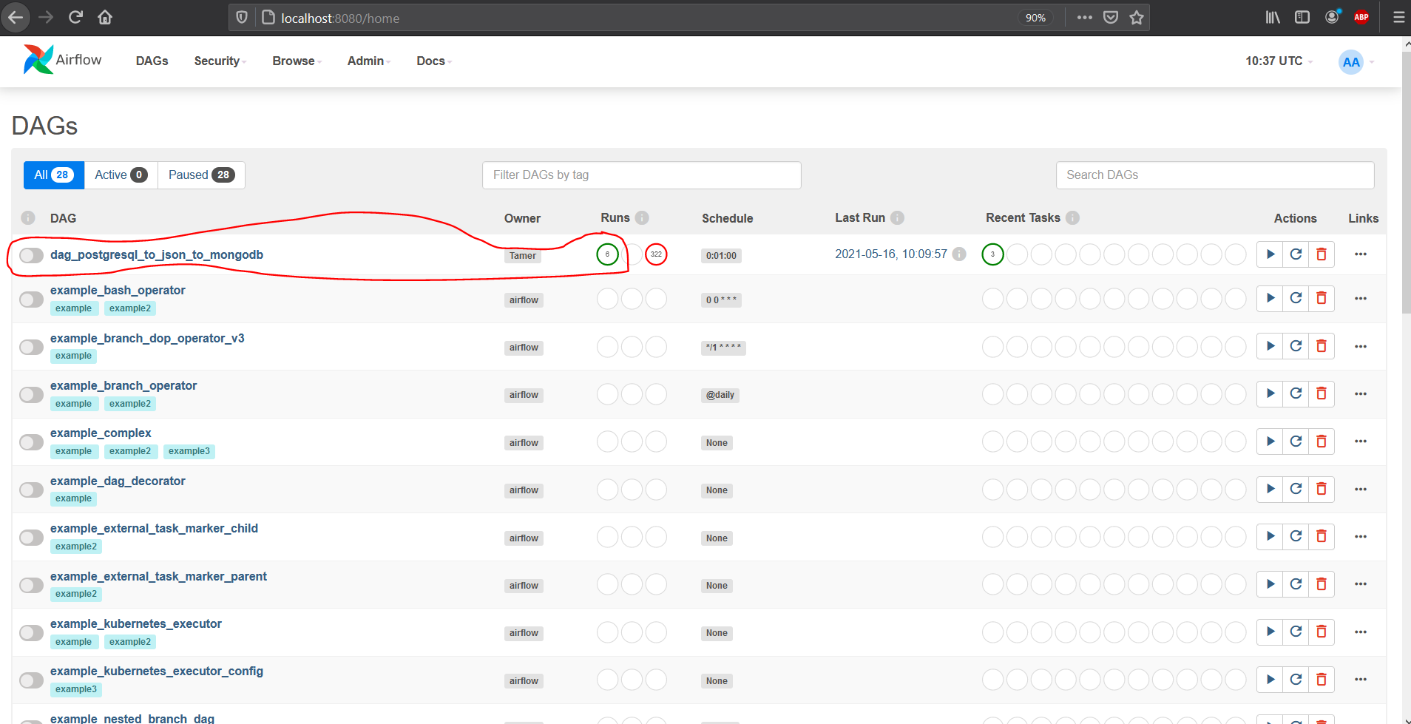
5- Airflow pipeline

Slide 15
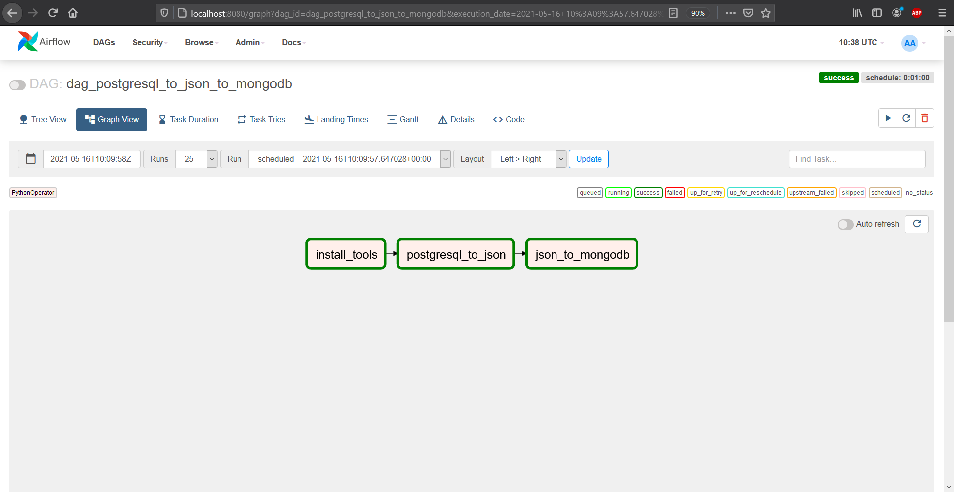
5- Airflow pipeline

Slide 16
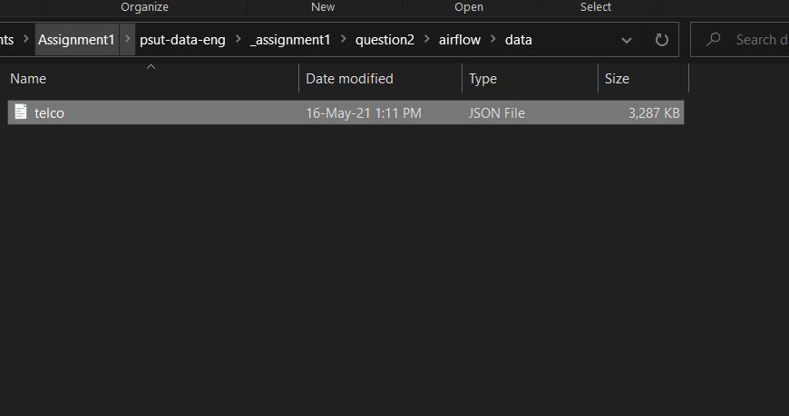
5- Airflow pipeline

Slide 17
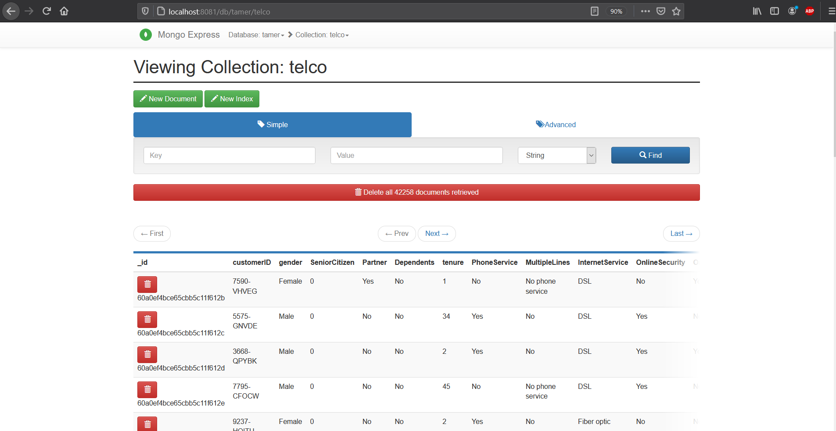
5- Airflow pipeline

Slide 18
5- Airflow pipeline
I have used .insert_many() so the mongodb records would be duplicated at each run.

Slide 19
Thank you

