Slide 1
INTRO FS13 Recap SW2

Slide 2
Systems & Realtime
Transforming, Reactive, Interactive
Trend: Heterogeneous Systems
Realtime: Correct result at the correct time
Logical correctness
Time in wich it is performed
Notes:
Transforming
-Data processing quality
-Throughput
-Optimized system load
-Optimized Memory Usage
Reactive
-External events are driving system
-Guaranteed response time
-Control loop
-Realtime
Interactive
-Short response time
-High system load
-Human-Machine Interaction (HMI)

Slide 3
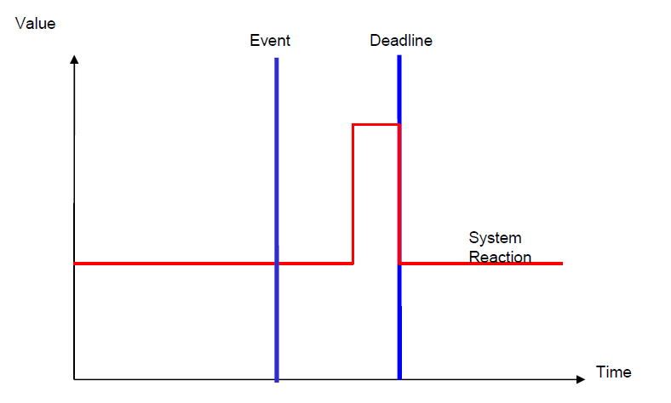
Systems & Realtime
Hard real-time: Missing a deadline is a total system failure
Soft real-time: results after its dead-line degrades the system‘s quality of service
Notes:
We can distinguish
Example Hard: Airbag
Soft: Skype

Slide 4
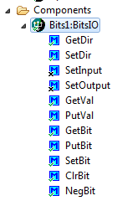
Processor Expert
Components
Methods, Properties, Events
Generate source code
Benefits:
Code-reuse
Fast implementation
More Overhead
Notes:
Disadvantage: Overhead

Slide 5
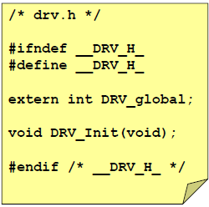
Includes
„Guarding“ in the header file
Multiple definitions/declarations
Recursive includes

Slide 6
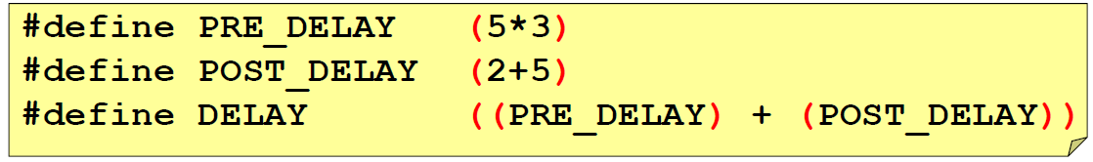
C & Macros
Textual Replacement #define
Traps
Turn off/on functionality
#define PL_HAS_LED 1
Notes:
Ben: readability, portability, configuration
Functionality : initialise or not

