Slide 1
Recap Clock & Timer
Leo Spichtig

Slide 2
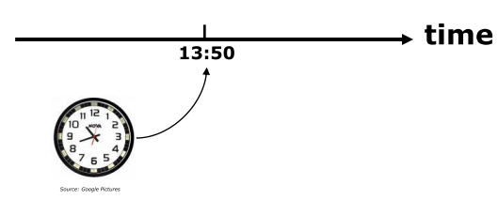
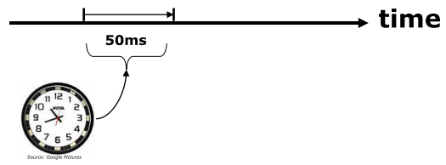
Timelines in Realtime Systems
Absolute
Relative

Slide 3
What needs a Realtime System?
Time base
Clock
Interrupt Synchronisation

Slide 4
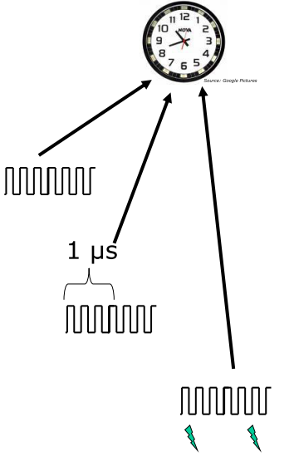
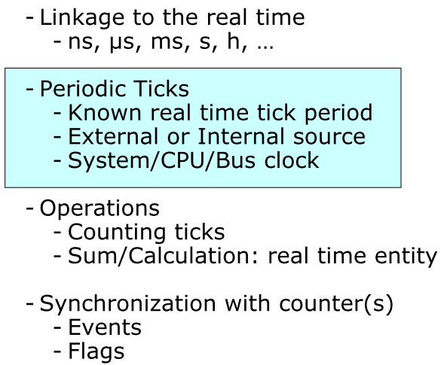
Possibilties
Time base
Clock
Interrupt Synchronisation

Slide 5
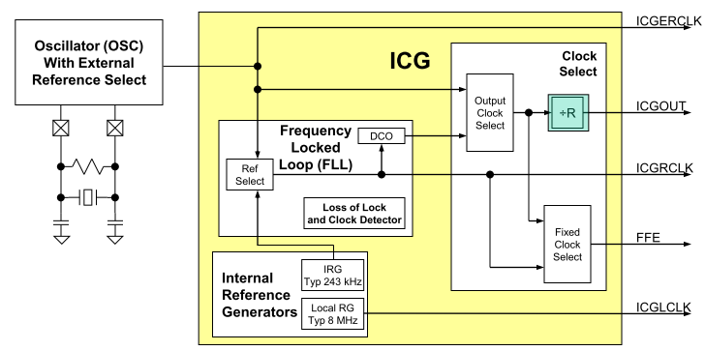
Internal Clock Generator Block Diagram
Clock divider
Reference Selection
Internal
External
Prescalter Select
Multiplication Factor
Division Factor

Slide 6
Interrupts on MCF52259 (Tower)
7 Levels and 8 priorities
Only unique and non-overlapping levels and priority definitions are allowed
Failure in this manner can result in undefined behavior!
Interrupt priorities are visible in vectors.c-File

Slide 7
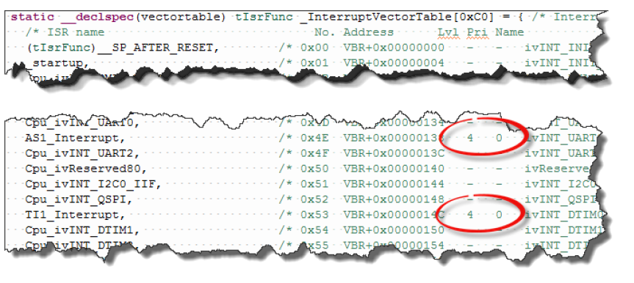
Interrupts on MCF52259 (Tower)
Vectors.c

Slide 8
Questions?

