Slide 1
INTRO FS13 Recap Shell

Slide 2
Shell – For What?
Easy and universal way to configure and inspect the target, even without debugging
Notes:
Easy way to configure and inspect the target without debugging

Slide 3
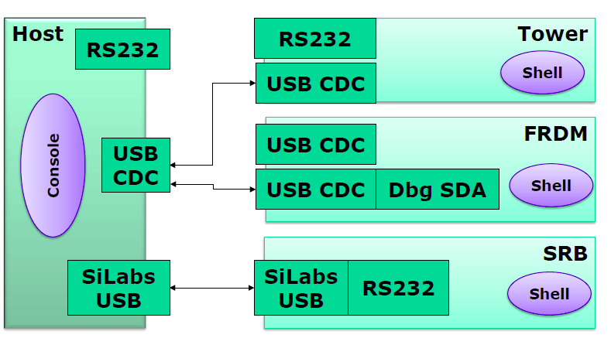
Shell Connections
Notes:
SRB –Board USB over USB bridge

Slide 4
USB (Universal Serial Bus)
Device Types
Host
powers the bus
PC, Laptop
Device
powered through the bus
Mouse, Keyboard, ..
OTG (On - the - go)
Changes between 2 devices
One device with limited host funcionality
Camera <-> printer

Slide 5
USB (Universal Serial Bus)
Device classes
Communication Device Class CDC
Modems, Network cards, …
Human Interface Device HID
Mouse, Keyboard, …
Mass Storage Class MSC
Memory –Stick, Harddisk, …

Slide 6
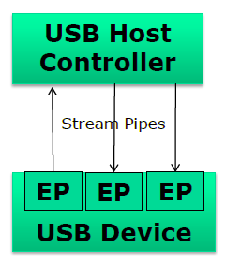
USB System & Application
Asymmetrical
Up to 127 devices
Pipes for communication
Message Pipe: bidirectional
Stream Pipe: unidirectional
Global memory Buffer
Application polls
Outgoing packets
Incoming packets
Handles control messages

Slide 7
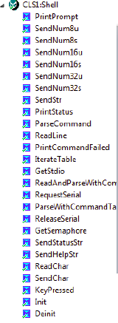
Shell Processor Expert component
Interfaces
USB (CDC)
Bluetooth (RS-232)
Serial (RS-232)
Core of ShellPrompt
Status
Help
Std I/O
Usage
help
status

Slide 8
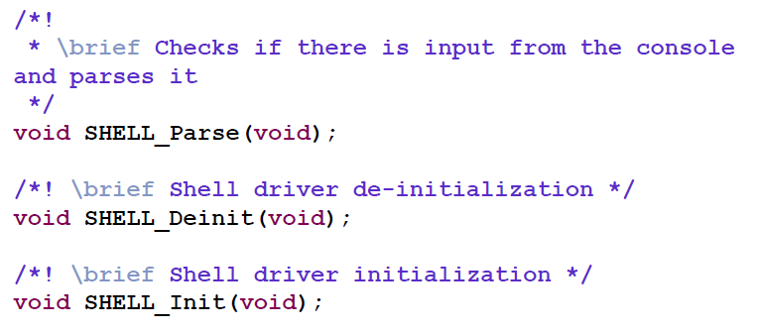
Shell interface
Notes:
-shell init
-shell deinit
-shell parse

Slide 9
Shell parser
Reads in chars and adds it to buffer
Performs USB AppTask() polling (50ms)
Parse buffer after “\r\n”
Iterates through a command table
Prints prompt and error message
Notes:
Parse buffer after a certain sign

Slide 10
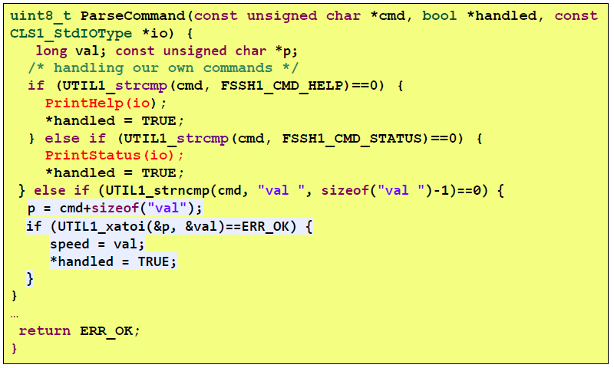
Example command parser

Slide 11
Questions ??

