Slide 1
ABOUT US
Project Object-Oriented-Programming
OOP Course by Prof.Nguyen Thi Thu Trang & TA Trinh Thu Hai
Hoang Thien Tam – 20194450: implementing the delete, update, search, types of trees button in GUI; report.
Tran Quoc Khanh – 20190085: Design class diagram; implement generic and node class; BFS & DFS, insert operation; main menu; report.
Hoang Van Khanh – 20194440: implement binary, balanced (binary) tree; slide; report.

Slide 2
Problem Statement
Visualization of operations on tree data structures by designing a program to display and explain some basic operations four types of tree.
Problem:
Basic Knowledge:
Generic tree, Binary Tree, Balanced tree and Balanced binary tree (all details in docs)
OPERATIONS on trees: CREATE, INSERT, DELETE, UPDATE, TRAVERSE.
Specification:
GUI: reference link: https://visualgo.net/en/bst
Design:
> Considering undirected-weight trees, with integer values and no duplicated values.
> For the types of balanced tree, the maximum difference in distance from root to
the leaf nodes is chosen by the user.
> Main Menu: SELECT-BUTTON on a type of data structure for visualization,HELP
BUTTON for basic usage and aim of project, QUIT BUTTON for exit the app with
asking for confirmation.

Slide 3
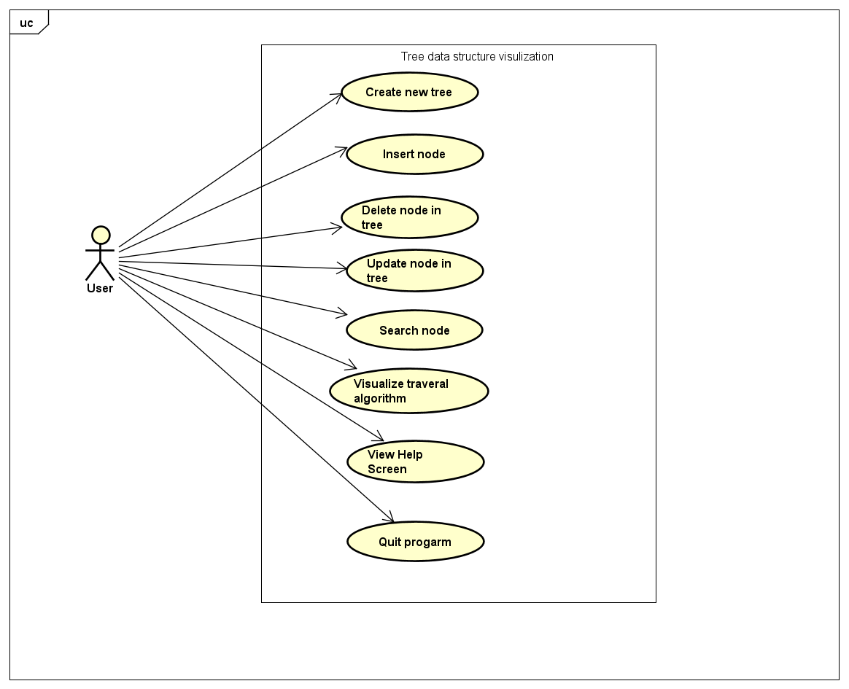
Use Case Diagram
For user’s actions:
Create new tree
Insert node
Delete node in tree
Update node in tree
Search node
Visualizing traversal algorithm
Get Help
Quit the application

Slide 4
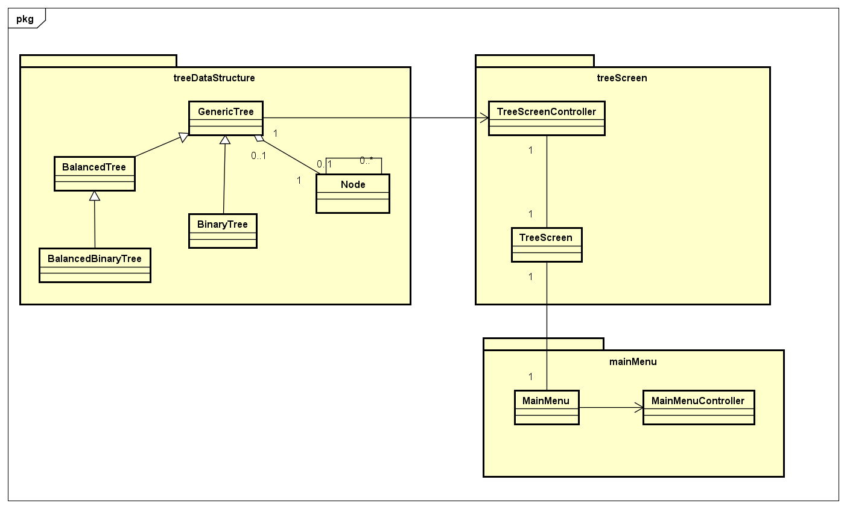
General Class Diagram

Slide 5
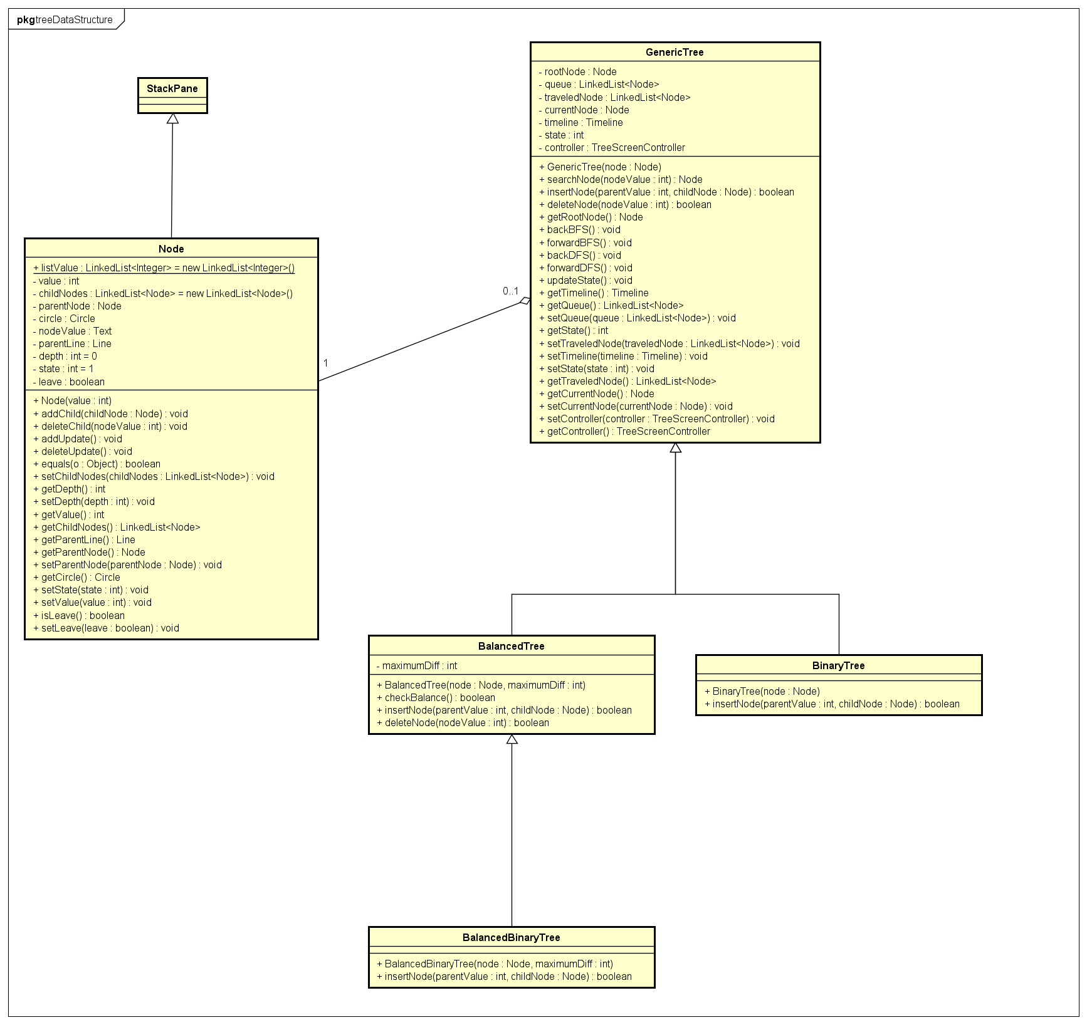
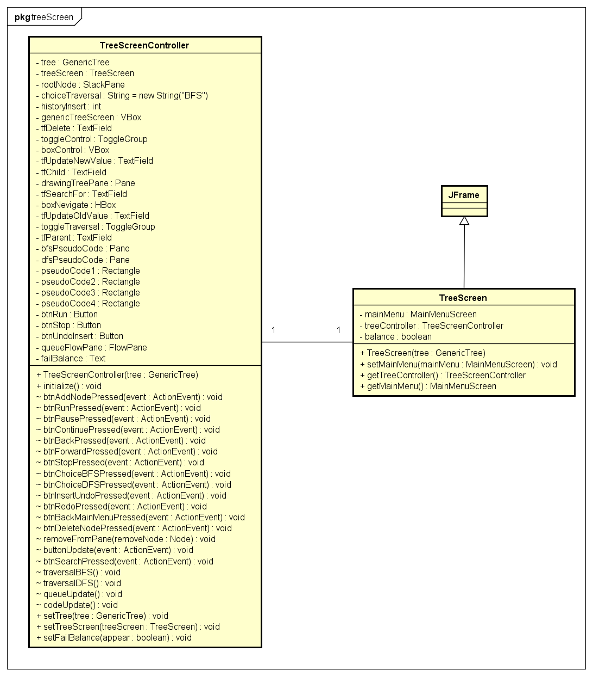
Package treeDataStructure
Package treeScreen

Slide 6
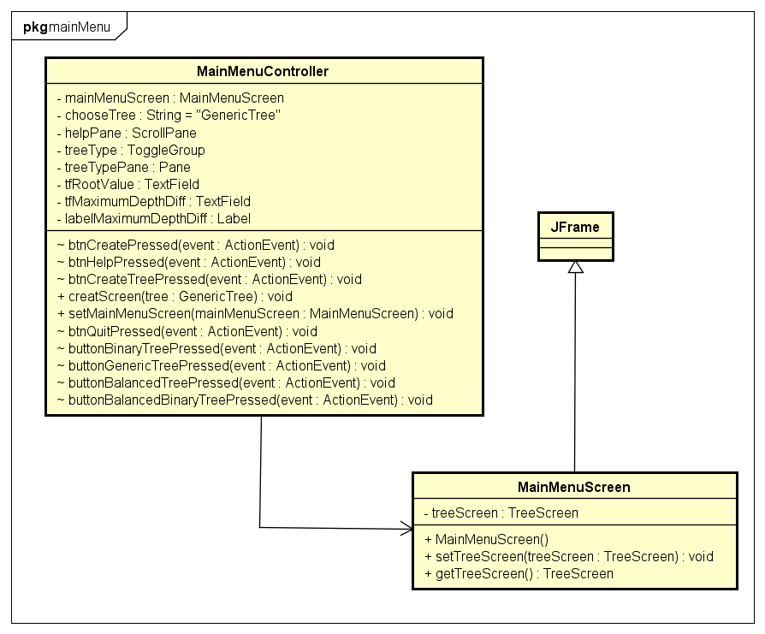
Package mainMenu

Slide 7
Demo Application Video
Demo Video

Slide 8
OOP Techniques
Inheritance:
BinaryTree, BalancedTree inherit from GenericTree; BinaryBalancedTree inherits from BalancedTree.
Aggregation:
GenericTree contains Node (rootNode).
Polymorphism:
insertNode method in GenericTree, BinaryTree, BalancedTree, BinaryBalancedTree; deleteNode method in GenericTree, BalancedTree.
Association:
Each node has its child nodes and its parent node; association in TreeScreenController, TreeScreen, MainMenuScreen, MainMenuScreenController.

Slide 9
Thank you for your listening!

