Slide 1
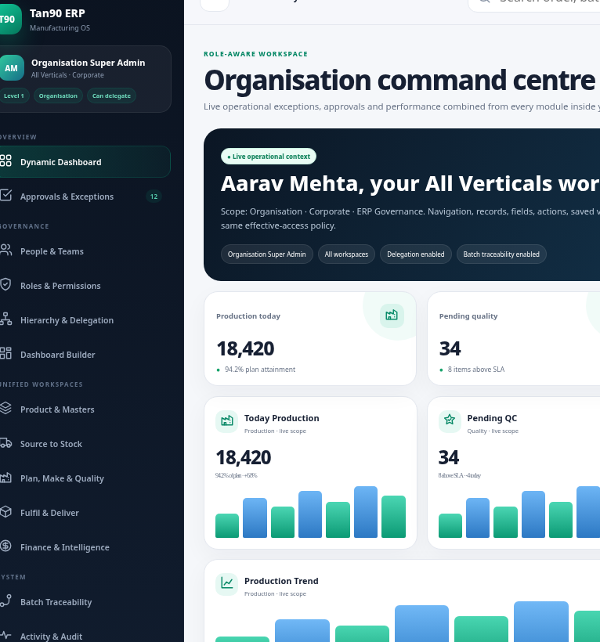
T90
CLIENT-READY MVP BLUEPRINT
Tan90 Unified Manufacturing ERP
Complete MVP architecture with bundled spaces, modules, flows, role features, permissions, screenshots and delivery roadmap.
7
56
4
100%
BUNDLED SPACES
MAPPED CAPABILITIES
HIERARCHY LEVELS
E2E TRACEABILITY
From demand to dispatch closure — one operational system.
Tan90 Manufacturing ERP MVP • Client-ready architecture deck
01

Slide 2
EXECUTIVE SUMMARY
Build a focused MVP first, then scale to full ERP
The MVP should not copy a long 16-module sidebar. It should bundle related modules into spaces that match how departments actually work.
01
Business goal
02
MVP approach
Reduce Excel/manual tracking and give live visibility from raw-material inward to final dispatch closure.
Bundle 16 ERP modules into 7 role-aware spaces with shared dashboards, approvals and traceability.
03
Client demo goal
04
Implementation rule
Show one complete batch moving from demand → MRP → purchase → GRN/QC → production → warehouse → POD.
Add new spaces beside current Tan90 pages. Do not break current screens, routes or workflows.
Recommended MVP name: Tan90 Operations Command OS
A space-based manufacturing ERP for stock, production, quality, warehouse, delivery, access control and traceability.
Tan90 Manufacturing ERP MVP • Client-ready architecture deck
02

Slide 3
RESEARCH FOUNDATION
Inputs used to design the MVP
The deck combines live Tan90 blueprint pages, the uploaded requirement notes, current Laravel code structure, UI references and manufacturing/security standards.
1
Tan90 live blueprint
Positions the product as a cold-chain manufacturing ERP covering material, production, QC and dispatch; MVP weeks shown as 8–10.
2
Uploaded requirement notes
Defines the E2E flow: demand, planning, procurement, GRN, QC, stock, production, FG, dispatch, POD and reports.
3
Current Laravel code
Shows existing operational roles plus Tan90 Master Data/BOM registry; new MVP should be additive.
4
UI references
Role/user management screens and MacBook-inspired prototype screenshots inform the admin UX.
5
Standards alignment
RBAC hierarchy, deny-by-default authorization, traceability events and manufacturing operations separation.
Tan90 Manufacturing ERP MVP • Client-ready architecture deck
03

Slide 4
CURRENT GAP
Why a space architecture is needed
The present app has useful pieces, but the client needs a single journey across material, production, quality and delivery.
Existing strength
Gate, unloading, QC, GRN posting, finance review, master-data registry, BOM/recipe/costing foundation.
Missing MVP flow
Demand/MRP, production planning, work orders, material issue, shop-floor execution, wastage, FG warehouse, dispatch/POD.
Access gap
Operational enum roles and Tan90 DB roles are not yet unified into one hierarchy + permission ceiling model.
UI gap
Role screens need deeper permissions: route, action, field, saved view, widget and user-specific overrides.
MVP target: complete operational slice + advanced access + dashboard builder, without replacing existing Tan90 pages.
Tan90 Manufacturing ERP MVP • Client-ready architecture deck
04

Slide 5
MVP DESIGN PRINCIPLES
Minimum, connected, demonstrable
Every space should produce a live business value, not just a menu item.
1
Flow-first
2
Space-based
3
Role-aware
Build a vertical slice from demand to POD closure, not isolated CRUD pages.
Bundle related modules into fewer workspaces so the sidebar is clean.
Each Head, Manager and Executive sees only relevant screens, data and widgets.
4
Ledger-backed
5
Additive
6
Demo-ready
Stock, batch, cost and audit are event ledgers—not just final balances.
Do not change current Tan90 pages; add the new MVP layer beside them.
Seed hierarchy-wise logins and sample data so the client can test the flow easily.
Tan90 Manufacturing ERP MVP • Client-ready architecture deck
05

Slide 6
SPACE ARCHITECTURE
Seven spaces instead of a 16-module maze
Each space contains related modules, screens, dashboards, data scopes and approvals.
01
Command Center
02
People & Access
03
Masters & Engineering
04
Source to Stock
Dashboard, tasks, approvals, alerts
Users, hierarchy, roles, permissions
SKU, BOM, routing, QC specs
PR, PO, gate, GRN, putaway
05
Production Space
06
Warehouse & Delivery
07
Finance & Traceability
MRP, WO, issue, job cards, output
FG, pick-pack, dispatch, POD
3-way match, reports, genealogy
Tan90 Manufacturing ERP MVP • Client-ready architecture deck
06

Slide 7
MODULE BUNDLING MAP
16 requested modules mapped into 7 spaces
This keeps the MVP minimal while still covering every requested capability.
01
Command Center
Dashboard & Reports, Audit Trail, My Tasks, Exceptions
02
People & Access
Company & Unit Management, User Role & Permission, Dashboard Builder
03
Masters & Engineering
Item/SKU Master, BOM/Material Planning, Machines, QC Specs
04
Source to Stock
Store/Inventory, GRN/Inward, Procurement/Purchase, Vendor Manufacturing input
05
Production Space
Production Planning, Work Order, Material Issue, Production Entry, Machine Usage, Wastage/Scrap
06
Warehouse & Delivery
Finished Goods Warehouse, Stock Transfer, Logistics/Dispatch Closure, POD
07
Finance & Traceability
Supplier invoice match, cost variance, claims, reports, batch traceability
Tan90 Manufacturing ERP MVP • Client-ready architecture deck
07

Slide 8
E2E PROCESS FLOW
Demand to POD closure in one demo story
The MVP should make this entire journey visible with one sample customer order and one manufactured batch.
Demand
Plan
BOM/MRP
PR/PO
Gate
QC
GRN
Issue
Produce
Final QC
FG Stock
Dispatch
POD
Input
Material control
Manufacturing control
Quality control
Fulfilment
Sales demand, forecast, target date
BOM requirement, shortage, purchase, receiving
Issue, machine, operator, output, wastage
Incoming, in-process, final, hold/rework/reject
FG receipt, pick-pack, vehicle, POD, closure
Demo story: 10,000 Thermal Sachets → shortage detected → PO issued → PCM received/QC accepted → production batch created → final dispatch closed.
Tan90 Manufacturing ERP MVP • Client-ready architecture deck
08

Slide 9
DATA FOUNDATION
Four ledgers make the MVP reliable
Every module must write immutable events so dashboards, stock and traceability are trustworthy.
LEDGER 1
LEDGER 2
LEDGER 3
LEDGER 4
Inventory Ledger
Batch Genealogy
Cost Ledger
Audit Ledger
receipt, QC release, issue, consumption, output, transfer, pick, dispatch, return
vendor lot, GRN, recipe version, work order, machine, operator, customer dispatch
PO rate, actual consumption, scrap, rework, variance, supplier claim
login, change, approval, permission grant, dashboard publish, status movement
Create planned demand
Post GRN
Release QC
Issue material
Record output
Close dispatch
Tan90 Manufacturing ERP MVP • Client-ready architecture deck
09

Slide 10
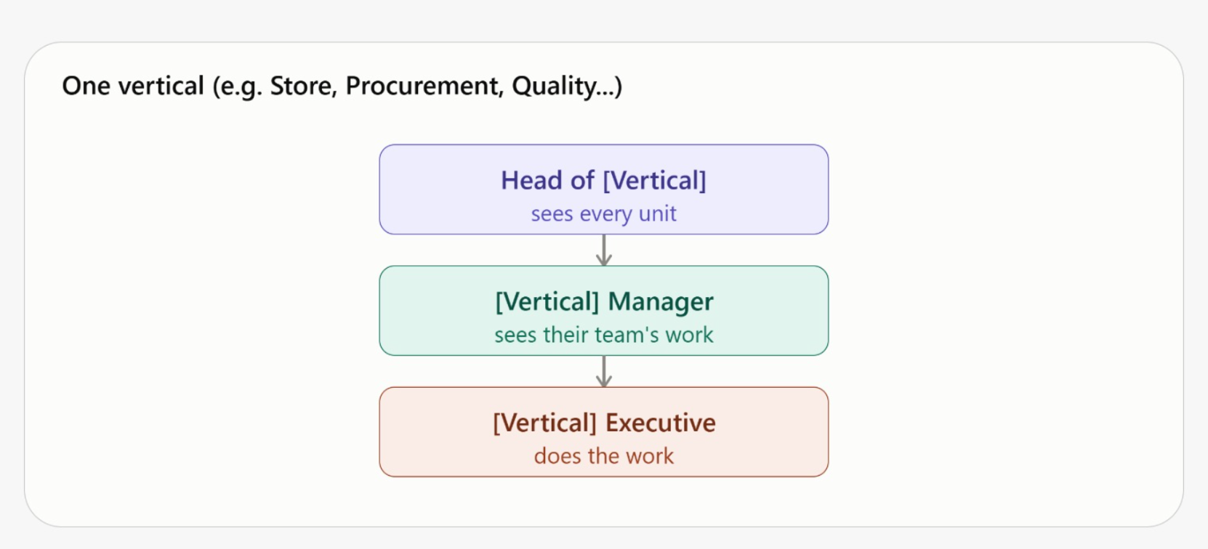
ROLE HIERARCHY
Four levels with controlled delegation
The hierarchy matches how access should flow: global control → vertical control → team control → execution.
L1
L1 Super Admin
Owns organisation-wide access, all spaces, demo seeds and configuration.
L2
L2 Head of Vertical
Creates managers, defines vertical role templates and controls vertical dashboards.
L3
L3 Manager
Creates executive roles, assigns user-specific permissions and reviews team activity.
L4
L4 Executive / Guard / Vendor
Performs work and can customise unlocked dashboard widgets.
Critical rule: child level can never assign permissions, views, widgets or data scopes outside its parent delegation ceiling.
Tan90 Manufacturing ERP MVP • Client-ready architecture deck
10

Slide 11
ACCESS ENGINE
Deep permissions, not only checkbox roles
The permission system must decide access at module, route, action, field, data and widget level.
Module
Navigation
Route/Page
Tab/Section
production.space.view
source.grn.menu
production.work_orders.show
grn.qc_tab.view
Action/Button
Field
Data Scope
Widget
qc.hold.release
vendor_invoice.value.mask
plant:BLR + team:A
dashboard.low_stock.view
Inherit
Allow
Deny
Delegable
Locked
Temporary
Approval required
Server-side decision pattern: deny by default → resolve roles → apply direct overrides → check scope → check field/action → log decision.
Tan90 Manufacturing ERP MVP • Client-ready architecture deck
11

Slide 12
MANAGER CONTROLS
User-specific permissions without editing shared roles
Managers can grant extra view/action/field/widget access to a particular subordinate when needed, but only within their own ceiling.
1
Select employee
2
Choose access type
3
Set scope
Only users inside manager team/scope
Page, action, field, saved view, widget
Plant, warehouse, team, assigned records
4
Reason + expiry
5
Preview effective access
6
Submit / approve
Temporary or permanent with audit reason
Show inherited + override + blocked items
Auto-apply or route to Head if required
Example: QC Manager gives “final_qc.release_hold” to Priya for Plant BLR only, valid 7 days, because the senior inspector is on leave. Activity log stores reason and expiry.
Tan90 Manufacturing ERP MVP • Client-ready architecture deck
12

Slide 13
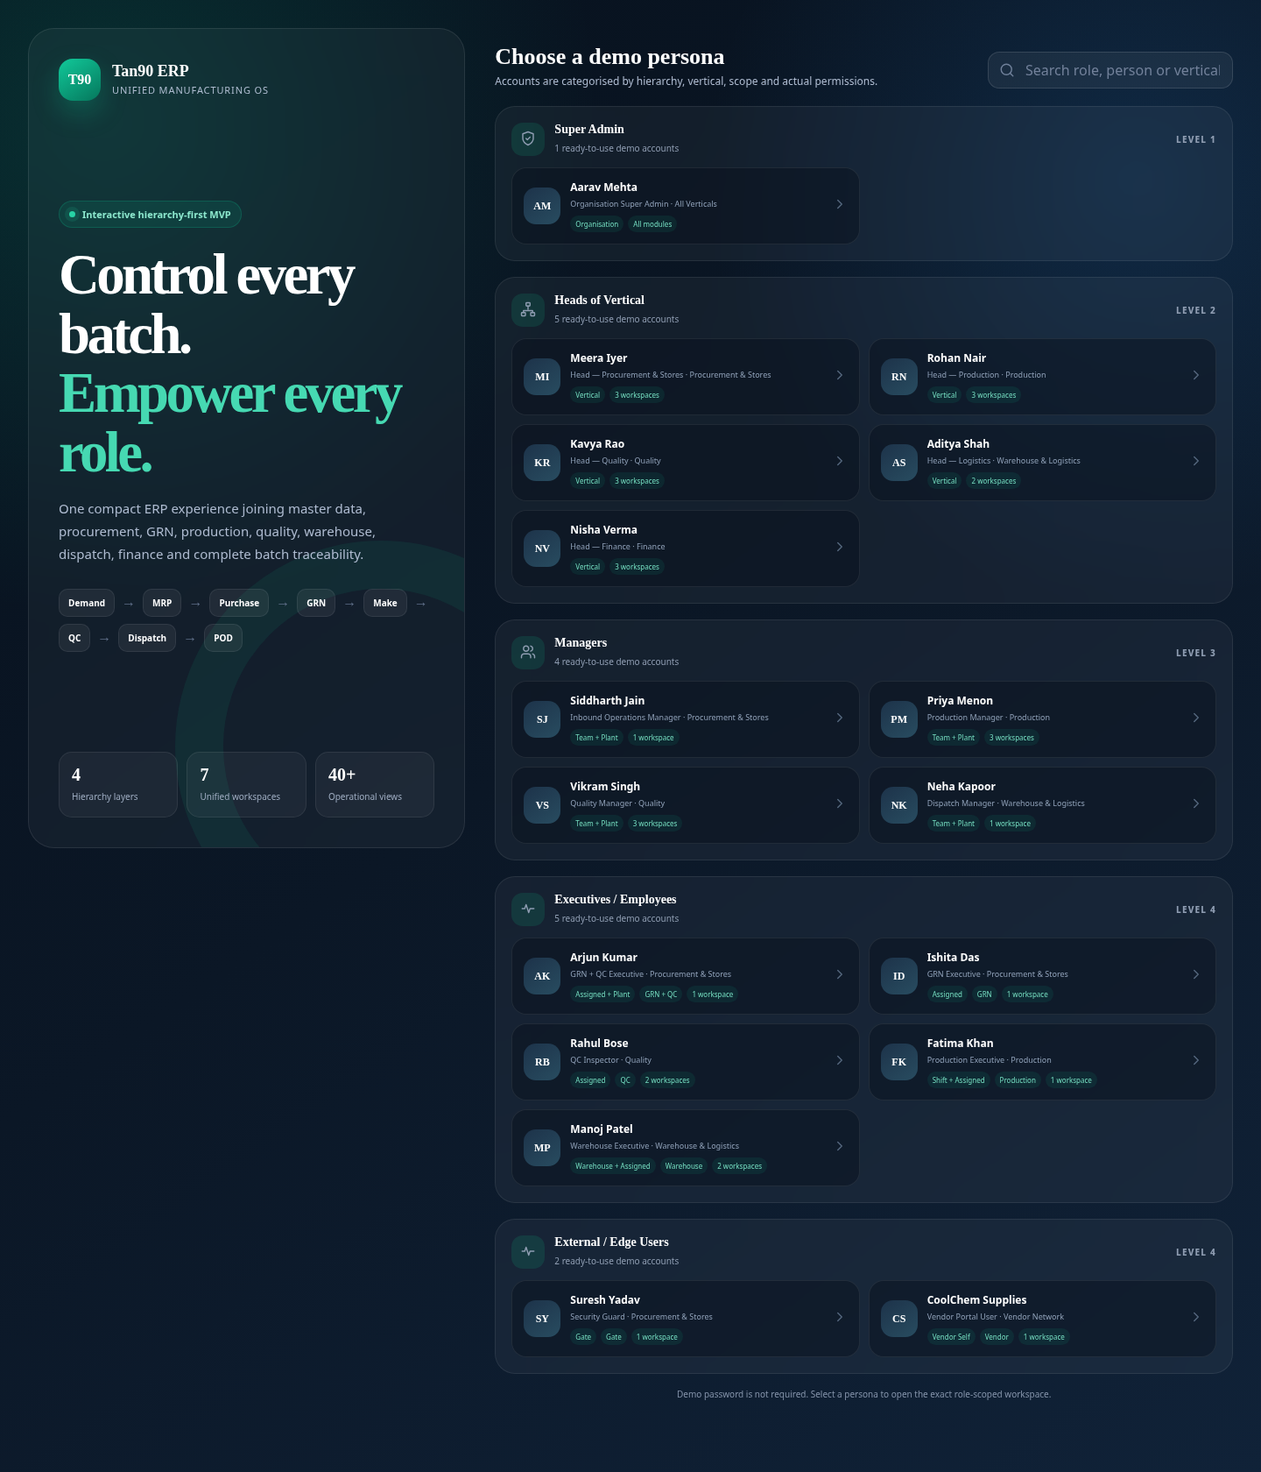
DEMO LOGIN
Categorised hierarchy-wise client testing
Client should be able to switch personas and immediately see menu, data, actions and dashboard changes.
1
Super Admin
Global Control
All spaces + seed data + audit + dashboard builder
2
Head: Production
Vertical Control
Managers, production role templates, space dashboards
3
Head: Source to Stock
Vertical Control
Procurement, GRN/QC, raw-material stock
4
Manager: GRN + QC
Team Control
Employee direct permissions, team queues, activity logs
5
Executive: GRN only
Operational
Post GRN, bin suggestion, assigned records
6
Executive: QC only
Operational
Inspect, hold, reject, release as permitted
7
Executive: GRN + QC
Hybrid Operational
Combined dashboard with both modules
8
Vendor Portal
External
ASN, delivery status, documents, limited access
Tan90 Manufacturing ERP MVP • Client-ready architecture deck
13

Slide 14
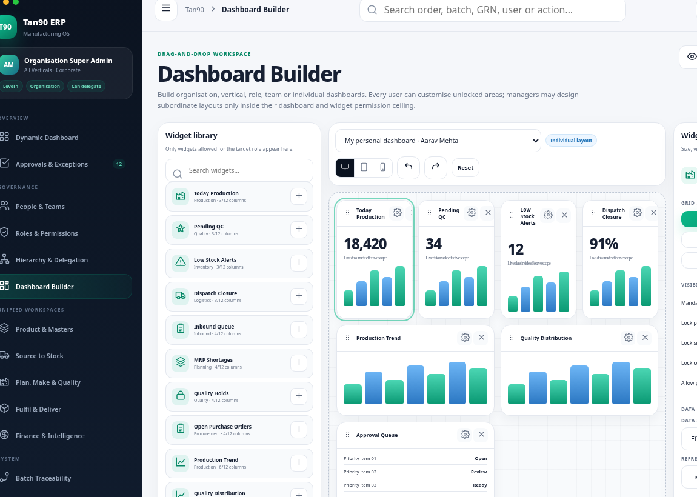
DASHBOARD BUILDER
Drag-and-drop dashboards for every level
Dashboard layouts should be controlled centrally but personalised safely by executives where unlocked.
1
Organisation default
Super Admin publishes base templates
2
Vertical default
Head configures KPIs for the vertical
3
Role template
Default dashboard for role
4
Team dashboard
Manager publishes team view
5
Individual dashboard
Manager gives user-specific widgets
6
Personal customisation
Executive reorders unlocked widgets
Widget permission is separate from dashboard layout permission. A finance widget cannot appear unless finance data access is allowed.
Tan90 Manufacturing ERP MVP • Client-ready architecture deck
14

Slide 15
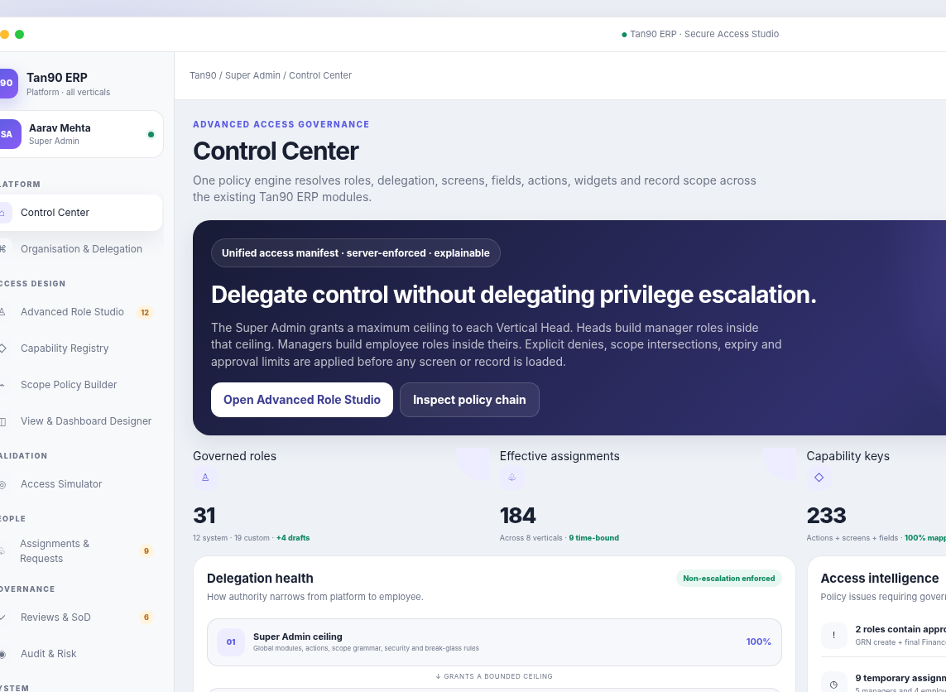
SPACE 01
Command Center & My Work
The first screen for every user: live KPIs, my tasks, approvals, alerts and exceptions based on permissions.
Live cockpit
Today production, pending QC, low stock, dispatch closure, wastage, machine utilization
My tasks
GRN pending, QC inspection, material issue, job card, approval, POD upload
Exceptions
Shortage, delay, quality hold, high wastage, unposted GRN, overdue dispatch
Drilldown
Plant-wise, SKU-wise, batch-wise, user-wise and warehouse-wise views
Tan90 Manufacturing ERP MVP • Client-ready architecture deck
15

Slide 16
SPACE 02
People, hierarchy & access control
This space controls users, roles, hierarchy, direct permissions, saved views, dashboard assignments and activity logs.
1
Manage users
2
Manage roles
3
Direct grants
Create, transfer, activate, deactivate, assign manager, team and plant
Role templates by vertical, module, screen, action, field and scope
Extra user permission with reason, expiry and ceiling validation
4
Saved views
5
Dashboard access
6
Activity logs
Column visibility, filters, field masks and row actions per role/user
Assign widget library, defaults, locks and personal customisation rights
Login, role change, permission grant, dashboard publish and employee action history
Tan90 Manufacturing ERP MVP • Client-ready architecture deck
16

Slide 17
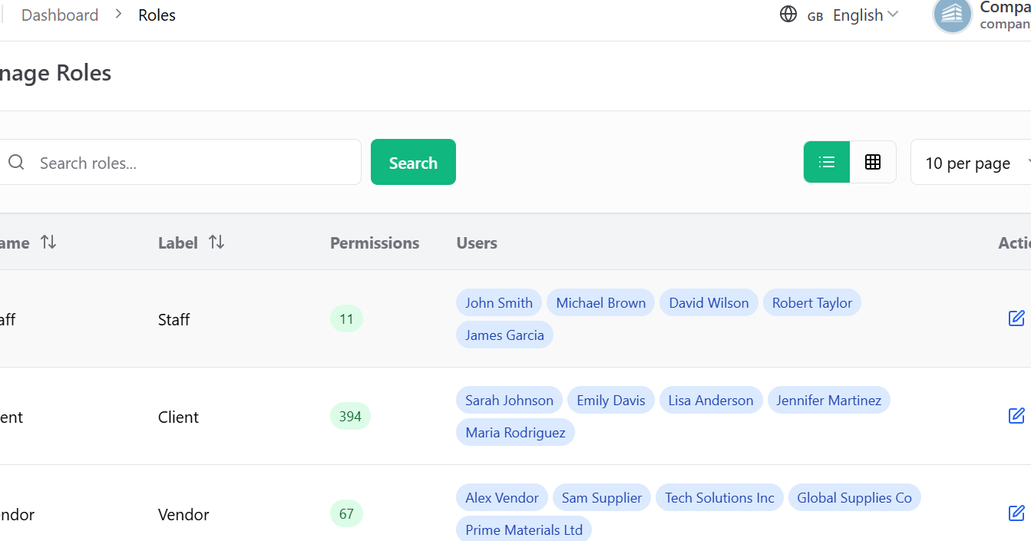
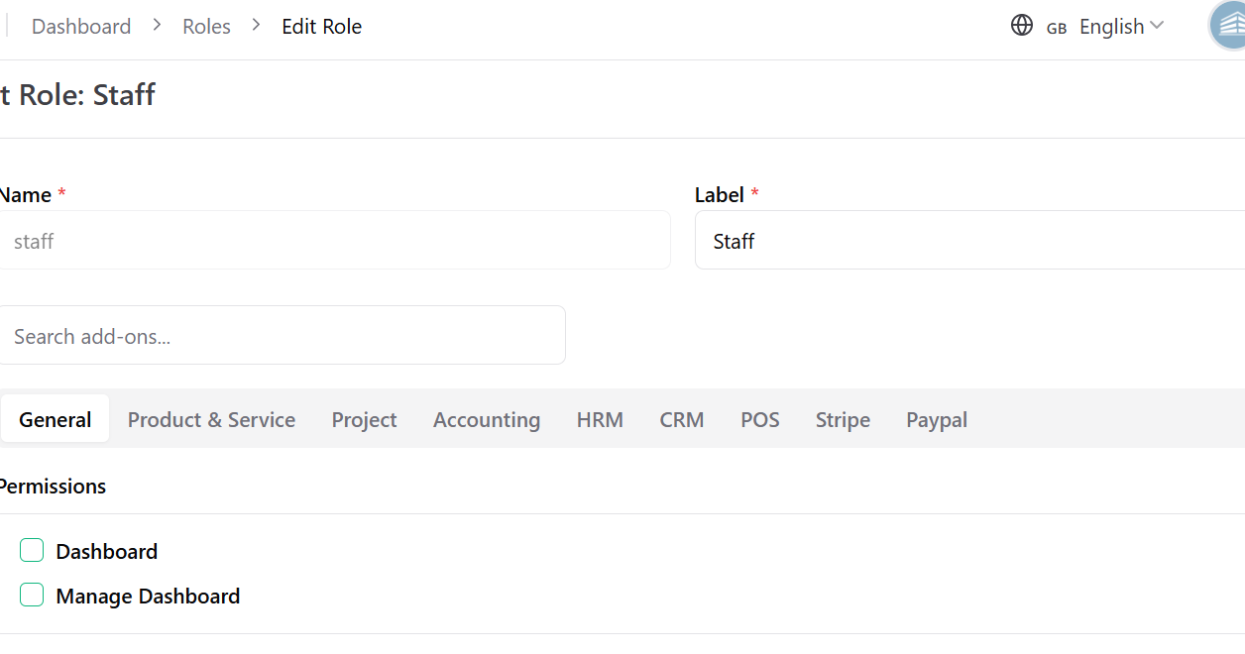
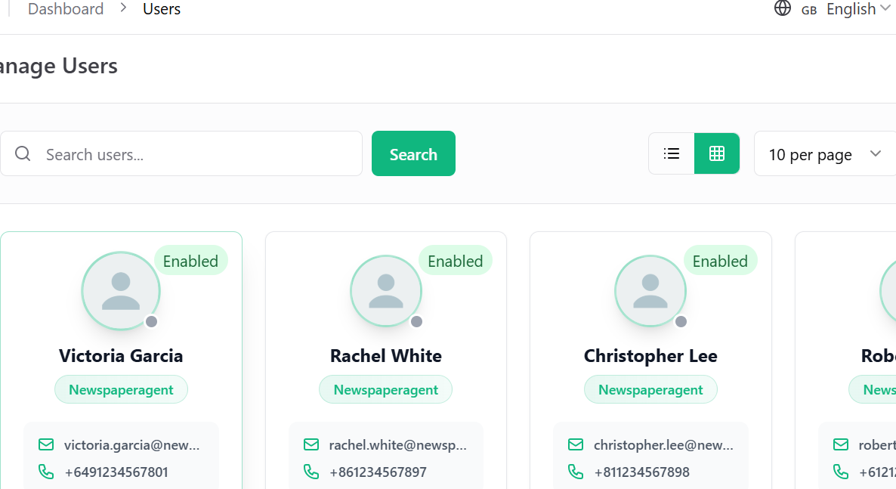
UI DIRECTION
Role/user management must feel familiar and advanced
Use the provided UI reference style, then add hierarchy, direct permissions and dashboard builder controls.
Manage Roles
Search, list/grid, permission count, users, edit/clone/delete
Edit Role
Module tabs, permissions, inherited/locked states, scopes
Manage Users
Card/list view, filters, direct grant, team transfer, activity
Enhancement required: hierarchy scope, data scope, direct overrides, saved views, field masks and widget permissions on top of this UI pattern.
Tan90 Manufacturing ERP MVP • Client-ready architecture deck
17

Slide 18
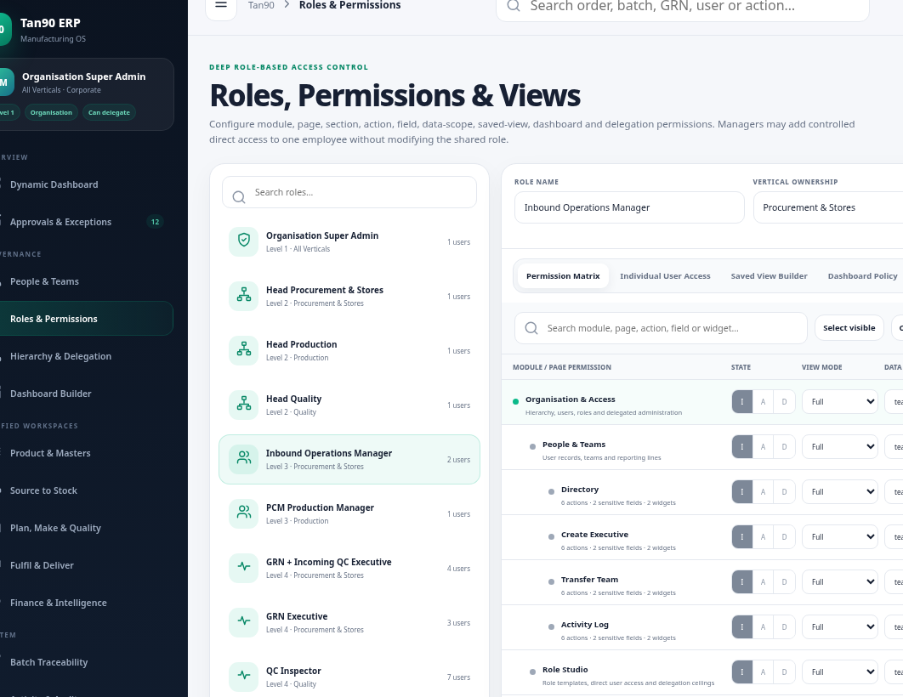
ROLE PERMISSION STUDIO
Client-ready advanced role editor
Role management should explain what is allowed, what is inherited, what is locked and what can be delegated.
Permissions
module, page, tab, action
Scope
plant, warehouse, team, records
Fields
hidden, masked, read-only, editable
Views
saved columns, filters, row actions
Users
assigned users, direct exceptions
Dashboard
widgets, locks, defaults
History
versions, compare, rollback
Every role save must show “effective access preview” before publish: allowed routes, blocked routes, data scope and impacted users.
Tan90 Manufacturing ERP MVP • Client-ready architecture deck
18

Slide 19
SPACE 03
Masters & Product Engineering
Reusable product, plant, warehouse, BOM, routing and quality setup that powers procurement, production and costing.
1
Organisation setup
2
Item & SKU master
3
BOM / Recipe
Company, business unit, plant, location, warehouse, zone, rack, shelf, bin
Finished goods, raw materials, packaging, UOM, temperature class, batch tracking
Versioned recipes, BOM lines, alternates, substitutions, release gates
4
Routing & machines
5
QC specifications
6
Costing baseline
Work centers, machine capacity, labor/machine rates, standard time
Parameters, sample size, acceptance rules, certificates, hold rules
Cost rates, rollup, standard cost, cost simulation and ECO impact
SKU
Recipe
BOM
Routing
QC Spec
MRP ready
Tan90 Manufacturing ERP MVP • Client-ready architecture deck
19

Slide 20
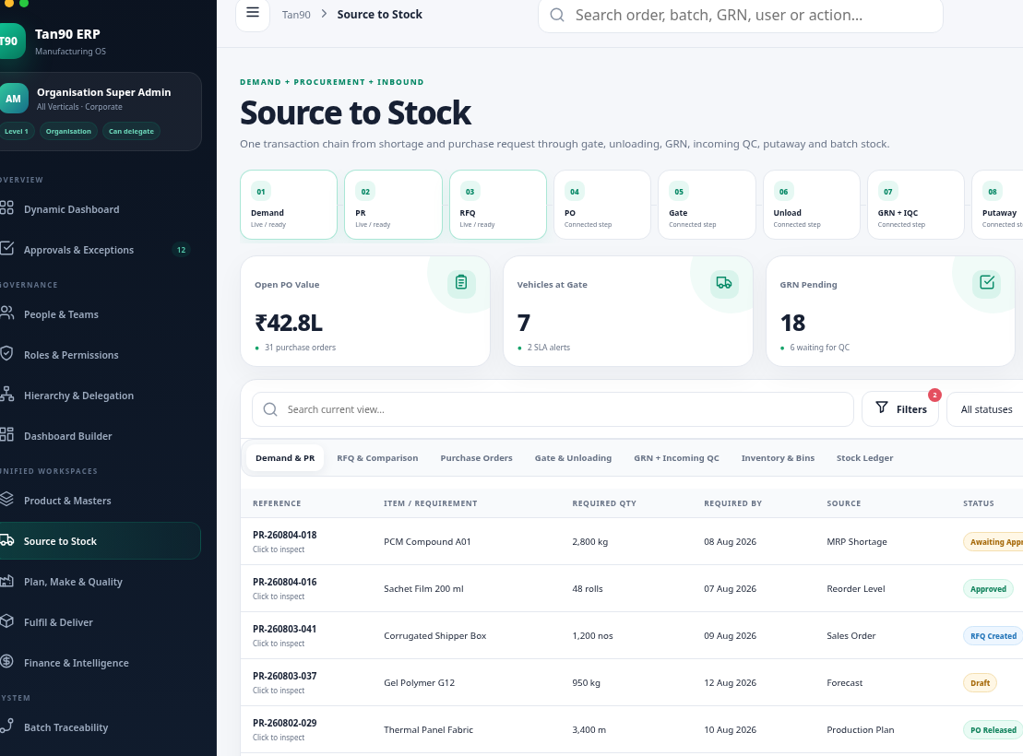
SPACE 04
Source to Stock
Procurement, vendor ASN, gate entry, unloading, incoming QC, GRN, putaway and raw-material inventory in one space.
MRP Shortage
Purchase Request
RFQ / PO
Vendor ASN
Gate Entry
Unloading
Incoming QC
GRN
Putaway
Stock Ledger
Output: trusted batch-wise raw-material stock, QC status and pending finance match.
Tan90 Manufacturing ERP MVP • Client-ready architecture deck
20

Slide 21
SOURCE-TO-STOCK FLOW
Procurement, QC and GRN should remain separated
QC should decide acceptance/rejection/hold; GRN should post stock only after QC release. This protects inventory accuracy.
PR
RFQ
PO
ASN
Gate
Unload
QC
GRN
Putaway
Ledger
shortage request
vendor quotes
purchase order
vendor dispatch
vehicle entry
qty/doc check
accept/reject/hold
stock post
bin/rack
batch stock
QC statuses
GRN controls
Finance handoff
Vendor visibility
Accepted, rejected, partially accepted, hold, rework, return to vendor
Invoice/challan match, accepted quantity only, bin suggestion, stock ledger
PO-GRN-invoice three-way match, variance and claims
ASN status, delivery documents, rejection reason, payment status
Tan90 Manufacturing ERP MVP • Client-ready architecture deck
21

Slide 22
SPACE 05
Production Space — all production modules together
A single production workspace contains demand, MRP, work orders, material issue, job cards, output, machine usage, wastage and WIP/final QC.
1
Demand & plan
2
MRP & shortage
3
Work orders
4
Material issue
sales demand, forecast, capacity
BOM explosion, stock check, PR
batch size, route, recipe version
request, approve, issue, return
5
Job cards
6
Output & wastage
7
In-process QC
8
FG receipt
operator, machine, shift
good output, scrap, consumption
sample checks, hold, rework
final QC release to warehouse
Batch-wise execution
Material control
Machine utilization
Wastage tracking
QC integration
FG handoff
Tan90 Manufacturing ERP MVP • Client-ready architecture deck
22

Slide 23
PRODUCTION FLOW
How one work order moves through the space
This is the client-demoable flow for a production manager and shop-floor executive.
Production Plan
MRP Check
Work Order
Material Issue
Target qty + due date
Material shortage
Recipe/BOM version
Store approves
Job Card
Output Entry
Final QC
FG Receipt
Machine + operator
Good + scrap
Release/rework/reject
Warehouse stock
Each step creates auditable events: who, when, plant, machine, shift, batch, material lot, output, scrap reason and QC status.
Tan90 Manufacturing ERP MVP • Client-ready architecture deck
23

Slide 24
PRODUCTION CONTROLS
Machine usage, wastage and efficiency
The MVP must capture daily/shift-wise production performance because wastage and machine utilization are core client goals.
Machine plan
Execution entry
Wastage reasons
machine allocation, capacity, planned run hours, changeover time
operator, shift, start/stop, downtime, produced qty, rejected qty
sealing issue, leakage, film waste, PCM loss, rework, scrap category
Efficiency KPIs
Approval gates
Reports
plan vs actual, OEE-ready utilization, wastage %, output per hour
manager approval for high wastage, breakdown reason, rework closure
unit-wise, machine-wise, SKU-wise, operator-wise trends
9,700
3.0%
7h
1h
Daily Output
Wastage %
Run Time
Breakdown
Tan90 Manufacturing ERP MVP • Client-ready architecture deck
24

Slide 25
QUALITY MODEL
QC is embedded at every critical gate
Quality is not a single module; it is a control layer over inward material, production WIP and finished goods release.
Incoming QC
In-process QC
Final QC
Vendor material check before stock posting
During job card execution
Before finished goods enter warehouse
Accept, reject, partial accept, hold
sample inspection, deviation, CAPA
release, rework, scrap, certificate
spec parameter
sample size
inspection value
acceptance rule
hold reason
release certificate
Quality records must attach to item, batch, supplier, work order and customer dispatch to support full traceability.
Tan90 Manufacturing ERP MVP • Client-ready architecture deck
25

Slide 26
SPACE 06
Warehouse, orders & delivery
Finished goods stock, reservations, pick-pack, dispatch, transporter handover, POD upload, returns and closure.
FG Receipt
Reservation
Pick List
Pack
Dispatch Challan
Vehicle
POD Upload
Closure
Stock accuracy
Dispatch closure
Customer traceability
bin-wise, batch-wise, FEFO/expiry, reserved vs available
vehicle, transporter, challan, invoice reference, POD status
which batch went to which customer and shipment
Tan90 Manufacturing ERP MVP • Client-ready architecture deck
26

Slide 27
SPACE 07
Finance, traceability & intelligence
Finance gets reconciliation and cost visibility; management gets reports and traceability from vendor lot to customer dispatch.
Finance controls
Traceability engine
Reports & analytics
Audit & compliance
Supplier invoice, PO-GRN-Invoice 3-way match, debit note, vendor claim
Backward/forward genealogy across vendor lot, GRN, QC, work order, dispatch
Stock aging, low stock, production efficiency, wastage, dispatch SLA, plant KPIs
Approval trail, permission changes, export history, user activity, change logs
Vendor lot
GRN
QC release
WO
Output batch
FG warehouse
Dispatch
Customer
Tan90 Manufacturing ERP MVP • Client-ready architecture deck
27

Slide 28
TRACEABILITY DIAGRAM
Backward and forward batch genealogy
The MVP should answer both questions: what went into this finished batch, and where did an affected vendor lot go?
Vendor Lot PCM-001
GRN-2026-001
Incoming QC Pass
WO-TS-BLR-021
Batch TS-BLR-001
Film Lot FLM-078
Packaging Lot PKG-11
FG Warehouse BLR
Dispatch DSP-144
ABC Pharma
Trace report output: materials used, supplier, QC results, work order, machine/shift/operator, FG batch, warehouse, dispatch and customer.
Tan90 Manufacturing ERP MVP • Client-ready architecture deck
28

Slide 29
REPORTS AND KPI CATALOGUE
What management should see from day one
Reports should be space-wise but linked through drilldown to the same batch, item, plant and period filters.
Stock
Production
Quality
Wastage
low stock, stock aging, batch balance, warehouse stock, ledger
plan vs actual, work order status, machine usage, output, downtime
pending QC, rejection %, hold status, rework, supplier quality
scrap %, material loss, reason trend, cost of waste
Dispatch
Finance
People
Traceability
pending dispatch, POD %, delivery SLA, returns, transporter performance
3-way match, cost variance, vendor claims, open invoices
activity log, approvals, permission changes, login history
vendor lot to customer, customer to source lot, affected-batch recall
34
91%
12
18,420
Pending QC
Dispatch POD
Low Stock
Today Output
Tan90 Manufacturing ERP MVP • Client-ready architecture deck
29

Slide 30
ROLE FEATURES BY SPACE
What each persona can do
The MVP should make hierarchy visible in navigation, actions, dashboards, data scope and activity logs.
Space
Super Admin
Head of Vertical
Manager
Executive
Vendor / Guard
Command Center
Global cockpit
Vertical cockpit
Team cockpit
My work
Portal tasks
People & Access
all users/roles
vertical roles
team users/direct grants
request access
none
Masters
all masters
vertical masters
view/edit assigned
view needed fields
limited
Source to Stock
all plants
source vertical
team queues
GRN/QC assigned
ASN/gate
Production
all production
production vertical
team WO/job cards
assigned job cards
none
Warehouse & Delivery
all warehouses
delivery vertical
team dispatch
assigned pick/POD
delivery docs
Traceability
all reports
vertical reports
team reports
own scope
own docs
Tan90 Manufacturing ERP MVP • Client-ready architecture deck
30

Slide 31
MVP SCREEN MAP
Screens needed for a complete demo
These are the minimum screen families to make the ERP look complete and operational.
1
Command
Dashboard, My Tasks, Approvals, Alerts, Exceptions
2
Access
Manage Users, Manage Roles, Edit Role, Direct Grant, Saved View, Dashboard Builder, Activity Log
3
Masters
Company, Plant, Warehouse, Bin, SKU, Raw Material, Vendor, Customer, Machine, QC Spec, BOM/Recipe
4
Source
MRP Shortage, PR, PO, ASN, Gate Entry, Unloading, QC, GRN, Putaway, Stock Ledger
5
Production
Plan, MRP, Work Order, Material Request, Issue, Job Card, Output, Machine, Wastage, Final QC
6
Delivery
FG Receipt, Transfer, Allocation, Pick Pack, Dispatch Challan, Vehicle, POD, Return
7
Finance/Reports
3-way Match, Claims, Cost Variance, Traceability, Stock, Production, QC, Wastage, Dispatch Reports
Tan90 Manufacturing ERP MVP • Client-ready architecture deck
31

Slide 32
DATA ARCHITECTURE
MVP database domains
Instead of hundreds of random tables, group data around domains and event ledgers.
Organisation
Identity & Access
Product Engineering
companies, units, plants, warehouses, bins, teams
users, roles, permissions, scopes, direct grants, dashboards
items, BOMs, recipes, routings, QC specs, versions
Procurement
Inventory
Production
PR, PO, vendor ASN, gate entry, unloading docs
stock lots, inventory transactions, bins, reservations, transfers
plans, MRP runs, work orders, job cards, outputs, wastage
Quality
Fulfilment
Finance & Audit
inspections, holds, rework, rejection, release certificates
sales demand, pick lists, dispatch, vehicle, POD, returns
invoice match, claims, cost events, audit logs, reports
Tan90 Manufacturing ERP MVP • Client-ready architecture deck
32

Slide 33
TECHNICAL IMPLEMENTATION
Additive Laravel MVP layer
Build the new spaces beside existing Tan90 pages using Laravel policies, services and event ledgers. Existing workflows continue to work.
Existing Tan90 pages
Guard, vendor, unloading, QC, GRN, finance, master data, BOM/recipe/costing
New workspace shell
Space landing pages, unified navigation, dashboard panels, role-aware menus
Access engine
Hierarchy, roles, direct grants, field rules, route middleware, data scopes
Domain services
Source-to-stock, production, quality, warehouse, finance, traceability
Event ledgers
inventory, batch, cost and audit events
Future integrations
Tally/Zoho, WhatsApp/SMS, barcode/QR, vendor/customer portal, optional IoT
Access rollout modes: legacy → hybrid → advanced. New permission checks apply first to new workspaces and opted-in users.
Tan90 Manufacturing ERP MVP • Client-ready architecture deck
33

Slide 34
MVP ROADMAP
Client-demoable delivery in practical phases
Phase by business value and a complete operating story, not by department wishlist.
Phase 1
Phase 2
Phase 3
Phase 4
Foundation
Source to Stock
Production Space
Delivery + Intelligence
spaces shell, hierarchy, demo logins, users/roles, masters, dashboard base
MRP shortage, PR/PO, gate, unloading, QC, GRN, stock ledger
plan, MRP, work order, material issue, job card, output, wastage, final QC
FG warehouse, dispatch/POD, 3-way match, traceability, reports, dashboard builder
MVP acceptance: one real sample order can move from demand through production and dispatch while roles, dashboards, reports and traceability update.
Tan90 Manufacturing ERP MVP • Client-ready architecture deck
34

Slide 35
CLIENT DEMO SCRIPT
What to show in the first walkthrough
Use one Thermal Sachet batch and switch persona at each step to prove hierarchy, controls and traceability.
1
Super Admin
Open command dashboard; show all spaces, hierarchy and seed data
2
Head / Source
MRP shortage creates PR/PO; vendor ASN appears
3
Guard / Store / QC
Gate entry → unloading → incoming QC → GRN posts accepted qty
4
Production Manager
Create work order, issue material, start job card
5
Executive
Enter output, wastage, downtime and in-process QC result
6
Warehouse / Logistics
FG receipt → pick pack → dispatch → POD closure
7
Management
Open traceability report and KPI dashboards
8
Manager
Grant temporary extra view to one employee and show activity log
Tan90 Manufacturing ERP MVP • Client-ready architecture deck
35

Slide 36
MVP ACCEPTANCE CRITERIA
How we know the MVP is complete
The MVP is complete when it can run the full demo story and prove access control without breaking current pages.
1
Complete flow
Demand → MRP → PO → Gate → QC → GRN → Stock → WO → Output → Final QC → Dispatch → POD
2
Role hierarchy
Super Admin, Head, Manager, Executive, Guard/Vendor demo logins with correct menus and data
3
Advanced permissions
Route/action/field/data/widget decisions are enforced server-side and logged
4
Dashboard builder
Org, vertical, role, team and user dashboards can be published and customised safely
5
Traceability
Finished batch traces backward to vendor lots and forward to dispatch/customer
6
Compatibility
Existing Tan90 pages and current workflows remain unchanged unless user is opted into advanced mode
Tan90 Manufacturing ERP MVP • Client-ready architecture deck
36

Slide 37
CLIENT DECISIONS NEEDED
Confirm before implementation
These decisions will lock scope and prevent overbuilding.
Plants and warehouses
Products and BOMs
QC parameters
Final list of manufacturing units, raw-material warehouses and FG warehouses.
Thermal Sachet, Thermal Panel and top SKUs to seed in demo data.
Incoming, in-process and final QC specification fields.
User hierarchy
Barcode / QR
Finance integration
Real department heads, managers, teams and approval limits.
Needed in MVP or Phase 2?
Manual 3-way match first, or immediate Tally/Zoho integration?
After decisions: convert this deck into Codex implementation plan + Laravel migrations/services/policies/UI tasks.
Tan90 Manufacturing ERP MVP • Client-ready architecture deck
37

Slide 38
SCREEN REFERENCE BOARD
Screens already aligned for MVP approval
These screens communicate the desired visual direction for the client walkthrough.
Dynamic dashboard
Source to Stock
Role Studio
Dashboard Builder
Manage Roles
Manage Users
Tan90 Manufacturing ERP MVP • Client-ready architecture deck
38

Slide 39
REFERENCES
Research sources used
Sources are used to support the MVP scope, access-control model and traceability approach.
Tan90 live blueprint
tan90.tesmed.in — MVP scope and cockpit direction
Tan90 modules page
tan90.tesmed.in/modules.html — module explorer intent
Tan90 roadmap
tan90.tesmed.in/roadmap.html — MVP phases and demo script
Uploaded Tan90 requirement notes
E2E flow, 10 core modules and 16 full modules
Current Laravel repository
Laravel 13.8, Livewire/Volt, operational roles, master-data and BOM registries
NIST RBAC
Core and hierarchical RBAC model for role inheritance
OWASP Authorization Cheat Sheet
Least privilege, deny by default, validate every request
GS1 Traceability
Critical Tracking Events and Key Data Elements for lifecycle traceability
ISA-95
Manufacturing operations management and enterprise-control integration model
Tan90 Manufacturing ERP MVP • Client-ready architecture deck
39

