Slide 1

myPhotos
Tahmina Yousafi

Slide 2

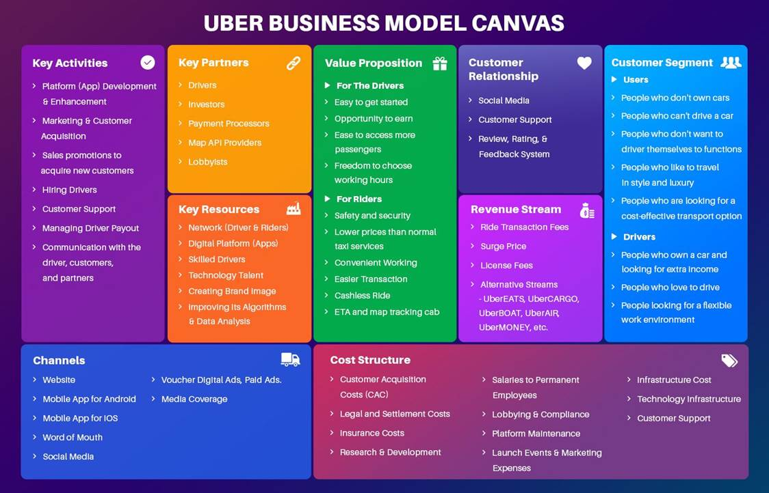
Business Model Canvas
Key Activities
nskjdskjcns
Key Activities
nskjdskjcns
Key Activities
nskjdskjcns
Key Activities
nskjdskjcns

