Slide 1
Photo website
Tahmina Yousafi

Slide 2
Inspirations
Google Photos
iPhoto
Photos on Windows

Slide 3
Frontend
Backend
Typescript
React
Hooks
Node Express
S3 buckets on AWS

Slide 4
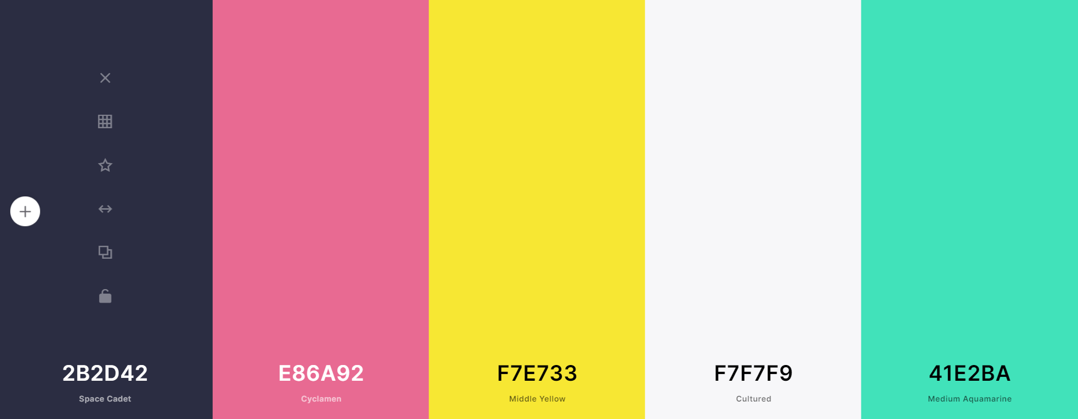
Color Scheme

Slide 5
fonts
Logo: Otomanopee One
Headers: Poppins
Text: Roboto

Slide 6
Demo

Slide 7
Done so far
To do
Many of the frontend pages, designs, and layouts
User interactions
Initial attempts at Node Express
Connecting the pages, fixing links, good flow of website
Other frontend features (slideshows, albums, editing info)
Node Express
AWS connection
Uploading and storing images
Login/Accounts

