Slide 1
A RELIABLE AND OPTIMIZED APPROACH FOR SPOT PRICE PREDICTION USING TIME SERIES ANALYSIS
TEAM MEMBERS:
S TAMIL SELVAN(9325)
J FAIJUL MEERAN(8846)
M SHRIDHARAN(8862)
PROJECT SUPERVISOR
Mrs.LIJITHA.C.JAFFRIN

Slide 2
ABSTRACT
Public cloud providers, such as Amazon EC2, offer idle computing resources known as spot instances at a much cheaper rate compared to On-Demand instances.
Spot instance prices are set dynamically according to market demand. Cloud users request spot instances by submitting their bid, and if user’s bid price exceeds current spot price then a spot instance is assigned to that user.
The problem however is that while spot instances are executing their jobs, they can be revoked whenever the spot price rises above the current bid of the user.

Slide 3
  In such scenarios and to complete jobs reliably, we propose a set of improvements for the cloud spot market which benefits both the provider and users.
  This proposed system reports the typical content of this method kit, including a group of central tendency analysis methods and two types of distribution modeling analysis methods.
  In a generic sense, we particularly argue that open methods act as a higher-level strategy over open-source tools and open-access data for scientific studies in any research domain.

Slide 4
INTRODUCTION
Based on an arc cotangent-function-type system model, our novel bidding mechanism imitates fuzzy and intuitive human activities to refine and issue new bids according to previous errors.
The validation is conducted by using Amazon’s historical spot price trace to perform a set of simulations and comparisons.
The result shows that the feedback control-based mechanism obtains a better trade-off between bidding rationality and success rate than the other five comparable strategies.
Although this mechanism is only for black-box bidding (price prediction) at this current stage, it can be conveniently and gradually upgraded to take into account external constraints in the future

Slide 5
EXISTING SYSTEM
The existing system aims to present logistic regression model to predict one-week-ahead and one-day-ahead spot prices. The prediction would assist cloud users to plan in advance when to acquire spot instances, estimate execution costs, and also assist them in bid decision making to minimize execution costs and out-of-bid failure probability
Drawbacks of Existing System
✵ Long-term revenue is minimized
✵ Not at-all best-fit billing cycle to maximize social welfare
✵ VM Overhead Maintenance cost is not considered

Slide 6
PROPOSED SYSTEM
Amazon’s spot price history cannot directly be treated as pure price values without considering the prices’ timestamps. For example, it is inaccurate to calculate the average price (or mean) by using the price values only, because the spot service changes (and records) price irregularly, while its unchanged price can still be recorded from time to time.
Advantages of Proposed System
✓ Provides market-driven dynamic pricing mechanisms
✓ Revenue maximization problem addressed
✓ Supports non-homogeneous demand model

Slide 7
Existing Algorithm:
Logistic Regression
Proposed Algorithm:
Arima (Autoregressive Integrated Moving Average)
Advantages of Proposed System:
✓ Easy Implementation
✓ Constantly evolves with new data
✓ Low Computational cost

Slide 8
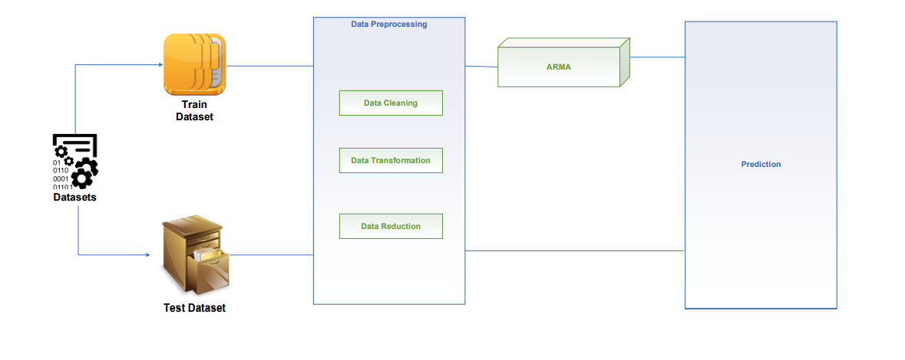
ARCHITECTURE DIAGRAM

Slide 9
MODULES DESCRIPTION
DATA ANALYSIS
The terms data visualization and information visualization (casually, data viz and info viz) are useful for referring to any visual representation of data that is: algorithmically drawn (may have custom touches but is largely rendered with the help of computerized methods); easy to regenerate with different data (the same form may be repurposed to represent different datasets with similar dimensions or characteristics); often aesthetically barren (data is not decorated); and relatively data-rich (large volumes of data are welcome and viable, in contrast to infographics)

Slide 10
DATA CLEANING & TRANSFORMATION
Data cleaning is the process of fixing or removing incorrect, corrupted, incorrectly formatted, duplicate, or incomplete data within a dataset. When combining multiple data sources, there are many opportunities for data to be duplicated or mislabeled. If data is incorrect, outcomes and algorithms are unreliable, even though they may look correct.

Slide 11
TIME SERIES ANALYSIS
Time series analysis is a statistical technique that deals with time series data, or trend analysis. Time series data means that data is in a series of particular time periods or intervals. A set of observations on the values that a variable takes at different times

Slide 12
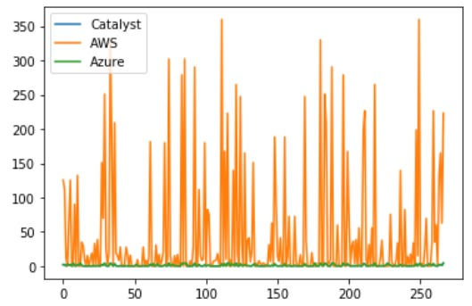

Slide 13
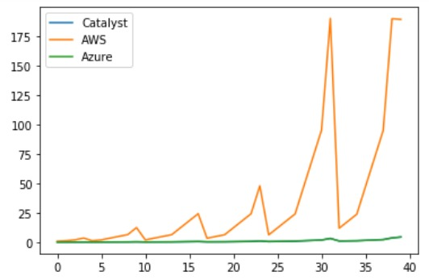

Slide 14
CONCLUSION
The problem considered by us in this paper is related to studying global temporal and spatial trends in Amazon EC2 compute optimized spot instance prices which would assist in planning for spot instance purchase in various Amazon EC2 regions with an objective of lowering out-of-bid failure and monetary cost for batch processing of compute optimized jobs.

Slide 15
FUTURE ENHANCEMENT
In the future, we will explore a dynamic solution to cope with the changing demands of users and providers. We plan to exploit the best-fit auction based policies to suit the new fine-grained pricing scheme in the future

Slide 16
REFERENCES
[1] S. Yi, A. Andrzejak, and D. Kondo, “Monetary Cost-Aware Checkpointing and Migration on Amazon Cloud Spot Instances,” IEEE Transactions on Services Computing, vol. 5, no. 4, pp. 512–524, 2012
[2] V. K. Singh and K. Dutta, “Dynamic Price Prediction for Amazon Spot Instances,” 2015 48th Hawaii International Conference on System Sciences, Jan. 2015
[3] R. Wolski, and J. Brevik. "Providing statistical reliability guarantees in the AWS spot tier." In Proceedings of the 24th High Performance Computing Symposium, p. 13. Society for Computer Simulation International, 2016
[4] K. Xu, Y. Zhang, X. Shi, H. Wang, Y. Wang, and M. Shen, “Online combinatorial double auction for mobile cloud computing markets,” in Proc. IEEE IPCCC ’14, Dec. 2014, pp. 1–8.

Slide 17
THANK YOU

