Slide 1




NEXT GEN EMPLOYABILITY PROGRAM
Creating a future-ready workforce
Team Members
College Name
Student Name :K.Tamiloli
Student ID :912421104050
Shanmuganathan engineering college

Slide 2

CAPSTONE PROJECT SHOWCASE
Project Title
Voting Application using Django Framework-tamiloli-(4050,SEC)
Abstract | Problem Statement | Project Overview | Proposed Solution | Technology Used | Modelling & Results | Conclusion

Slide 3
Abstract : Django Online Voting System
We will create a pollster (voting system) web application using Django. This application will conduct a series of questions along with many choices. A user will be allowed to give voting for that question by selecting a choice. Based on the answer the total votes will be calculated and it will be displayed to the user. Users can also check the result of the total votes for specific questions on the website directly. We will also build the admin part of this project. Admin user will be allowed to add questions and manage questions in the application.
Source :

Slide 4
Problem Statement
The primary objective of the Python Django online voting system is
to provide a convenient and efficient method for eligible voters to cast their votes using the internet.
Voters can access the voting process through a secure website or a dedicated voting application.
Aim to build a web application that facilitate voting on various questions . User can select their preferred choice for each question and t6he system will calculate and display the total votes
Source :

Slide 5
Project Overview
Application name : Voting Application
Category :Web application
Features :
1)conduct polls with questions and multiple choices
2)Allow user to vote for their preferred choice
3)Display the votes for each questions
4)admin panel for adding and managing questions
Technologies Used:
Django Framework to create a backend and handle database
SQLite Database Django come with sqlite by default
Source :

Slide 6
Proposed Solution
.
Implementation of the Project
Creating Project
Create Models
Create an Admin User
Create Views
Create Templates
Create Landing Page
Create routing inside the main urls.py file of the application
Testing of the Application
User Frontend
Source :

Slide 7
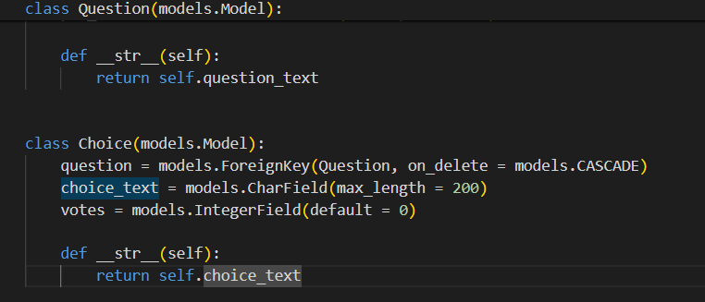
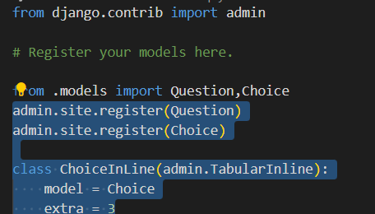
Models.py
Admin.py
Source :

Slide 8
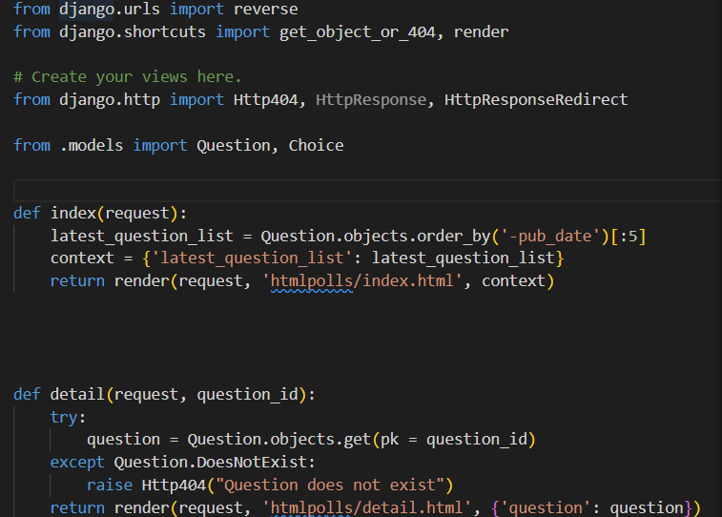
Views.py
Create view to handle displaying polls and submitting
votes
Source :

Slide 9


Technology Used
Front-end
Back-end
Source :

Slide 10
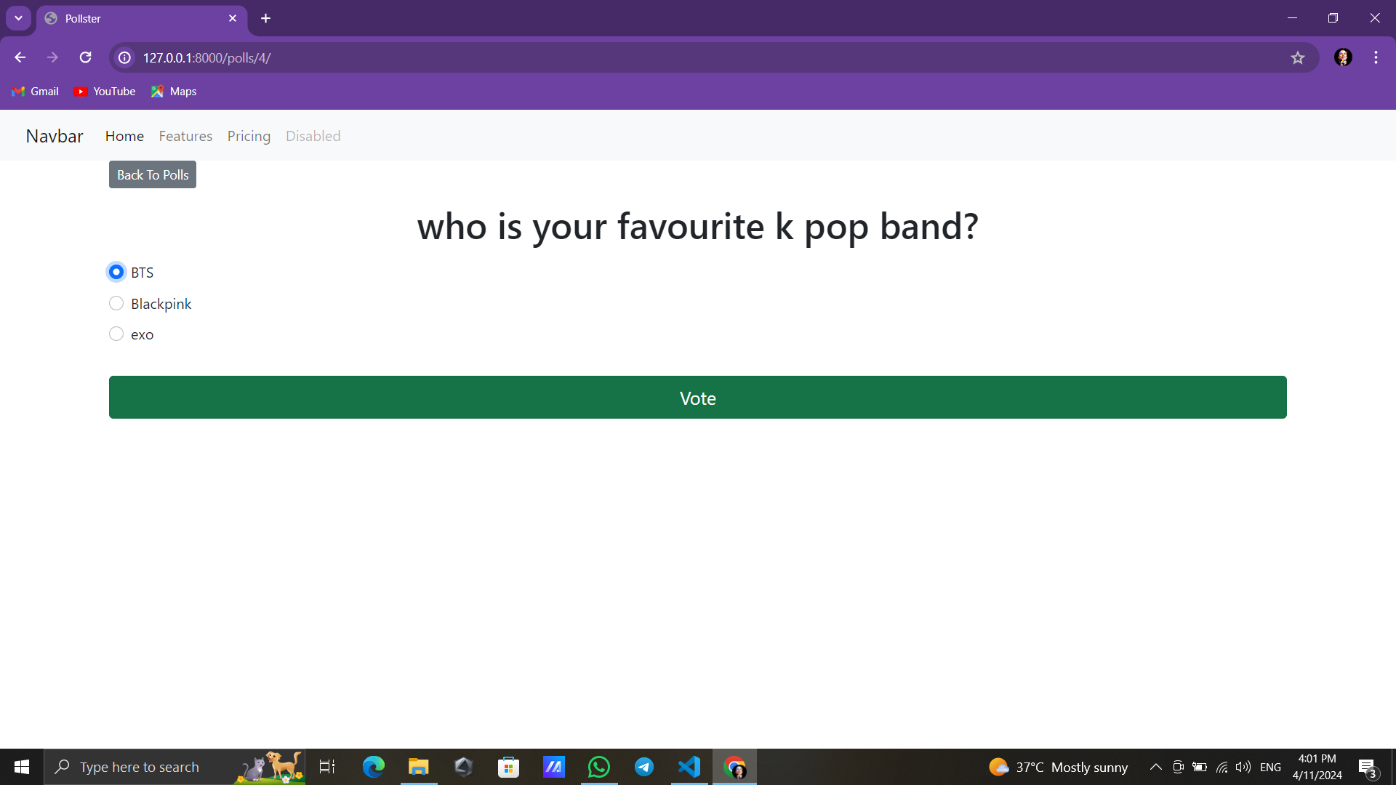
Modelling & Results
Source :

Slide 11
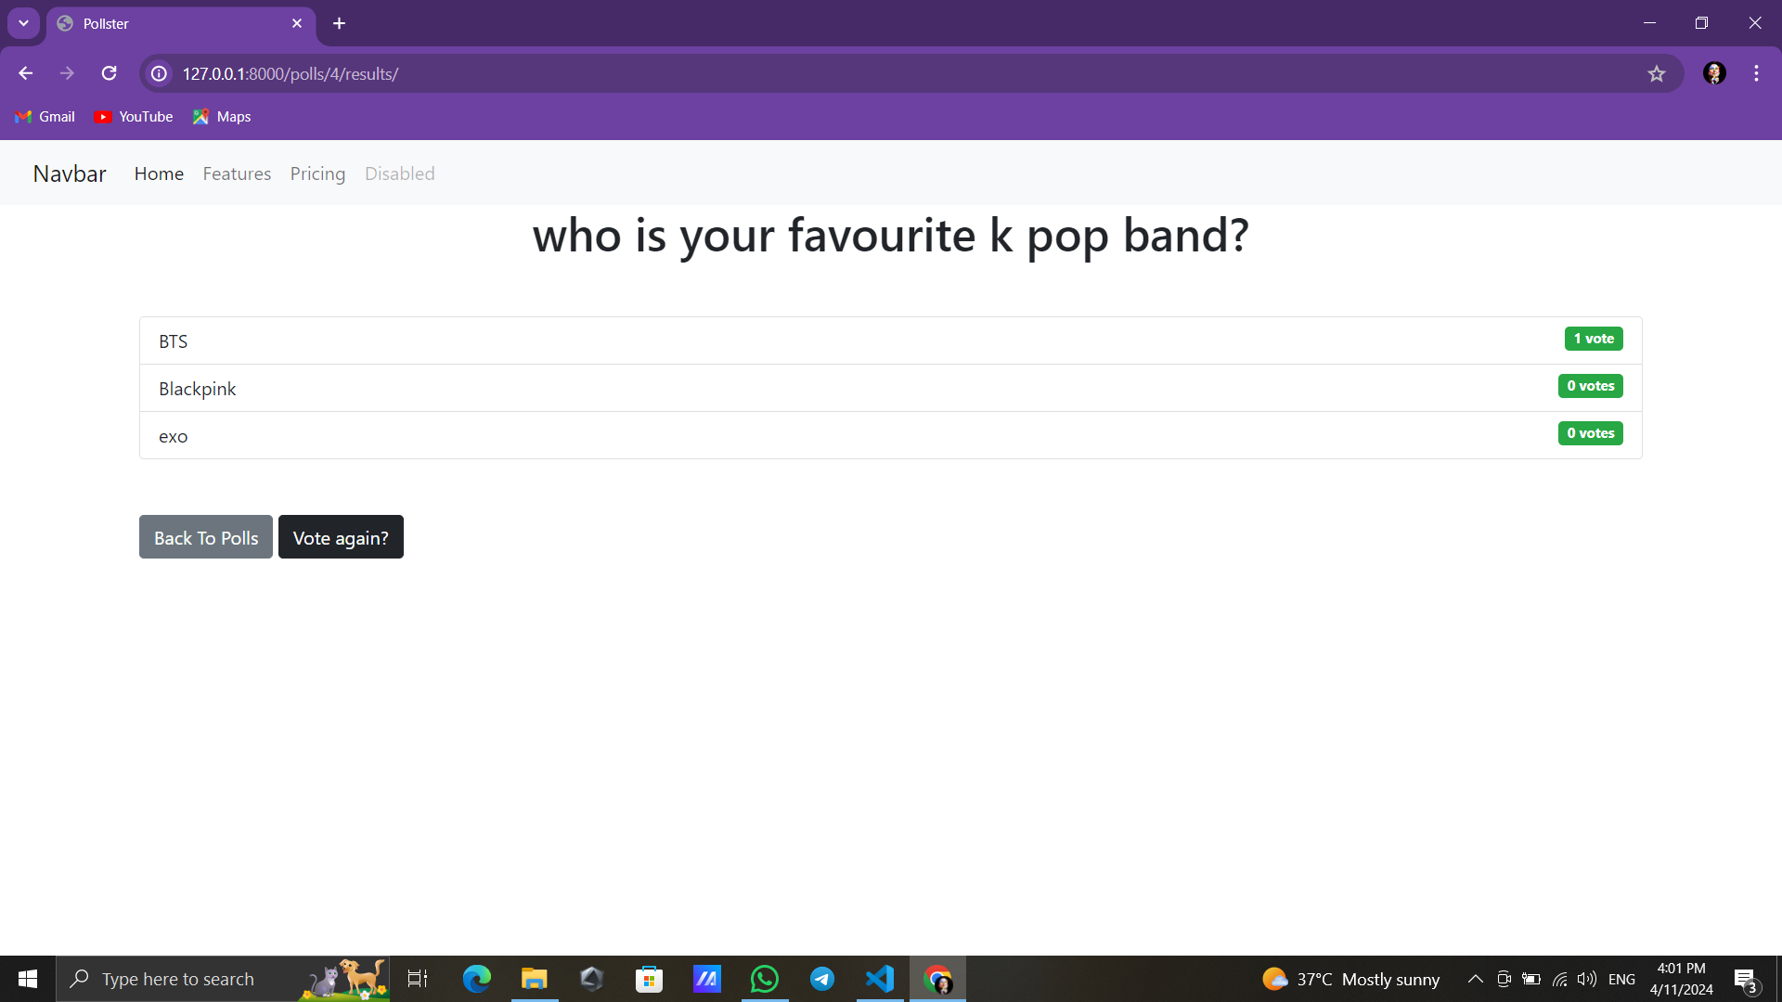

Slide 12
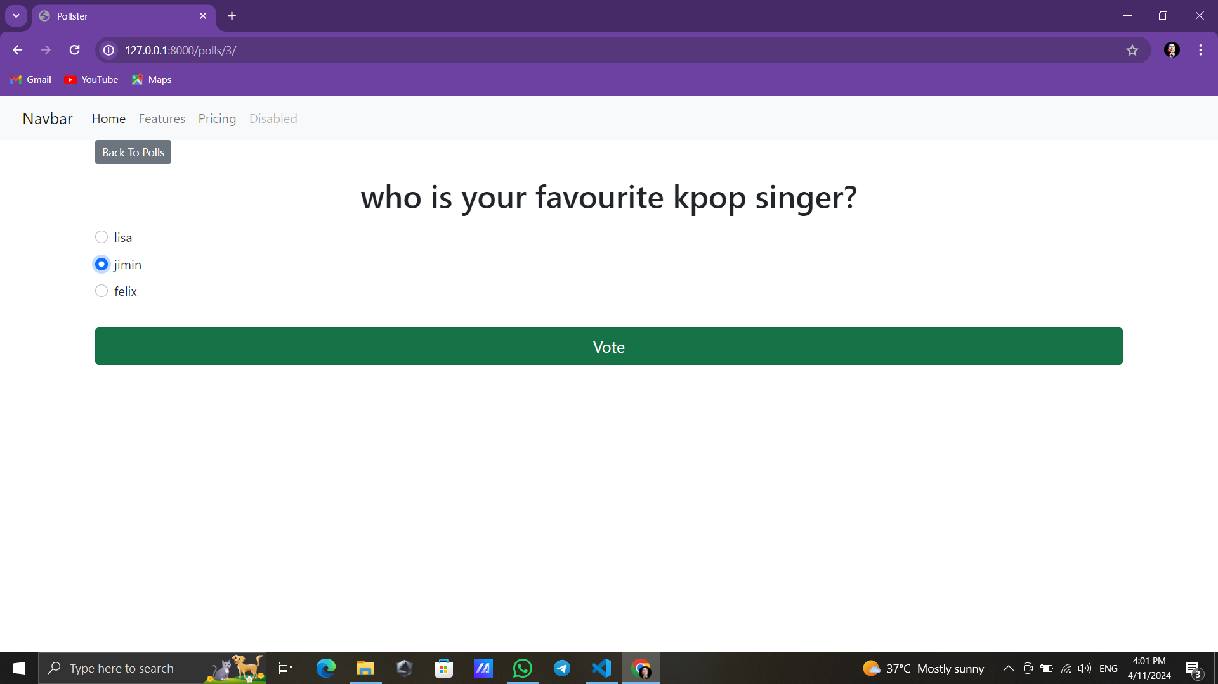


Slide 13
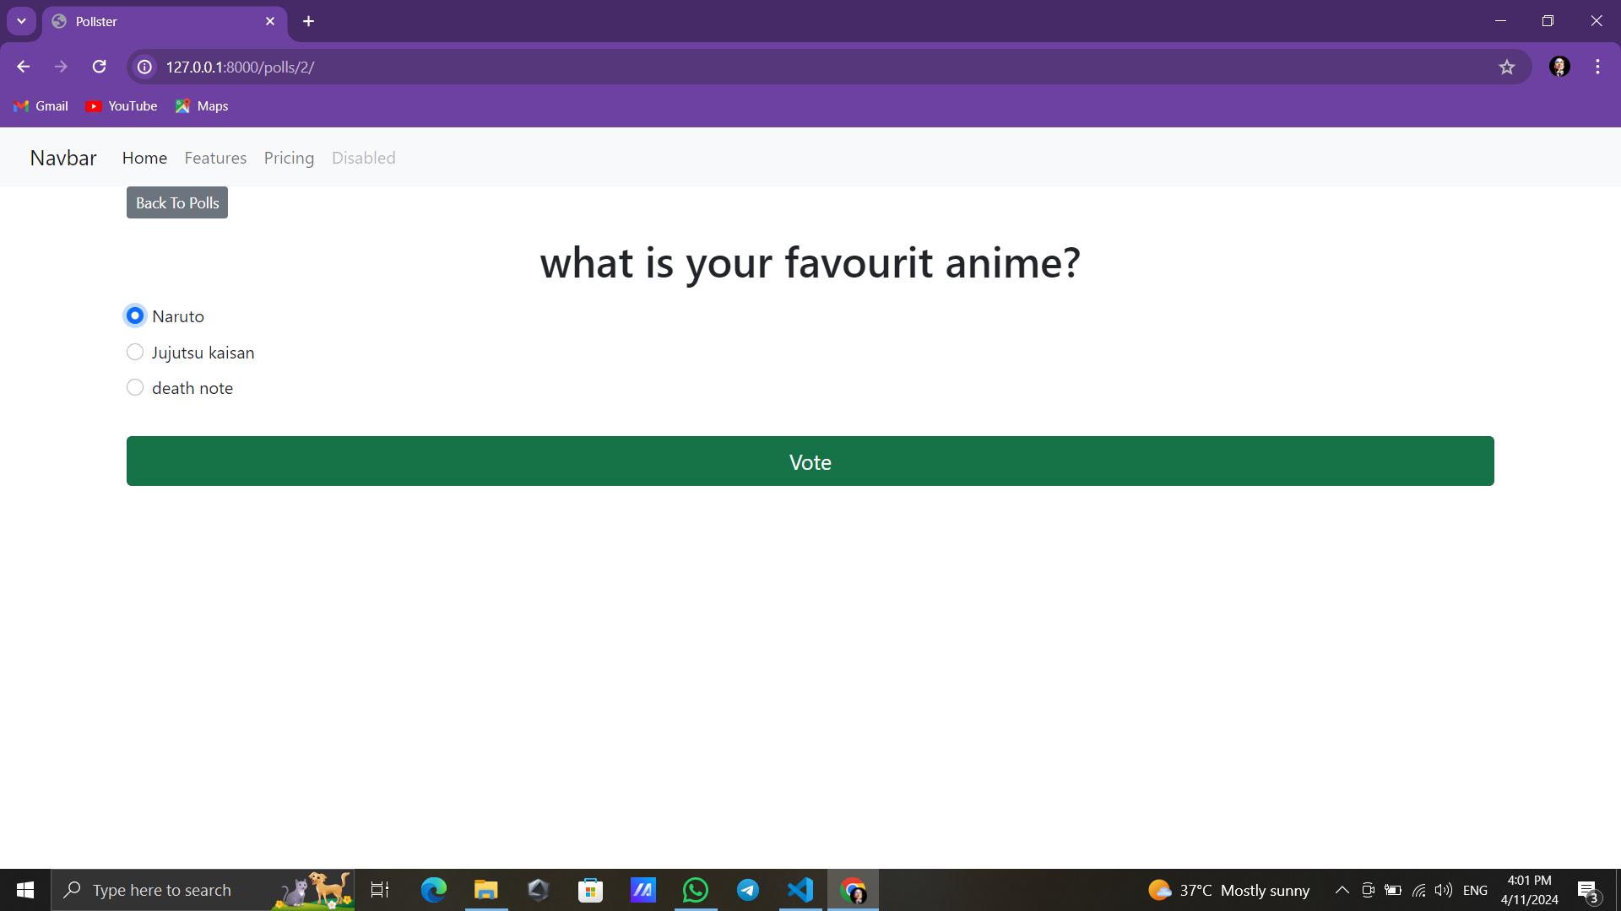
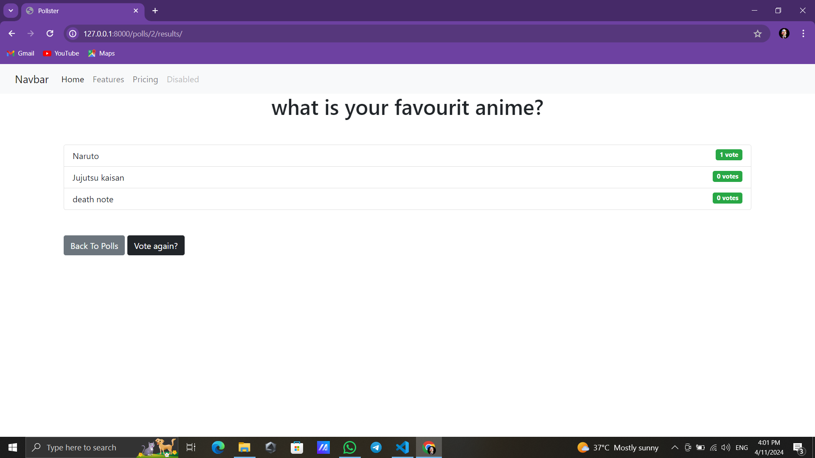

Slide 14
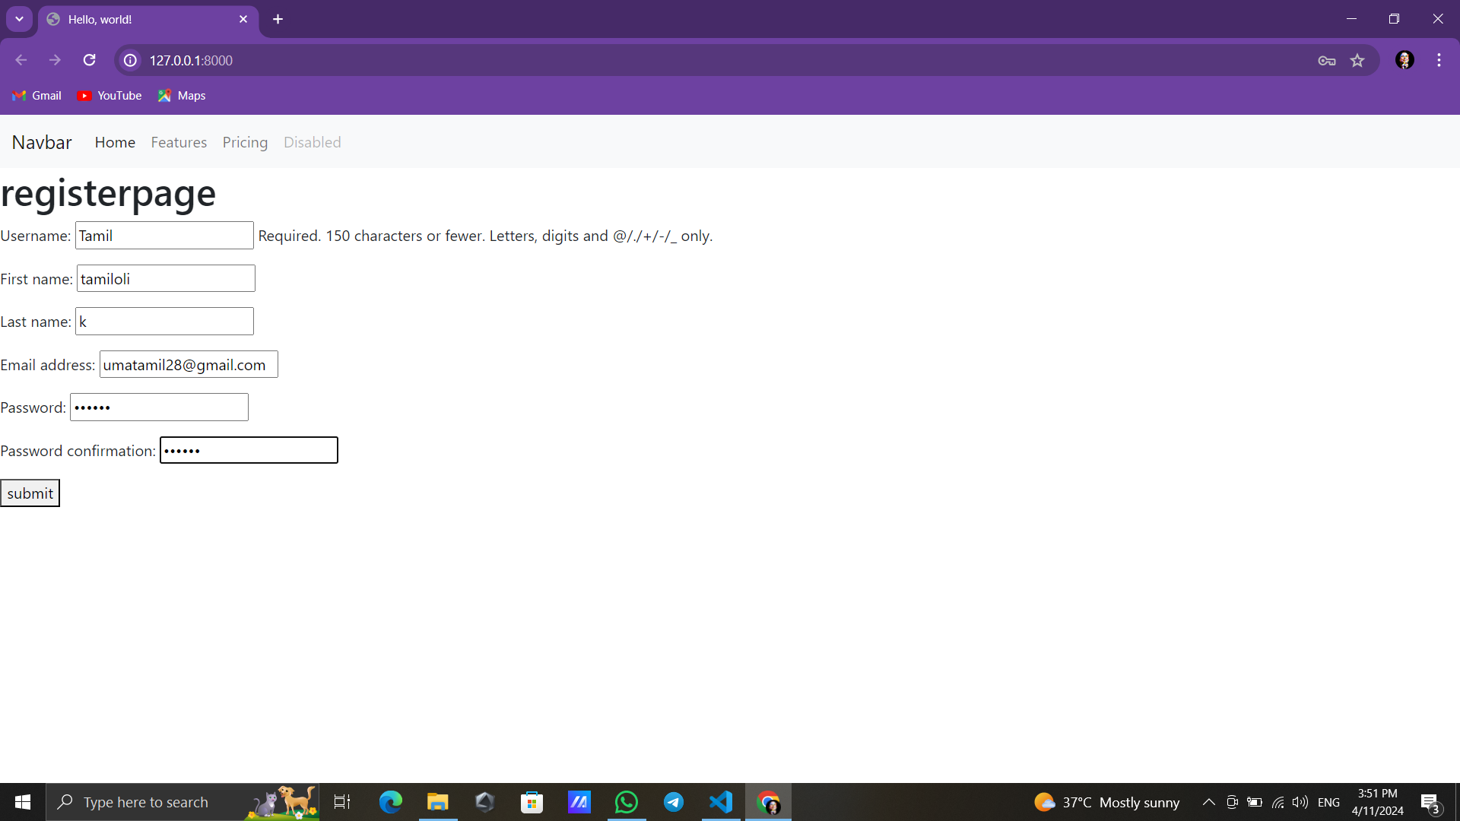
Register page

Slide 15
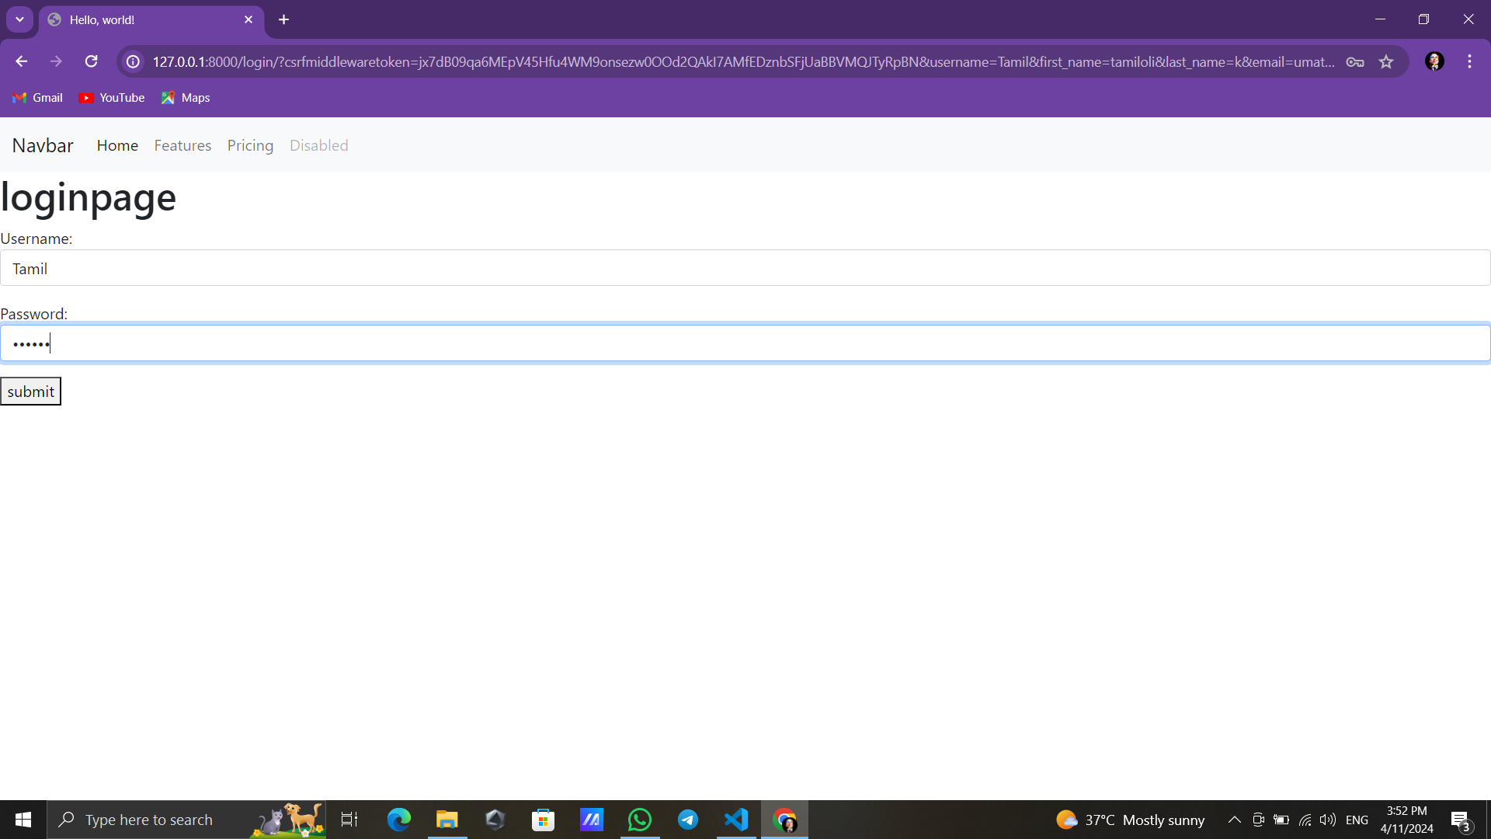
Login page

Slide 16
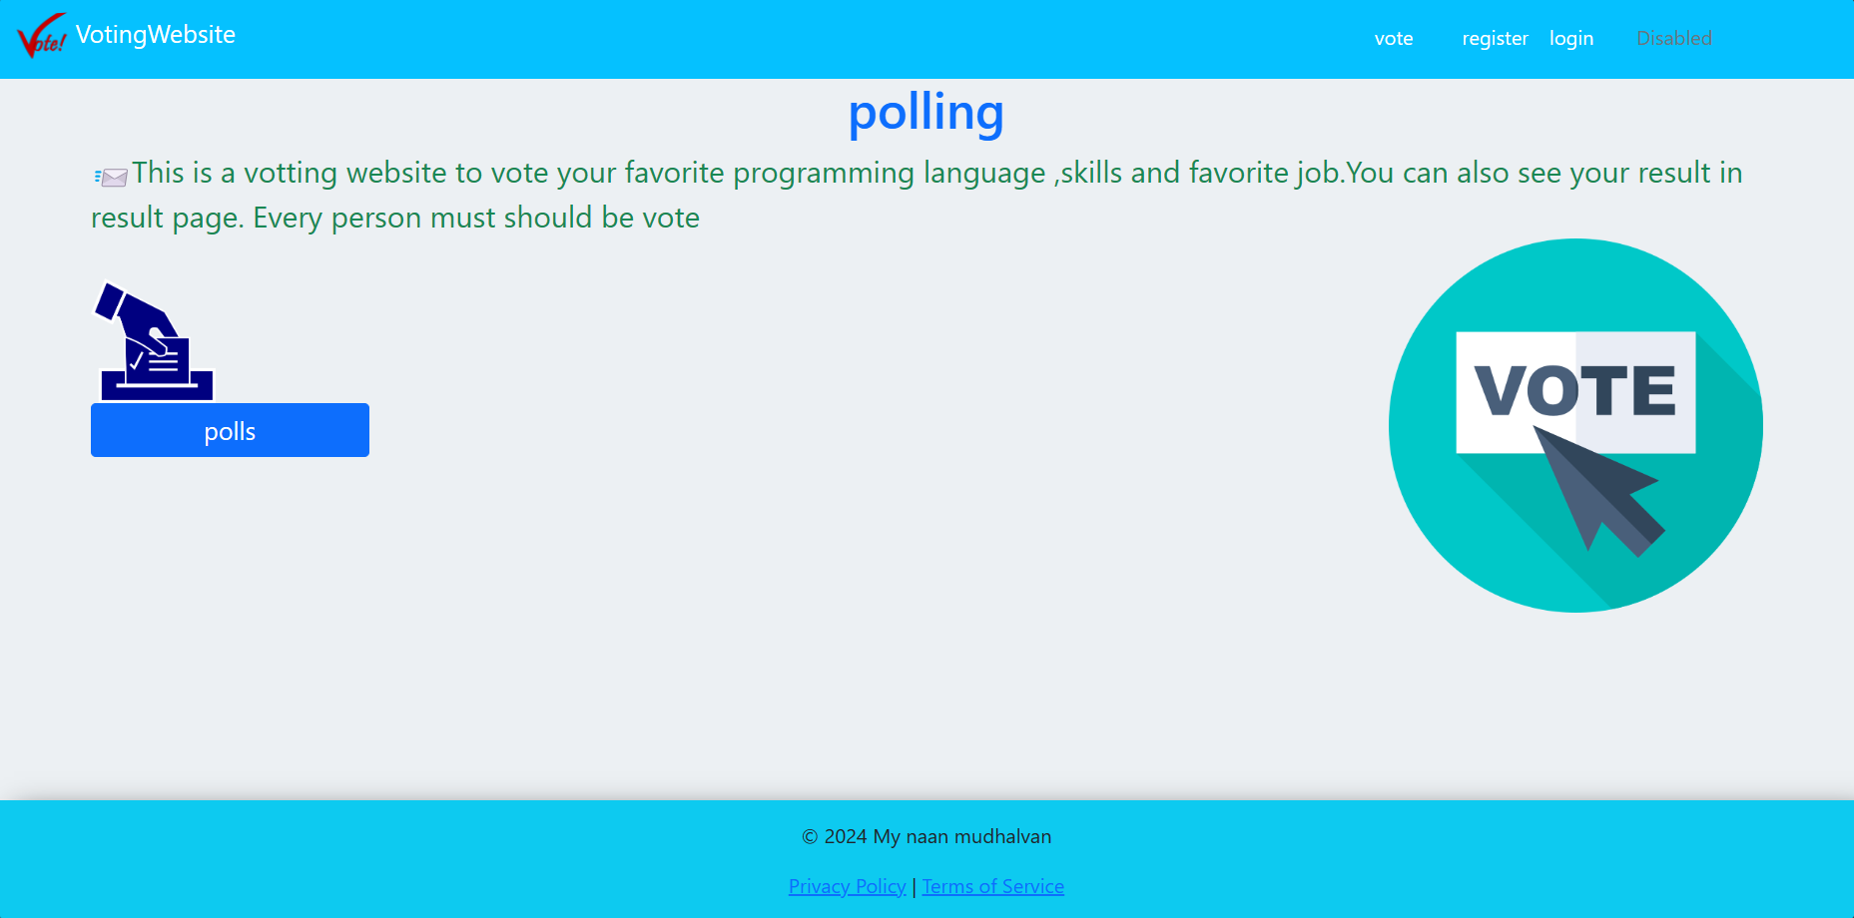
Home-page

Slide 17
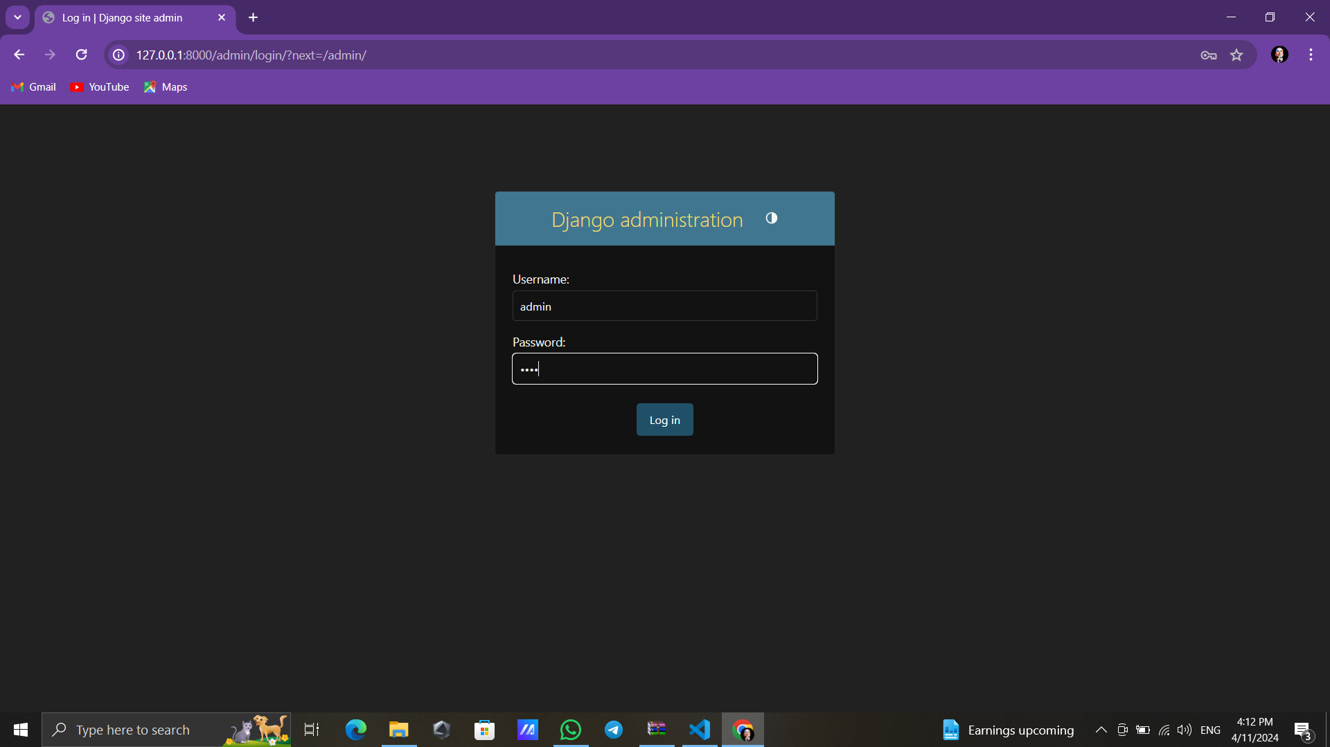

Slide 18
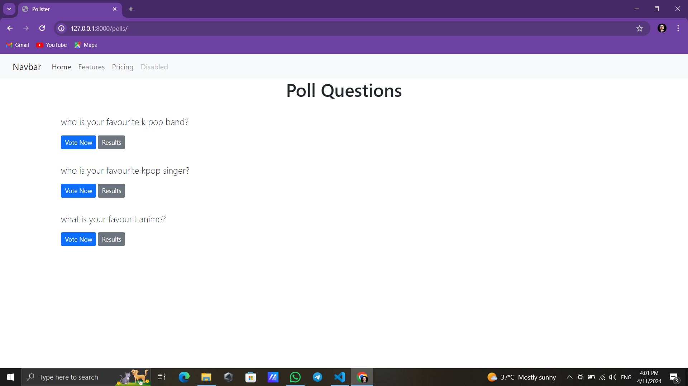
Question-page

Slide 19
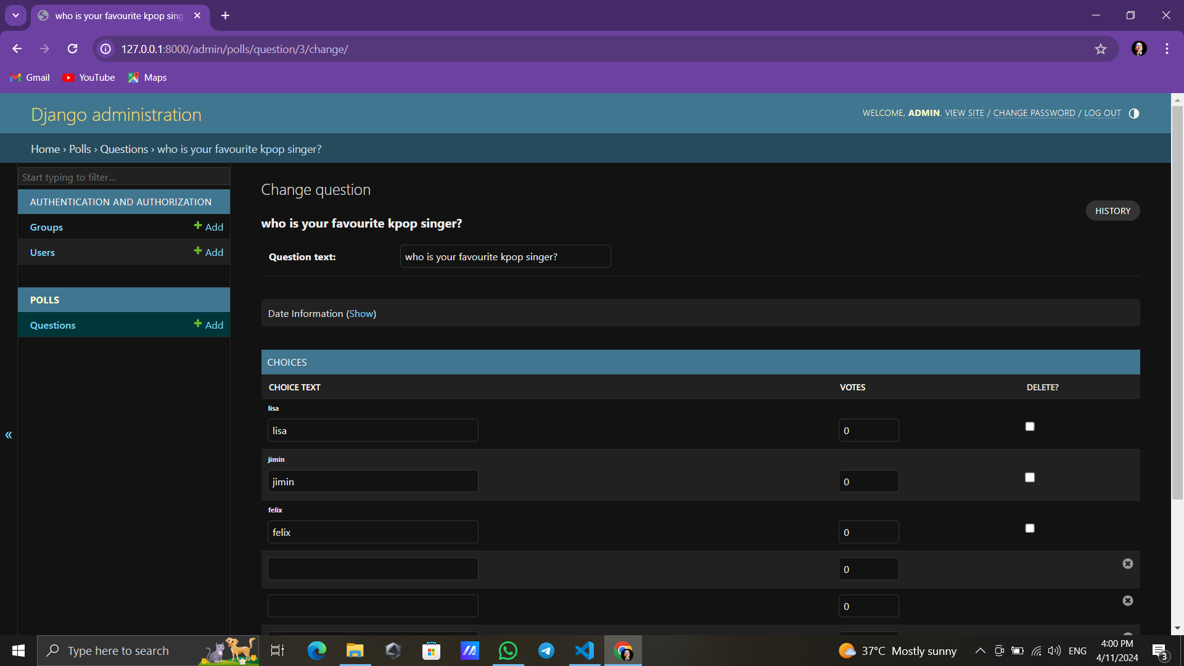
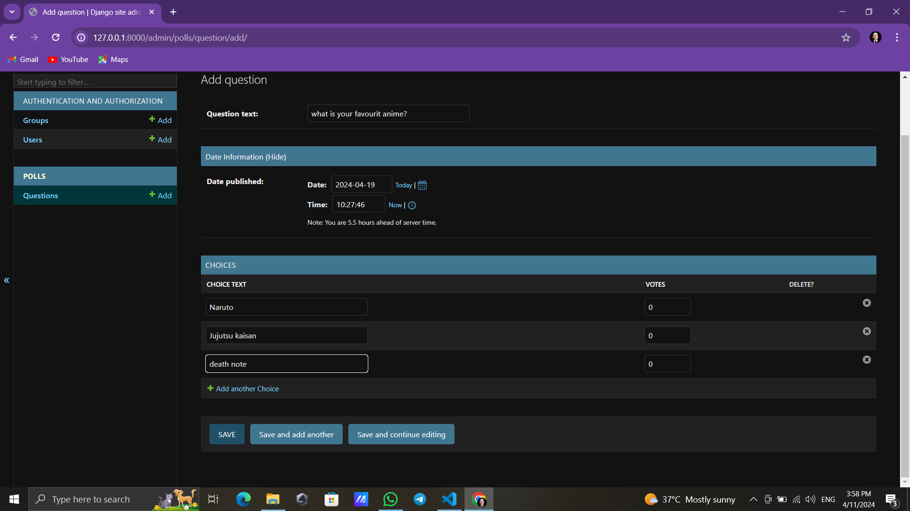
Question-page

Slide 20
Result-page

Slide 21
Future Enhancements:
User Authentication:
Implement user authentication to allow only registered users to vote.
Associate each vote with a user to prevent duplicate voting.
Multiple Choice Options:
Allow users to select multiple choices for a single poll.
Implement validation to ensure users do not exceed the allowed number of choices.
Real-Time Updates:
Use WebSockets or server-sent events to provide real-time updates of poll results without requiring page refreshes.
Improved UI/UX:
Enhance the user interface with modern design principles and responsive layouts.
Implement client-side validation for a smoother user experience. polls.

Slide 22
Conclusion
In conclusion, the Django polling application offers a comprehensive solution for conducting polls with various advanced features to enhance user experience and functionality. By leveraging Django's powerful framework, along with modern frontend technologies and third-party services, we've created a robust platform for managing polls and engaging users.
Source :

Slide 23
Thank You!
Notes:
Thank You !!

