Slide 1

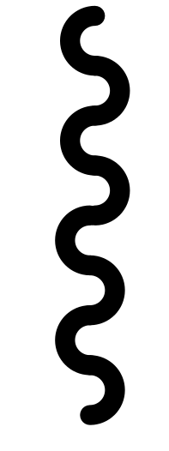

10. Stop the Mail Sender Service after sending all mails
1. Trigger happens every day
Mail Manager
2. Starts the Mail Sender Service
Task Scheduler
3. Request Creator service to
Create msg. and queue it for
sending.
Mail Sender Service
Mail Composer
8. Queue messages in the
Request Queue
7. Compose Mail
Asynchronously
Welcome Mail Composer
Mail Creator Service
Comeback Mail Composer
6. Identify list of user
should be notified
Mail sending
Request Queue
Multiple threads to connect SFTP
4. Request DAL to provide
User & Order List
Data Access Layer
5. Retrieve user and order info from DB
9. Dequeue request from
queue and send mail
Order DB
SMTP Server

