Slide 1
Advanced Signal Processing
Medical Informatics and Digital Health Lab, Department of Biomedical Engineering,
Indian Institute of Technology Hyderabad, Telangana
Notes:
A Unified Multi-Platform Framework for Real-Time Biosignal Acquisition, Processing, and Signal Quality Assessment
Over this ,I built a responsive desktop dashboard that connects directly to hardware, processes signals in real time, and provides immediate quality feedback."

Slide 2
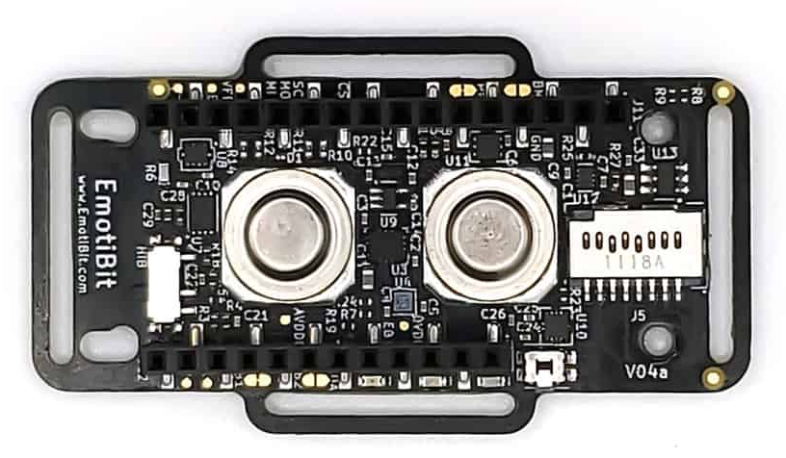
Data Acquisition & Real-Time Processing
Provide researchers and developers with a responsive, reliable interface to monitor physiological states in real-time.
PPG (Red, IR, Green) – 25 Hz
EDA – 15 Hz
Temp – 7.5 Hz
Acce – 25 Hz
Gyro – 25 Hz
Hardware Abstraction via BrainFlow
• Uses EmotiBit Board ID to interface natively with the hardware.
• Separates streaming channels into three logical presets: Default (IMU), Auxiliary (PPG), and Ancillary (EDA/Temp).
• QTimer event loop polls internal ring buffers at an optimized 40ms interval.
Application Framework: PyQt6 (Python-based GUI)
Bio-Signal Interface: BrainFlow library for hardware abstraction
Visual Engine: pyqtgraph (low-latency, hardware-accelerated plotting)
Data Processing: SciPy for real-time digital filtering
Notes:
The EmotiBit Workspace (EMOTI)
How it connects: The EmotiBit sensor has a built-in Wi-Fi module. It connects to the same local Wi-Fi network as your computer
How data comes from the sensor: Once connected, the EmotiBit streams raw biometric data packets wirelessly over the local network using the UDP (User Datagram Protocol).
The Library Used:
Brainflow and PLUX API is used
BY bridging low-level hardware interfaces (BrainFlow and PLUX APIs) with a multi-threaded visualization layout and scientific signal quality checking, this framework elevates the utility of wearable biosensors

Slide 3
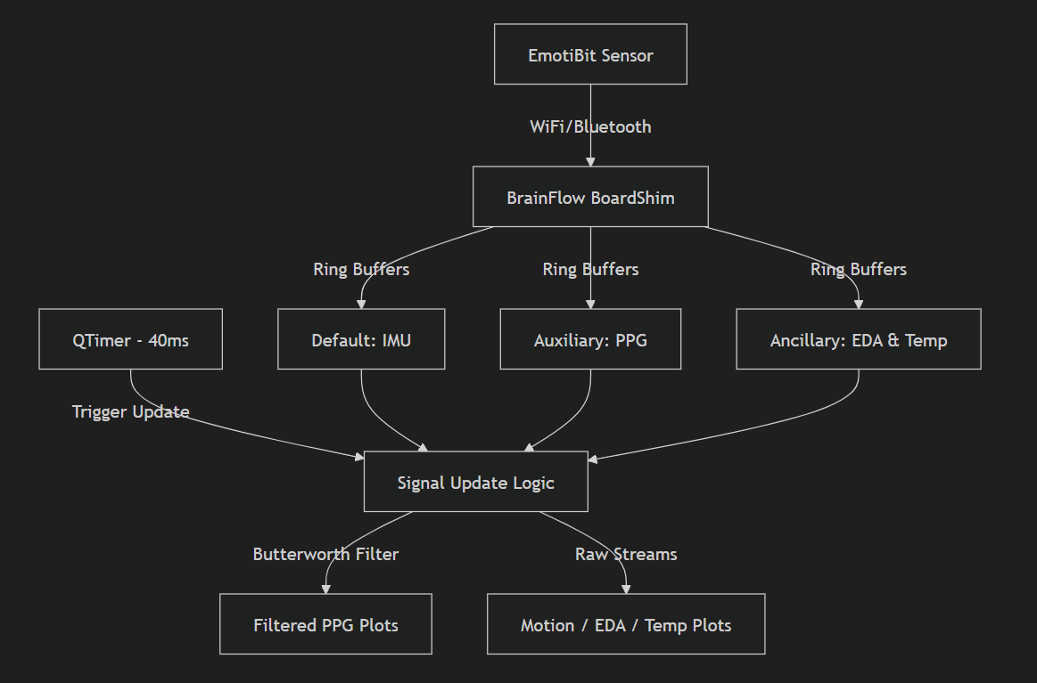
Acquisition & Processing Architecture
Focus:
The system employs a multi-threaded buffering technique to keep the user interface smooth and responsive.
Timed Loop: A QTimer queries the BrainFlow session every 40ms.
Raw PPG Filtering: SciPy’s 4th-order Butterworth bandpass filter ($0.5$–$5.0$ Hz) eliminates high-frequency noise and baseline drift in real time.
Notes:
system employs a multi-threaded buffering technique to keep the user interface smooth and responsive. This slide shows how our architecture keeps the user interface smooth and responsive, preventing the dashboard from lagging while processing live data First, the EmotiBit sensor streams data over Wi-Fi to the BrainFlow BoardShim. BrainFlow automatically organizes this incoming data into three independent Ring Buffers: IMU for motion, PPG for cardiac signals, and Ancillary for EDA and temperature. To update the dashboard, we use a QTimer that triggers every 40 milliseconds to pull new samples. Our Signal Update Logic then takes the raw PPG data, applies a SciPy 4th-order Butterworth bandpass filter to eliminate drift and noise, and immediately updates the filtered plots on the screen alongside the raw streams

Slide 4
INTERACTIVE VISUALIZATION INTERFACE
Tab Category | Displayed Streams | Unit/Scale | Visual Features
Motion | Accelerometer (X, Y, Z) Gyroscope (X, Y, Z) | $g$ $deg/s$ | Real-time multi-line plots, interactive pan/zoom.
PPG | Infrared (IR), Red, Green | Amplitude | Overlaid signals, real-time bandpass filter, and dynamic Y-axis auto-zoom.
EDA & Temp | EDA (Electrodermal Activity) Temp 1 & Temp 2 | $\mu S$ $^\circ C$ | Multi-grid layout mapping arousal and dual temperatures.
.
Y-Axis Auto-Zoom: Keeps PPG waves centered as skin contact or ambient illumination fluctuates.

Slide 5
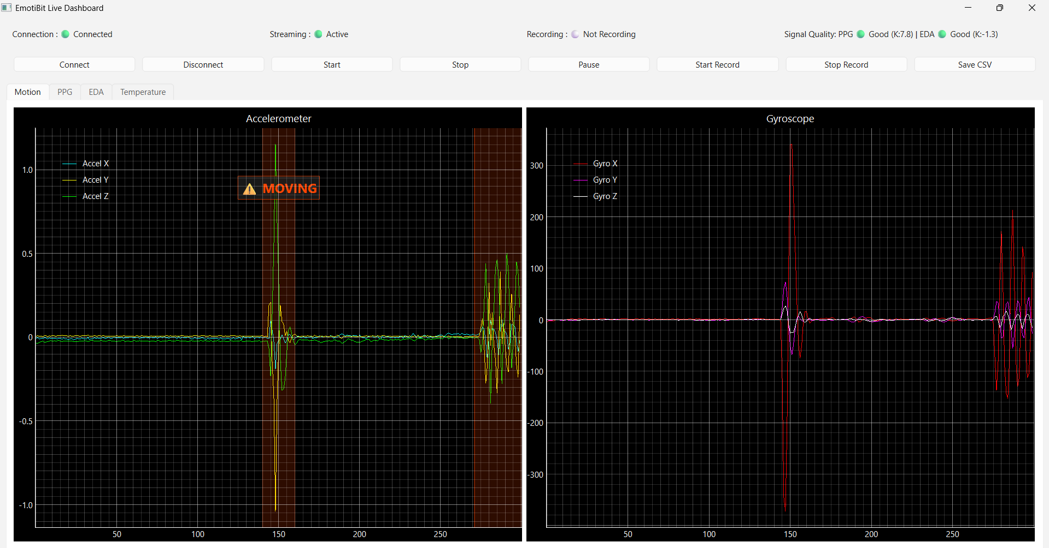
LIVE DEMO (IMU)
Notes:
This is a live screenshot of our running dashboard. At the top, you can see the connection is active and streaming. Most importantly, look at the Signal Quality status on the top right: it displays PPG: Good with a Kurtosis value of 7.8, and EDA: Good with a Kurtosis of -1.3. This our real-time background Signal Quality Assessment (SQA) engine is actively calculating metrics without lagging the UI. And in this dynamic motion detection algorithm immediately catches this: it automatically highlights the duration of the movement with a transparent orange band and overlays a flashing '⚠️ MOVING' warning label on the graph.

Slide 6
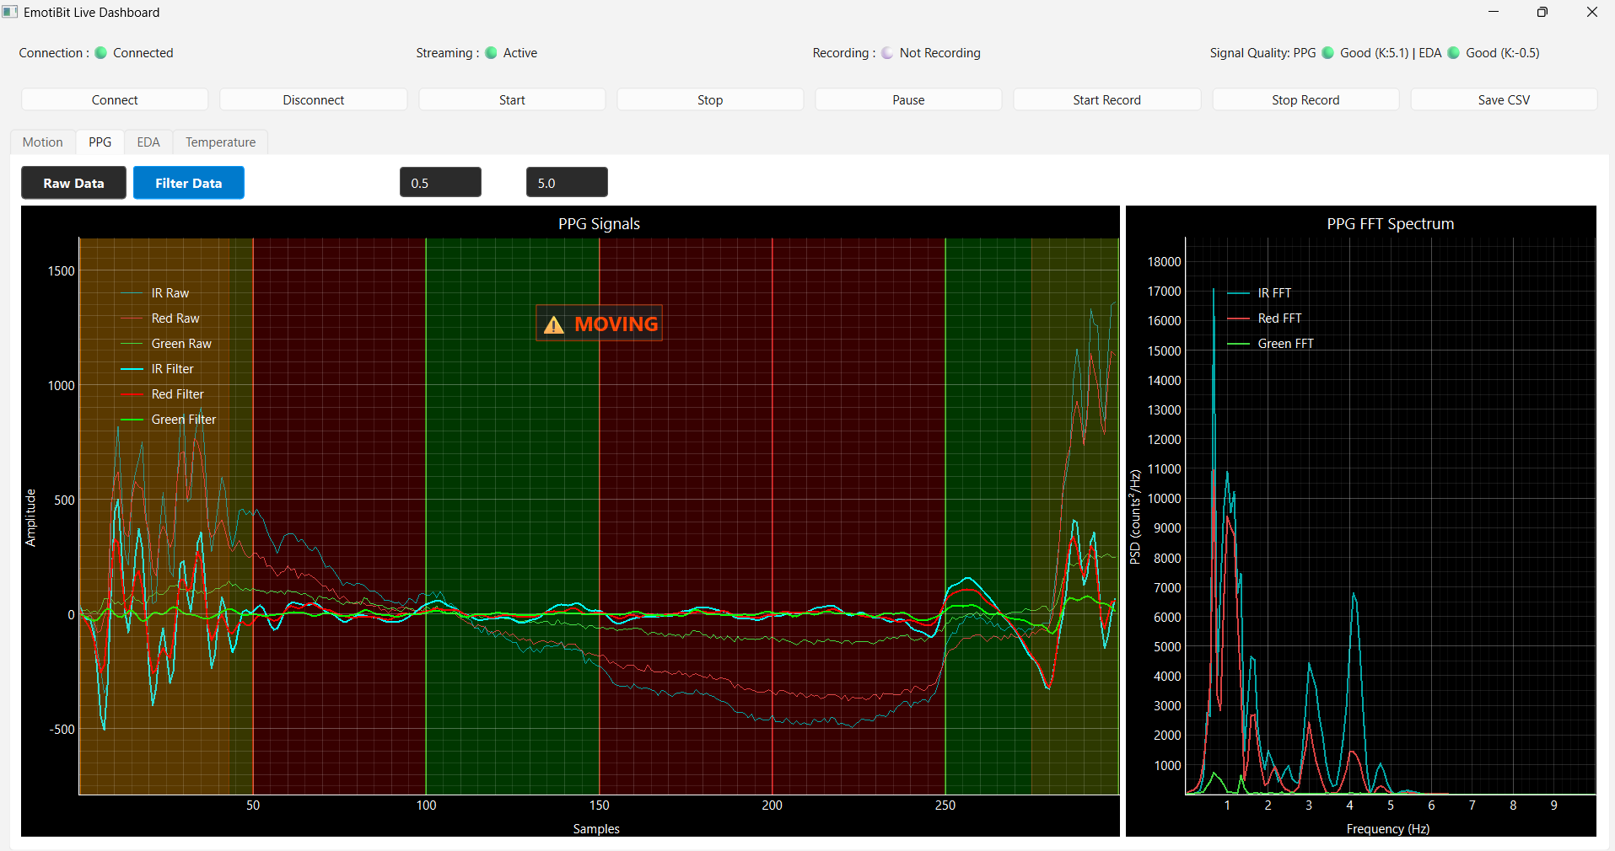
LIVE DEMO (Auxiliary)
Notes:
This screenshot shows the PPG (Photoplethysmography) tab. Here, we can dynamically toggle between viewing raw and filtered data using the 'Filter Data' button. We can also adjust the bandpass filter cutoffs on the fly—currently set here from 0.5 Hz to 5.0 Hz to isolate the heartbeat signal.
FFT (Fast Fourier Transform) Spectrum translates the time-domain signal (how the voltage/conductance changes over time) into the frequency-domain (which individual frequencies make up that signal Because the signal is clean, the FFT displays a very sharp, clear peak at 1.2 Hz

Slide 7
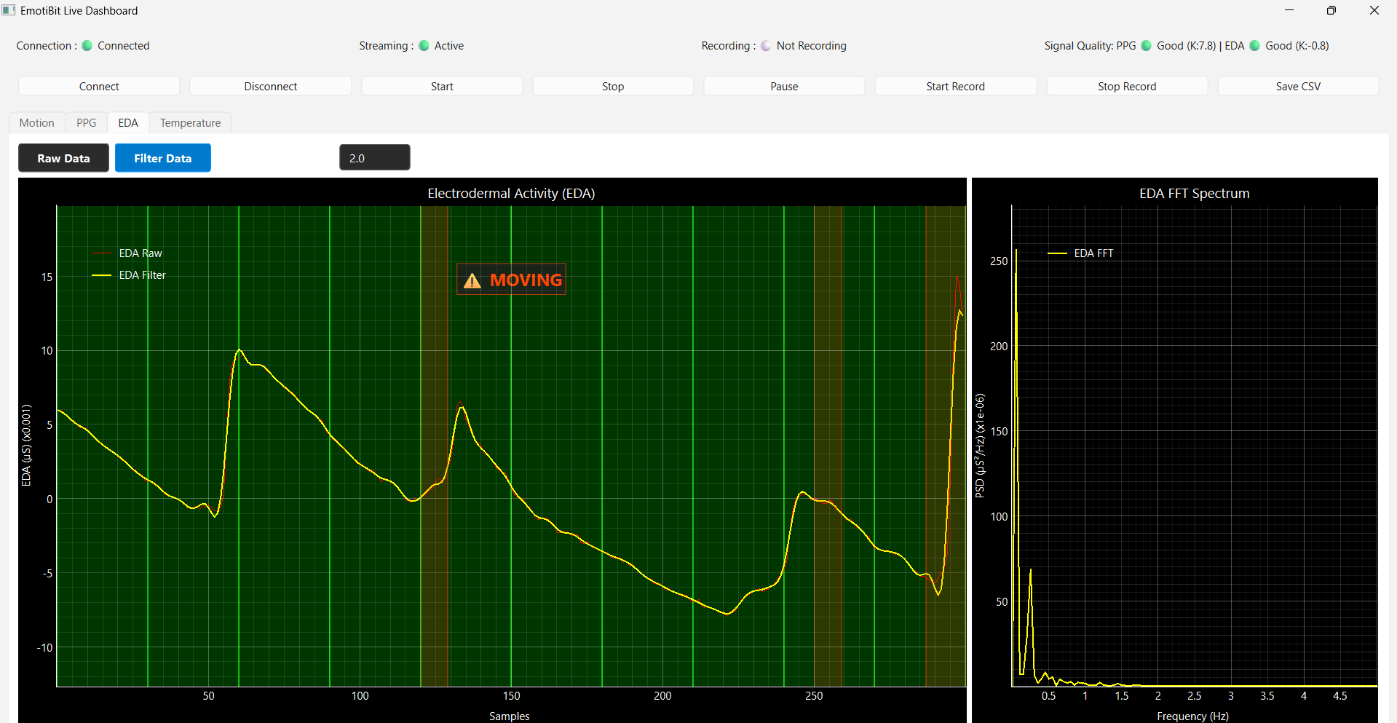
LIVE DEMO (ancillary)
Notes:
This is the EDA (Electrodermal Activity) tab, which monitors skin conductance. In the main graph, we can observe the characteristic peaks of skin conductance responses Because skin sweat changes very slowly, we apply a lowpass filter set at a cutoff of 2.0 Hz. This filter eliminates rapid tremors and electrical noise while preserving the true physiological sweat responses

Slide 8
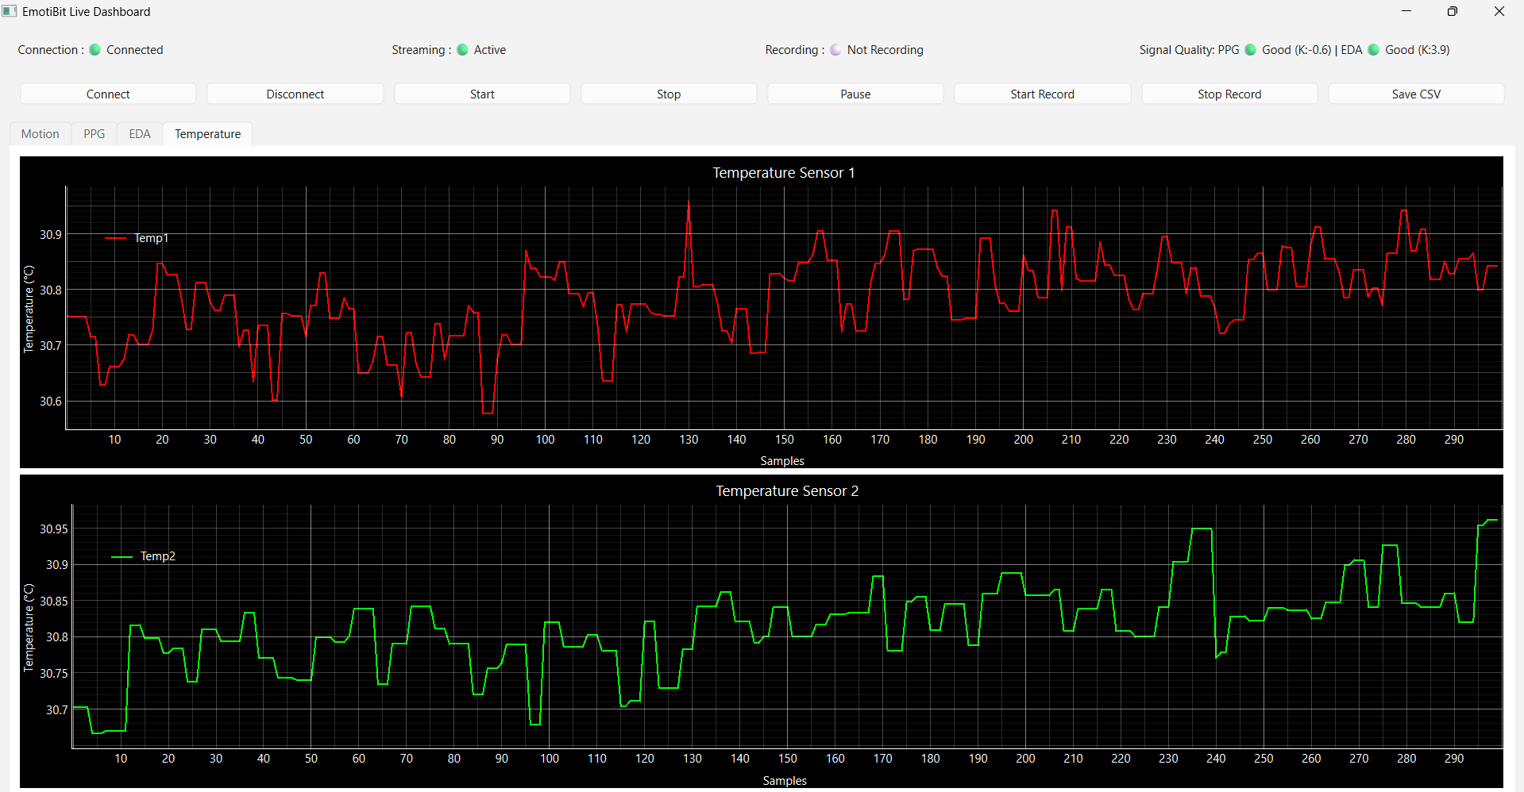
LIVE DEMO (ancillary)
Notes:
Temperature 1: Skin/Body Temperature (Thermistor) This measures actual skin temperature Temperature 2: Ambient / Board Temperature
This measures ambient (surrounding room) temperature

Slide 9
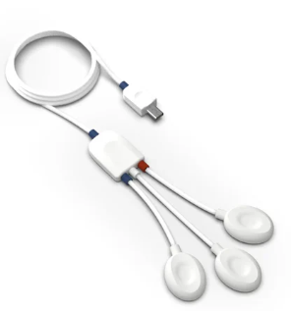
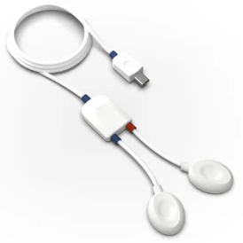
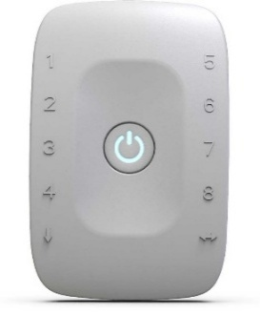
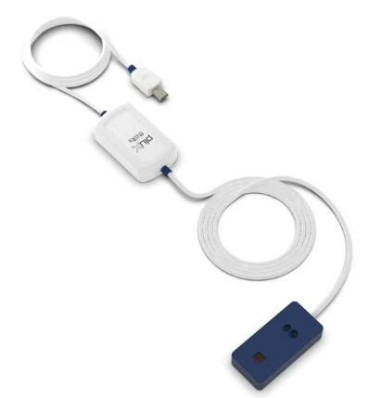
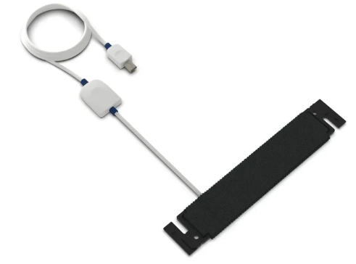
Data Acquisition & Real-Time Processing (BIOSIGNALPLUX)
ECG Sensor (Electrocardiography)
Measures electrical activity of the heart
Typical sampling rate: 250–1000 Hz
Applications: Heart rate, arrhythmia detection
EMG Sensor (Electromyography)
Captures muscle activation signals
Sampling rate: 1000–2000 Hz
Output: Voltage (mV)
Applications: Muscle fatigue, rehabilitation
Respiration Sensor
Tracks breathing cycles via chest expansion
Sampling rate: 10–50 Hz
Applications: Sleep studies, stress monitoring
fNIRS Sensor (Simple Properties)
LEDs: Red (660 nm) & Infrared (950 nm)
Sampling Rate: 500 Hz
Applications: Brain activity tracking, oxygen saturation, heart rate
8-Channel biosignalsplux
Sampling Rate: up to 3kHz per channel
Notes:
introduces the physical sensors we are using from the BioSignalsPlux platform:
The Hub: A wireless 8-channel transmitter that gathers and sends all our sensor data over Bluetooth.
ECG: Measures heart activity to track Heart Rate.
EMG: Measures muscle activity to track fatigue.
Respiration: Tracks chest movement to measure breathing cycles.
fNIRS: Uses red and infrared light to measure oxygen levels in the brain.
In my project, I programmed the software to automatically detect which of these sensors are plugged in, calibrate their raw voltages, and stream them into the dashboard in real-time

Slide 10
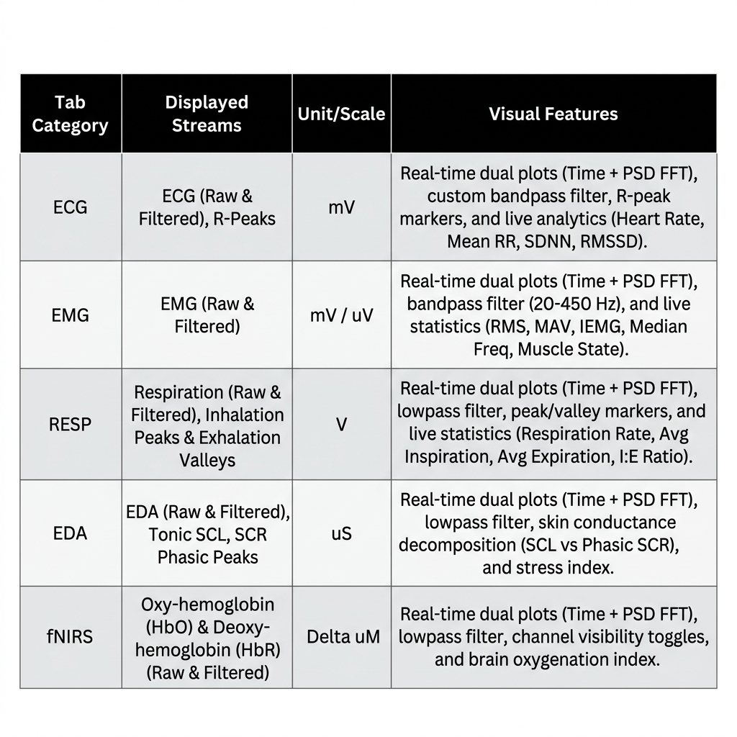
INTERACTIVE VISUALIZATION INTERFACE
.
Y-Axis Auto-Zoom: Keeps waves centered as skin contact or ambient illumination fluctuates.
Notes:
Bandpass Filters: Applied to high-frequency signals like ECG and EMG. Lowpass Filters: Applied to slow physiological signals like Respiration, EDA, and fNIRS. Notch Filters: Actively filters out 50 Hz or 60 Hz electrical power-line noise from our sensors. Since skin sweat levels (EDA) or brain light absorption (fNIRS) baseline levels drift when contact shifts, the graphs automatically scale the Y-axis. This keeps the waveforms centered and perfectly visible at all times. To connect the hardware sensors to our GUI in real-time, we built our tech stack using four key libraries.
For connectivity, we use the PLUX Python API wrapper for direct hardware communication, and Lab Streaming Layer for network stream routing.
On the software interface side, we rely on PyQt6 to drive the UI event loop and handle background thread security, paired with pyqtgraph, which is a GPU-optimized graphing library. This combination allows us to render high-frequency waves, like 1000 Hz EMG, instantly without lagging the computer."

Slide 11
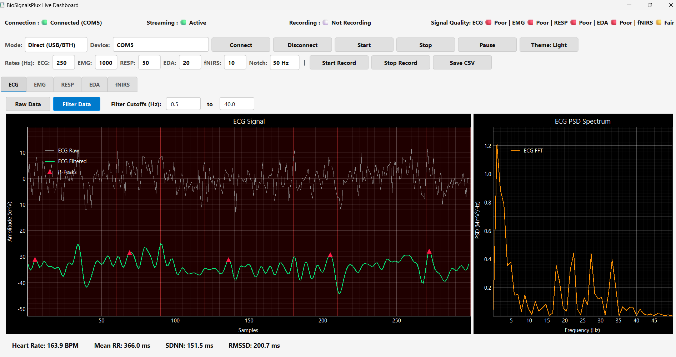
LIVE DASHBOARD (ECG)
Notes:
Let's look at the exact programming methods that run this data pipeline.
First, when a user connects, the software calls SignalsDev to establish the Bluetooth connection and runs getSensors to automatically map occupied ports.
Next, it calls device.start and enters the device.loop method in a background thread. This thread continuously triggers the onRawFrame callback method as raw packets arrive, which are stored in a locked buffer.
Finally, in the main thread, a QTimer fires every 40 milliseconds to read the buffer under a mutex lock, filter the data, and update the graph using the fast setData method. This ensures a secure, lag-free real-time visualization loop

Slide 12
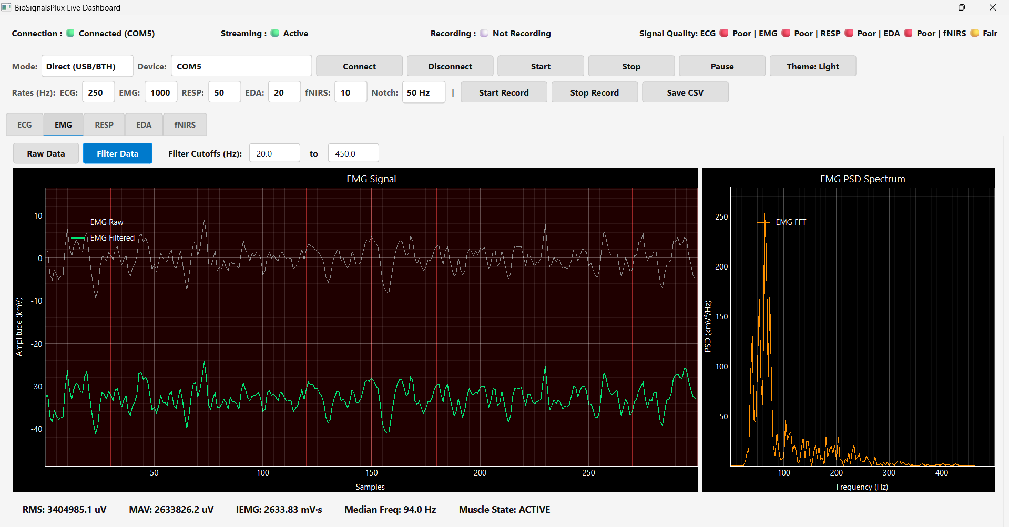
LIVE DASHBOARD (EMG)
Notes:
This slide demonstrates our dashboard tracking EMG data in real-time. Here are the key details:
EMG Filtering: The tab is set to Filter Data using a bandpass range of 20.0 Hz to 450.0 Hz. This window is specifically chosen because it blocks slow movement artifacts below 20 Hz and high-frequency electronic static above 450 Hz.
Left Time-Domain Plot: Shows the raw EMG (gray line) and the bandpass-filtered EMG (green line). The dark red background highlights our SQI algorithm flagging the raw signal quality as poor.
Right Frequency Plot (PSD): Shows the power spectrum of the signal. You can see a dominant peak between 70 Hz and 100 Hz, which represents the firing rate of the muscle fibers.

Slide 13
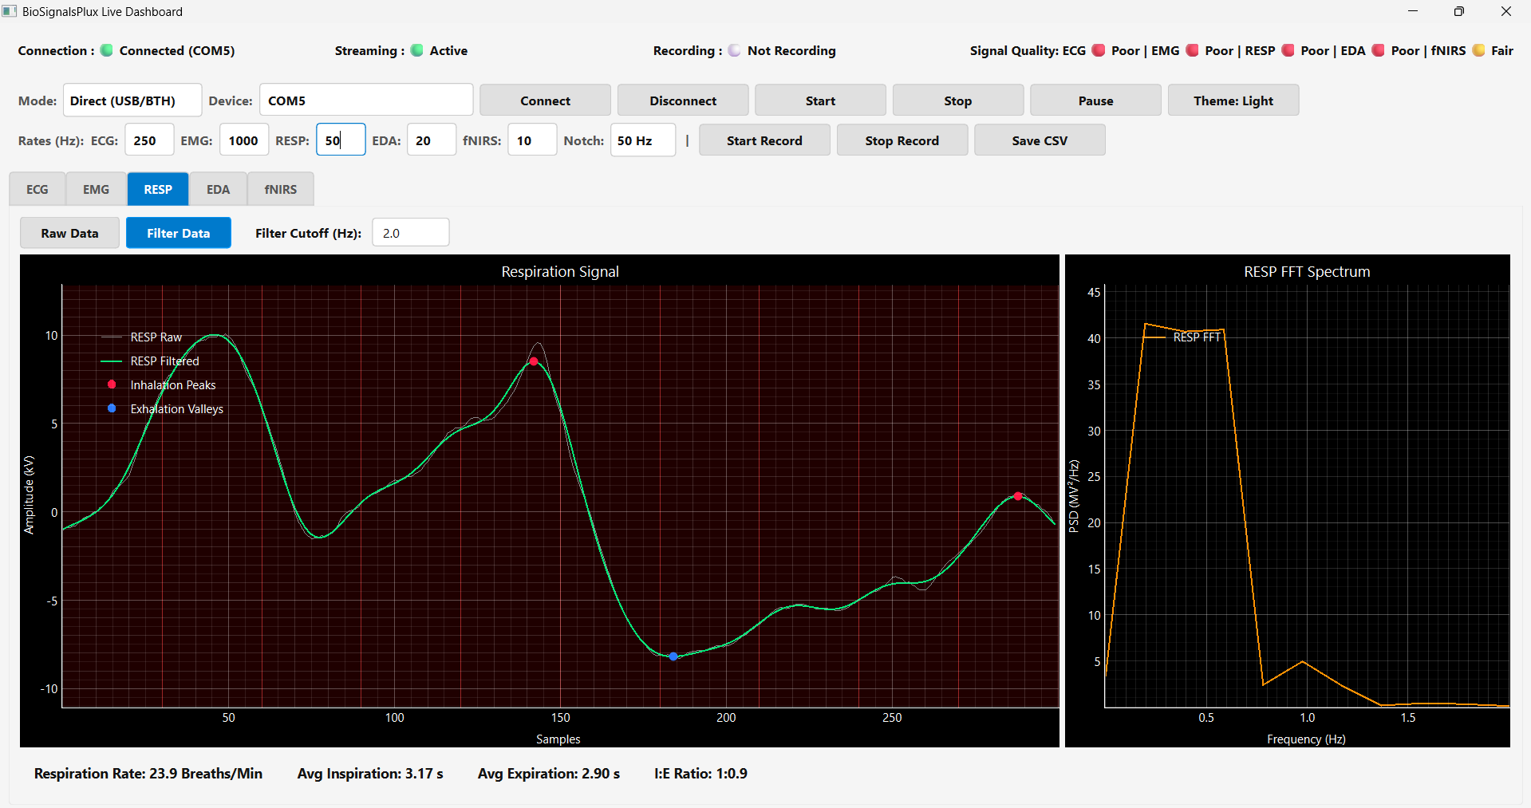
LIVE DASHBOARD(RESP)
Notes:
this dashboard tracking Respiration data in real-time. Respiration Filtering: The tab applies a lowpass filter set at a cutoff of 2.0 Hz. Since breathing is a slow mechanical movement, this lowpass filter is essential to remove all high-frequency electronic noise and muscle movement, leaving only a smooth breathing wave.
Left Time-Domain Plot: Shows the raw (gray) and filtered (green) breathing waves. You can see the system dynamically placing Red dots for Inhalation Peaks (the top of a breath) and Blue dots for Exhalation Valleys (the bottom of a breath).

Slide 14
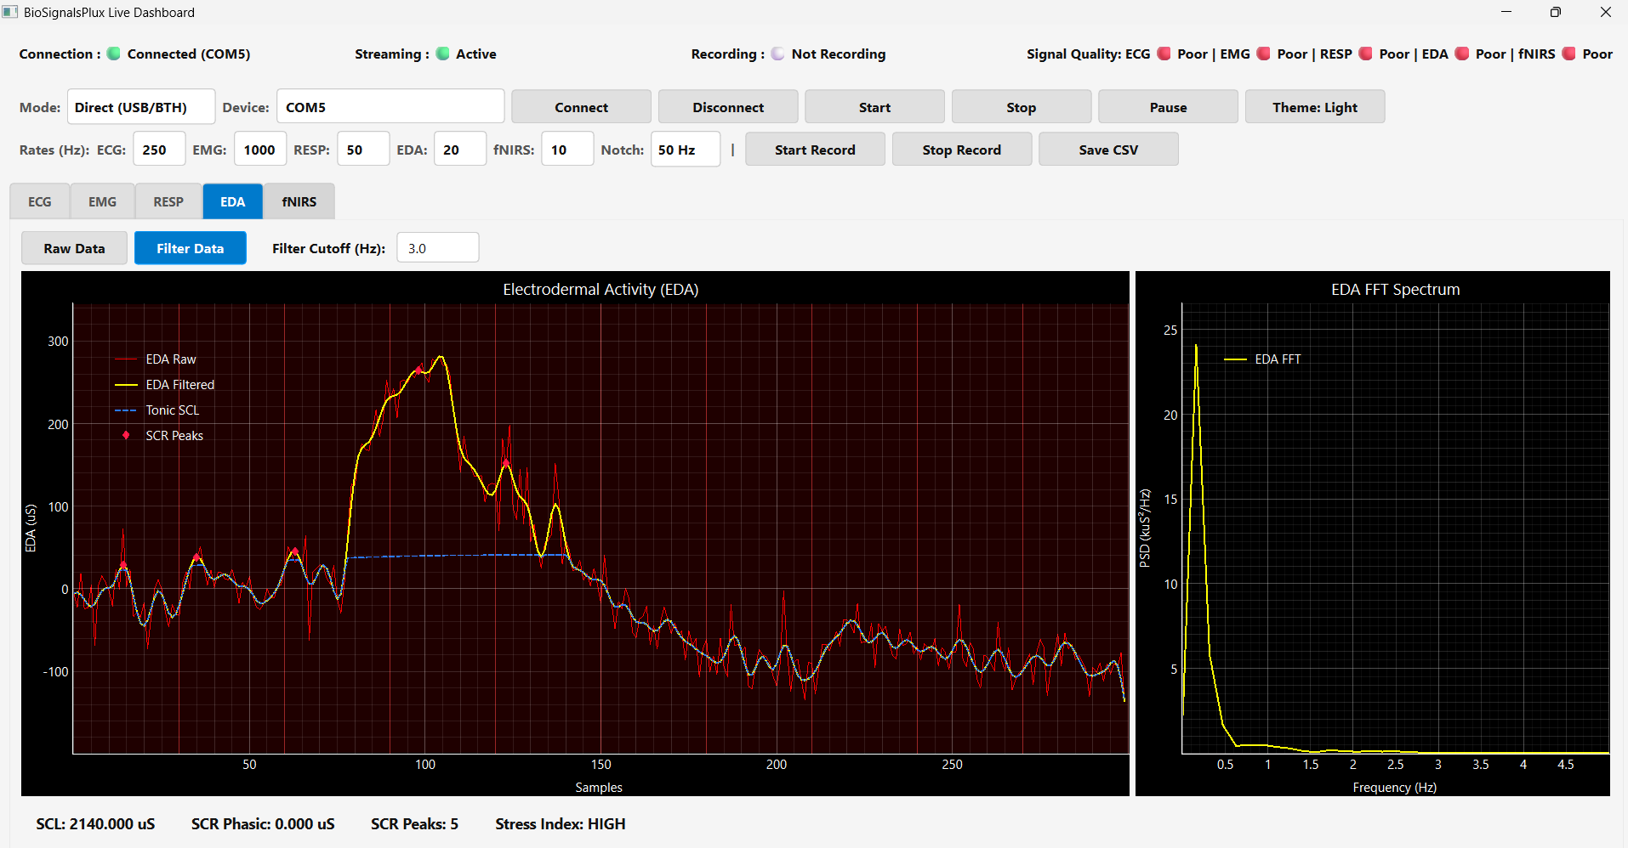
LIVE DASHBOARD (EDA)
Notes:
EDA Filtering: We apply a lowpass filter set at a cutoff of 3.0 Hz to smooth out fast electrical static while keeping the slow physiological sweat responses.
Left Time-Domain Plot: Our software decomposes the raw skin conductance wave (red line) into two major scientific components:
Tonic SCL (Skin Conductance Level): Represented by the blue dashed line. This tracks the slow, background baseline sweat level.
Phasic SCR (Skin Conductance Response): Shown as the transient spikes on the yellow curve. The system automatically detects these rapid sweat bursts and marks them with pink diamonds.

Slide 15
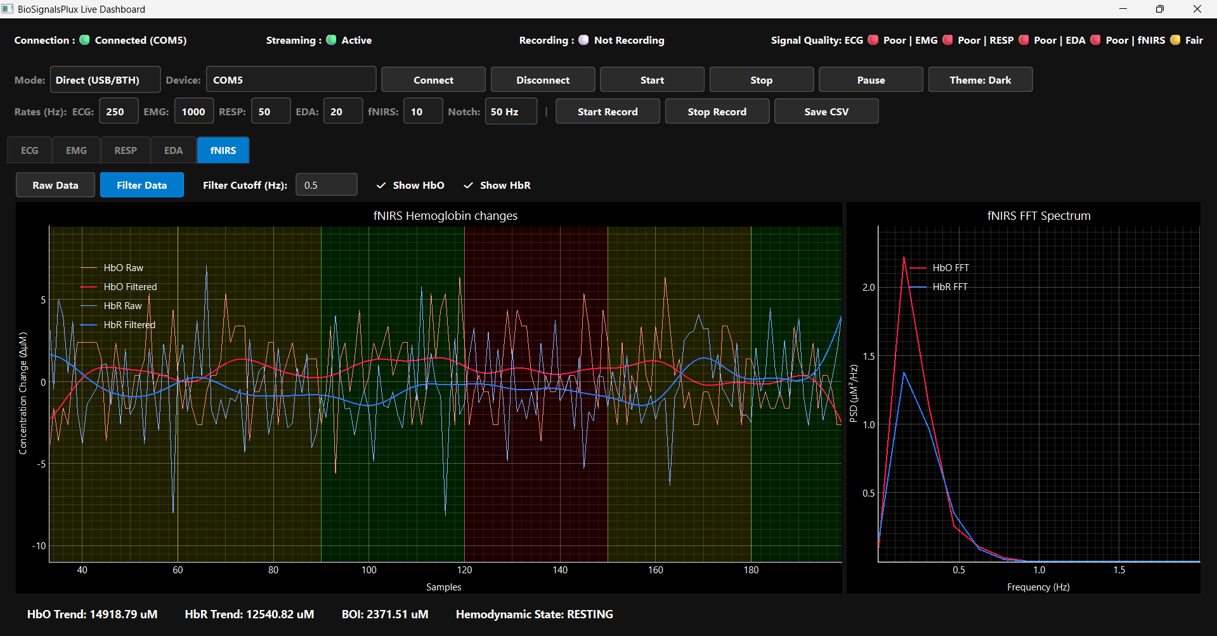
LIVE DASHBOARD (fNIRS)
Notes:
This dashboard tracking fNIRS data in real-time, fNIRS Configuration: The tab is set to Filter Data with a lowpass cutoff of 0.5 Hz. Because changes in brain blood flow are extremely slow, this cutoff effectively filters out respiration and cardiac pulse waves, leaving only true cognitive hemodynamics. The checkboxes allow the researcher to toggle the visibility of HbO (Oxy-hemoglobin) and HbR (Deoxy-hemoglobin). Multi-Segment SQI (The Colored Bands): This graph perfectly demonstrates our Signal Quality Index (SQI) in action. Instead of evaluating the whole plot at once, our algorithm divides the 20-second window into 10 smaller 2-second segments.

Slide 16
WEEKLY PROJECT PROGRESS
Week | Phase | Key Activities | Deliverables / Achievements | Status
Week 1 | Dashboard Development | Developed EmotiBit Dashboard GUI | Functional GUI for real-time visualization | Completed
Week 2 | Real-time Integration & Preprocessing | Integrated real-time EmotiBit data stream with preprocessing pipeline (filtering, artifact removal, and quality check using vital_sqi) | Real-time data pipeline producing clean, usable PPG/ECG data | In Progress
Week 3 | Pain Data Collection – Phase 1 | Start pain data collection protocol Apply vital_sqi for signal quality assessment Record synchronized pain scores with physiological data | Initial pain dataset with quality-labeled signals | Planned
Week 4 | Pain Data Collection – Phase 2 | Complete data collection Perform final SQI-based cleaning & validation Data annotation and basic analysis | Complete high-quality annotated pain physiology dataset | Planned

Slide 17
Thank you

