Slide 1


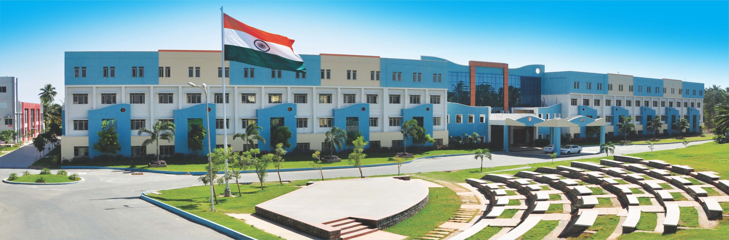
U19ME208 –ENGINEERING METROLOGY AND MEASUREMENTS(Module No. 3 – 5)
Presented by
Dr.V.Naveenprabhu , AP/Mechanical

Slide 2

1. Laser Interferometers
AC Laser Interferometer
DC Laser Interferometer

Slide 3

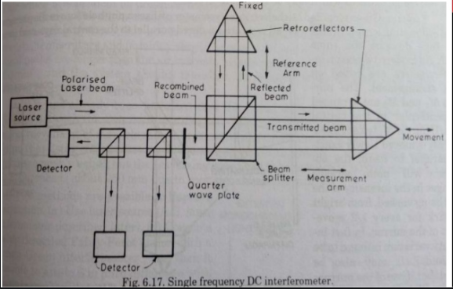
Laser Interferometers – 1. Single Frequency DC Laser Interferometer (DCLI)
It uses a single frequency circular polarised laser beam

Slide 4
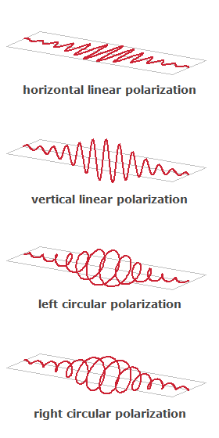
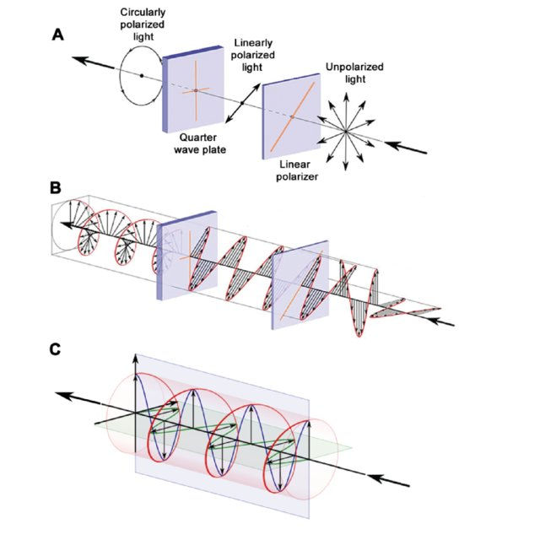
Laser Interferometers – 1. Single Frequency DC Laser Interferometer (DCLI)
Polarization of Laser beams

Slide 5

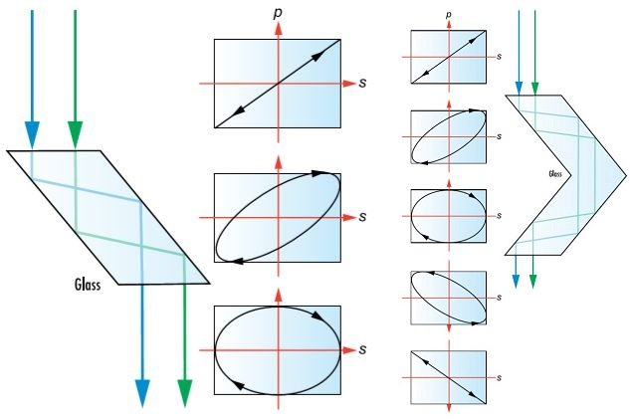
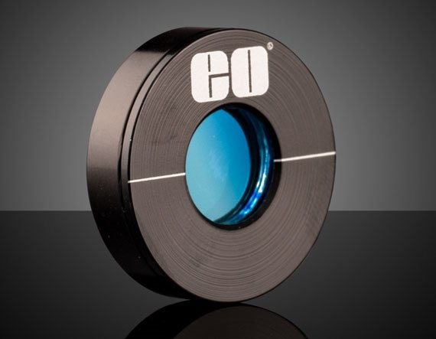
Laser Interferometers – 1. Single Frequency DC Laser Interferometer (DCLI)
Wave plates

Slide 6
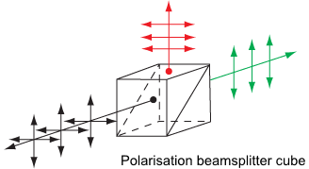
Laser Interferometers – 1. Single Frequency DC Laser Interferometer (DCLI)
It uses a single frequency circular polarised laser beam

Slide 7
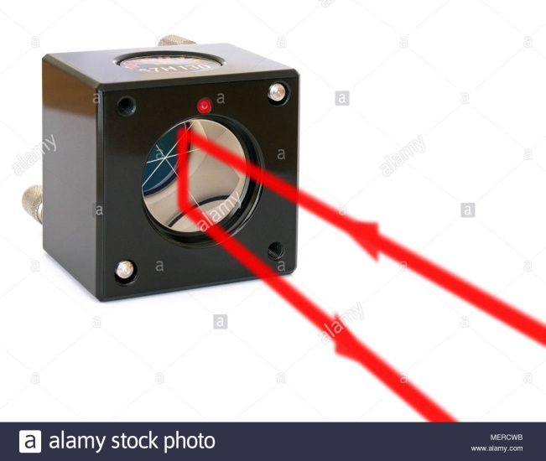
Laser Interferometers – 1. Single Frequency DC Laser Interferometer (DCLI)
It uses a single frequency circular polarised laser beam

Slide 8
Laser Interferometers – 1. Single Frequency DC Laser Interferometer (DCLI)

Slide 9
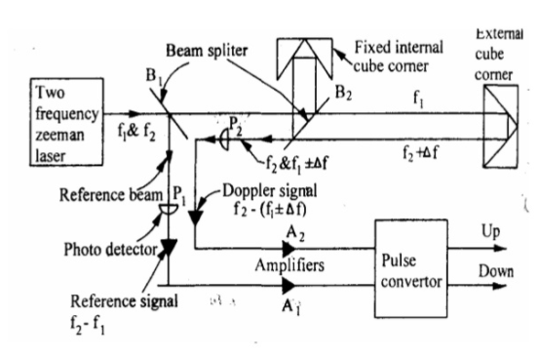
Laser Interferometers – 2. AC Laser Interferometer (ACLI)
It uses two frequency (Zeeman) Laser system

Slide 10
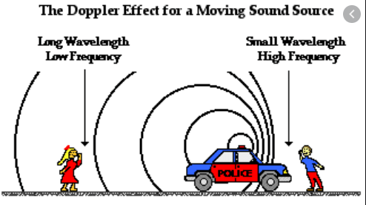
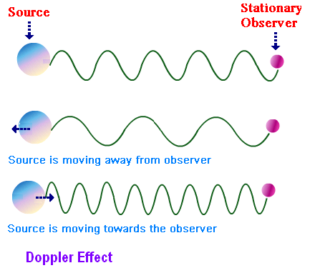
Laser Interferometers – 2. AC Laser Interferometer (ACLI)
Doppler shift

Slide 11
Laser Interferometers – 2. AC Laser Interferometer (ACLI)
It uses two frequency (Zeeman) Laser system

Slide 12
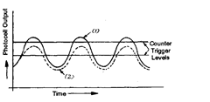
Laser Interferometers – 2. AC Laser Interferometer (ACLI)
Output of typical ACLI

Slide 13
QUERIES.....???

Slide 14


Session Handler Details
Dr.V.Naveenprabhu
Assistant Professor,
Department of Mechanical Engineering
Sri Eshwar College Of Engg.
Naveenprabhu.v@sece.ac.in

