Slide 1
IBM University Engagement Project Submission
“Exploring the Power of Machine Learning with IBM Cloud”

Slide 2

Project Tile – [Predictive Maintenance using Machine Learning with IBM watsonx.ai Auto AI]
Domain of Project – [Manufacturing / Industrial AI ]
Student Name | Recent Passport Photo | Email ID | Mobile number [WhatsApp]
TAMILARUVI.S |  | tamilaruvisjcetaids@gmail.com | 8838213528
Recommended font style and size: Font Style: Arial Font Size (Heading): 28
Font Size (Content): 20

Slide 3
Problem Statement :
Problem Statement - Predictive Maintenance using Machine Learning
Industrial machines play a vital role in modern manufacturing industries, where continuous operation is essential for maintaining productivity and reducing operational costs. However, unexpected machine failures can lead to production downtime, increased maintenance expenses, equipment damage, and significant financial losses. Traditional maintenance approaches, such as reactive maintenance and scheduled preventive maintenance, often fail to identify potential failures at the right time, resulting in inefficient maintenance planning.
This project aims to develop a Machine Learning-based Predictive Maintenance System capable of predicting machine failures using operational parameters such as air temperature, process temperature, rotational speed, torque, tool wear, and product type. The solution is developed using IBM watsonx.ai Studio with Auto AI, which automatically performs data preprocessing, feature engineering, model selection, training, optimization, and evaluation to identify the most accurate prediction model.
The developed system helps industries detect potential machine failures before they occur, enabling timely maintenance, reducing unexpected downtime, improving equipment reliability, optimizing maintenance schedules, lowering operational costs, increasing production efficiency, and supporting data-driven decision-making for smart manufacturing environments.

Slide 4
Proposed Solution :
Develop an intelligent Predictive Maintenance System using IBM watsonx.ai Studio and Auto AI to predict machine failures before they occur.
Upload the Machine Predictive Maintenance Classification dataset into IBM watsonx.ai Studio and create an Auto AI Experiment.
Perform data preprocessing and automatically train multiple Machine Learning models using IBM Auto AI.
Compare the generated models and select the best-performing model based on prediction accuracy and evaluation metrics.
Use the trained model to predict whether a machine is likely to fail or continue operating normally.
Generate prediction results that help maintenance teams identify potential failures and schedule maintenance in advance.
Reduce unexpected machine breakdowns, improve equipment reliability, minimize downtime, and lower maintenance costs.
Support industries in making data-driven maintenance decisions and improve overall operational efficiency through AI.

Slide 5
Technology Used :
IBM Cloud: Used as the cloud platform to create and manage the Machine Learning project.
IBM watsonx.ai Studio: Used to upload the dataset, build the Auto AI experiment, train and evaluate the Machine Learning model.
IBM Auto AI: Automatically performed data preprocessing, feature engineering, model selection, hyperparameter optimization, and generated the best predictive model.
Machine Learning Model Used: Auto AI Best Pipeline (Later, leaderboard-la exact model name — e.g., XG Boost, Snap Random Forest, etc.)
Accuracy Obtained: 100%
Enhancements and Hyperparameter Tuning: Automatically performed by IBM AutoAI to improve model performance and prediction accuracy.

Slide 6
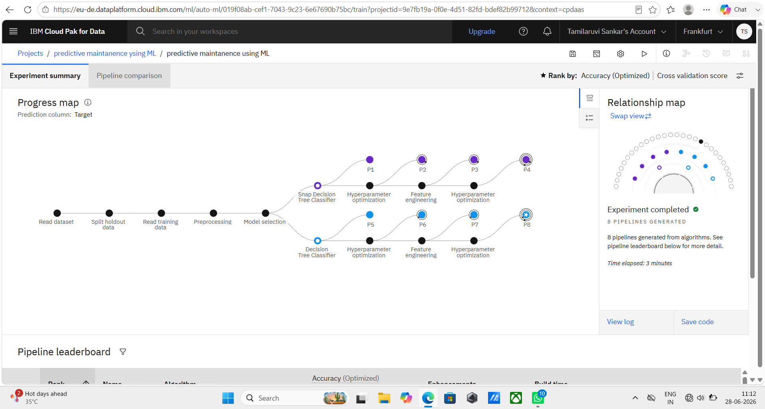
Training Screenshots :

Slide 7
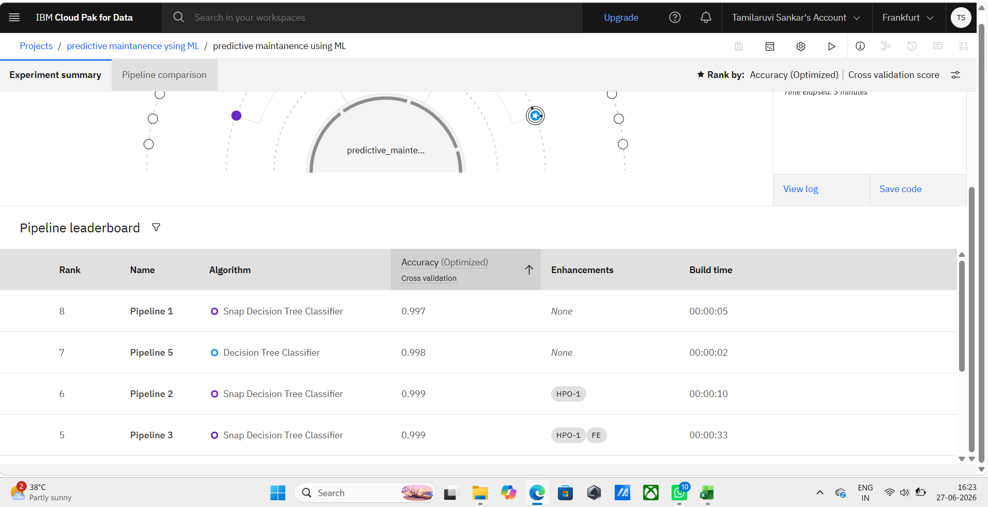
Best Model Screenshot :

Slide 8
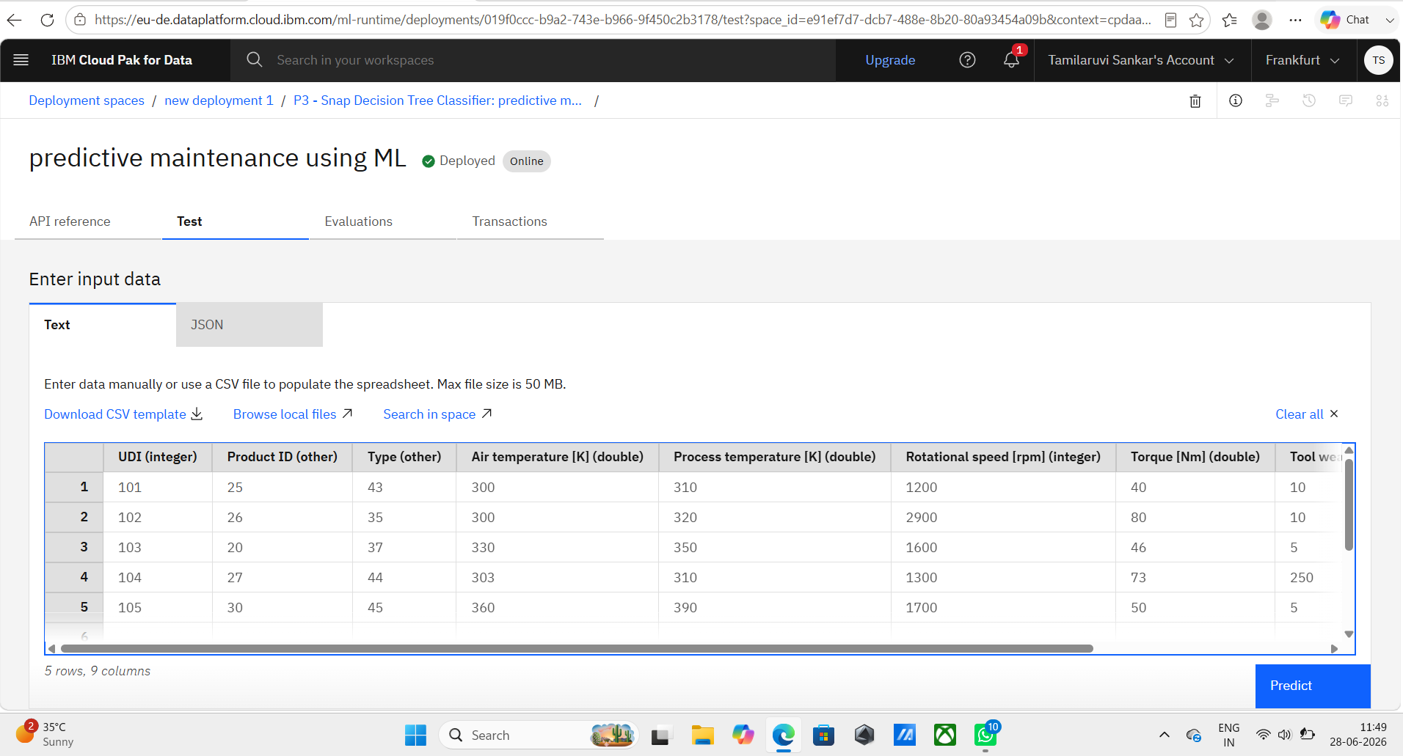
Testing Screenshot :

Slide 9
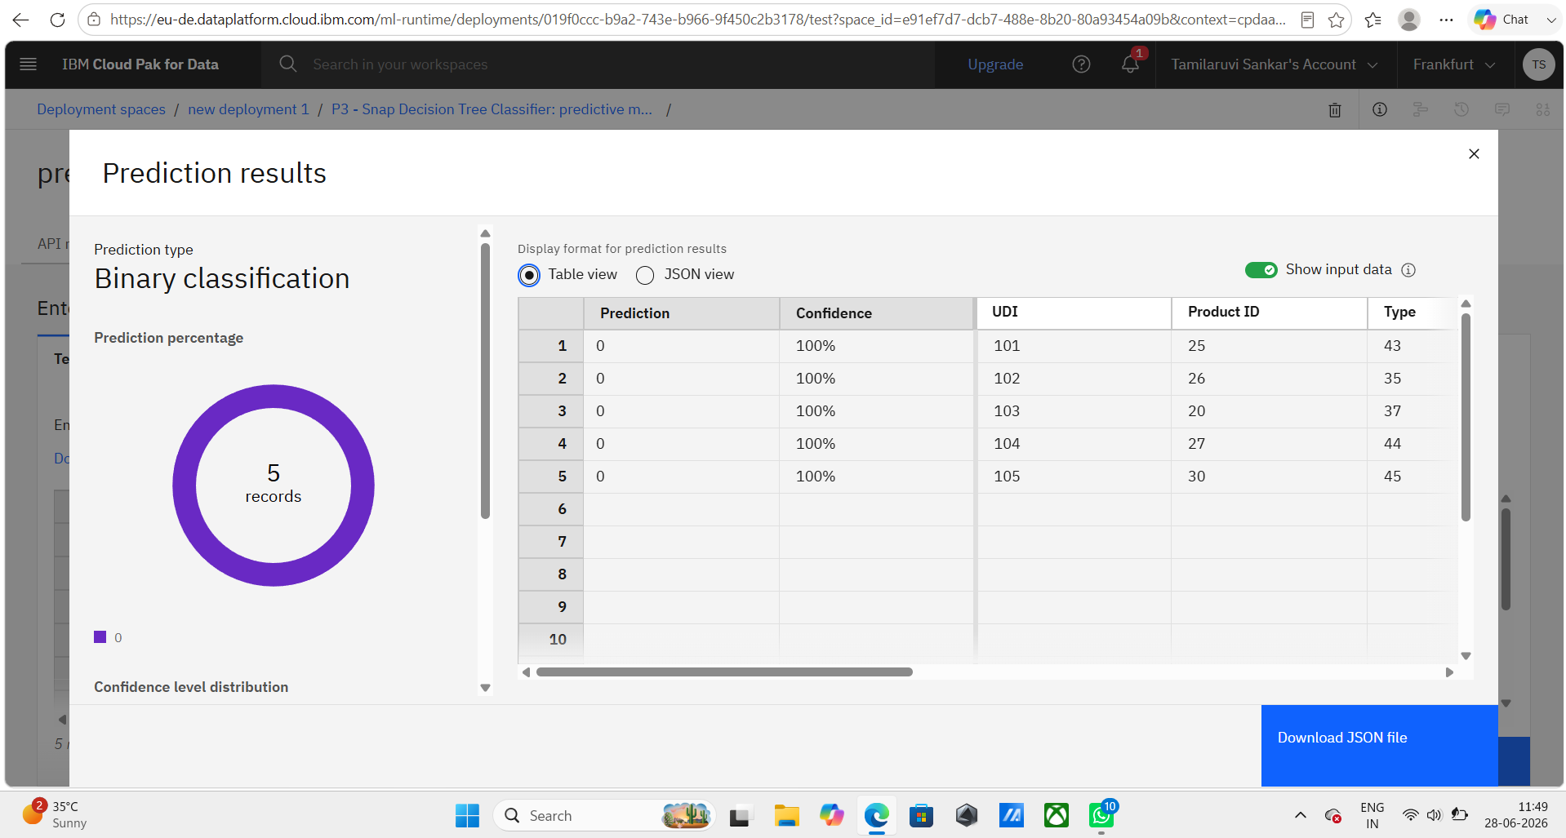
Testing Screenshot :

Slide 10
Novelty and Uniqueness :
Uses IBM watsonx.ai Auto AI to automatically build, train, and optimize Machine Learning models with minimal coding.
Predicts machine failures before they occur, enabling proactive maintenance instead of reactive maintenance.
Analyses multiple machine parameters such as temperature, rotational speed, torque, tool wear, and product type for accurate predictions.
Helps industries reduce unexpected downtime, improve equipment reliability, and optimize maintenance schedules.
Supports data-driven decision-making by providing accurate failure predictions based on machine operational data.
Provides a cost-effective and scalable solution that can be adopted by manufacturing industries to improve productivity and operational efficiency.

Slide 11
Git Hub Link
https://github.com/tamilaruvi485-source/predictive-maintenance-using-ML.git
Repository Contents:
README.md
Machine Predictive Maintenance Classification Dataset (.csv)
Project Presentation (.pptx)
Python Notebook (.ipynb)
Problem Statement PDF
Project Output Screenshots
Purpose: The GitHub repository contains all project resources, implementation files, documentation, and outputs for easy access and future reference.
·
·

Slide 12
Future Scope :
Integrate the system with IoT sensors for real-time machine health monitoring and failure detection.
Improve prediction accuracy by training the model with larger and more diverse industrial datasets.
Deploy the model on IBM Cloud to provide real-time maintenance alerts and predictions.
Extend the solution to support different types of industrial machines and manufacturing environments.
Develop an interactive dashboard to monitor machine performance, maintenance schedules, and prediction results.
Enable predictive maintenance across multiple industries to reduce downtime, improve productivity, and optimize maintenance planning.
·
·
·

Slide 13
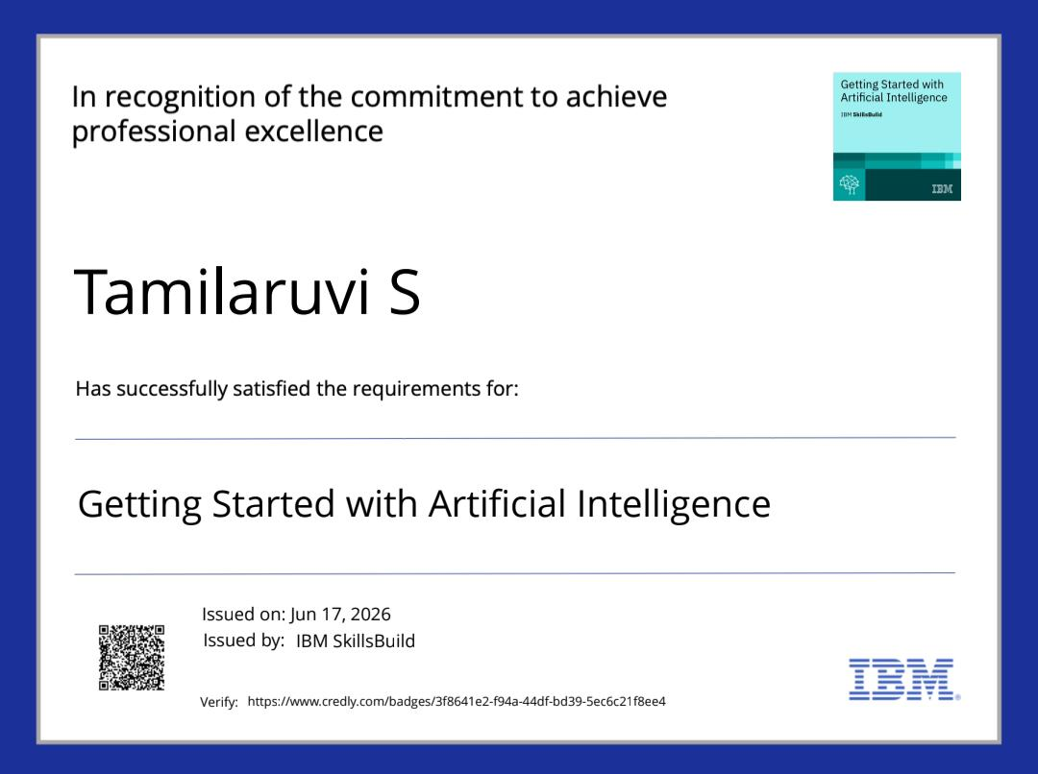
Certificates Earned:

Slide 14

Certificates Earned:

Slide 15
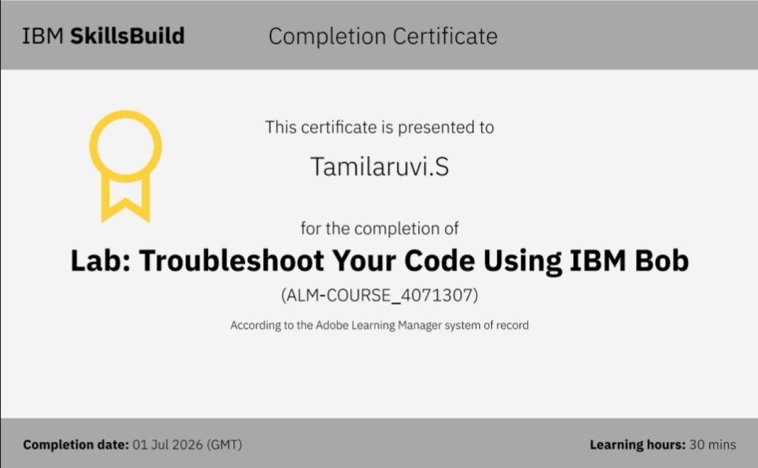
Certificates Earned:​

Slide 16


