Slide 1
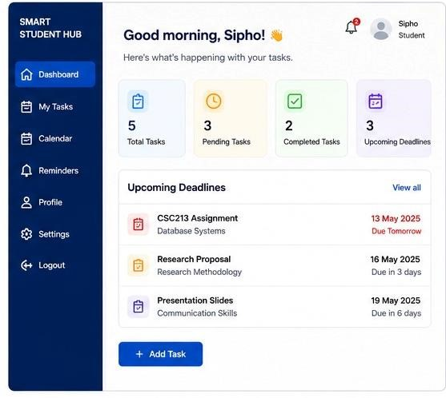
SMART STUDENT HUB
Task Tracking and Deadline Reminder System for UNESWA Students

Slide 2
Problem statement
University students at UNESWA face significant challenges in managing their academic commitments due to a lack of a centralized platform to track varying milestones across different courses. Students must simultaneously manage assignments, tests, lab reports, and presentations spread across disconnected modules.
Without an integrated view, students frequently suffer from poor planning, leading to academic stress, uncoordinated preparation windows, and missed deadlines. The absence of an automated, proactive monitoring system shifts the burden of deadline tracking entirely onto the student, compounding academic anxiety and decreasing overall institutional productivity. Therefore, there’s a need for a simple, centralized system that allows students to track assignments, tests dates and deadlines in one place while providing timely reminders

Slide 3
Objectives
Centralize academic tasks
Improve time management.
Provide automated reminders.
Reduce missed submissions.
Enhance student productivity.

Slide 4
Proposed solution
To centralize and streamline academic schedules for UNESWA students can:
Register and log-in securely
Create and manage tasks
Receive deadline reminders
Monitor progress through dashboards
.

Slide 5
How it solved the problem
It eliminates tracking across fragmented channels
The system automatically runs dynamic background checks against target task deadlines.
It visually isolates urgent priorities and automatically surfaces critical alert dialog entries the moment a user authenticates.
It allows students to gauge their workload instantly, encouraging better time management and reducing stress.

Slide 6
Key Features
Secure User Authentication:
Handles robust user account registration, validation, and session state preservation.
Comprehensive Task Management (CRUD Workspace)
Allow students to add, view, edit, delete task with course code, description and deadlines priority
Dashboard Analytics
Real –Time counters: Total, pending , completed and up coming tasks.
Automated Deadline Alert :
A modal interception window that automatically alerts users to near-term academic threats.

Slide 7
Benefits
Optimized Organisation- no more sticky notes or scattered reminders
Clear Priority Visibility- High/Medium/Low budgets show what needs attention first.
Reduce Late Submission – Multi-tier alerts catch deadlines before it pass
Low Academic Stress- predictable view reduces exam panic.

Slide 8
Database Design
Main Entities:
Student
Task
Notification
Relational database structure supports data
Integrity and future scalability.

Slide 9
Development Methodology
Waterfall model
Requirements analysis
System design
Database design
Development
Testing
Deployment

Slide 10
System Architecture
Frontend:HTML5,CSS3
Client Logic: JavaScript ES6+
Backend: PHP
Database: MySQL
Architecture follows a layered web application design.

Slide 11
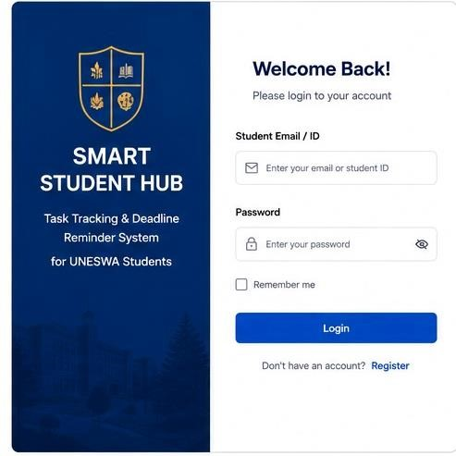
Log & Registration
Student ID
Password field
Remember me option
Login/Register controls

Slide 12
Dashboard
Components:
Navigation sidebar
Upcoming deadlines panel
Add task button
Statistic cards

Slide 13
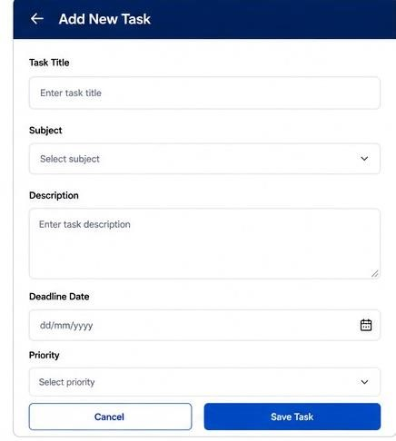
Add Task Interface
Form field:
Task title
Subject
Description
Deadline date
Priority selector
Save/cancel button

Slide 14
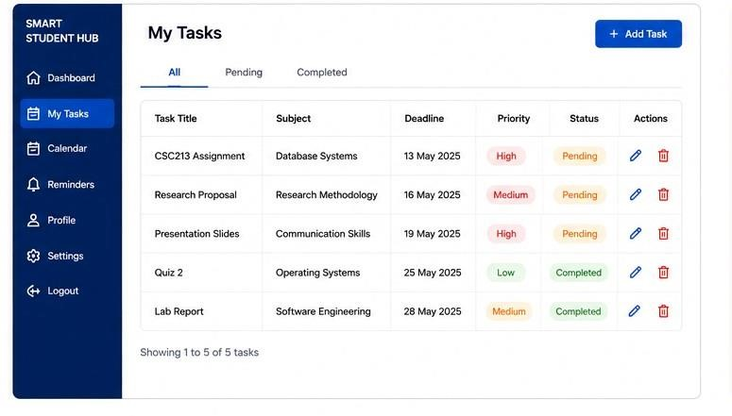
Task List Workspace
Data-Grid display:
Title
Subject
Deadline
Priority
Status
Edit/Delete actions

Slide 15
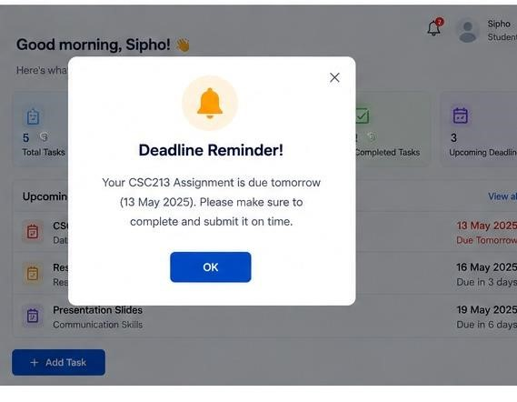
Reminder Notification
Model notification window showing:
Warning icon
Deadline message
Close button
Confirmation button

Slide 16
Expected outcomes
Improved academic performance
Better task organization
Reduced academic stress
Enhanced productivity

Slide 17
Conclusion
Smart Student Hub successfully addresses academic task management challenges by providing centralized task tracking, reminders, and productivity tools for UNESWA students. Link to DEMO.
https://student-hub.tiiny.site/

