Slide 1
Numpy
By
Govindarasan V D

Slide 2
What is NumPy?
NumPy (Numerical Python) is a Python library used for fast mathematical & scientific computing.
It provides a powerful object called the ndarray (N-Dimensional Array).
Why NumPy?
Very fast (up to 100x faster than Python lists)
Handles large numerical data easily
Supports vectorized operations
Used in Machine Learning, AI, Data Science, Image Processing, Deep Learning

Slide 3
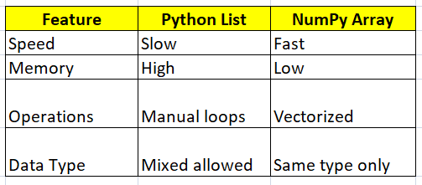
Difference Between Python List vs NumPy Array

Slide 4
Key Features
Key Features
High-performance N-dimensional arrays
Fast mathematical operations (vectorization)
Linear algebra, FFT, statistics
Integrates with Pandas, Sci-Py, ML libraries (TensorFlow, PyTorch)
Why NumPy is Fast?
Because it is written in C, uses contiguous memory blocks and supports vectorization (no python loops).

Slide 5
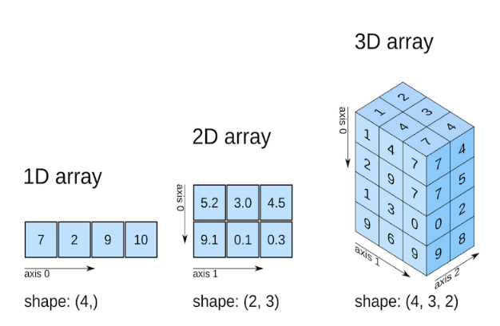
Numpy array

Slide 6
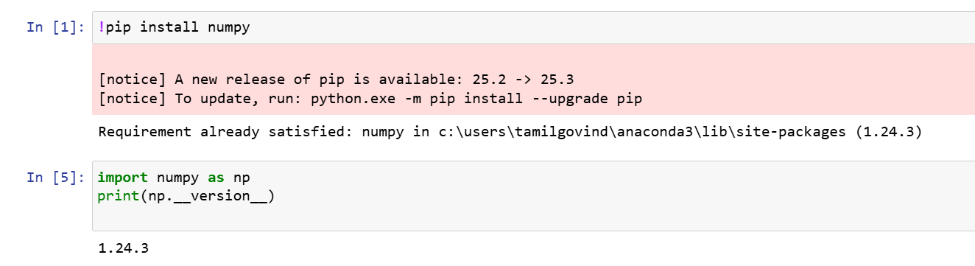
Installing NumPy

