Slide 1
B40 Education Assistance
A community pilot — continuing your studies at Malaysia’s public colleges and universities
About this programme
A small, community-supported effort helping students from low-income households continue at Malaysia’s public institutions — backed by fellow Malaysians who want to see you succeed. There is no big organisation behind this yet; it is a pilot, run by people who care.
About HalaTuju
HalaTuju is a Malaysian education-pathway platform that helps SPM/STPM students find courses they qualify for. This application process for this programme runs on HalaTuju — i.e. you will create or log in to your HalaTuju account to apply.
About this session
You already raised your hand on our Google form (thank you). The Google form told us who you are; today we will walk through the formal application that gives us the verifiable detail and consent we need before we can introduce you to a sponsor. Everything you share stays confidential — we never pass it on without your permission.
1 / 7

Slide 2
The /scholarship page
Your 8-step journey
Rolling basis — no fixed deadline.
1
Apply
Sign in with Google, confirm your HalaTuju profile, submit.
About 5–10 minutes
2
We confirm
An email acknowledging your application.
Same day
3
Shortlisting
We check your results and household income against the criteria and let you know.
Within 48 hours
4
Complete your profile
If shortlisted, share a few more details + upload documents (IC, results slip, proof of income).
A few minutes when ready
5
A short interview
Brief phone call (~20 min) in your preferred language. To get to know you, not test you.
After your profile is complete
6
Ready for sponsors
With your written consent, we prepare a confidential profile.
After the interview
7
Matched and awarded
Once a sponsor chooses to support you, we arrange the assistance and administer the funds together.
Up to ~2 months from application
8
Staying supported
Each semester, upload your latest results + a brief progress note. Support continues as long as you are progressing.
Throughout your studies
2 / 7

Slide 3
/scholarship → Can I apply?
You are eligible if all of these are true
1.
Malaysian citizen — who has just completed, or is completing, SPM or STPM.
2.
Low-income household — combined monthly income at or below RM5,860 (the national B40 threshold, DOSM 2024).
3.
Solid academic record — at least 5 A’s in SPM, or a PNGK of 3.0 or above in STPM.
4.
Continuing at a Malaysian public institution — Matrikulasi, Foundation/Asasi, STPM, IPTA, polytechnic or ILKA.
5.
Reachable for a short interview — usually a 20-minute phone call in English, Bahasa Malaysia, or Tamil.
6.
Willing to share progress — semester results + a brief update so support can continue.
Close, but not exactly? Apply anyway. Our bar is a little more generous than the headline — especially on grades. Applying lets us assess your eligibility; it does not guarantee assistance.
3 / 7

Slide 4
Step 1 — halatuju.xyz/scholarship/apply
The formal application form
5 short sections, save as you go.
About Me
Name, NRIC (one-time, pre-filled at sign-in), contact, school, preferred call language
My Family
Household income, household size, who supports the family, STR/JKM if applicable
My Results
Your SPM / STPM grades (re-uses what you have already entered on HalaTuju)
My Plans
What you intend to study, where, and how confident you are (it is fine to be still deciding)
Support
Other scholarships you are pursuing, anything else you would like us to know, consent to contact
⚠ Truthfulness matters. We later verify what you say against your documents (MyKad, results slip, income proof) and at the interview. Mismatches will likely disqualify your application. If you are unsure of an exact number, be honest about your uncertainty in the open notes rather than guessing. We can work with “I’m not sure”; we cannot work with information that does not match.
After submit (Steps 2 → 3): a same-day acknowledgement email arrives; within 48 hours you will hear whether you have been shortlisted (link to the next page) or not this round (a warm note explaining why). Please check your spam folder.
4 / 7

Slide 5
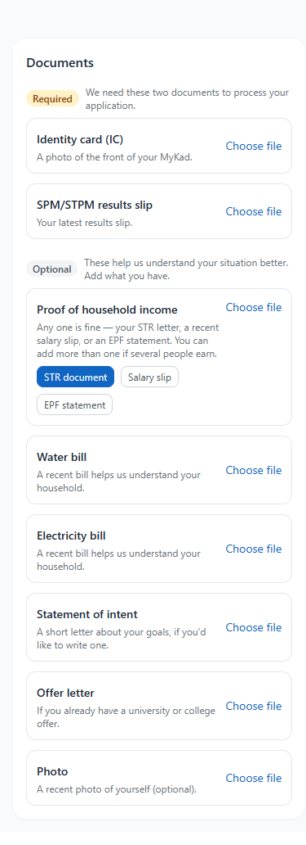
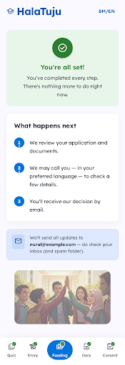
Step 4 — halatuju.xyz/scholarship/application
Five small tabs, no fixed time limit
1. Quiz
The HalaTuju course-fit quiz (re-uses your previous answers).
2. Your story
About your family + about you. Mostly optional. Write in BM, English, or Tamil.
3. Funding
Tick the categories support would help with (living, transport, accommodation, books, device). Plus a short note. Assistance is up to RM3,000 — could be less, depending on funds available and need.
4. Documents
Required: IC + results slip. Optional: one income proof (STR / salary slip / EPF), utility bills, statement of intent, offer letter, photo. The IC is auto-checked against your details — your photo isn’t kept at Google.
5. Consent
Your formal permission to share your confidential profile with potential sponsors. You can withdraw it at any time.
💡 Tell us as much as you can. "Your story" and the funding note are your chance to put a person behind the numbers — the more we know, the better we can advocate for you to sponsors. Write in your own words, in your most comfortable language. Same truthfulness rule applies: honest uncertainty is fine; mismatches will likely disqualify.
Documents tab → "You’re all set!" + What happens next
5 / 7

Slide 6
After your profile is complete
Steps 5 to 8 — and the things to keep in mind
Step 5 — The phone call
A few important things, plainly
~20 minutes, your preferred language. A warm conversation. We may also cross-check a few things — please be straightforward about anything you weren’t sure of in writing.
🆓 No fee, ever. Free to apply, free to be in.
Step 6 — Profile for sponsors
🔒 Confidential. Your information goes only to our small coordinator team and (with your consent) to potential sponsors.
A short, confidential profile based only on what you told us. A coordinator reviews it before any sponsor sees it.
✋ Soft signals, not hard blocks. The IC auto-check is a hint — a human always reviews your documents before any decision.
Step 7 — Matched and awarded
Once a sponsor chooses to support you, we arrange the assistance and administer the funds together. From application to award typically takes up to two months.
⚠ Truthfulness disqualifies. Mismatches between what you say and what your documents show will likely end your application. Be honest about uncertainty.
👨‍👩‍👧 Under 18? A parent/guardian co-signs the consent. We will guide you through it.
Step 8 — Staying supported
Each semester you upload your latest results + a short progress note. As long as you are progressing, support continues through your studies.
Public institutions only, this round — Matrikulasi, Asasi, STPM, University, polytechnic, Kolej Komuniti, IPGM, ILKA.
6 / 7

Slide 7
Questions?
We’re glad you’re here.
7 / 7

