Slide 1
Java Memory Management
and Garbage Collection
Notes:
Introduce JVM memory management and the trade-offs between collectors. JVM means Java Virtual Machine. GC means garbage collection. Examples use HotSpot, with Java 25 as the reference for modern collector guidance. CMS is historical. The audience should be able to explain object reachability and choose what to measure before selecting a collector.
Reference: https://docs.oracle.com/javase/specs/jvms/se25/html/jvms-2.html

Slide 2
Agenda
  JVM memory components and object lifetimes
  GC roots, marking and memory reclamation
  Serial, Parallel, CMS, G1 and ZGC
  Collector trade-offs and a GC log walkthrough
Notes:
The learning path starts with where information lives, then explains object reachability and collection steps. Finally compare collector designs and read a sample log. Define JDK as Java Development Kit. This is a beginner talk: explain terminology when it first appears and use the diagrams before introducing implementation details.
Reference: https://docs.oracle.com/javase/specs/jvms/se25/html/jvms-2.html

Slide 3
JVM Memory Areas
Eden
Old Generation
S0
S1
Young Generation
Heap
Metaspace
Code Cache
JVM Stack
Native Method Stack
Shared Libs
3
Notes:
The diagram separates the managed object heap from other memory components. Eden, S0 and S1 illustrate a traditional generational layout. G1 and ZGC organize generations differently. Metaspace holds class metadata, code cache holds generated machine code, and stacks hold active method state. The boxes are conceptual and are not equal fixed-sized physical partitions. This is a memory-area overview, not the Java Memory Model specification about visibility between threads.
Reference: https://docs.oracle.com/javase/specs/jvms/se25/html/jvms-2.html

Slide 4
Heap
  The heap is shared across Java threads.
  It holds objects and arrays created by the application.
  A heap object can outlive the method that created it.
  GC can reclaim an object after it becomes unreachable.
  Collectors organize and reclaim the heap in different ways.
  Shared objects need safe coordination when threads update them.
4
Notes:
Use an Order object that remains referenced after a helper method returns. The method frame ends but the Order can remain live through a caller or cache. Multiple threads can refer to the same object. Sharing storage does not make updates safe: application synchronization is a separate concern. Avoid saying that heap access is always slower than stack access, since compiler and hardware behavior matter. Optimizations may also eliminate allocations while preserving program behavior.
Reference: https://docs.oracle.com/javase/specs/jvms/se25/html/jvms-2.html

Slide 5
Metaspace
  Metaspace stores HotSpot class metadata outside the Java heap.
  Metadata describes class structure, fields and methods.
  It replaced PermGen in JDK 8 and can grow within configured limits.
  Example: the Order definition differs from each Order object.
Code Cache
  The Just-in-Time (JIT) compiler turns frequently executed code into machine code.
  The code cache stores this generated code so later execution can reuse it.
5
Notes:
A class is a definition and an object is one instance. Class loaders load definitions, whose internal descriptions occupy Metaspace in HotSpot. Class unloading can release metadata when its loader and classes are eligible, subject to collector behavior. Metaspace is native memory and can still exhaust available or configured limits. JIT means Just-in-Time compilation. Frequently executed bytecode may be compiled and its machine code stored in the code cache. Warm-up describes the period while loading and compilation affect performance.
Reference: https://docs.oracle.com/javase/specs/jvms/se25/html/jvms-2.html

Slide 6
JVM Stack
  Each Java thread has its own logical stack of active method calls.
  Each call adds a frame containing local values and calculation state.
  A local reference may point to an object in the shared heap.
  Returning from a method removes its frame from the active stack.
  Objects referenced by a frame can still be shared with other threads.
  A call chain that grows too deep can cause StackOverflowError.
6
Notes:
A frame is the workspace for one active method invocation. It contains local variables, an operand stack and linking information. Calling another method adds a frame, and returning removes it. A primitive field lives with its heap object, so do not say all primitive values live on stacks. Stack-local references can point to shared objects. Virtual threads have logical Java stacks too, but their physical storage differs from ordinary platform thread stacks. Deep recursion is a common stack-overflow cause.
Reference: https://docs.oracle.com/javase/specs/jvms/se25/html/jvms-2.html

Slide 7
Shared Libraries
  Native libraries contain code outside Java bytecode, such as operating-system routines.
  The process maps library code into memory when it loads the library.
Native Method Stack
  Native calls execute code written in languages such as C or C++.
  Their call state also needs stack storage. HotSpot may use the same underlying thread stack.
7
Notes:
JNI means Java Native Interface. Native methods allow Java to call code such as C or C++. The JVM specification permits native method stacks, but the implementation may combine Java and native call storage. Library code, native allocations and stacks all contribute to process memory beyond the Java heap. The operating system can share some mapped code pages. There is no universal guarantee that every library has exactly one mapping or that all native memory comes from libraries.
Reference: https://docs.oracle.com/javase/specs/jvms/se25/html/jvms-2.html

Slide 8
Stack and Heap
data = 10
class Sum{
int data = 10;
public int add(int n1, int n2){
return n1+n2;
}
}
public class Demo {
public static void main(String[] args) {
int val = 6;
Sum sum = new Sum();
int output = sum.add(2, 3);
System.out.println(output);
}
}
200
Heap
Stack
main() |  | add()
output
sum | 200 | n2 | 3
val | 6 | n1 | 2
Notes:
Read the code and diagram at the moment add(2, 3) is executing. The main frame has val=6 and sum refers to the heap object, whose data field is 10. The add frame holds n1=2 and n2=3. output has not yet received the result, so its cell is blank. On return, the add frame ends and output becomes 5. The address-like value 200 is only illustrative. Method code and metadata are stored separately from the per-instance data shown in the heap.
Reference: https://docs.oracle.com/javase/specs/jvms/se25/html/jvms-2.html

Slide 9
Memory beyond the Java heap
Direct buffers
ByteBuffer.allocateDirect() can allocate native memory for input and output.
Process memory
Heap + stacks + Metaspace + code cache + other native allocations.
Memory limit
-Xmx limits the Java heap. The whole process needs additional memory.
Example
A process can exceed its container limit while the heap still has free space.
9
Notes:
Native memory is memory outside the managed Java heap. A container is an environment that can enforce a total memory limit. Direct buffer objects have a small heap wrapper and can use larger native storage. A platform thread also needs stack memory. Do not set the heap equal to the total process limit. Required room depends on thread count, loaded classes, libraries and the workload. Native Memory Tracking helps with many HotSpot allocations, but does not cover every third-party allocation.
Sources:
https://docs.oracle.com/javase/specs/jvms/se25/html/jvms-2.html
https://docs.oracle.com/en/java/javase/25/troubleshoot/diagnostic-tools.html
https://docs.oracle.com/en/java/javase/25/docs/api/java.base/java/nio/ByteBuffer.html

Slide 10
What is Garbage Collection (GC)
GC automatically reclaims memory occupied by unreachable heap objects.
Reachable means a live reference path can still lead to the object.
Application code does not explicitly free each ordinary Java object.
Removing one reference does not delete an object if another live path remains.
GC does not know whether reachable data is still useful to the business.
Unwanted reachable data can still cause a memory leak.
Collection timing and pause behavior depend on the collector.
10
Notes:
GC follows reachability rather than human notions of usefulness. Imagine first and second both refer to one Order. Setting first to null leaves the object reachable through second. If no live path remains, its space can be reclaimed in a relevant collection, not necessarily immediately. GC reduces manual deallocation errors, but it does not fix an application that stores every past request in a live collection. Not every GC cycle examines every object or every generation.
Reference: https://docs.oracle.com/javase/specs/jvms/se25/html/jvms-2.html

Slide 11
Why Java can still have memory leaks
Example
A static List stores every completed request and never removes entries.
Reference path
The live class keeps the list reachable. The list keeps its entries reachable.
GC result
The collector must retain these objects even when the application no longer needs them.
Application fix
Remove obsolete entries or apply a bounded retention policy.
11
Notes:
A memory leak in managed Java commonly means unwanted retention. The program can still reach data that it no longer needs. GC cannot infer business intent. Explain the path from a static field to a list and then to each request. Increasing the heap delays exhaustion but does not repair the retention policy. A heap dump can show what retains an object. Never suggest that calling System.gc guarantees removal of reachable objects.
Sources:
https://docs.oracle.com/en/java/javase/25/troubleshoot/troubleshooting-memory-leaks.html

Slide 12
Why young and old generations help
Observation
Many temporary objects become unreachable soon after creation.
Young generation
Collect new objects frequently, where much of the garbage is likely to be.
Old generation
Move longer-lived survivors here and collect them less often.
Next example
Eden and S0/S1 illustrate the traditional Serial/Parallel layout.
S0 and S1 are survivor spaces. Their roles alternate between young collections.
12
Notes:
The weak generational hypothesis is an observed tendency, not a promise about every workload. Temporary parsing data may live briefly while a cache can live for hours. Survivor age counts collections survived, not wall-clock seconds. References from old objects to young objects still matter and collectors track them so a young collection need not scan all old objects. G1 uses region sets, and ZGC has a different layout. The next four diagrams are a simplified teaching sequence.
Sources:
https://docs.oracle.com/en/java/javase/25/gctuning/garbage-collector-implementation.html
https://docs.oracle.com/en/java/javase/25/gctuning/garbage-first-g1-garbage-collector1.html
https://docs.oracle.com/en/java/javase/25/gctuning/z-garbage-collector1.html

Slide 13
Object Allocation: New Objects
Eden
S0
S1
Old Generation
Most ordinary new objects enter Eden in this traditional generational example.
When allocation runs out of young-generation space, a young GC can reclaim space.
Notes:
This is a simplified traditional young-generation layout used to explain Serial and Parallel. Green rectangles represent allocated objects. Most ordinary new objects enter Eden. There are collector-specific and large-object exceptions. A young collection can occur when allocation cannot proceed. S0 and S1 are two survivor spaces whose roles alternate. The next picture jumps to after collection, so the audience can see the resulting memory state. Source: https://docs.oracle.com/en/java/javase/25/gctuning/garbage-collector-implementation.html
Reference: https://docs.oracle.com/javase/specs/jvms/se25/html/jvms-2.html

Slide 14
Object Allocation: First Survivors
After the first young collection
Eden
S0
S1
1
1
1 1
1
1
1
1 1
1
Old Generation
After more allocation and a young GC, survivors occupy S0 with age 1.
Eden is reusable. Objects that became unreachable did not survive the collection.
Notes:
At this point a young collection has finished. Reachable young objects have been copied from Eden to S0. Each shown survivor has age 1, meaning it survived one young collection rather than one second. Unreachable objects were omitted from the copy, so their source memory can be reused. The green blocks are survivors and the empty Eden is available for new allocations. Source: https://docs.oracle.com/en/java/javase/25/gctuning/garbage-collector-implementation.html
Reference: https://docs.oracle.com/javase/specs/jvms/se25/html/jvms-2.html

Slide 15
Object Allocation: Survivor Ageing
After another young collection
Eden
S0
S1
2
2
2 1
1
1
1
1 1
1
Old Generation
The next young GC copies survivors into S1. S0 becomes reusable.
Older survivors reach age 2. Newly surviving Eden objects have age 1.
Notes:
Between the two diagrams the application allocated more objects in Eden. Another young collection has now copied reachable objects from both Eden and the previous survivor space into S1. Objects that survived before can reach age 2. Newly surviving objects have age 1. S0 is empty and available as the next destination. Labels show conceptual ages, not addresses or timing measurements. Source: https://docs.oracle.com/en/java/javase/25/gctuning/garbage-collector-implementation.html
Reference: https://docs.oracle.com/javase/specs/jvms/se25/html/jvms-2.html

Slide 16
Object Allocation: Promotion
Survivors can move into the old generation
Eden
S0
S1
2
1
1 1
1
1
2
1 1
2
Old Generation
3
3
3 1
Objects that reach the promotion threshold move to the old generation.
Age 3 is illustrative. Actual thresholds adapt, and space pressure can cause earlier promotion.
Notes:
The traditional sequence alternates survivor spaces again. Some survivors now move to the old generation because they have reached the illustrative threshold of three collections. Real tenuring policies are adaptive, and survivor-space pressure can cause earlier promotion. Promotion does not make an object immortal. An old-generation object can later become unreachable and be reclaimed in a relevant collection. G1 uses region sets, and ZGC has a different generational layout. Source: https://docs.oracle.com/en/java/javase/25/gctuning/garbage-collector-implementation.html
Reference: https://docs.oracle.com/javase/specs/jvms/se25/html/jvms-2.html

Slide 17
Parallel and Concurrent GC
Parallel GC
Concurrent GC
Stop The World
GC
Threads
Application
Threads
Application
Threads
GC
Threads
Application
Threads
Parallel = several GC workers. Concurrent = GC work overlaps application execution.
Stop-the-world pauses application execution. Concurrent collectors can still have brief pauses.
17
Notes:
There are various phases of GC and those phase can be running parallelly or concurrently
Lets look at parallel phases
as you scan ee in the diagram application threads are running parallelly and then it pause to let GC threads run
Before GC threads run, all the application thread comes to global safe point so that there is no loss in data and then GC threads are run and when GC threads complete, application threads resume
Click
This phase is stop the world phase as application thread is not running during this time.
Click
whereas in concurrent phases application threads and gc threads both run concurrently without any pause

Slide 18
The main jobs of a tracing collector
Find starting points
Root scanning locates references that the runtime treats as live.
Trace live objects
Marking follows reference paths and records reachable objects.
Handle changes
Concurrent collectors track reference changes while the application runs.
Recover space
Sweep dead storage or copy live objects out of selected areas.
Stop-the-world (STW) means application execution pauses for a GC operation.
18
Notes:
This slide introduces jobs rather than one mandatory sequence. Some collectors reclaim regions after moving survivors and do not run a separate classic sweep. A collector may use short pauses to coordinate work while running most other work concurrently. Compaction reduces fragmentation by moving objects. The precise steps and pause boundaries are collector-specific. Define reachable as accessible by a chain starting at a live root.
Sources:
https://docs.oracle.com/en/java/javase/25/gctuning/garbage-collector-implementation.html
https://docs.oracle.com/en/java/javase/25/gctuning/garbage-first-g1-garbage-collector1.html
https://docs.oracle.com/en/java/javase/25/gctuning/z-garbage-collector1.html

Slide 19
GC Root Scanning
GC roots are the starting references used to find live objects.
Examples include live references in thread frames or registers.
JNI handles let native code keep references to Java objects.
Static fields of live classes can keep objects reachable.
The collector follows references from these starting points into the heap.
An object with no live path from a root can become eligible for collection.
Root processing and its pause behavior depend on the collector.
19
Notes:
Lets look at 1st phase which is GC root scanning
GC Roots are special objects for the Garbage Collector
What are different types of GC root ?
Classes loaded by a system class loader; contains references to static variables as well
Local variables and parameters to methods stored on the local stack
All active Java threads
Native code Java objects created for JNI calls
All these GC roots are stored in stack and they have reference to objects in the Heap Memory
If an object is not accessible from GC Root directly or indirectly is considered as Garbage

Slide 20
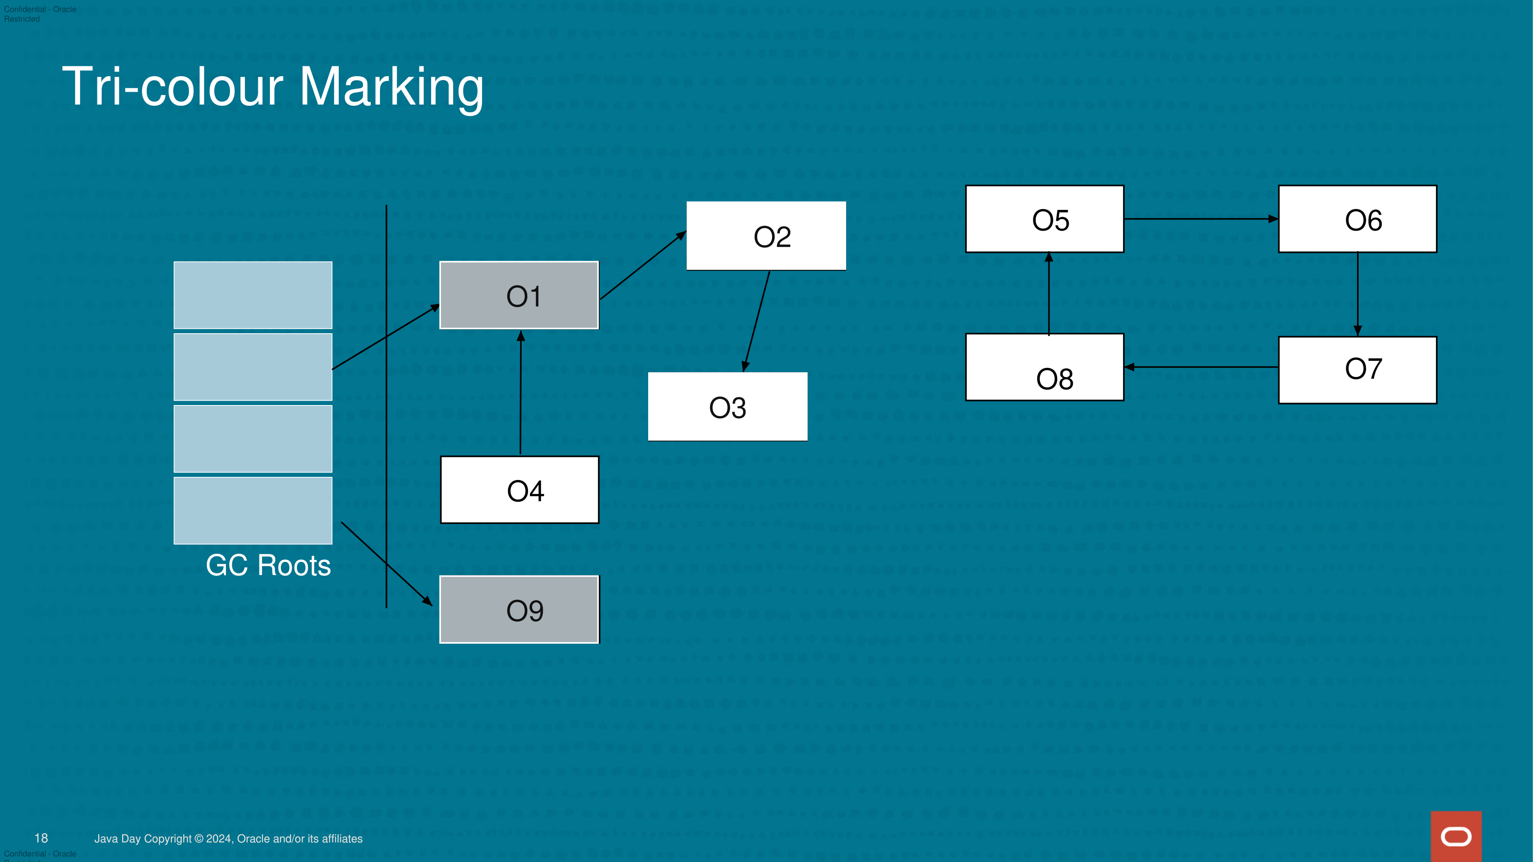
Root scanning: where tracing starts
1 Start at live roots
2 Discover O1 and O9
3 Queue them for scanning
Gray = discovered, with outgoing references still to scan.
20
Notes:
Start with the left-hand root entries. Their references discover O1 and O9. Gray means discovered but not fully scanned. Follow O1 to O2 and then O3 on later scans. O4 points toward O1, but that arrow does not create a path from a root to O4. Reachability follows arrow direction. The diagram is simplified and assumes ordinary strong references. Real roots include live references in frames or registers and JNI handles.
Sources:
https://docs.oracle.com/en/java/javase/21/gctuning/other-considerations.html

Slide 21
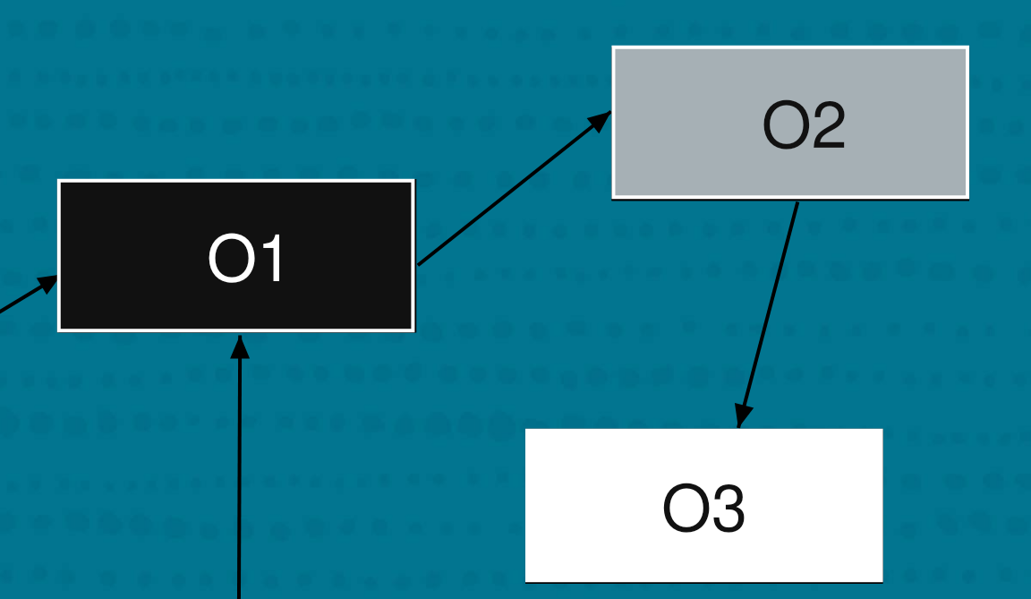
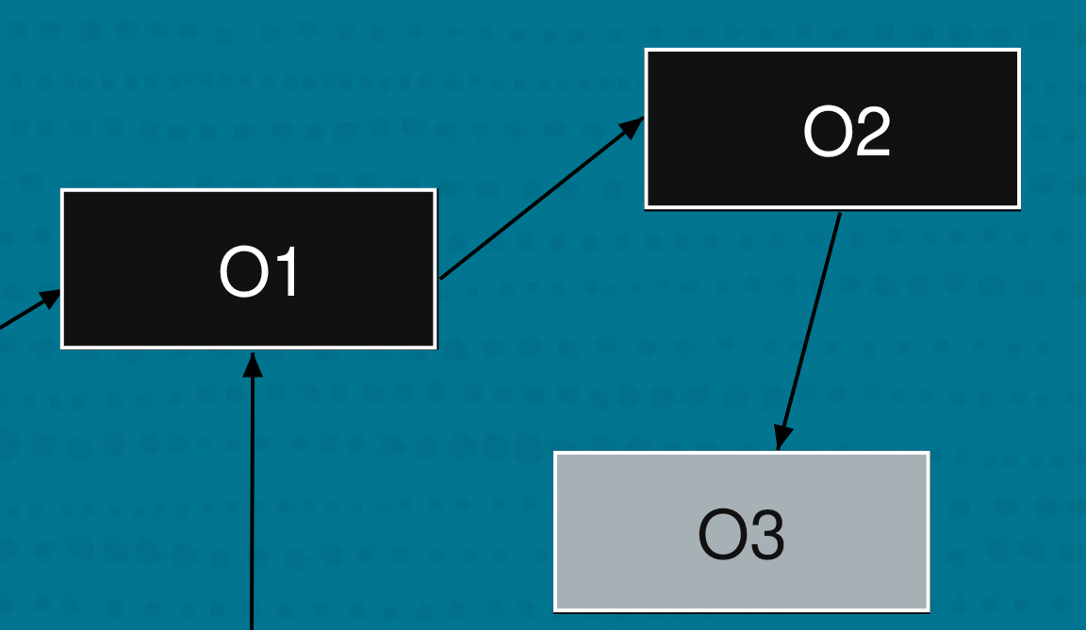
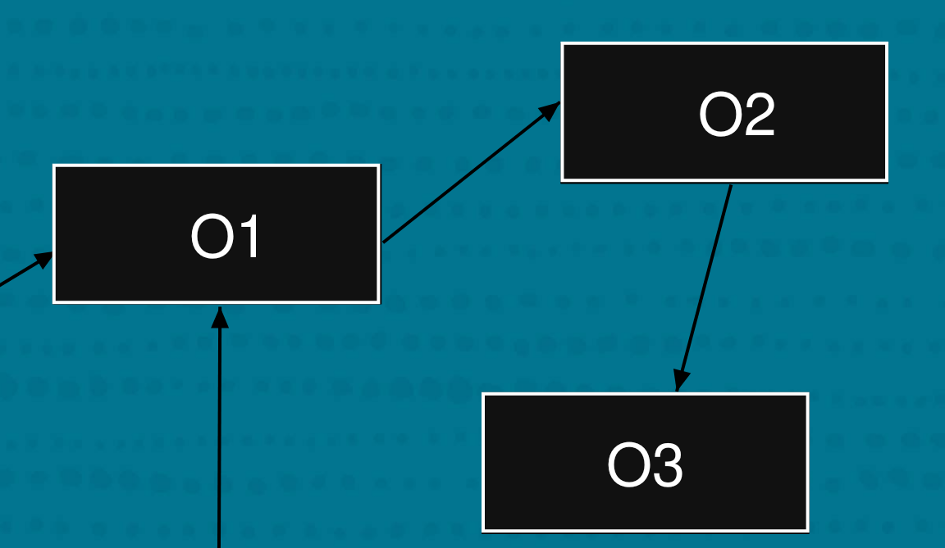
Tri-colour marking: three work states
Discover O1
Scan O1, find O2
Scan O2, find O3
Scan O3, finish
White: not discovered yet Gray: discovered, not fully scanned
Black: fully scanned
Close-up of O1–O3. The separately rooted O9 lies outside this close-up.
21
Notes:
The three colors represent bookkeeping states, not physical object colors. White means not discovered yet, so a white object can still be live during an unfinished scan. Gray means discovered and waiting for its outgoing references to be scanned. Black means the scan is complete. Begin with O1 gray. Scanning O1 discovers O2, so O2 becomes gray and O1 becomes black. Scanning O2 then discovers O3. Only after marking completes, with concurrent changes correctly handled, can remaining white objects be treated as unreachable in the collection scope.
Sources:
https://courses.cs.cornell.edu/cs4120/2026sp/notes/gc/index.html

Slide 22

Tri-colour Marking
O2
O5
O6
O2
O2
O1
O1
O1
O8
O7
O3
O3
O3
O4
GC Roots
O9
O9
O9
O4, O5, O6, O7 & O8 are eligible for GC
22
Notes:
In this phase whichever object can be referred directly or indirectly from GC roots are marked.
For marking 3 colors are used
White, Grey & Black
White – objects which are yet to be marked
Grey – Marking in progress
Black – Marking complete
O1 & O9 are accessible from GC roots and they are getting marked
Similarly other objects O2 & O3 are also marked
O4,O5,O6 & O8 are eligible for garbage collection

Slide 23
Tri-colour Marking (Concurrent)
O2
O5
O6
O2
O2
O1
O1
O1
O8
O7
O3
O3
O3
O4
GC Roots
New partial example: the application adds O3 → O4.
An existing live reference already keeps O4 accessible (not drawn).
Barriers track relevant changes. The exact mechanism depends on the collector.
O9
O9
O9
23
Notes:
What if marking is happening concurrently – Application and GC thread both are running and trying to modify same object
For instance as shown in diagram
O4 was eligible for garbage collection and now it is referred from O3 and O9 was referred from GC roots and now its not there any more
There are two issues here, incorrect marking and missed marking
Incorrect marking - O9 should be eligible for GC – anyway it wont break the application
But in case of missed marking, if O4 is collected by GC then application will break - for this read and write barriers are used, jit compiler adds an extra code on this object and it is saved for remarking phase

Slide 24
Re-marking
Collectors such as CMS and G1 use a pause to finish marking consistently.
They process outstanding marking work and collector-specific reference tasks.
Sweeping
Sweeping reclaims unreachable storage while leaving surviving objects in place.
CMS normally sweeps concurrently. Other collectors use different reclamation paths.
24
Notes:
Remarking - Those objects which were modified by applications during marking phase are marked in this phase. It’s stop the world phase but pause time has reduced from marking to just remarking phase
Sweeping – In this phase GC scans through the heap and identify dead object, remove them and reclaim memory. It runs concurrently

Slide 25
Compaction
Compaction moves live objects to reduce scattered gaps in free memory.
The collector maintains valid references when object locations change.
G1 moves objects during pauses. ZGC relocates objects concurrently.
Heap Before GC
Garbage
Live
Live
Garbage
Live
Garb
age
Live
GC cleaning garbage
and reclaiming memory
Live
Live
Live
Live
Memory compaction
Live
Live
Live
Live
25
Notes:
Whenever GC removes garbage from heap, there are a lot of fragments in between live object. Compaction is a process of moving all live objects together. If any object is moved then all the references to it is also updated to point to new object

Slide 26
How these jobs differ by collector
Collector | Typical collection work | What pauses?
Serial / Parallel | Copy young survivors, compact old objects | Collection work
CMS (historical) | Concurrent marking and sweeping | Initial mark, remark and young GC
G1 | Concurrent marking, region evacuation | Evacuation and coordination
ZGC | Concurrent marking and relocation | Brief coordination steps
A single root–mark–remark–sweep–compact sequence does not describe every collector.
26
Notes:
This table describes normal collection paths, not every fallback. Evacuation means copying live objects out of selected areas so those areas can be reused. CMS does not routinely compact during its normal old-generation cycle, and fragmentation can force a more expensive fallback. G1 can fall back to a full collection. ZGC moves objects concurrently but allocation can still stall if reclamation cannot keep up. Concurrent never means unlimited CPU or free memory.
Sources:
https://docs.oracle.com/en/java/javase/25/gctuning/available-collectors.html
https://docs.oracle.com/javase/8/docs/technotes/guides/vm/gctuning/cms.html
https://docs.oracle.com/en/java/javase/25/gctuning/garbage-first-g1-garbage-collector1.html
https://docs.oracle.com/en/java/javase/25/gctuning/z-garbage-collector1.html

Slide 27
Why new collectors were introduced
Earlier limitation | New approach | Remaining trade-off
Serial: one worker | Parallel uses several GC workers | Application still pauses
Long application pauses | CMS moves much old-gen work alongside the app | Fragmentation and CPU overhead
CMS leaves scattered gaps | G1 evacuates regions and plans pause work | Copying still needs pauses
G1 moves objects during pauses | ZGC relocates objects concurrently | Needs CPU and memory headroom
Parallel and CMS pursued different goals. Newer does not mean best for every workload.
27
Notes:
This is a design progression rather than a strict replacement chain. Parallel focused on throughput, while CMS pursued lower pause times. They address different priorities. G1 combines concurrent marking with incremental region evacuation, addressing fragmentation and pause planning. ZGC moves more work, including relocation, alongside the application. Each choice remains a trade-off. Serial and Parallel can still be appropriate. CMS was removed in JDK 14 and is included to explain the history.
Sources:
https://docs.oracle.com/en/java/javase/25/gctuning/available-collectors.html
https://docs.oracle.com/javase/8/docs/technotes/guides/vm/gctuning/cms.html
https://docs.oracle.com/en/java/javase/25/gctuning/garbage-first-g1-garbage-collector1.html
https://docs.oracle.com/en/java/javase/25/gctuning/z-garbage-collector1.html
https://docs.oracle.com/en/java/javase/14/migrate/index.html

Slide 28
Serial GC: simple collection with one worker
How it works
Pauses the application and lets one GC worker reclaim memory.
Strength
Low coordination overhead for a small heap or limited CPU resources.
Limitation
One worker cannot use extra CPU cores to shorten GC work.
What came next
Parallel GC adds workers. CMS targets shorter application pauses.
Selection flag: -XX:+UseSerialGC
28
Notes:
Serial is the easiest baseline to explain: application threads pause while one GC thread performs collection. The young generation copies survivors and old-generation collection compacts. It can be a sensible candidate when the live data set is small and pauses are acceptable. It does not become universally wrong simply because newer collectors exist. Its single worker makes large collection jobs harder to shorten through extra CPU cores.
Sources:
https://docs.oracle.com/en/java/javase/25/gctuning/available-collectors.html

Slide 29
Parallel GC: more throughput with multiple workers
Problem addressed
Serial leaves extra CPU cores unused during collection.
How it works
Several workers collect together while application threads pause.
Suitable goal
Finish a batch or compute job quickly when pauses are acceptable.
Remaining issue
Large collections can still create long pauses.
Selection flag: -XX:+UseParallelGC
29
Notes:
Throughput means useful application work completed per unit time. Parallel GC uses multiple workers to reduce collection time when hardware permits. Parallel describes multiple GC workers, not overlap with application execution. The application still stops for collection. Measure job completion time and CPU use rather than assuming more workers always help. A latency-sensitive service may instead investigate G1 or ZGC.
Sources:
https://docs.oracle.com/en/java/javase/25/gctuning/available-collectors.html
https://docs.oracle.com/en/java/javase/25/gctuning/parallel-collector1.html

Slide 30
CMS: shorter pauses, but fragmented free space
Problem addressed
Long old-generation pauses interrupt responsive applications.
How it worked
Concurrent Mark Sweep did much marking and sweeping beside the app.
Remaining issue
Normal cycles left gaps. A large object might not fit available holes.
Next approach
G1 moves live objects out of regions so complete regions become reusable.
Historical collector. Removed in JDK 14.
30
Notes:
CMS means Concurrent Mark Sweep. Initial marking and remarking still required pauses, and young collections also paused the application. Sweeping reclaimed unreachable objects without normally moving the survivors, leaving fragmentation: free memory split into holes. Concurrent collection also competed with the application for CPU and needed to finish before free space ran out. Failure could lead to a much longer collection. CMS is historical and cannot be selected in JDK 14 or later.
Sources:
https://docs.oracle.com/javase/8/docs/technotes/guides/vm/gctuning/cms.html
https://docs.oracle.com/en/java/javase/14/migrate/index.html

Slide 31
G1: region-based collection with a pause-time goal
Problem addressed
CMS fragmentation and difficulty controlling large collection pauses.
How it works
Divides the heap into regions and copies survivors out of selected regions.
Benefit
Reuses complete regions and chooses collection work around a pause goal.
Remaining issue
Object copying still pauses the application. The goal is not a deadline.
Selection flag: -XX:+UseG1GC. Default on most Java 25 configurations.
31
Notes:
G1 means Garbage First. A region is a managed chunk of the heap. Eden, survivor and old generations are sets of regions rather than fixed contiguous spaces. G1 marks much old-generation liveness concurrently. A young collection evacuates young regions, and mixed collections can include selected old regions as well. Evacuation means copying survivors elsewhere so source regions become available. Remembered sets track incoming references from other regions. Pause targets are best-effort, and insufficient free space can trigger expensive fallback collection.
Sources:
https://docs.oracle.com/en/java/javase/25/gctuning/garbage-first-g1-garbage-collector1.html

Slide 32
ZGC: concurrent relocation for very short pauses
Problem addressed
Moving many live objects can lengthen G1 evacuation pauses.
How it works
Marks and relocates objects while the application keeps running.
Reference safety
Barriers perform extra checks so references remain valid as objects move.
Remaining issue
Concurrent work uses CPU and spare memory. Allocation can still stall.
Java 25 ZGC is generational. Selection flag: -XX:+UseZGC
32
Notes:
ZGC is designed for very low GC pause times. It uses barriers, small pieces of runtime work around reference operations, together with pointer metadata to keep references correct while objects move. It is not a zero-pause collector and does not guarantee end-to-end response time. The application, operating system, CPU contention and allocation stalls can still introduce latency. Generational ZGC arrived in JDK 21, became the default ZGC mode in JDK 23, and the non-generational mode was removed in JDK 24. This deck uses Java 25 for current selection guidance.
Sources:
https://docs.oracle.com/en/java/javase/25/gctuning/z-garbage-collector1.html
https://docs.oracle.com/en/java/javase/24/migrate/removed-tools-and-components.html

Slide 33
Choosing a starting point for your workload
Workload priority | Candidate | What to validate
Small live data, limited CPU | Serial | Pause length and memory use
Batch throughput | Parallel | Completion time and pause tolerance
Balanced service performance | G1 / JVM default | Request latency and throughput
Very tight pause goals | ZGC | Tail latency, CPU and headroom
Maintaining an old CMS system | Plan migration | Behavior on a supported JDK
33
Notes:
These are starting candidates rather than guaranteed winners. First measure the JVM default on a representative workload. Keep hardware, heap limits, traffic and test duration comparable when evaluating alternatives. Check application performance rather than just average GC pause time. For a batch job, completion time may dominate. For an interactive service, high-percentile response time may dominate. CMS belongs only in the historical discussion and migration context.
Sources:
https://docs.oracle.com/en/java/javase/25/gctuning/available-collectors.html

Slide 34
What to measure before choosing a collector
Application
Requests per second, job completion time and p99 response time.
GC activity
Pause duration, collection frequency and bytes allocated per second.
Memory
Live heap after GC, total process memory and available headroom.
Tools
GC logs explain collection events. Java Flight Recorder adds runtime context.
Example logging option for modern HotSpot: -Xlog:gc*
34
Notes:
p99 is the 99th percentile: about 99 percent of measured requests finish within that response time. Tail latency captures unusually slow requests that averages can hide. Allocation rate is how quickly the application creates data. Live heap is memory occupied by surviving objects after collection, subject to the collection scope. Headroom is room available for new allocations and collector work. Java Flight Recorder, or JFR, collects runtime events. Compare repeated runs with realistic warm-up and load.
Sources:
https://docs.oracle.com/en/java/javase/25/troubleshoot/diagnostic-tools.html
https://docs.oracle.com/en/java/javase/25/gctuning/garbage-collector-implementation.html

Slide 35
Demo: reading one GC log line
Pause Young (G1 Evacuation Pause)
240M->80M(512M) 6.0ms
240M / 80M Heap used before / after this collection
512M Current heap capacity
6.0ms Duration of this GC pause
Illustrative log line. A lower heap value after one GC does not prove the application has no leak.
35
Notes:
The line is an invented teaching example in the shape of a modern HotSpot G1 message. M denotes the memory unit printed by the VM, and ms means milliseconds. 240M and 80M are used heap before and after this event, while 512M is the current heap capacity printed for the event, not necessarily the configured maximum. The 160M difference is an observed reduction in heap occupancy. One event cannot establish a leak, a performance trend, or the best collector. During a live demo, enable GC logging for an ordinary representative workload and compare several events. Do not force System.gc and treat that as normal traffic.
Sources:
https://docs.oracle.com/en/java/javase/25/gctuning/garbage-collector-implementation.html

Slide 36
Key takeaways
Memory
Heap objects, call frames, class metadata and compiled code have different roles.
Reachability
GC retains reachable objects, even when the application no longer needs them.
Collector evolution
New designs address earlier limits and introduce their own trade-offs.
Selection
Match application goals, then measure under realistic load.
36
Notes:
Ask the audience to explain why an object may survive a method return, why an unbounded list can cause a leak, and why parallel is different from concurrent. Ask which collector they would evaluate for a batch job and for a service with strict latency needs. Accept workload-dependent answers when they include measurement. The goal is understanding the mechanisms and trade-offs rather than memorizing a ranking of collectors.
Sources:
https://docs.oracle.com/javase/specs/jvms/se25/html/jvms-2.html
https://docs.oracle.com/en/java/javase/25/gctuning/available-collectors.html

Slide 37
Q & A
Notes:
Discussion questions: Why can an object survive the method that allocated it? Why does an unbounded live cache cause a leak? How do parallel workers differ from concurrent execution? What would you measure before moving a service from G1 to ZGC? Ask for reasoning based on goals and trade-offs rather than one universal best collector.
Reference: https://docs.oracle.com/javase/specs/jvms/se25/html/jvms-2.html

