Slide 1
COMPSYS 302 – Project B
“Science may never come up with a better office communication system than the coffee break.”
— Earl Wilson
Peer-to-peer Chat Application in Python

Slide 2
Brief
Executive team need to communicate with each other
The manager proposes a peer-to-peer chat application
A central server will be used to authenticate users
Users can find other online users on other computers
Users can create and maintain a simple profile
Users can send messages, images, audio, videos & other files

Slide 3
Why Login server model
Messages aren’t stored in a easily compromised central server
IP bootstrapping is no longer an issue as login server has the IPs
Operating cost is reduced as login server is less demanding than a central server
An administrator can restrict access to certain users

Slide 4
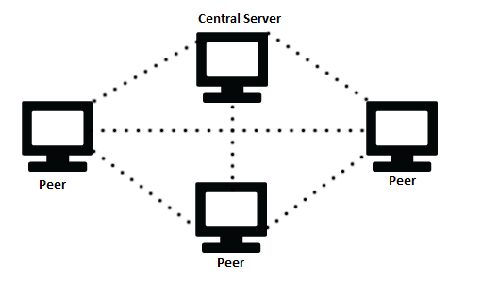
Peer-to-peer model with Central server

Slide 5

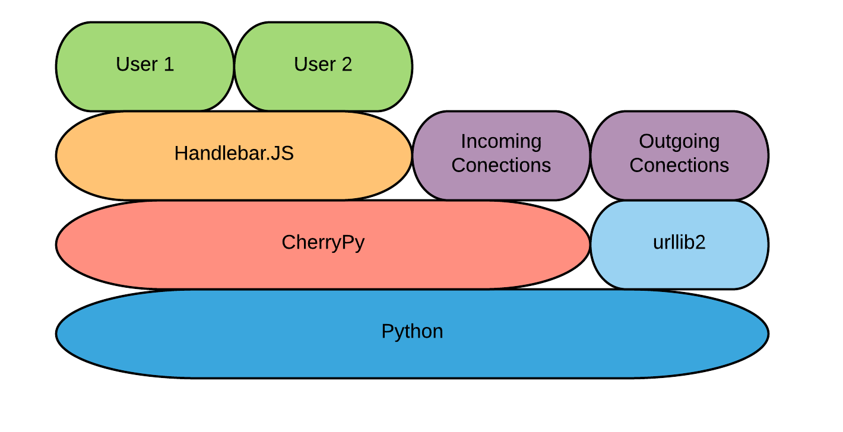


Technology stack

Slide 6
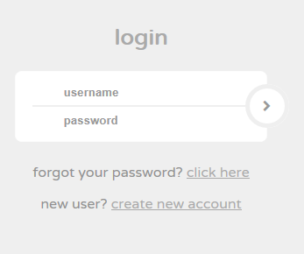
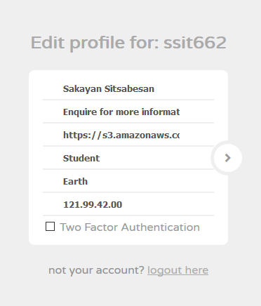
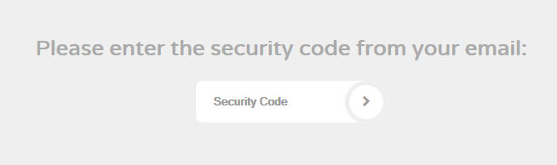

Slide 7
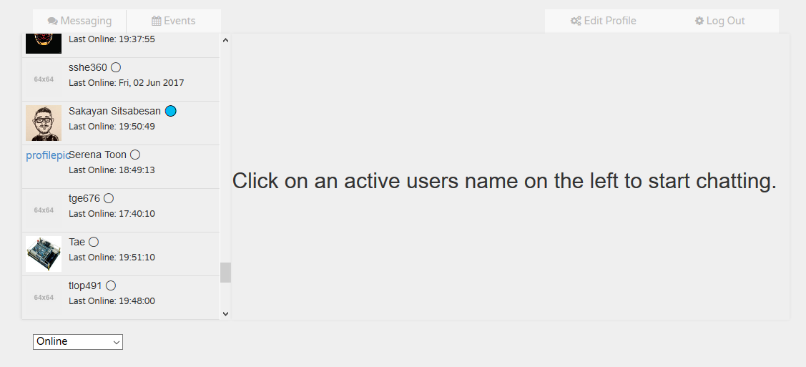

Slide 8
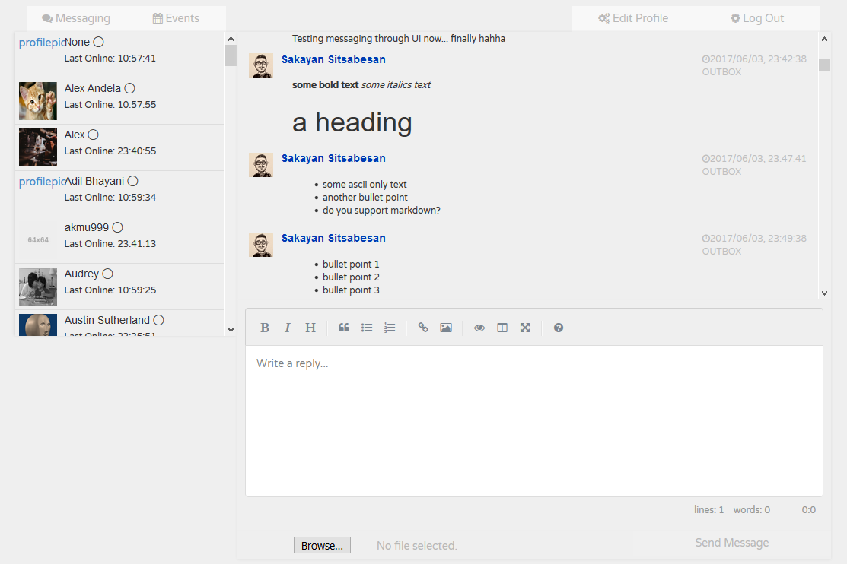

Slide 9
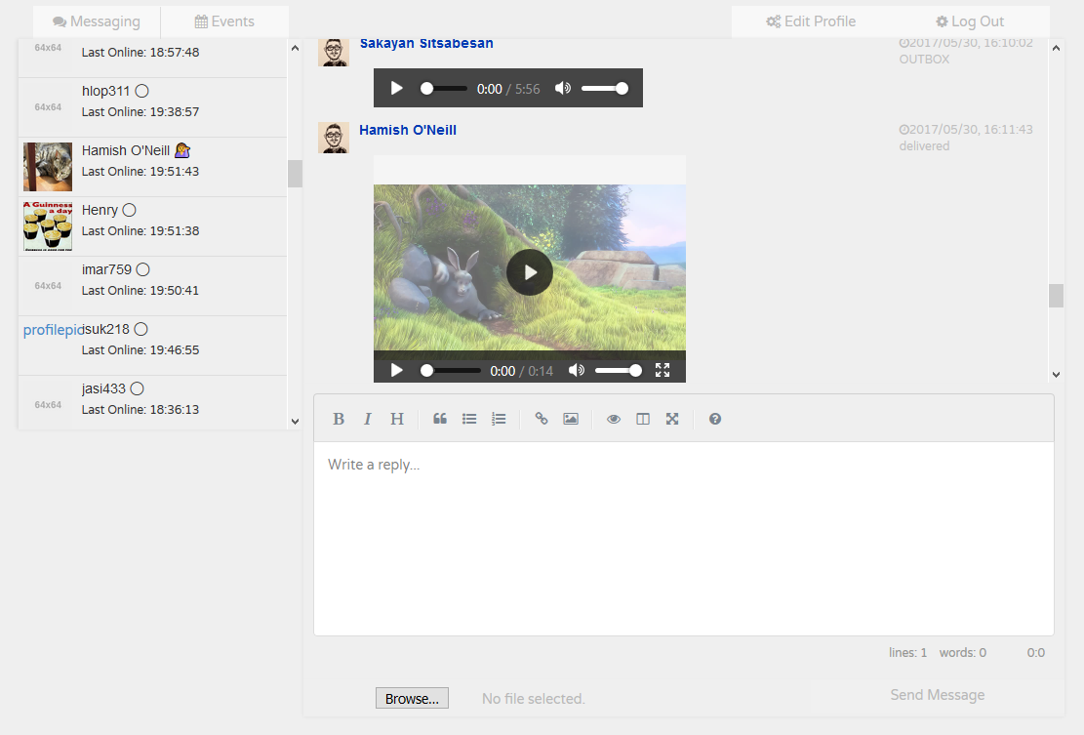

Slide 10
Special features
Multiple users can use a single node simultaneously
Two factor authentication of users by security code to email
An events coordination system for organizing meetings
Fallback p2p networking in the case of server outage
Forwarding of messages to offline clients
Daemon threads for making requests to other nodes
High standard of encryption and hashing with all communication
Communication of formatted messages (markdown)

