Slide 1
G L O B A L E - C O M M E R C E · S A L E S P E R F O R M A N C E R E V I E W
GLOBAL E-Commerce Sales Analysis
2023 – 2025

Slide 2
PROJECT OVERVIEW
Global E-Commerce Sales Analysis
A data-driven review of sales performance across 2023 – 2025
What is this project?
Why is it useful?
This project analyzes e-commerce orders to understand sales performance, profitability, top products, regions, customer segments, and payment trends over three years.
▸ Identify best-selling products & categories
▸ Find strongest markets & regions
▸ Measure profit vs loss orders
▸ Understand customer payment preferences
▸ Support business decisions & strategy
Total Sales
Orders
Profit Rate
Top Region
Top Category

Slide 3
PROJECT AGENDA
What We Will Cover
Project Overview
Introduction & objective of the analysis
Sales Performance
Total sales, orders, and average order value
Category & Product Analysis
Top categories and best-selling products
Regional Performance
Sales breakdown by region and country
Customer & Payment Insights
Customer segments and payment methods
Profitability Analysis
Profit vs loss orders and key findings
Key Insights & Conclusion
Summary of findings and recommendations

Slide 4
POWER QUERY · DATA PREPARATION
Data Cleaning Process
Steps performed in Power Query Editor before building the model
01
02
03
Load Source
Remove Duplicates
Data Type Fix
Imported global_ecommerce_sales Excel table (2,000 rows × 21 columns)
Checked Order_ID – no duplicate order IDs found. Kept all 2,000 unique orders.
Order_Date → Date | Unit_Price, Total_Sales, Profit → Decimal | Quantity → Whole Number
04
05
06
Null / Blank Check
Add Columns
Rename & Order
No nulls in key columns (Order_ID, Total_Sales, Profit). Shipping_Cost & Discount handled.
Created: net_sales, profit_margin, price_tier (low/med/high), profit_status (profit/loss)
Standardized column names, reordered for model clarity, set final data types.
Global E-Commerce Sales Analysis | Confidential
2 / 6

Slide 5
KEY PERFORMANCE INDICATORS
KPI Scorecard
Core business metrics calculated from the cleaned data model
$484.6K
2,000
$242.28
$158.9K
Total Sales
Total Orders
Avg Order Value
Total Profit
7,115
$25.8K
32.8%
1,728
Units Sold
Shipping Cost
Profit Margin
Profitable Orders
QUICK INSIGHT
Furniture = 53% of revenue · Europe is top region ($137K) · Credit Card = 40% of sales · 86% of orders are profitable
Global E-Commerce Sales Analysis | Confidential
3 / 6

Slide 6
DAX MEASURES
Key DAX Formulas
Measures created in the data model for KPI cards and visuals
Total Sales
Profit Margin %
Total Sales = SUM( Sales[Total_Sales] )
Profit Margin = DIVIDE( [Total Profit], [Total Sales] )
Total Orders
Net Sales
Total Orders = DISTINCTCOUNT( Sales[Order_ID] )
Net Sales = SUM( Sales[net_sales] )
Average Order Value
Shipping Cost
AOV = DIVIDE( [Total Sales], [Total Orders] )
Shipping Cost = SUM( Sales[Shipping_Cost] )
Total Profit
Profitable Orders
Total Profit = SUM( Sales[Profit] )
Profit Orders = CALCULATE( [Total Orders], Sales[profit_status] = "profit" )
Global E-Commerce Sales Analysis | Confidential
4 / 6

Slide 7



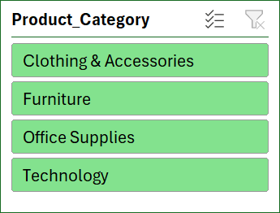
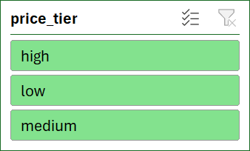
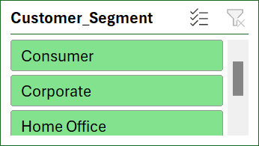
GLOBAL ECOMMERCE SALES DASHBOARD PRODUCT ANALYSIS
FILTER
TOP CATEGORY
Furniture
TOP PRODUCT
Standing Desk Converter
CATEGORY
4
PRODUCT TRACKED
43
PRODUCT ANALYSIS

Slide 8



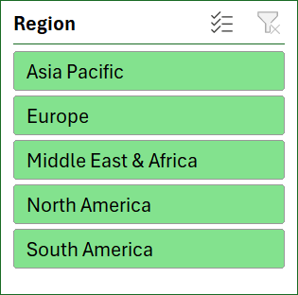
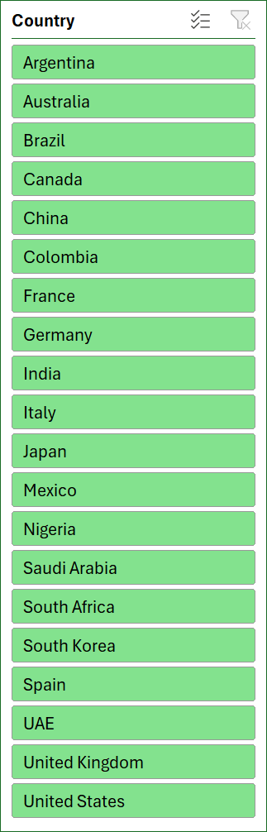
GLOBAL ECOMMERCE SALES DASHBOARD REGION SALES
FILTER
TOP REGION
EUROPE
TOP COUNTRY
MEXICO
QUANTITY
4420
UNIT SOLD
1833
REGION SALES

Slide 9



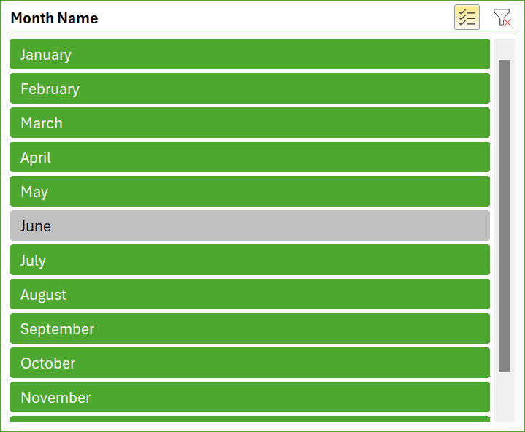
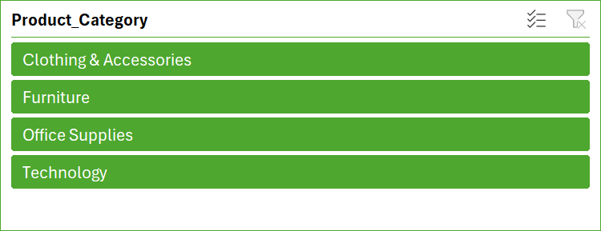
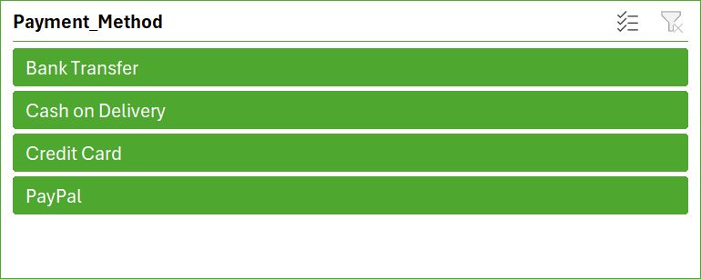
GLOBAL ECOMMERCE SALES DASHBOARD sales overview
Total Sales
₹ 4,84,559.34
Total Orders
2000
AVG Order Value
₹ 242.28
Shipping Cost
₹ 25,804.24
FILTER
SALES OVERVIEW

Slide 10
METHODOLOGY & NOTES
Data Notes & Assumptions
Important points about source, cleaning and calculations
Data Source
Excel file → sheet: global_ecommerce_sales. 2,000 order-level rows covering Jan 2023 – Dec 2025 across 5 regions and 20 countries.
Power Query Steps
Promoted headers → Set correct data types → Checked for nulls & duplicates → Added calculated columns (net_sales, profit_margin, price_tier, profit_status) → Final clean table loaded to model.
Calculated Columns Logic
net_sales = Total_Sales × (1 − Discount%/100) | profit_margin = Profit ÷ Total_Sales | price_tier based on Unit_Price bands | profit_status = "profit" if Profit > 0 else "loss"
Global E-Commerce Sales Analysis | Confidential
5 / 6

Slide 11
conclusion
Key Takeaways & Recommendations
What the cleaned data and KPIs tell us
01
Furniture drives the business
02
Europe + North America = 56%
53% of total revenue comes from Furniture. Focus inventory & marketing on Standing Desk Converter, Ergonomic Chair and L-Shaped Desk.
These two regions deliver more than half of all sales. Prioritise stock levels and campaigns here.
03
Strong profitability
04
Credit Card & PayPal rule
86% of orders are profitable. Review the 272 loss-making orders (mostly low-price Office Supplies + high shipping).
Together they account for ~70% of revenue. Keep checkout experience smooth and secure for these channels.
05
October is the peak month
06
Consumer is the largest segment
Highest monthly sales ($51K). Plan promotions and inventory for Q4 peak season.
Consumers generate 53% of sales. Corporate follows at 30%. Create segment-specific campaigns.
Global E-Commerce Sales Analysis | Confidential
6 / 6

Slide 12
THANK YOU

