Slide 1


Energy Efficiency in Smart Buildings

Slide 2
Content
Abstract
Problem Statement
Objective
Data Collection and Preparation
Proposed Solution (Methodology)
Model Performance Evaluation
Screenshots / Demonstration (video)
Future Scope
Conclusion
Notes:
Abstract
Problem Statement (Clearly define the challenge)
Objective (State your project's goal)
Background and Research (Discuss existing solutions, trends, and gaps)
Data Collection and Preparation (Focus on data sources, cleaning, and augmentation)
Proposed Solution (Methodology)
Model Architecture (e.g., CNN, U-Net, YOLOv5)
Key Techniques (e.g., Transfer Learning, Image Augmentation)
Model Performance Evaluation
Metrics (Accuracy, Precision, Recall, IoU, etc.)
Graphs (Confusion Matrix, ROC Curve, etc.)
Screenshots / Demonstration (Visual proof of system functionality)
Future Scope (Improvements, scalability, and integration ideas)
Conclusion (Summarize results and impact)
Q&A Session

Slide 3
Abstract
) Smart buildings account for a significant portion of global energy
consumption.
) AI-driven predictive models can analyze energy usage patterns, optimize
HVAC systems, and provide actionable insights to reduce energy waste.
) This project focuses on developing a Gradient Boosting model to predict
energy consumption and identify inefficiencies.

Slide 4
Problem Statement
) Buildings contribute nearly 40% of global energy consumption, making energy
efficiency a crucial factor in sustainability. Traditional energy management lacks real-
time adaptability.
) AI-based predictive models can enhance energy efficiency by identifying
inefficiencies and suggesting optimizations.

Slide 5
Objective
Develop a machine learning model to predict building energy consumption.
Identify key factors contributing to energy inefficiencies.
Provide actionable recommendations to optimize energy usage.
Support sustainability efforts by reducing unnecessary energy waste.

Slide 6
Data Collection and Preparation
Dataset:
Building energy usage data, occupancy levels, and weather conditions over two years.
Preprocessing:
1).Convert timestamps to date,time format.
2).Select relevant features: occupancy, outdoor temperature, humidity, wind
speed, solar radiation, hour, and day of the week.
3).Normalize data using Standard Scaler.
4).Split dataset into training and testing sets (80/20 split).

Slide 7
Proposed Solution (Methodology)
Feature Engineering:
1). Selected key energy-influencing features.
2). Explored additional features such as building insulation and HVAC
efficiency.
Machine Learning Model:
1). Implemented Gradient Boosting Regressor with 200 estimators and max
depth of 5.Trained on scaled data to improve performance.
Energy Inefficiency Detection:
1). Compared predicted vs. actual energy consumption.
2).Flagged high-consumption periods exceeding the 95th percentile.

Slide 8
Model Performance Evaluation
Mean Squared Error (MSE):
Evaluated model accuracy inpredicting energy
consumption.
R2 Score:
Assessed the predictive power of the model.
Feature Importance Analysis:
Visualized key factors affecting energy use.

Slide 9
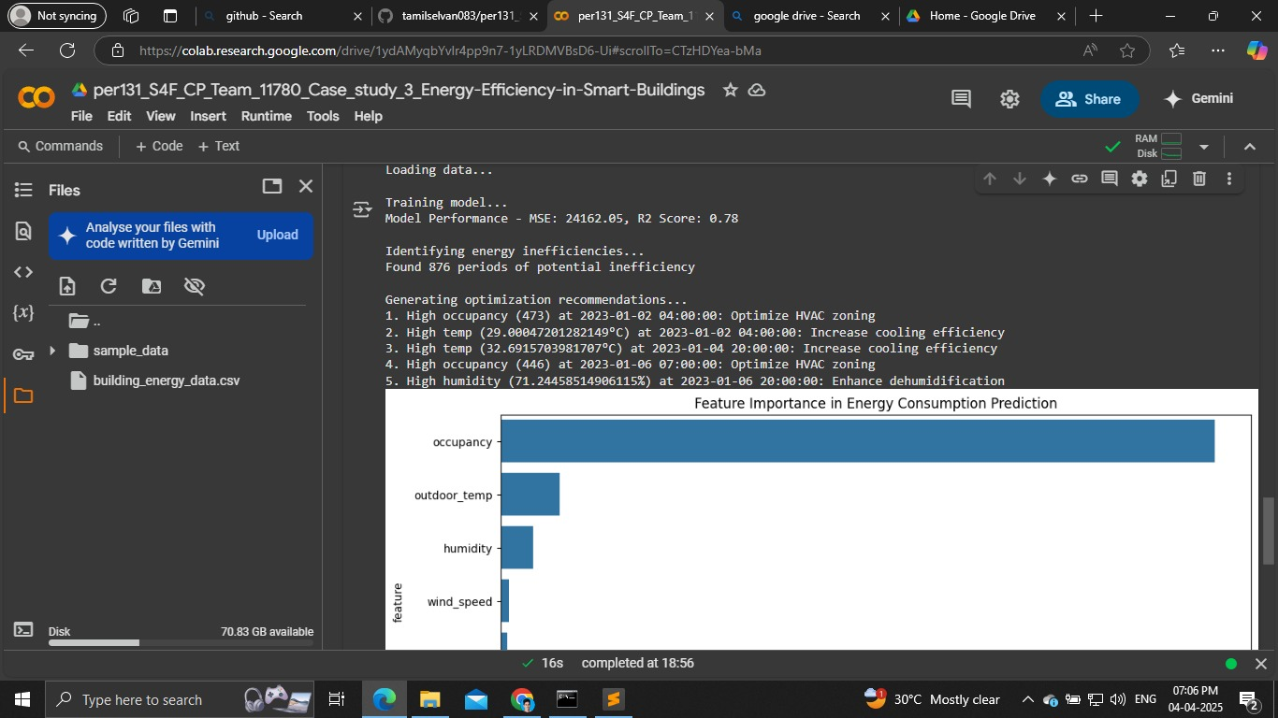
Screenshots / Demonstration (video)

Slide 10
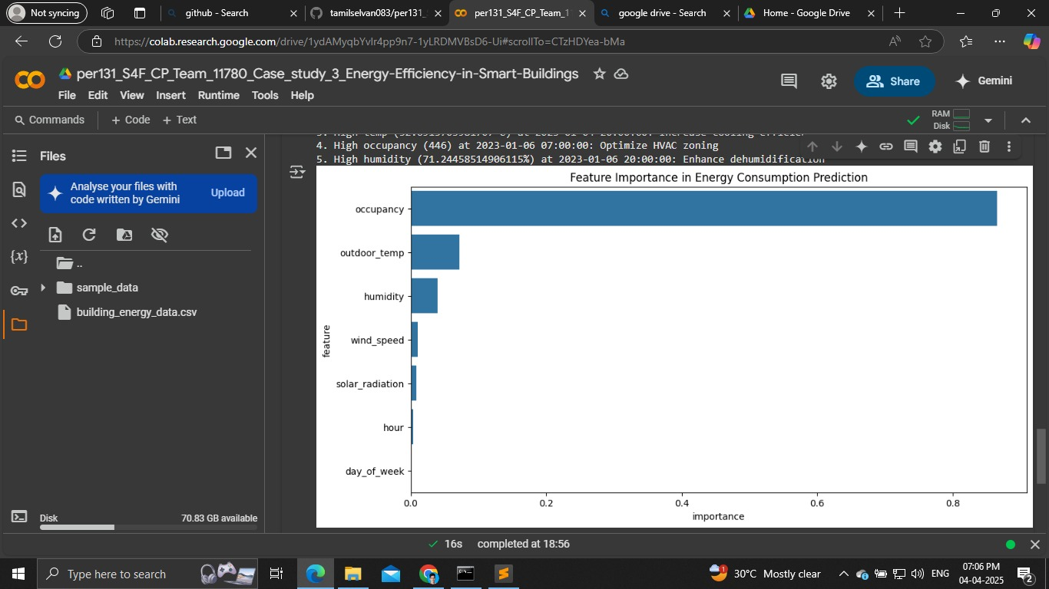
Collab link: https://colab.research.google.com/drive/1ydAMyqbYvlr4pp9n7-1yLRDMVBsD6-Ui#scrollTo=CTzHDYea-bMa
Git hub link: https://github.com/tamilselvan083/per131_S4F_CP_Team_11780_Case_study_3_Energy-Efficiency-in-Smart-Buildings

Slide 11
Future Scope
Enhanced Feature Set:
Integrate indoor temperature, insulation properties, and real-time
sensor data.
Integration with IoT Systems:
Enable real-time monitoring and automated adjustments.
Application to Smart Cities:
Expand to larger-scale energy management for urban infrastructure.
Renewable Energy Optimization:
Utilize solar energy data for peak load balancing.

Slide 12
Conclusion
AI-driven energy management significantly improves efficiency by
identifying inefficiencies and optimizing resource allocation.
Predictive analytics contribute to sustainable building operations, reduce
costs, and support net-zero energy goals.
Implementing such solutions in commercial buildings can lead to
substantial energy savings and environmental benefits.

