Slide 1
Digital PORTFOLIO
STUDENT NAME : TAMILSELVAN N
Nmid: C617876E7EEEC2690E5411EFD80F4927
DEPARTMENT: INFORMATION Technology COLLEGE: BHARADHIYAR university

Slide 2
Project TITLE
TAMILSELVAN PORTFOLIO

Slide 3
AGENDA
1. PROBLEM STATEMENT 2. PROJECT OVERVIEW 3. END USERS 4. TOOLS AND TECHNOLOGY 5. PORTFOLIO DESIGN AND LAYOUT 6. PEATURES AND FUNCTIONALITY 7. RESULTS AND SCREENSHOT 8. CONCLUSION 9. GITHUB LINK

Slide 4
PROBLEM STATEMENT
Clearly define the issue or gap your project aims to address Describe the challenges or pain points faced by users. Why this problem is significant and worth solving. Example “Many freelancers lack an easy way to showcase their skills and projects, making it harder for them to attract clients.”

Slide 5
PROJECT OVERVIEW
. Provide a concise summary of your project Describe what your project is and its main purpose Give an overview of its scope (what it covers and doesn’t cover) . Highlight the core idea behind your work

Slide 6
End users
Identify the intended audience or users. Who will benefit from this project? How will they use it? Example: Students, freelancers, recruiters, developers, etc

Slide 7
Tools and technologies
List and briefly describe the tech stack used Frontend: HTML, CSS, JavaScript, React, etc. Backend: Node.js, Django, Flask, etc. Databases: MySQL, MongoDB, etc. Others: APIs, libraries, or frameworks. Mention why you chose these tools.

Slide 8
Portfolio design and layout
Explain how you designed your portfolio. Structure: Sections (About Me, Projects, Skills, Contact). Aesthetic choices: Colors, fonts, UI elements. Layout style: Grid, single-page application, or multipage. Responsive design and user experience focus.

Slide 9
Features and functionality
List key features that make your project unique. Example: User authentication system. Dark mode toggle. Downloadable resume. Interactive project showcase Contact form with email integration

Slide 10
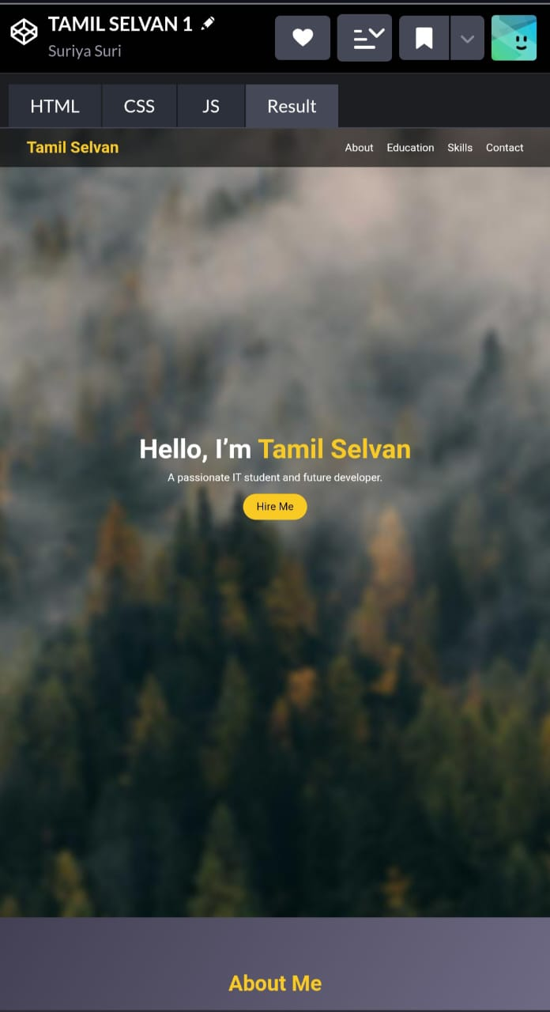
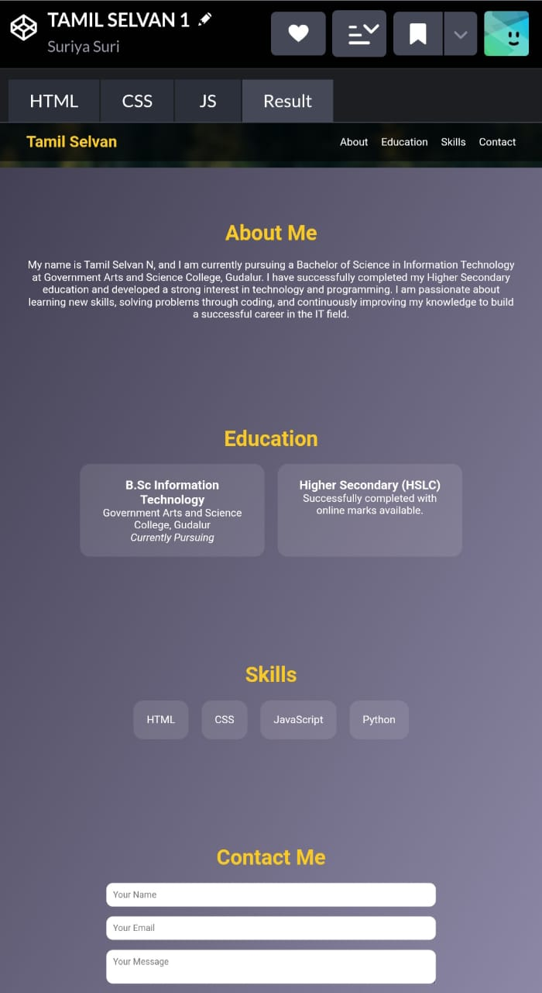
Result and screenshot

Slide 11
Conclusion
Summarize the value of your project. State how it solves the identified problem. Reflect on your learning experience. Suggest future enhancements or scalability options

