Slide 1

CSE 4000 :Thesis/Project
Recognition of Emotion and Classification with Intensity using Deep Learning
Supervised By: Md. Abdus Salim Mollah Assistant Professor Department of Computer Science and Engineering Khulna University of Engineering & Technology
Presented By:
Md. Tanvir Hossain Tamim
Roll: 1907060
Department of Computer Science and Engineering
Khulna University of Engineering & Technology

Slide 2
Outline
Introduction
Literature Review
Related works
Problem statement
Objectives
Methodology
Implementation
Thesis Timeline
Conclusion
References

Slide 3
Introduction
The Problem:
Many existing systems rely on 2D features extracted from audio signals, which may not capture the full complexity of emotional expression in speech.
Emotion recognition can be affected by speaker variability (e.g., accent, tone) and environmental factors.
The Solution:
DL based Speech Emotion Recognition and classification.

Slide 4
Introduction (Cont.)
The Techniques to be used to solve :
Speech Emotion Recognition Using ANN on MFCC.
Multimodal Emotion Recognition using Deep Learning.
Emotion recognition of human speech using deep learning method and mfcc features.
Emotion Recognition and Classification in Speech using Artificial Neural Networks.

Slide 5
Literature Review
Table 1: Literature Review
Serial No | Title | Reviews
1 | Emotion Recognition and Classification in Speech using Artificial Neural Networks.[3] | effectively recognize basic emotions (e.g., happy, sad, angry) based on prosodic. Limited speaker-independence and difficulty in handling complex emotions.
2 | Multimodal Emotion Recognition using Deep Learning.[2] | significantly improves emotion recognition accuracy compared to unimodal approaches. high computational cost and complexity.
3 | Recognition of Emotion with Intensity from Speech Signal Using 3D Transformed Feature and Deep Learning.[1] | ability to recognize both emotion and intensity, providing higher accuracy. More complex models like 3D CNNs and Bi-LSTMs.

Slide 6
Literature Review
Table 1.1: Literature Review
Serial No | Title | Reviews
4 | Speech Emotion Recognition Using ANN on MFCC Features .[6] | lightweight and computationally efficient, suitable for real-time applications. Does not leverage advanced architectures like CNNs or RNNs.
5 | A Hybrid Machine Learning Model for Emotion Recognition From Speech Signals .[5] | efficient for handling multi-class classification tasks. restricts its applicability in complex real-world interactions.
6 | Efficient Feature-Aware Hybrid Model of Deep Learning Architectures for Speech Emotion Recognition.[4] | improves classification by combining handcrafted and deep learning-derived features. require significant computational resources.

Slide 7
Related Works
1. Machine Learning for SER: Early SER systems relied on traditional machine learning techniques like SVM, which provided a foundation for later deep learning approaches.
2. Multimodal Emotion Recognition: Previous works in this field focused on combining audio and visual signals to improve emotion recognition, with a growing emphasis on using attention mechanisms and deep learning architectures like CNN and LSTM to handle complex, multimodal data sources.
3. Signal Transformation Methods: Previous research on signal transformations such as MFCC, STFT, and Chroma STFT has shown effectiveness in feature extraction for SER.

Slide 8
Related works(cont.)
4. ANN for Emotion Classification: Neural networks were explored to improve the accuracy of emotion classification from speech, focusing on improving the recognition of basic emotions such as happiness, sadness, anger, and neutral states.
5. Use of Pretrained Models and Architectures: Work on using pretrained architectures like BERT for emotion recognition in text, which can be combined with speech and visual modalities, has shown promising results in improving recognition performance.
6. Emotion Intensity Recognition: While emotion classification has been widely researched, recognizing emotion intensity (e.g., normal vs. strong emotions) is a relatively new direction.

Slide 9
Related works(cont.)
Table-2:Statistical comparison among the methods
Method | Pros | Cons
ANN[1] | effectively recognize basic emotions. capacity to handle more nuanced emotions. | Limited speaker-independence. models struggle with capturing complex emotional dynamics.
Multimodal Approaches[2] | improves emotion recognition accuracy compared to unimodal approaches. Attention mechanisms further enhance the performance of these models. | high computational cost and complexity. Current multimodal systems have not fully optimized for real-time applications.
3D Transformation method and DL[3] | primarily focus on emotion categories. enhances the model’s ability to recognize both emotion and intensity. | More complex models like 3D CNNs and Bi-LSTMs. further work is needed to streamline the model for practical applications.

Slide 10
Problem Statement
Limitations in Current SER Models
Lack of Emotion Intensity Detection
Inadequate Feature Representation
Need for Improved Accuracy
Applications in Critical Areas

Slide 11
Objectives
Develop a Novel Framework
Integrate 3D Transformed Features
Explore Deep Learning Models
Compare Two DL Architectures
Evaluate Performance on RAVDESS Dataset

Slide 12
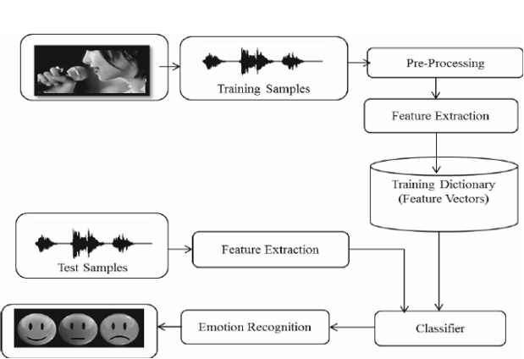
Methodology
1. Signal Processing:
The raw speech signal is initially cleaned and preprocessed to remove background noise and normalize the audio levels.
The signal is then segmented into short frames (windows) to capture the temporal variations in speech, as emotions often change dynamically over short time spans.
Figure-1: Basic process of proposed SER system.

Slide 13

Methodology(cont.)
2. Signal Transformation:
Mel-Frequency Cepstral Coefficients (MFCC)
Short-Time Fourier Transform (STFT)
Chroma STFT.
3. Feature Extraction:
A deep learning model is designed, incorporating convolutional neural networks (CNNs) for spatial feature extraction and recurrent neural networks (RNNs) or long short-term memory (LSTM) networks to capture temporal dependencies in speech data.
Speech signal
Sampling
Normalization
Segmentation
Feature
Extraction
Figure-2:Preprocessing for emotion recognition

Slide 14
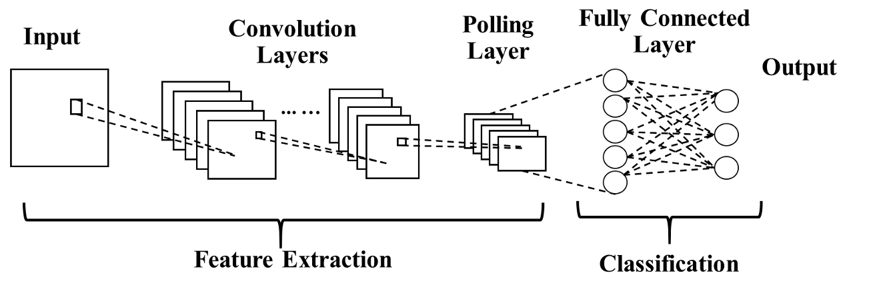
Methodology(cont.)
Figure-3:Feature Extraction and Classification methods

Slide 15
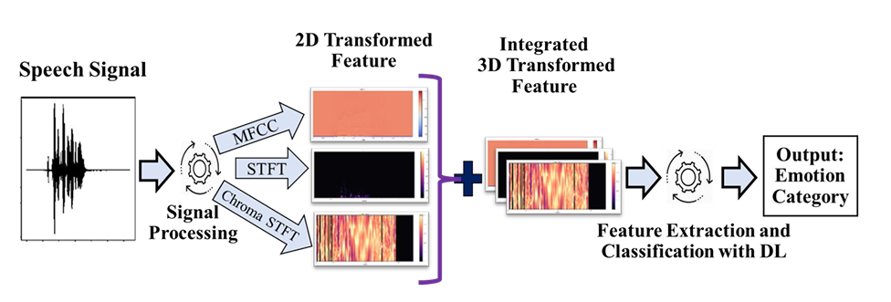
Methodology(cont.)
Figure-4: General architecture of proposed REIS approach

Slide 16
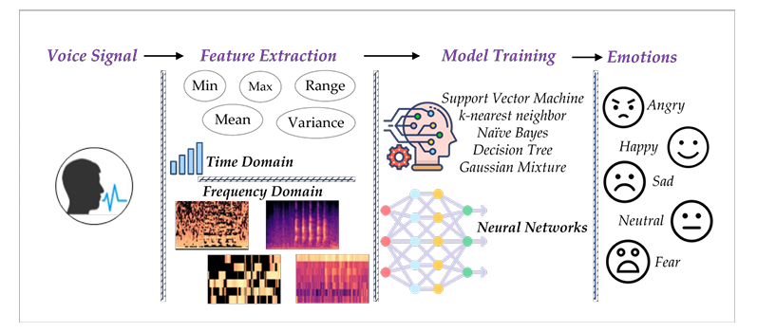
Methodology(cont.)
4. Model Architecture:
3D Convolutional Neural Networks (CNN).
Time Distributed Flatten (TDF) Layer.
Bidirectional Long Short-Term Memory (Bi-LSTM).
Figure-5:Train model using various algorithm

Slide 17
Methodology(Cont.)
5. Framework for Classification:
Single Framework: This model simultaneously classifies both emotion and intensity within a single network.
Cascaded Framework: This approach first classifies the emotion and then performs intensity classification based on the detected emotion.
6. Dataset and Training:
The model will be trained and evaluated on the RAVDESS dataset, which contains speech samples with various emotional states. Both frameworks will trained separately, and performance metrics are compared.

Slide 18
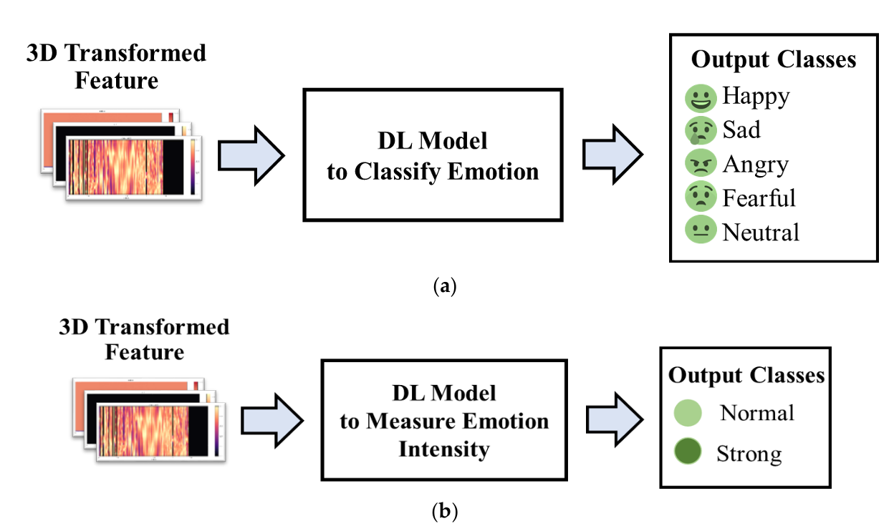
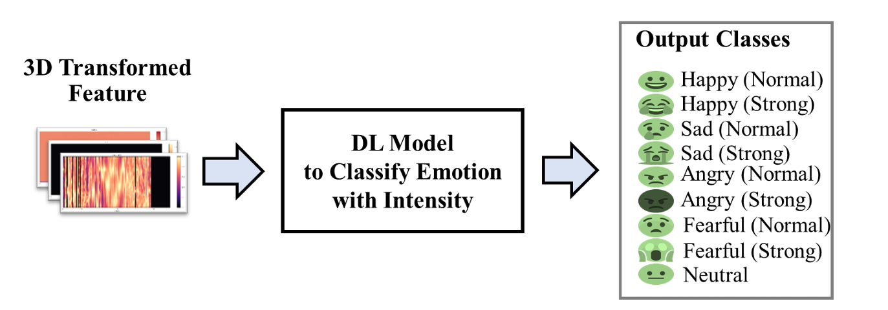
Methodology(Cont.)
Figure-6:single DL vs Cascaded DL Framework

Slide 19
Implementation
Programming Environment Setup:
Language: Python
Preferred IDE: Spyder, PyCharm, Google colab etc.

Slide 20
.
Implementation(cont.)
Collected Dataset: Use an emotional speech dataset like RAVDESS or another similar dataset with labeled emotions and intensities.
Preprocessing:
Convert the audio files to a suitable format (e.g., WAV).
Normalize the audio signals to ensure consistent volume.
Segment the audio into frames to capture both short-term and long-term features.
Feature Extraction:
MFCC (Mel-Frequency Cepstral Coefficients): Extract MFCC features from the speech signals to represent the power spectrum.
STFT (Short-Time Fourier Transform): Apply STFT to capture time-frequency information in the speech signals.
Chroma STFT: Use Chroma STFT to capture harmonic and melodic features of the speech signal.

Slide 21
Implementation(cont.)
Dataset
TESS+SAVEE+RAVDESS
TESS+SAVEE
TESS+RAVDESS
Preprocessing
Extract Feature with MFCC
Data Normalization
CNN+LSTM
ANN
CNN
LSTM
MLP
Compare accuracy and select best model
Predict Data
Figure-7: step by step implementation

Slide 22
Future Work
Integration with Multimodal Data
Real-Time Emotion Recognition
Transfer Learning and Pre-trained Models
Emotion-Specific Intensity Mapping
Personalized Emotion Recognition Models
Ethical and Privacy Considerations

Slide 23
Thesis Timeline
2024
2025
Mar April May June July Aug Sep Oct Nov Dec Jan Feb
Topic Selection
Topic Confirmation
Study Literature
Dataset Acquisition
Study Preceding Methodology Pre-Defense Preparation
Developing Model
Evaluation and Modification
Result Analysis and Fine Tuning
Complete Work
Currently working
Future Work

Slide 24
Conclusion
Successful Framework Development
Advanced Feature Extraction
Validated on RAVDESS Dataset
Improved Accuracy
Real-World Applications

Slide 25
References
M. R. Islam, M. A. H. Akhand, M. A. S. Kamal, and K. Yamada, "Recognition of Emotion with Intensity from Speech Signal Using 3D Transformed Feature and Deep Learning,"
A. V. Geetha, T. Mala, D. Priyanka, and E. Uma, "Multimodal Emotion Recognition with Deep Learning: Advancements, Challenges, and Future Directions," Information Fusion, vol. 105, p.
R. Vardhan, "Emotion recognition and classification in speech using Artificial Neural Networks," International Journal of Computer Applications, vol. 140, no. 8, pp. 1-5, 2016.
M. Ezz-Eldin, A. A. M. Khalaf, H. Hamed, and A. Hussein, "Efficient Feature-Aware Hybrid Model of Deep Learning Architectures for Speech Emotion Recognition," IEEE Access, vol.
D. Bharti and P. Kukana, "A Hybrid Machine Learning Model for Emotion Recognition From Speech Signals," in Proceedings of the International Conference on Security and Privacy (ICOSEC), 2020, pp.
M. N. Adnan, R. Ema, S. Galib, S. K. Kabir, and S. K. Hazra, "Emotion recognition of human speech using deep learning method and MFCC features," Radioelectronic and Computer Systems, vol. 2022, pp.

Slide 26
Thank You

