Slide 1
Predicting Income Level
from U.S. Census Data
A supervised learning study on the UCI Adult / Census Income dataset
Logistic Regression vs. Random Forest • Education, Age & Hours Worked as Key Predictors

Slide 2
The Problem
32,561
Research question
Which demographic and employment attributes are most strongly associated with earning over $50,000/year — and how well can standard classifiers predict income class from them?
Why it matters
The Adult dataset (Kohavi, 1996) is one of the most-used ML benchmarks, but later work shows it also encodes real historical bias — so strong accuracy alone isn't the full story.
census records
(1994 U.S. Census)
14
demographic &
employment attributes
~25%
of individuals
earn >$50K/year

Slide 3
Method
1
2
3
4
Clean
Prepare features
Split
Model & evaluate
Drop rows with missing values ("?"). 32,561 → 30,162 records.
Standardize 5 numeric features; one-hot encode 7 categorical features.
Stratified 80/20 train-test split on the income label.
Train Logistic Regression and Random Forest; compare accuracy, precision, recall, F1, ROC AUC.

Slide 4
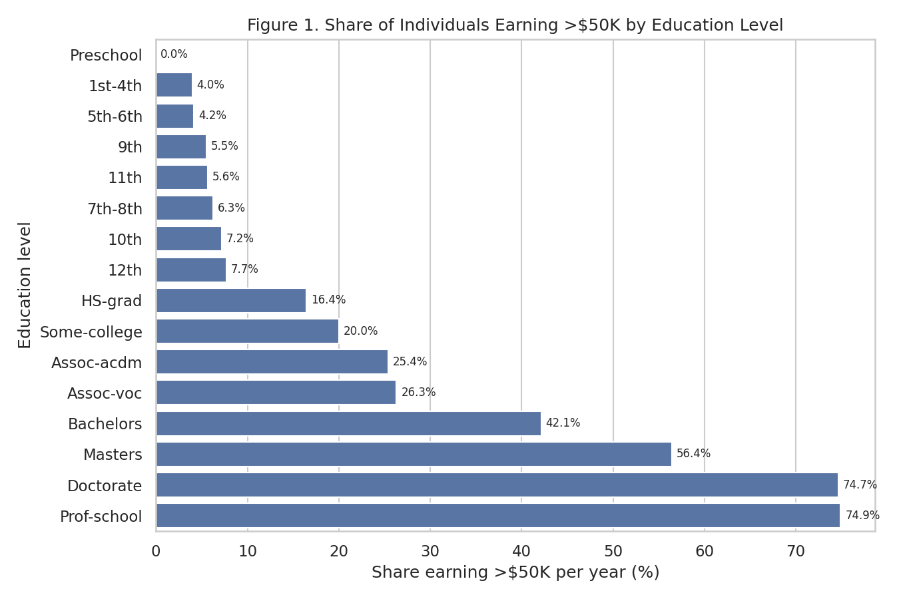
Results: Education is the strongest visible driver
Prof-school / Doctorate
~75% earn >$50K
No diploma
<8% earn >$50K

Slide 5
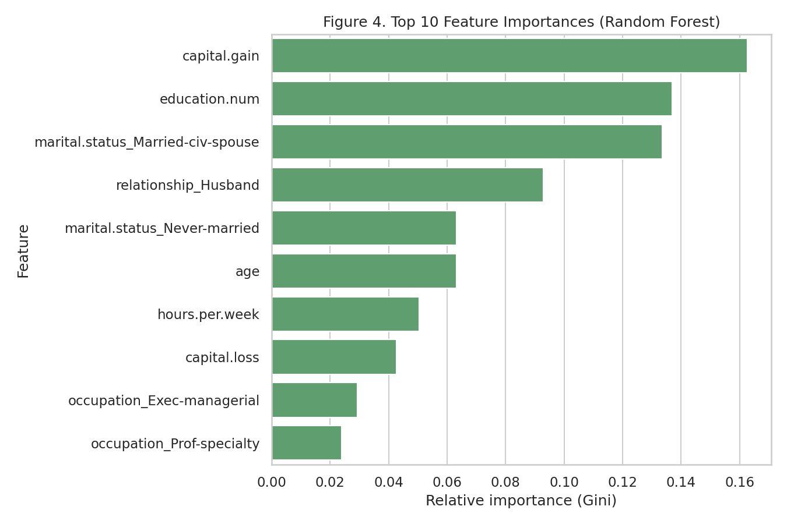
Results: Random Forest edges out Logistic Regression
Model | Acc. | Prec. | Recall | F1 | AUC
Logistic Regression | 0.853 | 0.751 | 0.615 | 0.676 | 0.913
Random Forest | 0.865 | 0.821 | 0.585 | 0.683 | 0.921

Slide 6
Takeaway
Education, age, hours worked, and relationship status are the dominant correlates of income in this dataset — and a Random Forest model captures them only slightly better than a simple Logistic Regression.
But strong accuracy isn't the whole picture: prior fairness research on this same dataset shows these models can reproduce historical gender and demographic bias, so results should inform, not dictate, real decisions.
86.5%
Best model accuracy
(Random Forest)

